Slide 1
Using Office Backstage
Microsoft Excel 2013
Lesson 3

Slide 2
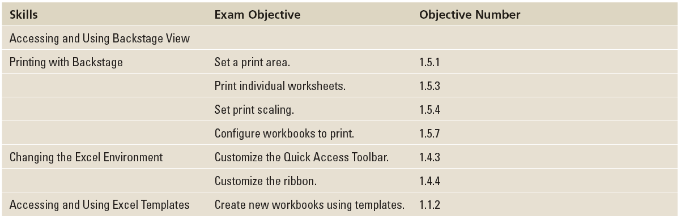
Objectives

Slide 3
Software Orientation
The ribbon is a visual interface that allows you to work in a file and perform tasks such as changing fonts, creating charts, and formatting numbers. The Backstage view, on the other hand, is a visual interface that lets you use and master Excel's file management features—functions that allow you to do things to a file rather than in a file.

Slide 4
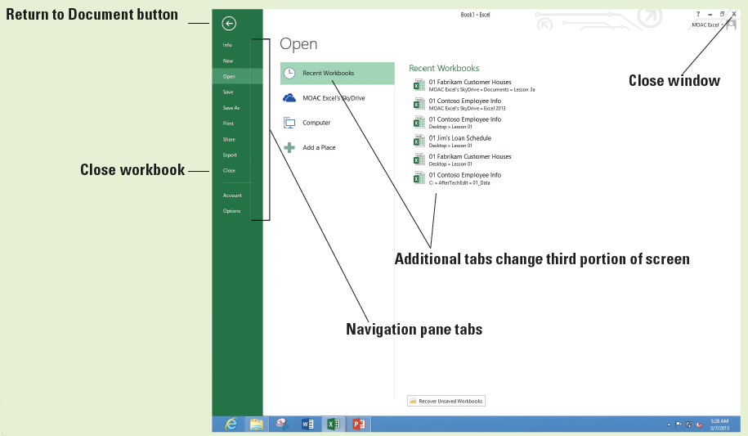
Software Orientation
Backstage view's left-side navigation pane (below) gives you access to workbook and file-related commands through a series of tabs, including Info, New, Open, Save, Save As, Print, Share, Export, Close, Account, and Options.

Slide 5
Software Orientation
Some of the tabs give you additional tabs. Other tabs allow you to select from many different options or settings. Finally, some tabs accomplish a task and return you to the workbook.
Notes:
Take Note: The Exit command is no longer available in Office 2013, at least in the same way it was available in prior versions. In this case, the Close tab in Backstage view closes the workbook. The Close (X) button in the upper right corner of the Excel 2013 window closes Excel.

Slide 6
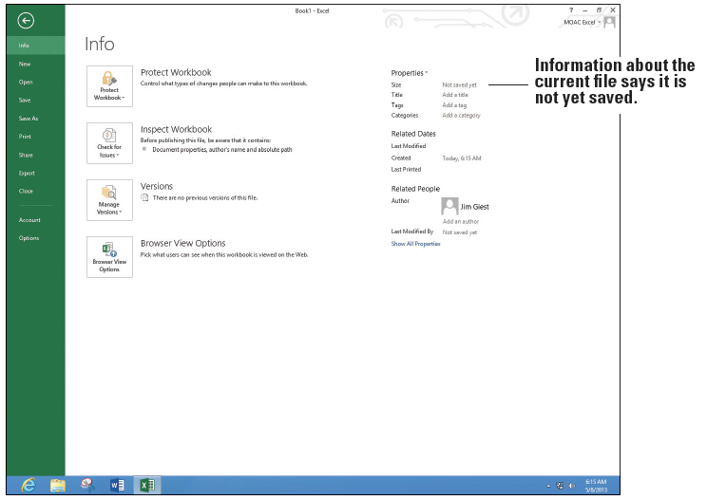
Step by Step: Access Backstage View
GET READY. LAUNCH Excel and OPEN a blank workbook.
Click the FILE tab to display Backstage view with the Open tab selected.
In the upper left corner of Backstage view, click the Return to document button.
In cell A1, type abc and press Enter.
Click the FILE tab. Backstage view, like the ribbon, is context- sensitive and changes to the Info tab (above).
Notes:
Another Way: You can also press Alt + F to select FILE and go to the Backstage view.

Slide 7
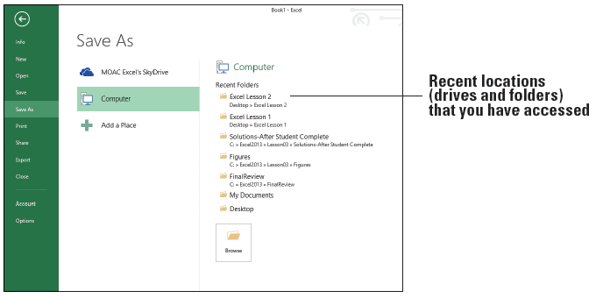
Step by Step: Access Backstage View
Click the Save tab. Notice that there are additional tabs depending on your setup. In this case, SkyDrive, Computer, and Add a Place appear.
Click the Save As tab. Notice that this looks identical to the Save tab. This is how it looks the first time you save the file.
Click Computer and notice that the Recent Folders section where you last saved your previous workbooks appears (below).

Slide 8
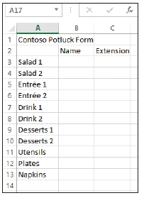
Step by Step: Access Backstage View
Click Browse, in the File name box, type Temp, and then click Save.
Click FILE. Notice the Info tab appears.
Click Save. Notice that you do not see the options shown at right (and Step 5 previously), but that you return directly to the workbook.
Click FILE and click Close. This action closes the workbook, but not Excel.
Click FILE and the Open tab appears. In the list of Recent Workbooks, select Temp and your workbook returns.
PAUSE. EXIT Excel.

Slide 9
Step by Step: Print and Preview a Document
GET READY. LAUNCH Microsoft Excel 2013.
Create a new workbook, enter the worksheet data shown at right, and save it as 03 Contoso Potluck.
EXIT Excel.
LAUNCH Excel again and notice that 03 Contoso Potluck Solution appears in your Recent list. Click the file to bring it back up.
Notes:
Another Way: Another way to create a new workbook is with the Ctrl + N keyboard shortcut.

Slide 10
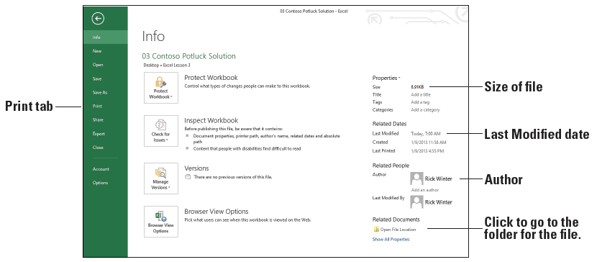
Step by Step: Print and Preview a Document
Click the FILE tab to automatically display the Info tab. As shown below, the Properties area shows the size of the file, when it was last modified, and who the author is.

Slide 11
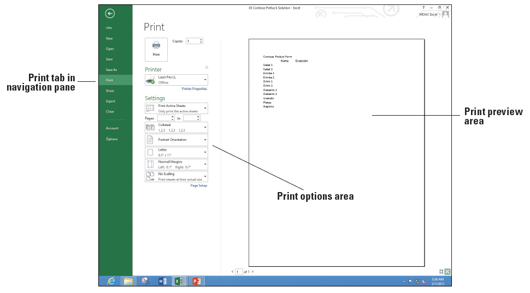
Step by Step: Print and Preview a Document
Click the Print tab. Note that this displays the Print options in Backstage view. Take a moment to preview the workbook in the Print Preview section in the right pane and read through the Print options listed in the center section of the page (right).
To print your work- sheet, at the top of the Print screen, click the Print button.
PAUSE. LEAVE the workbook open for the next exercise.
Notes:
Another Way: You can also activate Backstage view and access Print options by pressing Ctrl + P.

Slide 12
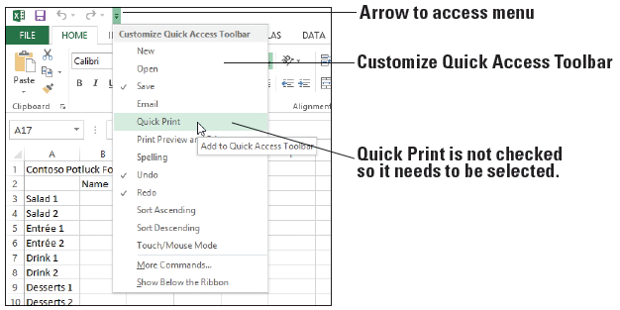
Step by Step: Use Quick Print to Print a Worksheet
GET READY. USE the open workbook from the previous exercise or open 03 Contoso Potluck Solution.
On the Quick Access Toolbar, if you do not see the Quick Print button, click the Customize Quick Access Toolbar arrow at the end of the toolbar, and select Quick Print (below).
Notes:
Take Note: Discuss with your instructor whether you can print in the classroom. If you cannot, view all the documents in preview mode to see how the document print whenever printing is mentioned in this book.

Slide 13

Step by Step: Use Quick Print to Print a Worksheet
On the Quick Access Toolbar, click Quick Print (below).
Retrieve the printed copy of the worksheet from your printer.
Click the FILE tab, and then click Print. The preview pane should match what was printed.

Slide 14
Step by Step: Use Quick Print to Print a Worksheet
Click the Return to document arrow.
Notice that a dotted vertical line appears in the middle of the screen. The line shows the right edge of the printed page. The line displays the first time you print or preview a page.
PAUSE. LEAVE the workbook open for the next exercise.

Slide 15
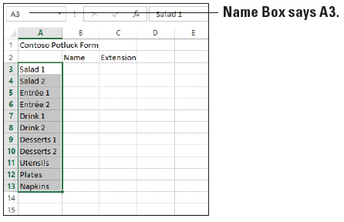
Step by Step: Set the Print Area
GET READY. USE 03 Contoso Potluck Solution that is already open or create the workbook shown on slide 11.
Click the PAGE LAYOUT tab.
In the Page Setup group, point to the Print Area button. Note the ScreenTip that displays and defines the task to be completed.
On the worksheet, click cell A3, hold the mouse button, and drag to cell A13. Your cell range should be highlighted in gray (above).

Slide 16
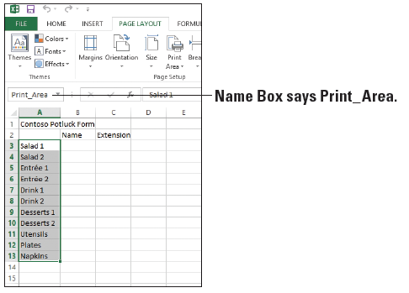
Step by Step: Set the Print Area
With these cells highlighted, click the Print Area drop-down arrow and click Set Print Area from the menu that appears. You have now set the print area. While the area is still selected, note that the Name Box now says “Print_Area” (right).
Click the FILE tab to access Backstage view.

Slide 17
Step by Step: Set the Print Area
Click Print and notice in the Print Preview pane that you can see only the list of items to bring and not the text in rows 1 and 2 and columns B and C.
Click the Return to document button. You will not print at this time.
PAUSE. SAVE the workbook with the current name 03 Constoso Potluck Solution and CLOSE Excel.

Slide 18
Step by Step: Print Selected Worksheets
GET READY. LAUNCH Excel 2013, and then perform these steps:
OPEN 03 Contoso Potluck Depts. This is a modified version of the potluck workbook you created previously. In this case, there are three different worksheets for three different departments.
Click each of the three worksheet tabs: HR, Operations, and Finance. Notice that the title in C1 shows the department name and there are a different number of items to bring to each potluck depending on the size of the department. Click the HR tab.

Slide 19
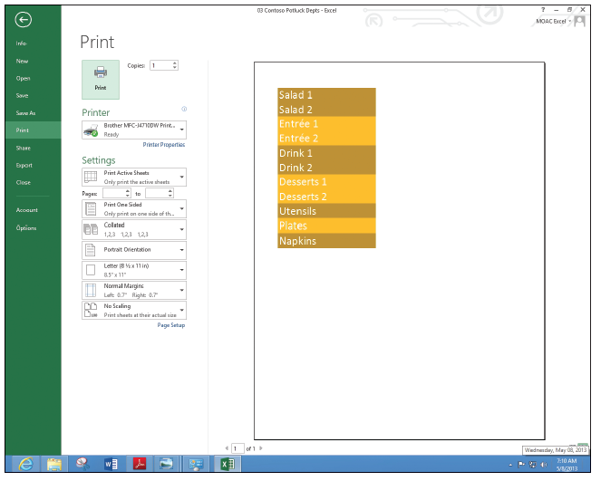
Step by Step: Print Selected Worksheets
Press Ctrl + P to display the Print options in the Backstage view. In the Print Preview pane, the entire worksheet does not display (right). This is because of the selected print area.
Press Esc or click the Return to document button.
Click the PAGE LAYOUT tab, click Print Area, and then Clear Print Area.

Slide 20
Step by Step: Print Selected Worksheets
Click the FILE tab and click Print. Notice that the entire worksheet for HR appears. Also notice that the page number shows 1 out of 1 indicating that only one of the worksheets will print, and it will all fit on one page.
In the Settings section of the center pane in Print options, click the Print Active Sheets drop-down arrow. In the drop-down menu that appears, as shown in Figure 3-12, you can select several printing options for your workbook or worksheet.

Slide 21
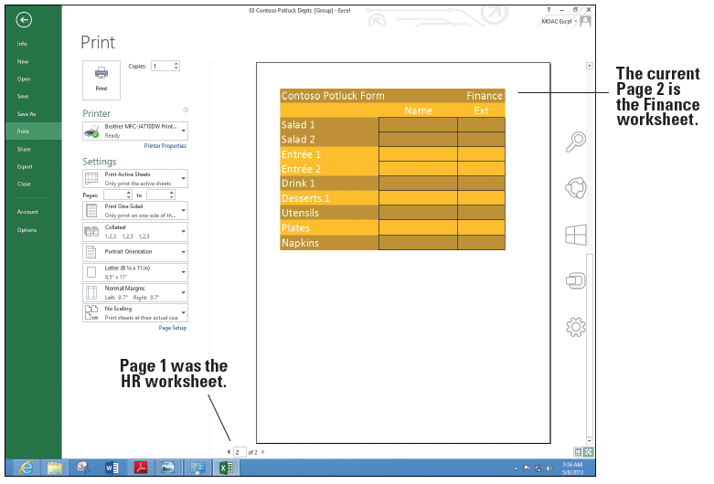
Step by Step: Print Selected Worksheets
Click the Return to document button.
While the HR worksheet is active, hold down Ctrl and click on the Finance tab. Now both the HR and Finance worksheets are selected.
Click the FILE tab and click Print. Now in the Print Preview area, the bottom of the screen shows 1 of 2 with the HR worksheet preview. Click the right arrow to go to the second page and notice that the Finance worksheet previews (above).

Slide 22
Step by Step: Print Selected Worksheets
Click the Return to document button to return to the workbook without printing.
PAUSE. CLOSE the workbook without saving. LEAVE Excel open for the next exercise.

Slide 23
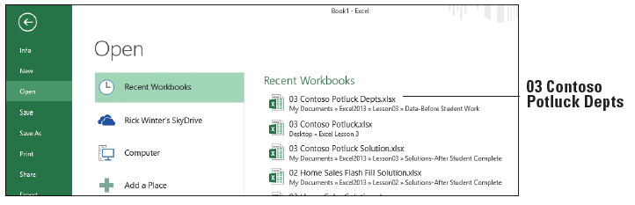
Step by Step: Print Selected Workbooks
GET READY. With Excel open from the previous exercise, perform the following steps.
Click the FILE tab and click Open if it is not selected. Because you just used the 03 Contoso Potluck Depts workbook, it should be at the top of the list of the Recent Workbooks (below).
Click 03 Contoso Potluck Depts to open it.
Click the FILE tab and click Print.

Slide 24
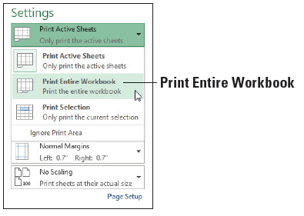
Step by Step: Print Selected Workbooks
Notice that the complete worksheet for HR does not display. This is because you did not save the workbook after you cleared the print area. Clear the print area as you did in Step 5 of the previous section and return to the Print tab of Backstage view.
In the Print window’s Settings options, click the Print Active Sheets drop-down arrow and click Print Entire Workbook (right). You will not print at this time.
PAUSE. EXIT Excel and do not SAVE the workbook.

Slide 25
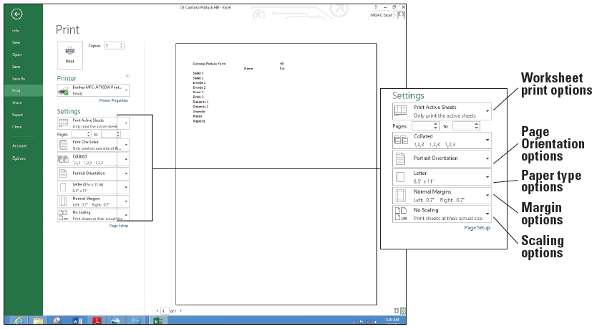
Step by Step: Apply Print Options
GET READY. LAUNCH Excel, OPEN 03 Contoso Potluck HR, and make sure the HR-P1 worksheet is selected.
Click the FILE tab and select Print (below). Notice that the worksheet is small and it might be nice to have lines for people to write in on a printed page.

Slide 26
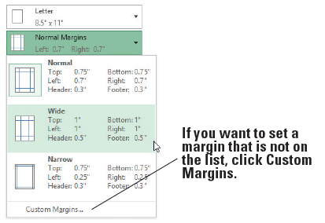
Step by Step: Apply Print Options
In the Settings section of the Print window, click the Margins drop-down and click Wide (below). The new margins will allow the worksheet to be hole-punched and put in a binder.

Slide 27
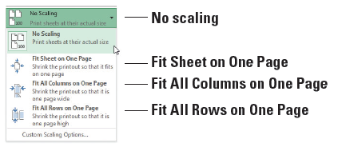
Step by Step: Apply Print Options
Click the Scaling drop- down and see the choices below (right). The scaling options ensure that all columns, rows, or the entire worksheet fit on one page.
Current choice is No scaling, so the document prints the same size as the screen.
If you want to fit everything that is on the worksheet on one page, select Fit Sheet on One Page.
If there are just a couple of columns extra, click Fit All Columns on One Page. If there are just a couple of rows extra, click Fit All Rows on One Page.

Slide 28
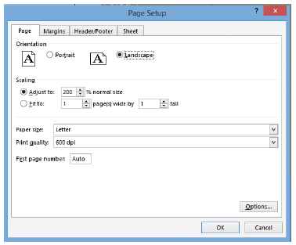
Step by Step: Apply Print Options
In this case, you make the text larger without changing the font. Click Custom Scaling Options. The Page Setup dialog box opens.
Make sure that the Page tab is selected and select Landscape so the page prints horizontally.
In the Scaling area, type 175 for the % normal size (right).
Click the Sheet tab and in the Print section, select the Gridlines box.
Notes:
Another Way: You can customize the workbook settings and options from the PAGE LAYOUT tab in the Page Setup, Scale to Fit, and Sheet Options groups.

Slide 29
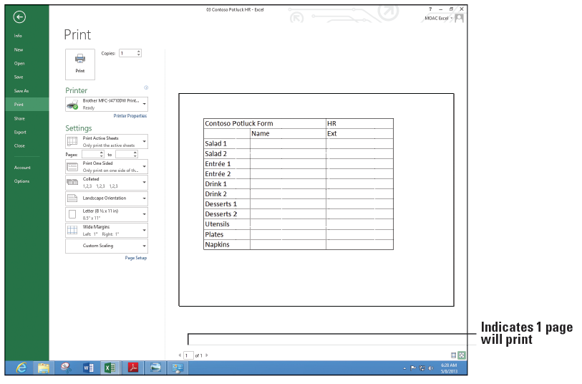
Step by Step: Apply Print Options
Click OK to return to Backstage view. Notice that the bottom of the screen still says, "1 of 1," meaning that only one page will print and notice that Print Preview shows larger text with boxes around each cell (below).

Slide 30
Step by Step: Apply Print Options
Without printing the document, click the Return to document button and then click the HR-P2 worksheet.
Press Ctrl + P to go to the Print tab of the Backstage view and notice that the bottom of the screen indicates that the document will print on two pages.

Slide 31
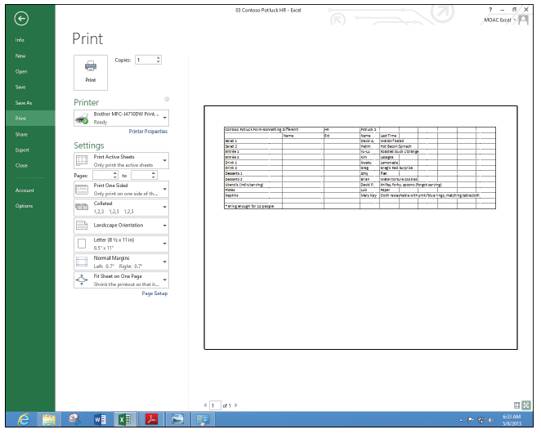
Step by Step: Apply Print Options
Change the Settings to print Landscape, to Fit Sheet on One Page, and add gridlines based on the previous steps in this section. Print Preview should look like the figure at right.
SAVE the workbook as 03 Contoso Potluck HR Print Ready Solution.
PAUSE. LEAVE the workbook open for the next exercise.

Slide 32
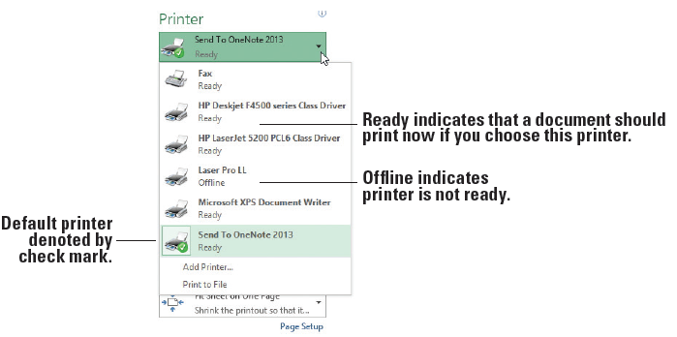
Step by Step: Change a Printer
GET READY. Continue with the previous workbook or if necessary, open 03 Contoso Potluck HR Print Ready Solution.
Press Ctrl + P to display the Print tab of the Backstage view.
Your current default printer is displayed in the Printer options section of the Print tab. Click the Printer drop-down arrow to produce a menu of installed printers, similar to the one shown above. Your printers will be either Ready or Offline.

Slide 33
Step by Step: Change a Printer
Click on a printer (other than your default printer) in the printer list. This printer should now be visible as your active printer. Should you attempt to print at this time with an inactive printer, you will get an error.
Once again, click the drop-down arrow for the printer, and select your default printer (the one with the checkmark).
PAUSE. CLOSE your workbook and don't save if prompted.
Notes:
Troubleshooting: To change a default printer in Windows 8, click the Start button, type change default printer, click the Settings button (1 item should match your search), click the Change default printer button, right-click your printer, and select Set as default printer.

Slide 34
Step by Step: Customize the Quick Access Toolbar
GET READY. OPEN a blank workbook in Excel.
Click the FILE tab to access Backstage view.
In the navigation pane, click the Options tab. The Excel Options dialog box opens.

Slide 35
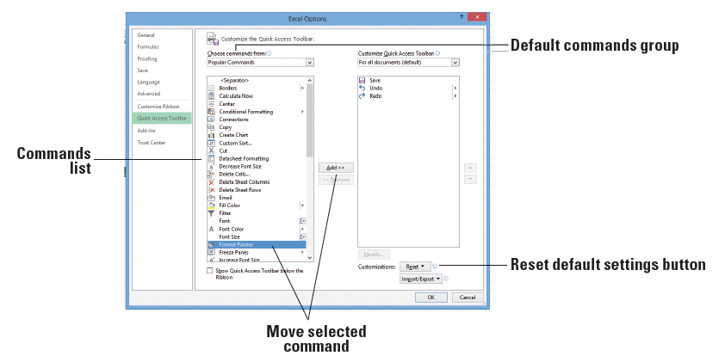
Step by Step: Customize the Quick Access Toolbar
In the left pane of the dialog box, click Quick Access Toolbar to display the Quick Access Toolbar options (below). In the right pane, the list on the left includes the commands that you can add to the toolbar. The list on the right shows the commands that are currently included on the toolbar.

Slide 36
Step by Step: Customize the Quick Access Toolbar
In the list on the left, scroll down and click Format Painter, and then click the Add button in the center of the two lists to add the Format Painter to the Quick Access Toolbar.
Using the same process, move five more commands you use often to the Quick Access Toolbar. When you are done, click OK to apply your changes (the changes don't take effect until you click OK).

Slide 37
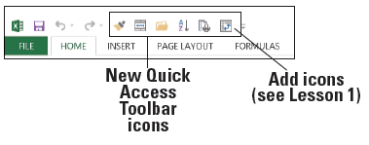
Step by Step: Customize the Quick Access Toolbar
Your Quick Access Toolbar should now include additional command buttons, much like the example shown below. Similarly, you can remove any command that you added to the toolbar. At any time, you can reset the toolbar to its default settings. See the Reset button on slide 43.
PAUSE. CLOSE Excel.
Notes:
Another Way: You can right-click on any button on the ribbon and select Add to Quick Access Toolbar to instantly add it to the Quick Access Toolbar.

Slide 38
Step by Step: Customize the Ribbon
GET READY. OPEN a blank workbook in Excel.
Click the FILE tab to access Backstage view.
Click the Options tab in the navigation pane.

Slide 39
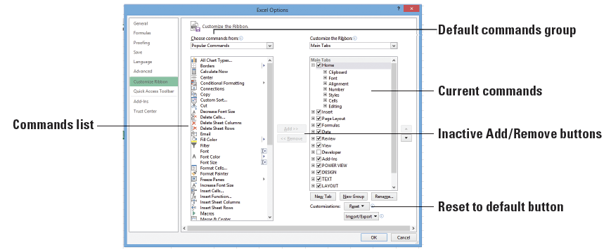
Step by Step: Customize the Ribbon
In the Excel Options dialog box, click Customize Ribbon. The Customize the Ribbon options appear (below). By default, Popular Commands is selected in the Choose Commands From drop-down box. The list of Popular Commands appears in the list below the drop-down box. Also, by default, the Main Tabs option appears in the Customize the Ribbon box on the right, with the ribbon’s main tabs listed below.

Slide 40
Step by Step: Customize the Ribbon
In the list of Popular Commands, click Format Painter. Note the Add button in the center of the dialog box is now active.
In the Customize the Ribbon list on the right, click the + preceding Home to expand the list of command groups within the Home tab if it isn't already expanded. You can use this method to display the current groups available on a Ribbon tab.

Slide 41
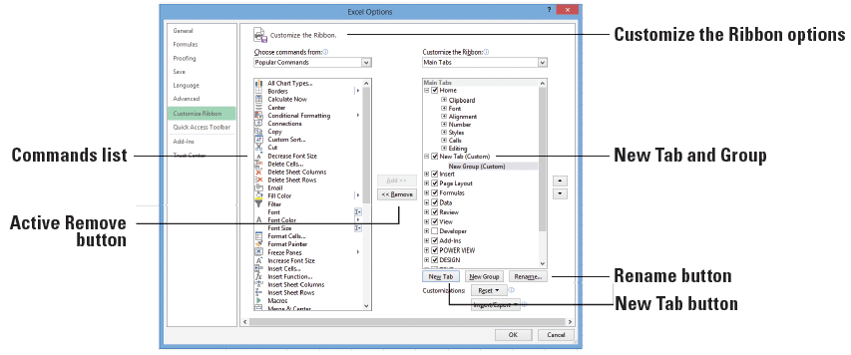
Step by Step: Customize the Ribbon
Under the Customize the Ribbon options, click the New Tab button (below) to insert a new blank tab into the Customize the Ribbon list. When you create a New Tab, New Group is automatically created inside that New Tab.

Slide 42
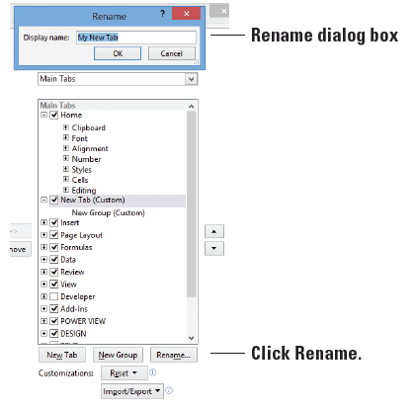
Step by Step: Customize the Ribbon
Click the New Tab (Custom) list item on the right to select it, and then click the Rename button. In the Rename dialog box that appears, type My New Tab (right), and then click OK.

Slide 43
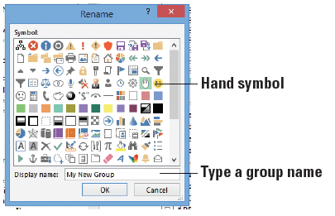
Step by Step: Customize the Ribbon
Under your new tab, click New Group (Custom) to select it. Click the Rename button again. This time, the Rename dialog box allows you to select a symbol (right). Select the hand symbol, in the Display name box, type My New Group, and then click OK. You see the New Group renamed.

Slide 44
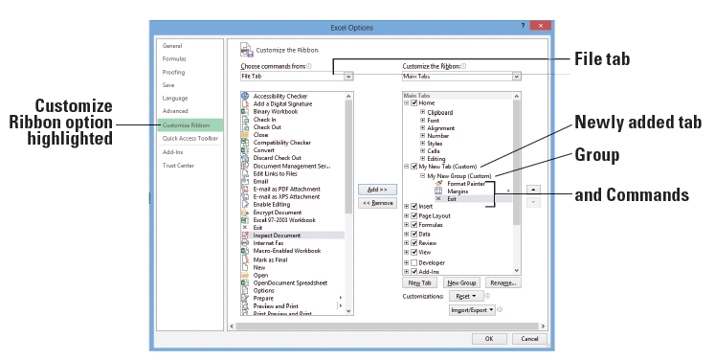
Step by Step: Customize the Ribbon
In the Customize the Ribbon list on the right, click the My New Group list item. In the command list on the left, click on a command of your choice, and then click the Add button. The command appears on your new ribbon tab. In the Choose commands from list, select All Commands and then add another command from this list. In the Choose commands from list, select File Tab and then add another command. Your screen should look similar to the figure below.

Slide 45
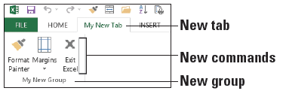
Step by Step: Customize the Ribbon
Click OK to close the Excel Options dialog box. When you exit, you see your tab named My New Tab on the ribbon.
Click the My New Tab tab. Your commands display in the tab’s My New Group (below).
PAUSE. LEAVE the workbook open for the next exercise.

Slide 46
Step by Step: Customize the Excel Default Settings
GET READY. Continue with a blank workbook from the previous exercise.
Click on the FILE tab to access Backstage view.
In the navigation pane, click Options. By default, the Excel Options dialog box opens with the General options displayed.

Slide 47
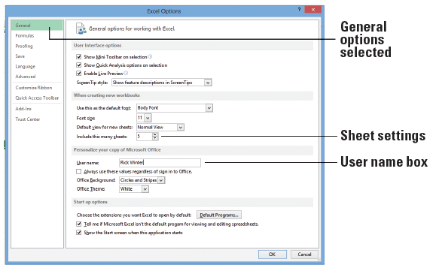
Step by Step: Customize the Excel Default Settings
In the When creating new workbooks section, click in the Include this many sheets text box and type 5 to change the number of worksheets that appear by default in new workbooks.
In the Personalize your copy of Microsoft Office section, click the User name box and type [your first and last name] in the text box (right). Click OK.

Slide 48
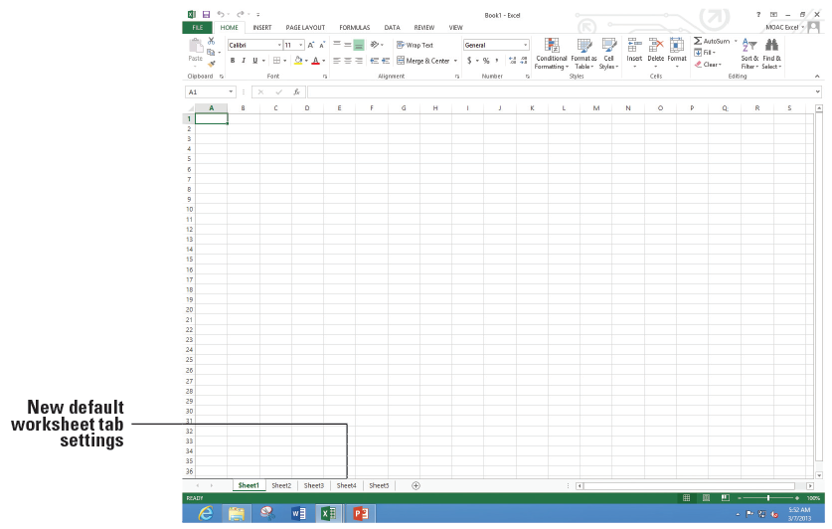
Step by Step: Customize the Excel Default Settings
EXIT and RESTART Excel and select Blank workbook. Note that instead of one worksheet tab, you now have five in your workbook (below).
PAUSE. LEAVE the workbook open for the next exercise.

Slide 49
Step by Step: Reset Default Settings, Ribbon, and Quick Access Toolbar
GET READY. Continue with a blank workbook from the previous exercise.
Click the FILE tab, and click Options.
On the General tab, in the When creating new workbooks section, in the Include this many sheets box, type 1.
Click the Customize Ribbon tab.
In the bottom right of the dialog box, click the Reset button and then click Reset all customizations.

Slide 50
Step by Step: Reset Default Settings, Ribbon, and Quick Access Toolbar
In the Confirmation dialog box, click Yes to clear all ribbon and Quick Access Toolbar customizations for this program.
Click OK to return to the workbook.
PAUSE. LEAVE the workbook open for the next exercise.
Notes:
Take Note: The ribbon and Quick Access Toolbar changes are immediate, but you need to open a new, blank workbook to notice the change for the number of displayed workbooks.

Slide 51
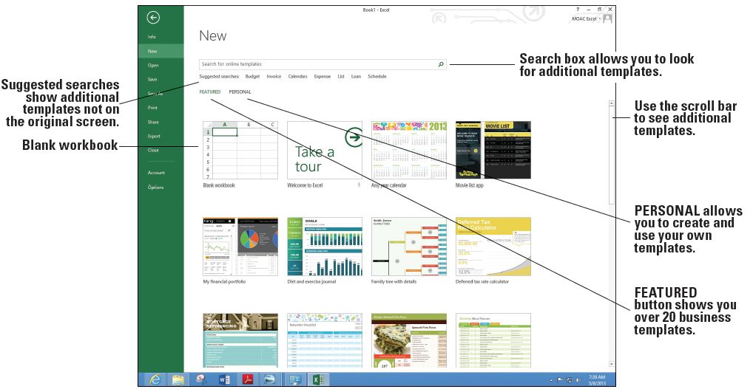
Step by Step: Select a Template from the New Tab
GET READY. If necessary, OPEN a blank workbook.
Click the FILE tab and click New. The New window displays as shown below, with a series of featured templates. You already used the Blank workbook template in this book.

Slide 52
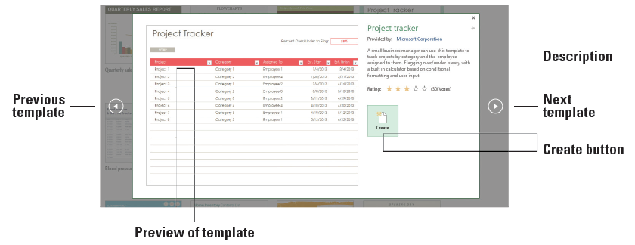
Step by Step: Select a Template from the New Tab
Scroll down if necessary, and click on the Project Tracker icon. The figure below shows a larger window with a larger picture and description of the template.

Slide 53
Step by Step: Select a Template from the New Tab
Click the Create button. Excel might take a moment to download the workbook.
Notice that there are two worksheets in this workbook: Project Tracker with the sample data you can change and Setup that allows you to input a list of categories and employees. When you are finished looking at this template, click FILE and click Close. If prompted, do not save changes.

Slide 54
Step by Step: Select a Template from the New Tab
Click the FILE tab, click New, and scroll to the bottom of the templates list.
Click the Any year calendar template and click the Create button.
Click cell M3 and type [the current year].
On the bottom of the screen, select the current month’s tab.

Slide 55
Step by Step: Select a Template from the New Tab
Print the month's worksheet and put on your wall, if desired.
SAVE the workbook as 03 My Calendar Solution.
Click the FILE tab and click New. Notice that the Any year calendar template appears as the third item on your list of templates because it was recently used.
PAUSE. CLOSE the workbook and LEAVE Excel open for the next exercise.
Notes:
Take Note: You can modify this new workbook with your name, company name, favorite pictures for each month to personalize your calendar and make it your own, or use as a gift for others.

Slide 56
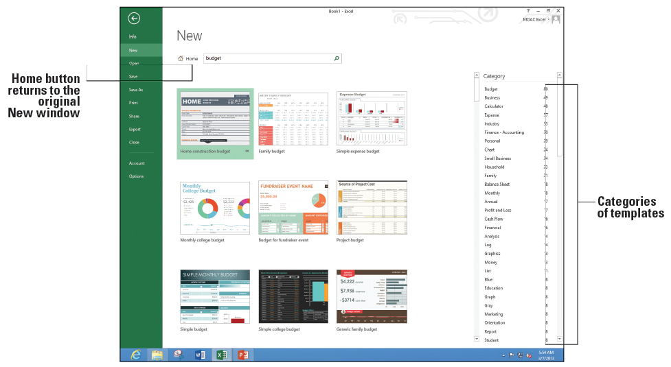
Step by Step: Search for Additional Templates
GET READY. If necessary, OPEN a blank workbook.
Click the FILE tab and click New. Notice the Suggested searches and Search for online templates box.
Click Budget on the Suggested searches row. As shown below, the New window changes to show templates specifically related to working with budgets.

Slide 57
Step by Step: Search for Additional Templates
Scroll to the bottom of the window and click on a few templates to see their descriptions.
Scroll back to the top of the New window and click Home to return to the original templates screen.
In the Suggested Searches row, click Calendars.
In the Category pane to the right, click Student.
Scroll to the Student assignment planner and read the description. Close the template description window.

Slide 58
Step by Step: Search for Additional Templates
In the Search box, type College and press Enter. Scroll through the list of suggested templates for college students and open the Weekly college schedule template.
Type in [Monday's date] in B1 and play with the workbook.
SAVE the workbook as 03 My Weekly Schedule Solution. Click Yes when prompted to save this as a macro-free workbook.
PAUSE. EXIT Excel.

Slide 59
Skills Summary

