Slide 1
Formatting Cells and Ranges
Microsoft Excel 2013
Lesson 6

Slide 2
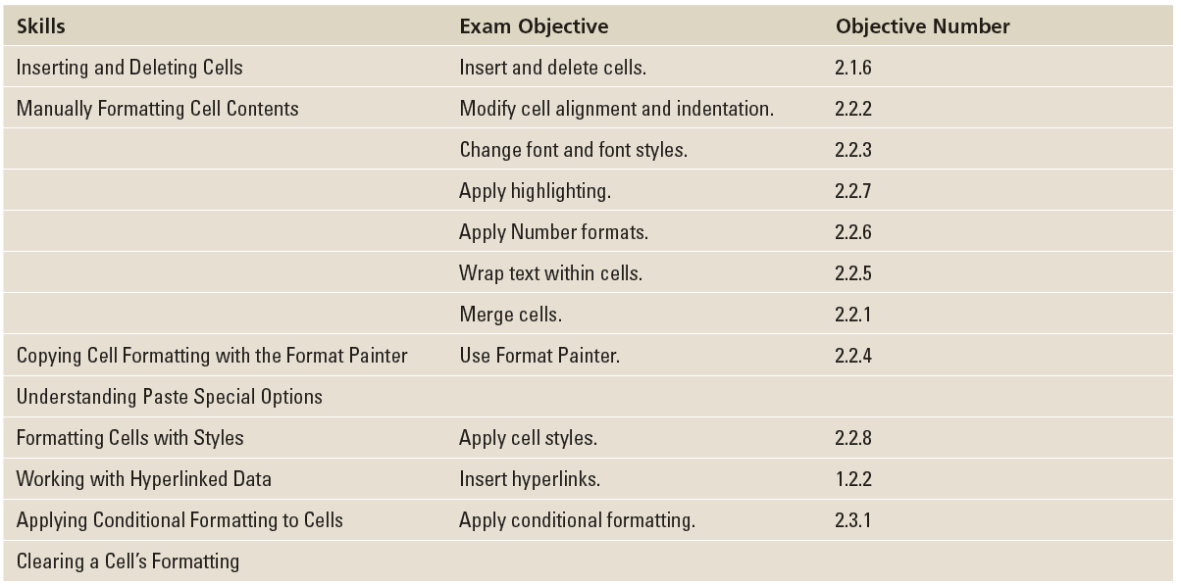
Objectives

Slide 3
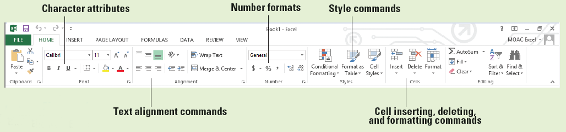
Software Orientation
The Excel HOME tab shown below contains formatting and editing commands that help you enhance the appearance and readability of your worksheets.
You will use commands from almost every group on this tab as you learn to apply formatting to data, copy formatting, and apply styles.
Excel provides many ways to format text and values in a worksheet. In the business world, worksheets are usually printed or shared with others. Therefore, you want your worksheets to be as appealing and understandable as possible.

Slide 4
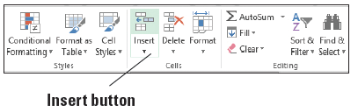
Step by Step: Insert Cells into a Worksheet
GET READY. Launch Microsoft Excel.
OPEN the 06 Patient Visits Insert Delete data file for this lesson. Click Enable Editing, if prompted.
Click in cell G5 to make it the active cell.
On the HOME tab, in the Cells group, click the top part of the Insert button, as shown below. All cells in column G beginning with G5 shift down one cell.
Notes:
Another Way: You can right-click in a cell and select Insert from the shortcut menu to open the Insert dialog box.

Slide 5
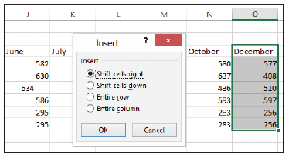
Step by Step: Insert Cells into a Worksheet
Type 590 and press Enter.
Now let’s insert a range of cells. Select O3:O9.
On the HOME tab, in the Cells group, click the Insert button arrow and then select Insert Cells.
In the Insert dialog box, ensure the Shift cells right option is selected, as shown below. Click OK.

Slide 6
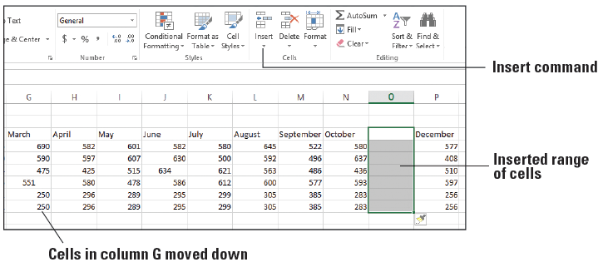
Step by Step: Insert Cells into a Worksheet
Notice that the cells formerly in O3:O9 shift one cell to the right. The worksheet should look similar to the figure below.
In cell O3, type November.
Enter the following numbers in cells O4 through O9:
480
502
446
577
302
302
SAVE the workbook.
PAUSE. Leave the workbook open to use in the next exercise.

Slide 7
Step by Step: Delete Cells from a Worksheet
GET READY. USE the workbook you modified in the previous exercise.
Click cell P7 to make it the active cell.
On the HOME tab, in the Cells group, click the Delete button arrow, and then select Delete Cells.
In the Delete dialog box, select the Shift cells left option and click OK. The content in cell Q7 shifts to the left and appears in cell P7.
Notes:
Another Way: You can right-click in a cell and select Delete from the shortcut menu to open the Delete dialog box.

Slide 8
Step by Step: Delete Cells from a Worksheet
Highlight the range A8:P8.
Right-click the selection, which is a duplicate of the next row of data, and select Delete from the shortcut menu.
In the Delete dialog box, ensure Shift cells up is selected and click OK.

Slide 9
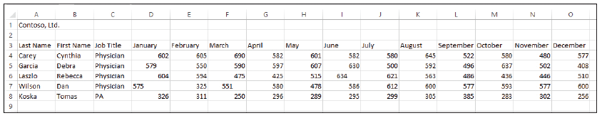
Step by Step: Delete Cells from a Worksheet
To delete a range of cells in a column, highlight the range D3:D8, and on the HOME tab, in the Cells group, click the Delete button arrow and then select Delete Cells. Ensure Shift cells left is selected, and click OK. The worksheet should look similar to the figure below.
SAVE the workbook as 06 Patient Visits Insert Delete Solution and CLOSE the file.
PAUSE. Leave Excel open to use in the next exercise.

Slide 10

Step by Step: Align Cell Contents
GET READY. LAUNCH Excel if it is not already running.
OPEN the 06 Patient Visits Format Cells data file for this lesson. Click Enable Editing, if prompted.
Select A3:O3.
On the HOME tab, in the Alignment group, click the Center button, as shown below. The column labels are now horizontally centered.
Notes:
Troubleshooting: Manual formatting is applied only to selected cells. Therefore, you need to select the cell or a range of cells before applying the formatting.

Slide 11
Step by Step: Align Cell Contents
Select D4:O8, and then on the HOME tab, in the Alignment group, click the Align Right button. All numbers in the months columns are now right-aligned.
SAVE the workbook.
PAUSE. Leave the workbook open to use in the next exercise.

Slide 12

Step by Step: Indent Cell Contents
GET READY. USE the workbook you saved in the previous exercise.
Select C4:C8.
On the HOME tab, in the Alignment group, click the Increase Indent button, as shown above. The cell content moves toward the right cell border.
Click the Decrease Indent button. The cell content moves back toward the left cell border.
PAUSE. Leave the workbook open to use in the next exercise.
Notes:
Another Way: You can press the Alt key and press H, and then press 6 to indent a cell’s content.

Slide 13
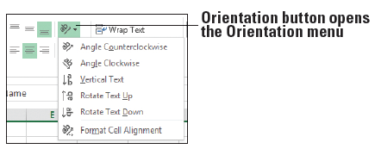
Step by Step: Change Text Orientation
GET READY. USE the workbook from the previous exercise.
Select A3:O3.
Click the Orientation button to open the menu, as shown below.
Select Angle Counterclockwise. The column heading labels appear angled from lower left to upper right within each cell.

Slide 14
Step by Step: Change Text Orientation
Click the Orientation button, and select Angle Clockwise. The column heading labels appear angled from upper left to lower right.
Click the Orientation button, and select Vertical Text. The column heading labels appear in a vertical line from top to bottom.
Click the Orientation button, and select Rotate Text Up and then Rotate Text Down to see how these settings affect the text.
Click the Orientation button, and select Format Cell Alignment. In the Format Cells dialog box, enter 0 in the Degrees box and click OK. The column heading labels return to their original orientation.
PAUSE. Leave the workbook open to use in the next exercise.

Slide 15
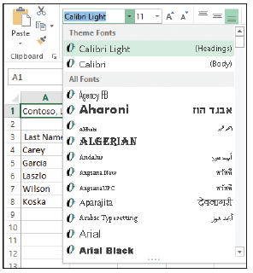
Step by Step: Choose Fonts and Font Sizes
GET READY. USE the workbook from the previous exercise.
Click A1.
On the HOME tab, in the Font group, open the Font menu and select the first option under Theme Fonts at the top, Calibri Light, as shown at right. Only the text in cell A1 changes to the new font.

Slide 16
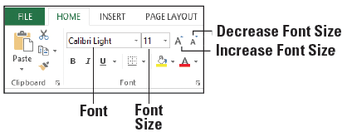
Step by Step: Choose Fonts and Font Sizes
With cell A1 still selected, open the Font Size menu indicated below. Select 18. The font size of the text changes to 18 point.
Select A3:O3 and from the Font list, select Arial.
With A3:O3 still selected, change the Font Size to 10. The column heading labels are now in Arial 10-point.
SAVE the workbook.
PAUSE. Leave the workbook open to use in the next exercise.

Slide 17
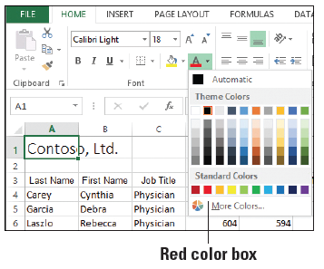
Step by Step: Change Font Color
GET READY. USE the workbook you saved in the previous exercise.
Click A1.
Open the Font Color menu, as shown at right, and under Standard Colors, click the Red color box. The text “Contoso, Ltd.” now has a red font color.
Select A3:O3, open the Font Color menu, and click the Blue color box under Standard Colors (third from the right).
SAVE the workbook.
PAUSE. Leave the workbook open to use in the next exercise.

Slide 18
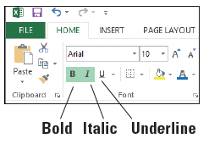
Step by Step: Apply Special Character Attributes
GET READY. USE the workbook you saved in the previous exercise.
Select A3:O3.
In the Font group, click the Bold button, and then click the Italic button, as shown below. The column labels appear in bold and italics.
Notes:
Another Way: You can press Ctrl + B to apply boldface, Ctrl + I to apply italics, or Ctrl + U to apply underlining to selected text.

Slide 19
Step by Step: Apply Special Character Attributes
Select A4:B8 and click the Bold button. The first and last names are now bolded.
SAVE the workbook.
PAUSE. Leave the workbook open to use in the next exercise.

Slide 20
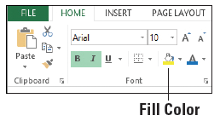
Step by Step: Fill Cells with Color
GET READY. USE the workbook you saved in the previous exercise.
Select A3:O3.
In the Font group, click the Fill Color button arrow, as shown below. The Theme Colors and Standard Colors palettes appear.

Slide 21
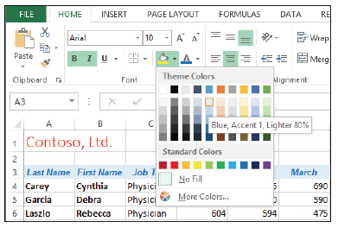
Step by Step: Fill Cells with Color
Select the Blue, Accent 1, Lighter 80% color box, as shown at right. A light blue background is applied to the column heading row.
SAVE the workbook as 06 Patient Visits Format Cells Solution and CLOSE the file.
PAUSE. Leave Excel open to use in the next exercise.

Slide 22
Step by Step: Apply Number Formats
GET READY. With Excel running, perform these actions:
OPEN the 06 Contoso Revenue data file for this lesson. Click Enable Editing, if prompted.
Ensure that Sheet1 is the active sheet.
Select B4:D8. This data should be formatted as General, without commas or decimal places.

Slide 23
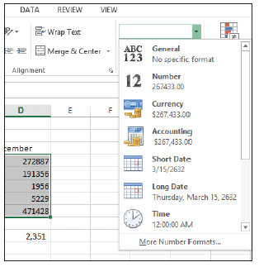
Step by Step: Apply Number Formats
On the HOME tab, in the Number group, open the Number Format menu as shown at right.
Select Currency. The numbers are now formatted as dollars, with two decimal places to represent cents.
With B4:D8 still selected, in the Number Format menu, select Accounting. This format left-aligns the dollar sign in each cell.
Notes:
Another Way: You can also apply number formats using the Format Cells dialog box. Just right-click a cell or range of cells and select Format Cells from the shortcut menu. In the Format Cells dialog box, click the Number tab.

Slide 24
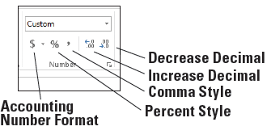
Step by Step: Apply Number Formats
In the Number group, click the Decrease Decimal button twice to display no decimal places. The Increase Decimal and Decrease Decimal buttons are shown below. The numbers are now rounded to whole dollars.
Click in a blank cell, such as A11.
Click Sheet2.
Select B6:B11.

Slide 25
Step by Step: Apply Number Formats
In the Number group, click the Comma Style button. Notice that the numbers are formatted with a thousands separator and two decimal places but no dollar sign.
With B6:B11 still selected, in the Number group, click the Accounting Number Format button, and then click the Decrease Decimal button twice. These actions make the current range consistent with the number format on Sheet1.
Select C6:C11.
In the Number Format menu, select Short Date. The dates are now in the mm/dd/yyyy format.

Slide 26
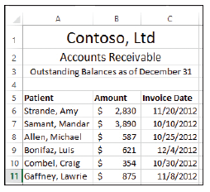
Step by Step: Apply Number Formats
Manually decrease the width of column C to eliminate extra space, similar to the figure at right.
SAVE the workbook.
PAUSE. Leave the workbook open to use in the next exercise.

Slide 27
Step by Step: Wrap Text in a Cell
GET READY. USE the workbook you saved in the previous exercise.
Click Sheet1. Notice that the content in two cells in column A cannot be fully displayed because of length.
Click A4, and then hold down the Ctrl key and click A7. Both cells—A4 and A7—are selected.

Slide 28
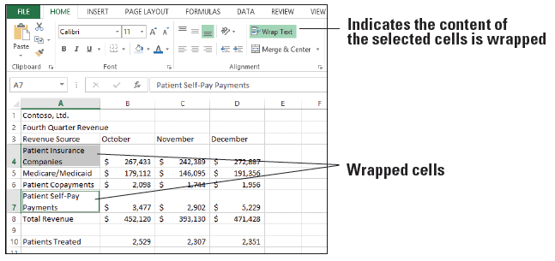
Step by Step: Wrap Text in a Cell
On the HOME tab, in the Alignment group, click the Wrap Text button. The text in both cells wraps to a second line without affecting the column width, as shown below. Notice that the Wrap Text button takes on a green background, indicating that the text in the current cell is wrapped.

Slide 29
Step by Step: Wrap Text in a Cell
SAVE the workbook.
PAUSE. Leave the workbook open to use in the next exercise.
Notes:
Troubleshooting: If you choose a different default font and/or font size, that font is used only in workbooks you create after you change the default and restart Excel. Existing workbooks are not affected.

Slide 30
Step by Step: Merge and Split Cells
GET READY. USE the workbook you saved in the previous exercise.
On Sheet1, select A1:D1.
On the HOME tab, in the Alignment group, click the main part of the Merge & Center button. The company name remains in a single cell, which is now centered across the columns.
Select A2:D2.
On the HOME tab, in the Alignment group, open the Merge & Center menu. Select Merge & Center. The heading remains in a single cell, which is now centered across the columns. This step has the same effect on A2:D2 as Step 2 had on A1:D1.

Slide 31
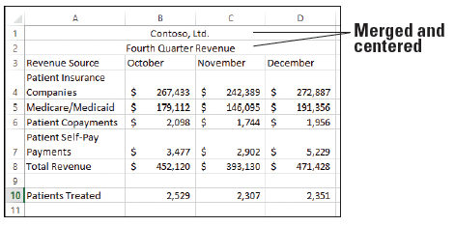
Step by Step: Merge and Split Cells
Select A3:D3.
Select Merge & Center from the Merge & Center menu.
Read the error message that appears and click OK.
Only the heading in the first column remains, which is not the effect we want. Press Ctrl + Z to undo the last change and restore the headings (below).

Slide 32
Step by Step: Merge and Split Cells
SAVE the workbook.
PAUSE. Leave the workbook open to use in the next exercise.

Slide 33
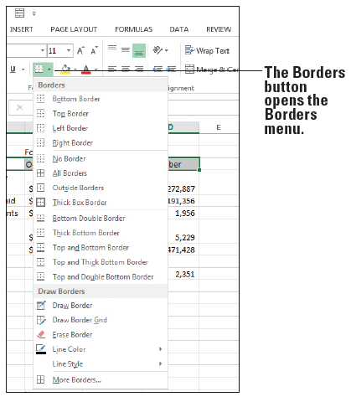
Step by Step: Place Borders around Cells
GET READY. USE the workbook you saved in the previous exercise.
On Sheet1, select A3:D3.
On the HOME tab, in the Font group, click the Borders button to open the Borders menu, as shown at right.
Select Top and Bottom Border. The selected text now has a top and bottom border.
With A3:D3 still selected, open the Borders menu and select More Borders.

Slide 34
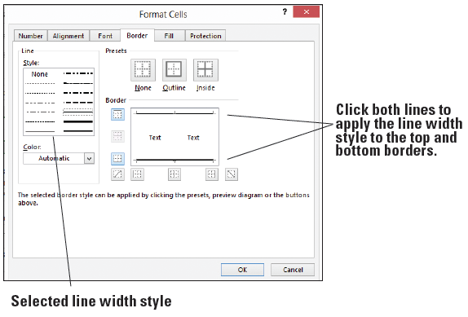
Step by Step: Place Borders around Cells
In the Format Cells dialog box, click the Border tab, if necessary.
Click a thicker line weight, such as the fifth line in the second column under Style. Then click the top and bottom border lines shown in the preview to the right to apply the thicker line. See above.

Slide 35
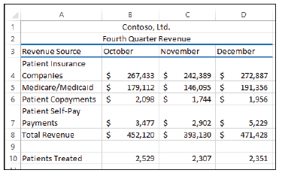
Step by Step: Place Borders around Cells
Open the Color list and under Standard Colors, select the Blue color box (third from right under Standard Colors), and then click the top and bottom border lines shown in the preview to the right to apply the color. Click OK and then click in a blank cell so you can view the result. See right.
SAVE the workbook as 06 Contoso Revenue Solution and CLOSE the file.
PAUSE. Leave Excel open to use in the next exercise.

Slide 36
Step by Step: Use the Format Painter to Copy Formatting
GET READY. LAUNCH Excel if it is not already running.
OPEN the 06 Contoso Painter Paste Special data file for this lesson. Click Enable Editing, if prompted.
Click Sheet2.
Click in cell A5.
On the HOME tab, in the Alignment group, click the Center button.

Slide 37
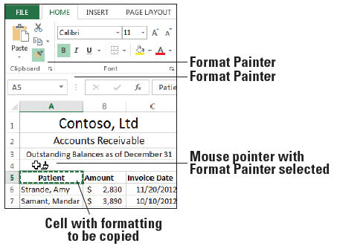
Step by Step: Use the Format Painter to Copy Formatting
On the HOME tab, in the Clipboard group, click the Format Painter button. The mouse pointer changes to plus sign with a paint brush, as shown below.
Drag over B5:C5. The formatting from A5 is applied to B5 and C5.
Notes:
Another Way: Format Painter is available on the Mini toolbar as well as in the Clipboard group.

Slide 38
Step by Step: Use the Format Painter to Copy Formatting
If Format Painter is still active, click the Format Painter button again or press Esc to turn off the Format Painter.
SAVE the workbook.
PAUSE. Leave the workbook open to use in the next exercise.

Slide 39
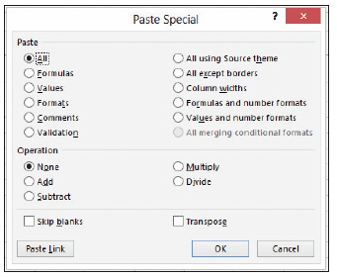
Step by Step: Understand Paste Special Options
GET READY. USE the workbook you saved in the previous exercise.
Ensure you are on Sheet2.
In cell A12, type Jacobsen, Lola.
Select B11:C11.
Press Ctrl + C to copy the selection to the Clipboard.
Right-click in cell B12 and select Paste Special from the shortcut menu. The Paste Special dialog box opens, as shown above.

Slide 40
Step by Step: Understand Paste Special Options
Select Formats and click OK. Only the formatting from B11:C11 is applied to B12:C12.
In B12, type 1534 and press Enter. The content is formatted the same as B11.
In C12, type 12/15/12 and press Enter. The content takes on the same date format as C11.
Click in A13 and type the label Total.
Click in B13, and on the HOME tab, in the Editing group, click the AutoSum button, and press Enter. The values in B6:B12 are totaled.
Click in B13 and press Ctrl + C to copy the selection to the Clipboard.

Slide 41
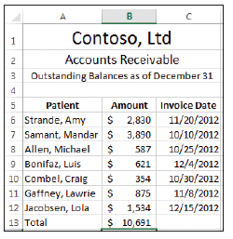
Step by Step: Understand Paste Special Options
Right-click in B14, select Paste Special, in the Paste Special dialog box, select Values, and then click OK. Press Esc to cancel the moving border in cell B13. Only the value of the formula in B13 was copied to B14, not the formula itself or any cell formatting.
Delete the content in cell B14. See right.
SAVE the workbook as 06 Contoso Painter Paste Special Solution and CLOSE the file.
PAUSE. Leave Excel open to use in the next exercise.

Slide 42
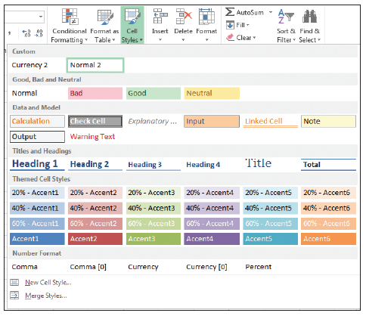
Step by Step: Apply Cell Styles
GET READY. LAUNCH Excel if it is not already running.
OPEN the 06 Contoso Cell Styles data file for this lesson. Click Enable Editing, if prompted.
Click Sheet1.
Select cell A1.
On the HOME tab, in the Styles group, open the Cell Styles menu. The Cell Styles gallery appears, as shown at right.

Slide 43
Step by Step: Apply Cell Styles
In the Titles and Headings section, select the Heading 1 style to apply it to the first cell of the worksheet.
Select cell A2.
Open the Cells Styles gallery and in the Themed Cell Styles section, select Accent1. A blue background with white text is applied to cell A2.
Select A8:D8.

Slide 44
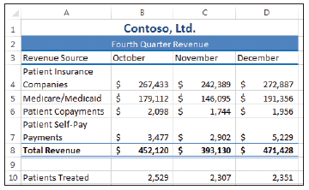
Step by Step: Apply Cell Styles
Open the Cells Styles gallery and in the Titles and Headings section, select Total. A thin blue border appears above A8:D8, and a double underline appears under the range of cells. Select a blank cell to see the results. See right.
SAVE the workbook.
PAUSE. Leave the workbook open to use in the next exercise.

Slide 45
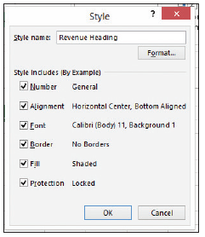
Step by Step: Customize a Cell Style
USE the workbook you saved in the previous exercise.
On Sheet1, click A2.
On the HOME tab, in the Styles group, open the Cell Styles menu and select New Cell Style near the bottom of the menu. The Style dialog box opens.
In the Style name text box, enter Revenue Heading, as shown at right.
Click the Format button.

Slide 46
Step by Step: Customize a Cell Style
Click the Font tab, in the Font style list, select Bold Italic, and click OK.
Click OK to close the Style dialog box.
With A2 still selected, open the Cell Styles menu and click Revenue Heading to apply the new style.
SAVE the workbook as 06 Contoso Cell Styles Solution.
PAUSE. Leave Excel open to use in the next exercise.

Slide 47
Step by Step: Insert a Hyperlink in a Cell
GET READY. LAUNCH Excel if it is not already running.
OPEN the 06 Contoso Hyperlink data file for this lesson. Click Enable Editing, if prompted.
Click Sheet2.
Click in cell A15.
Type Company website: and press Enter.
Manually widen column A until all content displays properly in cell A15.

Slide 48
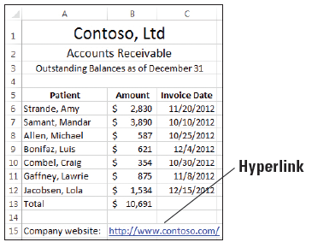
Step by Step: Insert a Hyperlink in a Cell
Right-click cell B15 and select Hyperlink from the shortcut menu.
In the Insert Hyperlink dialog box, type http://www.contoso.com/ in the Address box and click OK. The hyperlink appears in the worksheet, as shown below.
SAVE the workbook as 06 Contoso Hyperlink Solution.
PAUSE. Leave the workbook open to use in the next exercise.
Notes:
Another Way: You can open the Insert Hyperlink dialog box by clicking the Hyperlink command in the Links group on the INSERT tab.

Slide 49
Step by Step: Use a Hyperlink
GET READY. USE the workbook you saved in the previous exercise.
Click the hyperlink in cell B15. Because the hyperlink points to a website, your default web browser opens.
Close the browser window.
PAUSE. Leave the workbook open to use in the next exercise.

Slide 50
Step by Step: Remove a Hyperlink from a Cell
GET READY. USE the workbook you saved in the previous exercise.
Right-click cell B15 and select Remove Hyperlink from the shortcut menu, as shown in Figure 6-35. The hyperlink is removed from the URL, but the URL text remains.
CLOSE the workbook without saving your changes.
PAUSE. Leave Excel open to use in the next exercise.

Slide 51
Step by Step: Apply a Specific Conditional Format
GET READY. LAUNCH Excel if it is not already running.
OPEN the 06 Patient Visits Conditional Formatting data file for this lesson. Click Enable Editing, if prompted.
Select D4:O8.
Open the Conditional Formatting menu in the Styles group on the HOME tab and select Highlight Cells Rules > Greater Than. The Greater Than dialog box appears.
Enter 600 in the Format cells that are GREATER THAN box.

Slide 52
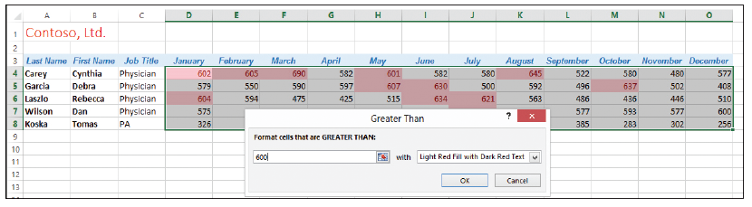
Step by Step: Apply a Specific Conditional Format
Leave the default fill color, as shown below. Click OK. Cells that contain a value greater than 600 are formatted with a light red background color and a dark red text color. This data represents the months in which the physicians were seeing more than the ideal number of patients.
SAVE the workbook.
PAUSE. Leave the workbook open to use in the next exercise.

Slide 53
Step by Step: Apply Multiple Conditional Formatting Rules
GET READY. USE the workbook you saved in the previous exercise.
Select D4:O8.
On the HOME tab, in the Styles group, click the Conditional Formatting menu and then select Highlight Cells Rules > Less Than.
Enter 300 in the Format cells that are LESS THAN box.

Slide 54
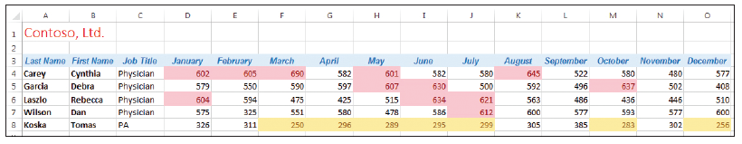
Step by Step: Apply Multiple Conditional Formatting Rules
Select the Yellow Fill with Dark Yellow Text option from the drop-down menu. Click OK. All values of less than 300 appear with a yellow background and dark yellow text color, along with values over 600 indicated by a light red background and dark red text, as shown below.
SAVE the workbook as 06 Patient Visits Conditional Formatting Solution.
PAUSE. Leave the workbook open to use in the next exercise.

Slide 55
Step by Step: Use the Rules Manager to Apply Conditional Formats
GET READY. USE the workbook you saved in the previous exercise.
Select D4:O8.
On the HOME tab, in the Styles group, click the Conditional Formatting menu and select Clear Rules > Clear Rules from Selected Cells.
Open the Conditional Formatting menu again and select Manage Rules. The Conditional Formatting Rules Manager dialog box appears.

Slide 56
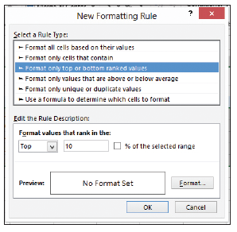
Step by Step: Use the Rules Manager to Apply Conditional Formats
Click the New Rule button. In the New Formatting Rule dialog box, select Format only top or bottom ranked values. The dialog box changes as shown at right.
In the Edit the Rule Description section, click the % of the selected range checkbox.
Click the Format button. The Format Cells dialog box opens.

Slide 57
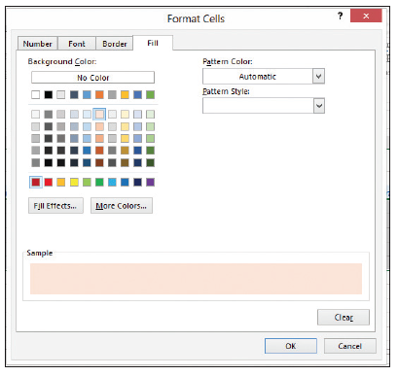
Step by Step: Use the Rules Manager to Apply Conditional Formats
Click the Fill tab if it’s not already selected, and then select the light red (pink) color box, as shown at right. Click OK twice.
In the Conditional Formatting Rules Manager dialog box, click the New Rule button.
In the New Formatting Rule dialog box, select Format only top or bottom ranked values.

Slide 58
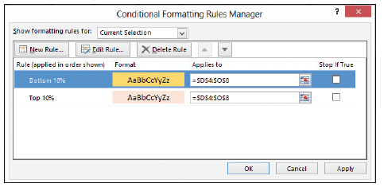
Step by Step: Use the Rules Manager to Apply Conditional Formats
In the Edit the Rule Description section, select Bottom from the first drop-down list on the left and click the % of the selected range checkbox.
Click the Format button.
In the Format Cells dialog box, click a yellow background color on the Fill tab, and then click OK twice. The Conditional Formatting Rules Manager dialog box should look similar to the figure above.

Slide 59
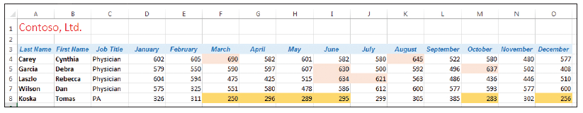
Step by Step: Use the Rules Manager to Apply Conditional Formats
Click OK. The Rules Manager applies the rules to the selected cells, as shown below. This view lets you see the top 10 percent and bottom 10 percent values in the range.
SAVE the workbook as 06 Patient Visits Conditional Formatting Revised Solution.
PAUSE. Leave the workbook open to use in the next exercise.

Slide 60
Step by Step: Clear a Cell’s Formatting
GET READY. USE the workbook you saved in the previous exercise.
Select A3:O3.
On the HOME tab, in the Editing group, click the Clear menu and select Clear Formats. The formatting for the range A3:O3 is removed.
Click the Select All button (at the intersection of the column and row headings) in the upper-left corner of your worksheet, or press Ctrl+A.

Slide 61
Step by Step: Clear a Cell’s Formatting
From the Clear menu, click Clear Formats. All worksheet formatting disappears.
Close the workbook without saving your changes.
CLOSE Excel.
As you saw in this exercise, clearing formatting from cells or an entire worksheet does not affect the text, numbers, or formulas in the worksheet.

Slide 62
Skills Summary

