Slide 1
Managing Worksheets
Microsoft Excel 2013
Lesson 8

Slide 2
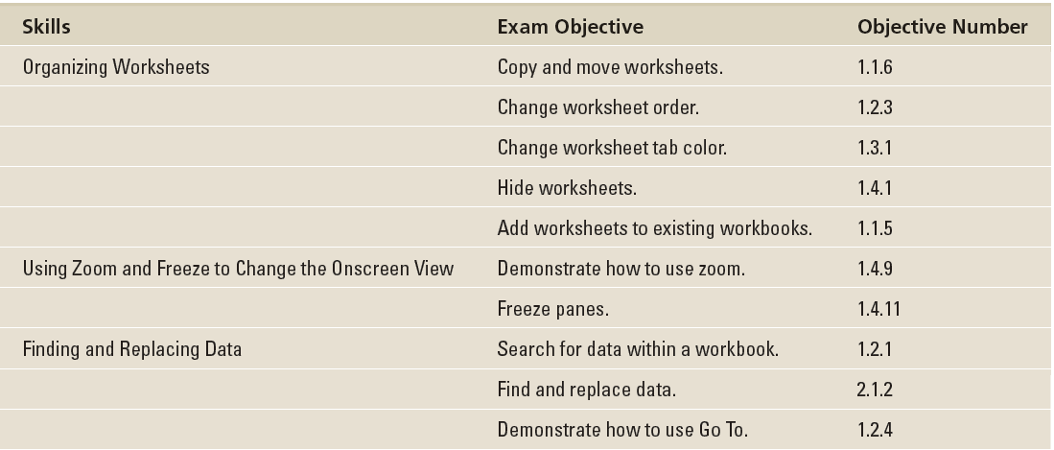
Objectives

Slide 3
Software Orientation
In this lesson, you become familiar with how a workbook contains worksheets, and how you manipulate those worksheets within a workbook the way you might reorganize the contents of a folder in your desk drawer.
Unlike the old desk drawer, though, you have a few tools that will remind you that you’re using a computer, such as the Find command to help you search for certain contents.

Slide 4
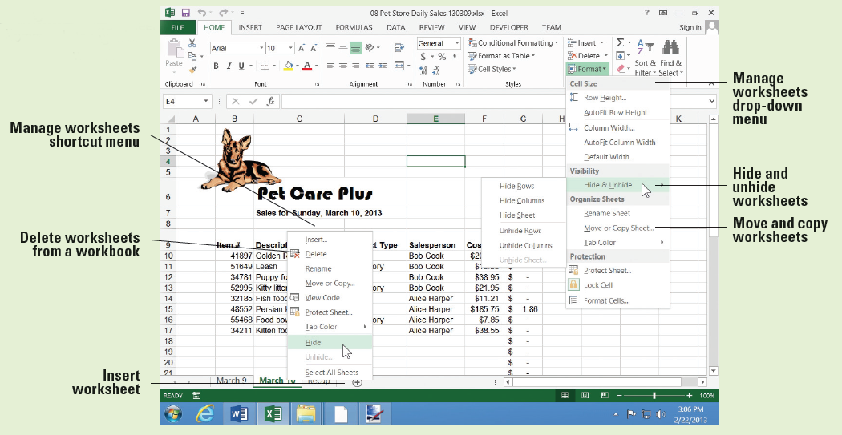
Software Orientation
You find the commands for this lesson located in the Cells group and Editing group, which are both located on the HOME tab (below).

Slide 5
Step by Step: Copy a Worksheet
GET READY. Before you begin these steps, LAUNCH Microsoft Excel.
OPEN the 08 Spa Services workbook for this lesson.
Click the FILE tab and then click Save As. At the bottom of the Computer list, click Browse.
In the Save As dialog box, in the left pane, scroll to the group of storage devices listed under Computer. Click the entry that represents your USB flash drive.
Click New Folder. In the right pane, type Lesson 8 and press Enter.
SAVE the workbook in the Lesson 8 folder as 08 Spa Services Week of 2-18-13 Solution.
With the Monday worksheet active, click the HOME tab, in the Cells group, click Format.

Slide 6
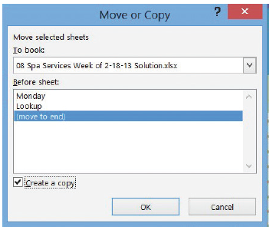
Step by Step: Copy a Worksheet
Click Move or Copy Sheet. The dialog box shown at right opens. Here, the Before sheet list shows the current sequence of worksheets in the workbook even if there’s only one. The sheet selected represents the place you want to put the copied sheet in front of.

Slide 7
Step by Step: Copy a Worksheet
In the Before sheet list, select (move to end). Next, select the Create a copy box, as shown at right, and then click OK. A copy of the Monday worksheet is inserted at the end of the sequence, to the right of Lookup. The new worksheet is given the default name Monday (2).
Notes:
Another Way: You can also right-click a worksheet’s tab to display the shortcut menu, and then click Move or Copy to display the Move or Copy dialog box.

Slide 8
Step by Step: Copy a Worksheet
Click the Monday worksheet tab. Next, click and hold the Monday tab, and then press and hold Ctrl. The pointer changes from an arrow to a paper with a plus sign in it.
Drag the pointer to the right until the down-arrow just above the tabs bar points to the divider to the right of Monday (2). Release the mouse button and Ctrl key. A new worksheet is created, with its tab located just to the right of where the down-arrow was pointing. Its name is Monday (3).
With Monday (3) active, click cell B4 and type the date 2/19/2013.

Slide 9
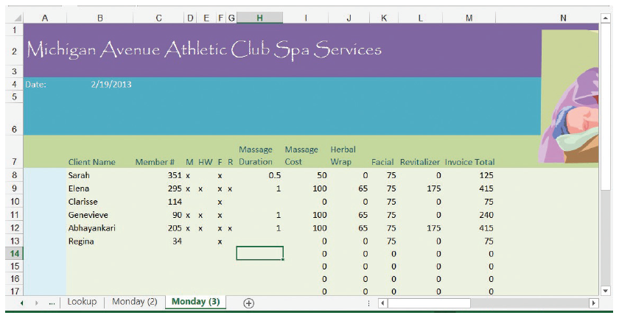
Step by Step: Copy a Worksheet
Select cells B8:H13.
Beginning in cell B8, enter the following data, skipping over cells without an “x” or a number, as shown in the following (below):

Slide 10
Step by Step: Copy a Worksheet
PAUSE. SAVE the workbook and LEAVE it open to use in the next exercise.

Slide 11
Step by Step: Rename a Worksheet
GET READY. USE the workbook from the previous exercise.
Double-click the Monday (3) worksheet tab to select its name.
Type Tuesday and press Enter. The new name appears on the tab.
Repeat this process for the Monday (2) worksheet tab, renaming it Wednesday.
With the Wednesday worksheet active, select cell B4 and type the date 2/20/2013.
Select cells B8:H15.
Notes:
Another Way: You can also right-click a worksheet’s tab to display the shortcut menu, and then click Rename.

Slide 12
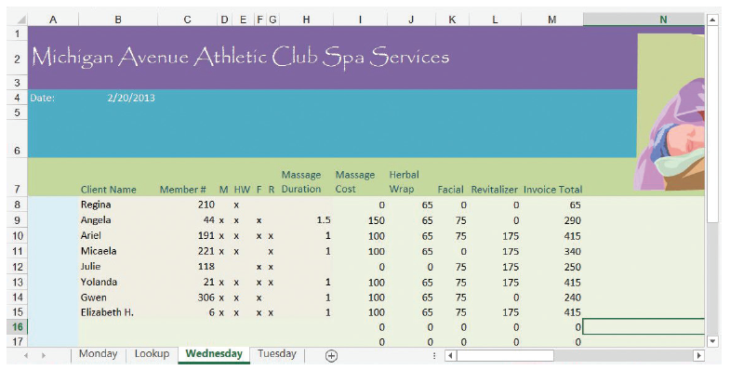
Step by Step: Rename a Worksheet
Beginning in cell B8, enter the following data, skipping over cells without an “x” or a number as shown in the following (below):
PAUSE. SAVE the workbook and LEAVE it open to use in the next exercise.

Slide 13
Step by Step: Reposition the Worksheets in a Workbook
GET READY. USE the workbook from the previous exercise.
Click the Tuesday worksheet tab. On the HOME tab, in the Cells group, click Format.
Click Move or Copy Sheet. The Move or Copy dialog box opens.
To make sure Tuesday appears before Wednesday, click Wednesday in the Before sheet list, and then click OK.

Slide 14
Step by Step: Reposition the Worksheets in a Workbook
Click and hold the Lookup worksheet tab. The pointer changes from an arrow to a paper without a plus sign.
Drag the pointer to the right until the down-arrow just above the tabs bar points to the divider to the right of Wednesday. Release the mouse button. The Lookup worksheet is repositioned at the end of the sequence, and nothing inside the worksheet itself is changed.
Click the Monday worksheet tab.

Slide 15
Step by Step: Reposition the Worksheets in a Workbook
Select cells B8:H11.
Beginning in cell B8, enter the following data, skipping over cells without an “x” or a number as shown in the following:
PAUSE. SAVE the workbook and LEAVE it open to use in the next exercise.
Notes:
Take Note: The worksheet you see when you first open a workbook is whichever sheet is active when you close the workbook, regardless of where that sheet falls in the tab order.

Slide 16
Step by Step: Change the Color of a Worksheet Tab
GET READY. USE the workbook from the previous exercise.
Right-click the Monday worksheet tab.
In the shortcut menu, click Tab Color.
In the popup menu, under Standard Colors, click Red. Excel gives a slightly red tint to the Monday worksheet tab.
Click the Tuesday worksheet tab. Notice the Monday worksheet tab is now the bold red color you chose. Excel applies only the gradient tint to the tab for the currently visible worksheet to make it stand out above the others.
Repeat the color selection process for the Tuesday and Wednesday worksheet tabs, choosing Orange and Yellow, respectively.

Slide 17
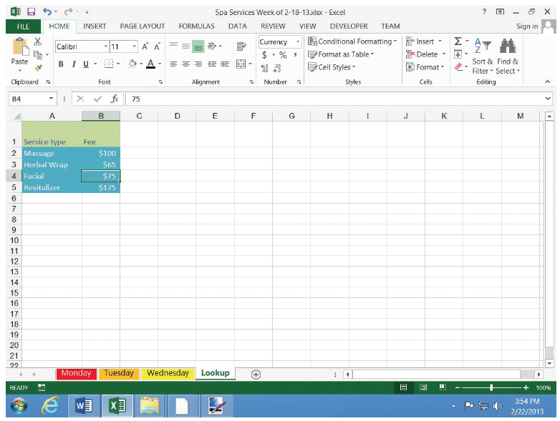
Step by Step: Change the Color of a Worksheet Tab
Click the Lookup worksheet tab. Your tabs bar should now appear as shown at right.
PAUSE. SAVE the workbook and LEAVE it open to use in the next exercise.
Notes:
Take Note: When you copy a worksheet whose tab has been given a color, that color is copied to the new worksheet along with its contents and formatting.

Slide 18
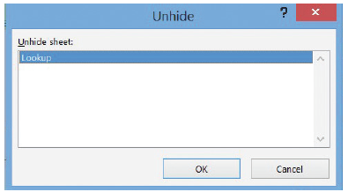
Step by Step: Hide and Unhide a Worksheet
GET READY. USE the workbook from the previous exercise.
With the Lookup worksheet tab active, on the HOME tab, in the Cells group, click Format.
Click Hide & Unhide and then click Hide Sheet. The Lookup worksheet is no longer visible.
Click Format, click Hide & Unhide, and then click Unhide Sheet. The Unhide dialog box appears (right).

Slide 19
Step by Step: Hide and Unhide a Worksheet
Make sure Lookup is chosen in the Unhide sheet list, and then click OK. The Lookup worksheet reappears and is activated.
In the Lookup worksheet, select cell B3.
Type 70 and press Enter.
Right-click the Lookup worksheet tab, and click Hide. The Lookup worksheet disappears again, although the change you made to one price is reflected in the other sheets that refer to it.
PAUSE. SAVE the workbook and LEAVE it open to use in the next exercise.
Notes:
Take Note: When a workbook contains hidden worksheets, the Unhide Sheet command is enabled in the Format menu, and the Unhide command is enabled in the shortcut menu when you right-click any tab.

Slide 20
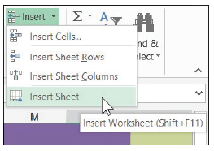
Step by Step: Insert a New Worksheet into a Workbook
GET READY. USE the workbook from the previous exercise.
Click the Wednesday tab.
On the HOME tab, in the Cells group, click the down-arrow next to Insert (right).
Click Insert Sheet. A new, blank worksheet is created, and its tab is inserted before the tab of the active sheet (Wednesday). Excel gives it a temporary name, beginning with Sheet followed by a number.
Move the new worksheet to the end of the tab sequence.

Slide 21
Step by Step: Insert a New Worksheet into a Workbook
Rename the new worksheet Survey.
Click the Wednesday worksheet tab again.
Click the + button to the right of the worksheet tabs. Another new worksheet is created with a temporary name, and this time, its tab is inserted after Wednesday.
Rename this new worksheet Totals.
PAUSE. SAVE the workbook and LEAVE it open to use in the next exercise.
Notes:
Another Way: Excel has a process for inserting a number of different things into a workbook, with a worksheet being one of the selections. Right-click the tab to the right of the spot you want the new worksheet, and then click Insert. To insert a blank worksheet (as opposed to an existing sheet with something in it), choose Worksheet from the Insert dialog box as shown in Figure 8-9. Some examples of preconfigured worksheets appear under the Spreadsheet Solutions tab.
Take Note: In addition to common elements of Excel such as a worksheet and chart, the Insert dialog box might also contain templates you have created yourself or downloaded from online. This way, if you build a worksheet into a reusable form, then you can save that form as a template, and insert new copies of that form into a workbook as you need them.

Slide 22
Step by Step: Delete a Worksheet from a Workbook
GET READY. USE the workbook from the previous exercise.
Click the Totals worksheet tab.
On the HOME table, in the Cells group, click the down-arrow next to Delete.
Click Delete Sheet. The Totals worksheet is removed and its tab disappears.
Right-click the Survey tab, and click Delete. The Survey worksheet is removed and its tab disappears.
PAUSE. SAVE the workbook and LEAVE it open to use in the next exercise.
Notes:
Take Note: You can use the tabs bar to delete more than one worksheet at a time. To select a block of worksheets whose tabs are adjacent to one another, click the tab at one end of the block, then while holding down the Shift key, click the tab at the other end. To select a group of worksheets that might not be adjacent, click one worksheet’s tab, then while holding down the Ctrl key, click each tab for the others. Once all the tabs you want to delete are highlighted, right-click any of those tabs and in the shortcut menu, click Delete.
Troubleshooting: Although Excel offers a reliable way to undo many of the things you do to workbooks by accident (press Ctrl + Z to step back over mistakes you made, for instance), you cannot undo the deletion of a worksheet from a workbook. To protect yourself against losing hours of work, save your workbook often. That way, if you do accidentally delete a worksheet, you can at least recover a slightly older version from a saved file.

Slide 23
Step by Step: Work with Multiple Worksheets in a Workbook
GET READY. USE the workbook from the previous exercise.
SAVE the workbook in the Lesson 8 folder as 08 Spa Services Week of 2-18-13 Solution 2.
Right-click any worksheet’s tab and click Select All Sheets. The title bar now reads Spa Services Week of 2-18-13.xlsx [Group]. All visible worksheets are enrolled in this group, whereas hidden worksheets are excluded. Although all the worksheets’ tabs are now boldface, the active worksheet remains highlighted in green.
Select cells I8:M33.

Slide 24
Step by Step: Work with Multiple Worksheets in a Workbook
Click $ (Accounting Number Format) in the Number group of the Home menu tab. The cell formats for the range switch to a currency style where the dollar sign is aligned left, and the value aligned right with dollars and cents. Column K (Facial) is too narrow for its contents, so its values currently read ####.
vAdjust the width of column K to fit its contents (see Lesson 7, “Formatting Worksheets”).
Select column M.
In the Font group, click B (Bold). All cells in column M are now boldfaced.
Notes:
Take Note: You can paste data from the Clipboard to multiple worksheets simultaneously when they’re grouped like this. You cannot, however, paste linked or embedded data (see Lesson 6, “Formatting Cells and Ranges”) to multiple worksheets, only to one.

Slide 25
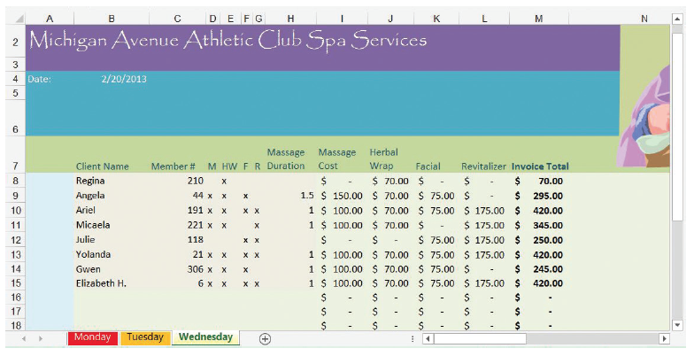
Step by Step: Work with Multiple Worksheets in a Workbook
Click the tab for a worksheet other than Wednesday. The group is now dissolved, but the changes you made to the previous sheet are reflected here, as demonstrated by the reformatted Wednesday worksheet shown below.
Select the Monday worksheet.
Notes:
Another Way: Another way to ungroup a group of worksheets is to right-click any tab in the group, and then click Ungroup Sheets.

Slide 26
Step by Step: Work with Multiple Worksheets in a Workbook
On the VIEW tab, in the Window group, click New Window. A new Excel window appears, also containing the Monday worksheet.
With the new window active, select the Tuesday worksheet.
Click the View tab and click New Window again. Another window appears.
With this new window active, select the Wednesday worksheet.
On the VIEW tab, in the Windows group, click Arrange All. The Arrange Windows dialog box opens.

Slide 27
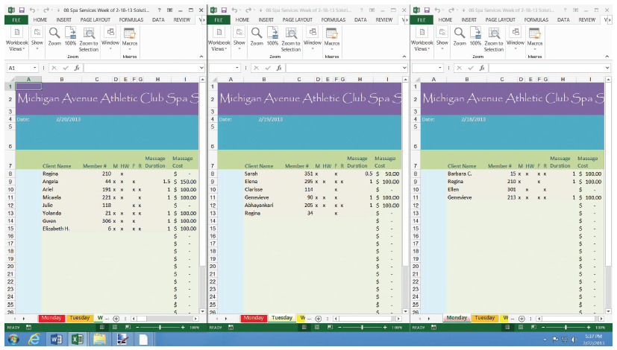
Step by Step: Work with Multiple Worksheets in a Workbook
In the dialog box, click Vertical, and then click OK. Excel rearranges your three windows to appear as shown below.
PAUSE. LEAVE the workbook open to use in the next exercise.

Slide 28
Step by Step: Hide and Unhide Worksheet Windows in a Workbook
GET READY. USE the workbook from the previous exercise.
With all three non-hidden worksheets visible, click the title bar of the window containing the Monday worksheet.
On the VIEW tab, in the Window group, click Hide. The Monday window is closed.
In either of the visible windows, on the VIEW tab, in the Window group, click Unhide. The Unhide dialog box appears.
In the Unhide workbook list, choose the hidden window and click OK.
PAUSE. SAVE the workbook and LEAVE it open to use in the next exercise.

Slide 29
Step by Step: Use Zoom and Freeze to Change the Onscreen View
GET READY. USE the workbook from the previous exercise.
SAVE the workbook in the Lesson 8 folder as 08 Spa Services Week of 2-18-13 Solution 3.
Maximize the window containing the Monday worksheet.
Select cell B8.

Slide 30
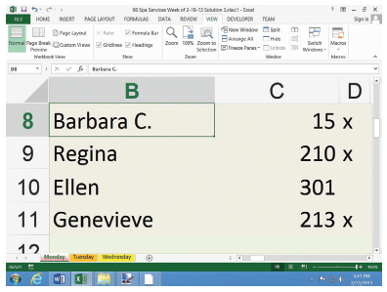
Step by Step: Use Zoom and Freeze to Change the Onscreen View
To increase magnification, click and hold the zoom control in the lower right corner (right) and slide the pointer to the right. The maximum zoom is 400%. Notice the window zooms in on the cell you select.
Click the VIEW tab, and in the Zoom group, click 100%. The worksheet returns to standard magnification. Scroll to the top of the worksheet so that row 1 is visible again. If you need to, scroll left so you can also see column A again.
Notes:
Another Way: To choose a precise screen magnification, rather than just eyeballing it, click Zoom on the View tab, and in the Zoom dialog box, under Magnification, in the Custom box, type a number, and click OK.

Slide 31
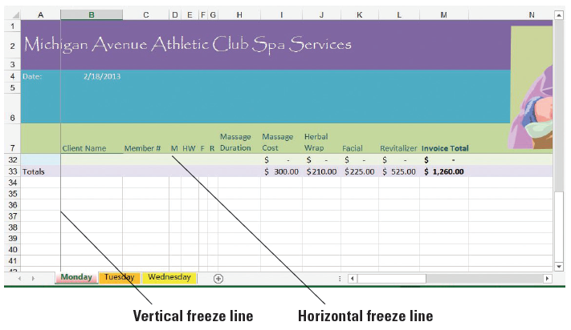
Step by Step: Use Zoom and Freeze to Change the Onscreen View
On the VIEW tab, in the Window group, click Freeze Panes, and then click Freeze Panes in the menu that appears. Cells above and to the left of the selected cell (B8) are now frozen in place for scrolling.
Scroll down so that row 33 comes close to the labels in row 7. Notice that rows 1 through 7 remain in place (below).

Slide 32
Step by Step: Use Zoom and Freeze to Change the Onscreen View
Press Ctrl + Home to scroll the worksheet to the top. In the Window group, click Freeze Panes, and then click Unfreeze Panes. The thin lines denoting the frozen borders of the worksheet disappear.
PAUSE. LEAVE the workbook open to use in the next exercise.
Notes:
Take Note: The Freeze Top Row and Freeze First Column commands in the Freeze Panes menu of the Window group do not work in complement to one another. Choosing Freeze First Column, for instance, unfreezes anything that was frozen previously, including the top row with Freeze Top Row.

Slide 33
Step by Step: Locate Data with the Find Command
GET READY. USE the workbook from the previous exercise.
Select the Monday worksheet. Select cell B8.
On the HOME tab, in the Editing group, click Find & Select (the binoculars button). Click Find. The Find and Replace dialog box appears.
In the dialog box, click Options. The dialog box expands.
Click the Within down arrow, and in the drop-down list, click Workbook.
Notes:
Another Way: You can also open the Find and Replace dialog box with the keyboard shortcut Ctrl+F.

Slide 34
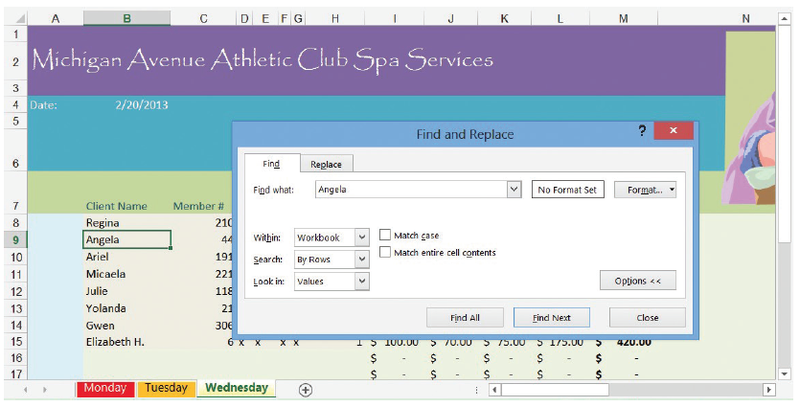
Step by Step: Locate Data with the Find Command
Click the Look in down arrow, and in the drop-down list, click Values.
Click the Find what text box, delete any contents that might appear there, and type Angela. Click Find Next. The workbook window moves to Wednesday, and automatically selects Angela in cell B9. Meanwhile, the dialog box appears as shown below.

Slide 35
Step by Step: Locate Data with the Find Command
Double-click the Find what text box, press Delete, and then type Beth. Click Find Next. Excel highlights cell B15, whose contents include “beth,” in the middle of the cell and in a non-matching case.
Select cell B9.
In the dialog box, click Match case, and then click Find Next. This time, Excel reports the text can’t be found, because it’s looking for a name that begins with a capital “B.” Click OK to dismiss the message.

Slide 36
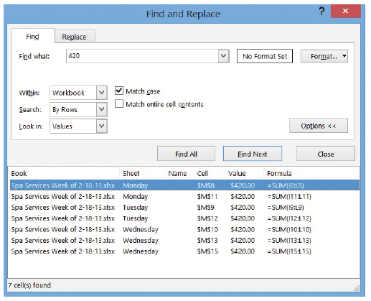
Step by Step: Locate Data with the Find Command
Double-click the Find what text box, press Delete, and then type 420. Click Find All. The dialog box shows a detailed report listing all the cells in the workbook that contain the value 420 (right). In this case, it points to all the locations where customers paid “the works” for all the services together.
Notes:
Troubleshooting: If you can’t see the complete list shown here, you can scroll the list up or down using the scroll bar along the right side of the list, or you can expand the dialog box to make it bigger, as in Figure 8-15. Click and hold on the lower right corner of the frame, and then drag down to stretch the frame larger.

Slide 37
Step by Step: Locate Data with the Find Command
Click the first item in the list whose Sheet entry is marked Tuesday. Excel brings up the Tuesday worksheet and selects cell M9, which contains an entry for $420.00.
Click Close to dismiss the dialog box.
Close the other two open workbook windows.
PAUSE. LEAVE the workbook open to use in the next exercise.
Notes:
Troubleshooting: When you choose the Match entire cell contents option in the Find and Replace dialog box, Excel skips over cells whose contents do not match the text in the Find what box in their entirety. For instance, in this case a search for “Elizabeth” would skip the cell containing “Elizabeth H.” if the Match entire cell contents option was checked.
Take Note: Excel searches for text or values in a worksheet or workbook by scanning from the current cell pointer location down, not up. So if the active cell is below the text you’re searching for, it might locate a cell down the list first. As you keep clicking Find Next, eventually Excel will wrap around to the beginning and will find the text above the original cell pointer location. But it does matter where you start.

Slide 38
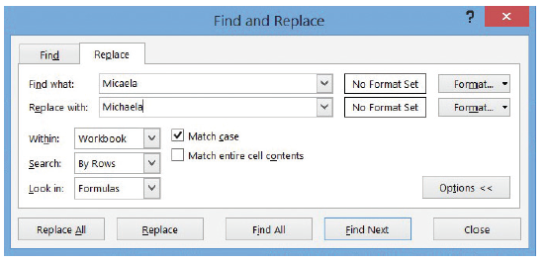
Step by Step: Replace Data with the Replace Command
GET READY. USE the workbook from the previous exercise.
Select the Wednesday worksheet. Select cell B8.
On the HOME table, in the Editing group, click Find & Select. Click Replace in the menu. The Find and Replace dialog box appears (below).
Notes:
Another Way: To display the Find and Replace dialog box with the Replace tab active instead of Find, press Ctrl+H.

Slide 39
Step by Step: Replace Data with the Replace Command
Make sure certain options are visible and that Workbook is the selected option for Within.
If the Find what text box shows the contents of the previous search, then double-click the text box and press Delete to erase its contents.
Click in the Find what text box and type Micaela.
Click in the Replace with text box and type Michaela. The dialog box should now appear.

Slide 40
Step by Step: Replace Data with the Replace Command
Click Replace All. Excel searches for all instances of Micaela and adds an “h” to the middle (correcting this client’s spelling), and then will notify you when the job is done. Excel makes one replacement.
Click OK, and then click Close.
SAVE the workbook, and LEAVE it open to use in the next exercise.
Notes:
Troubleshooting: Use Replace All only when you are certain you need to replace every instance of a passage of text or an item of data. There will be times when you need to replace only some instances but not all of them, and it’s impossible to explain to Excel how to choose which ones change and which don’t. In such a case, you can review each instance one-by-one in a list, and make the decision yourself. Click Find Next to have Excel bring up the next instance, and then click Replace if you do need to replace it or Find Next again to skip it and go to the next one.
Take Note: When you need to search and replace only text or parts of a formula within a part of a worksheet, select the range of cells to search first. When you open the Find and Replace dialog box, do not use Replace All—that will search the entire worksheet or workbook (depending on the option set). Instead, click Replace to have Excel replace the instance of the matched text under the cell pointer, and then automatically search for the next instance within the block.

Slide 41
Skils Summary

