Slide 1
Understanding Word
Microsoft Word 2013
Lesson 1

Slide 2
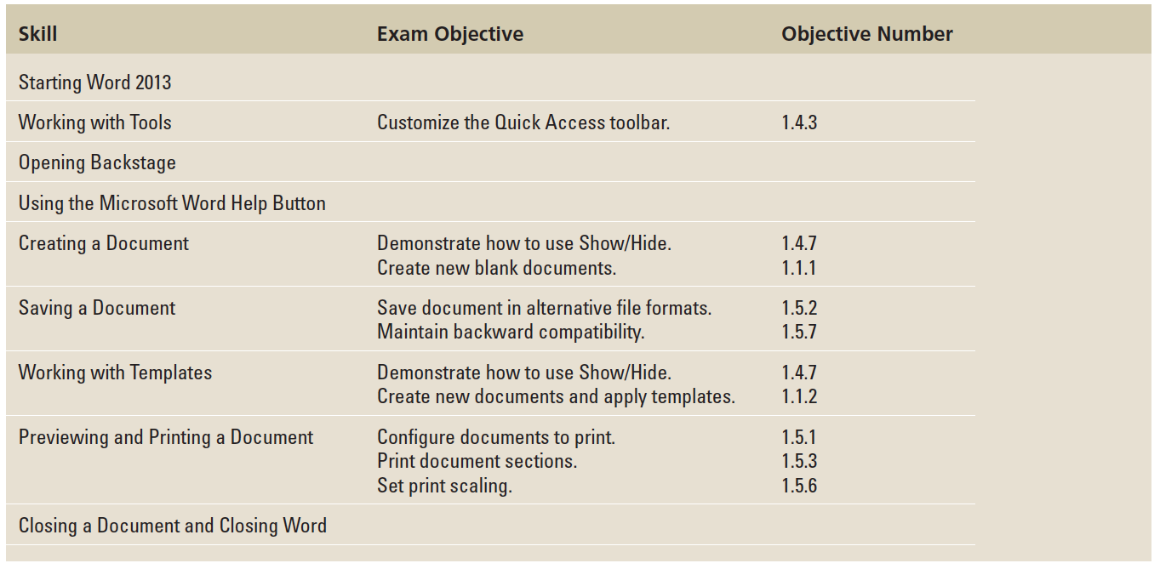
Objectives

Slide 3
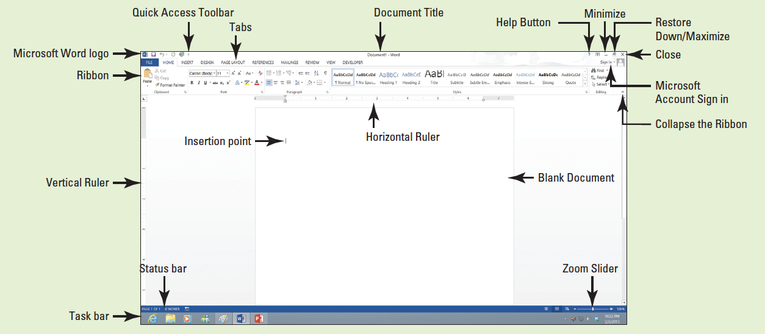
Software Orientation
Before you begin working in Microsoft Word 2013, you need to acquaint yourself with the primary user interface (UI). When Microsoft Word 2013 is opened, you see a screen similar to that shown below.

Slide 4


Step by Step: Start Word
GET READY. Before you begin these steps, be sure to turn on and/or log on to your computer.
From the Start screen of Windows 8, locate Word 2013 and click the icon . For Windows 7 users, locate the Windows task bar, click the Start button, and then click All Programs. A menu of installed programs appears. Click the Microsoft Office folder. Next click Microsoft Word 2013. The new Word 2013 screen opens.
Notes:
Another Way: In Windows 7, you can use the Search Programs and Files box, type Microsoft Word 2013 and press Enter. You can also search for a program or file by clicking the Start button and then typing the first two characters of the program or filename into the Search box; files and programs beginning with those letters appear in the Start menu. By right-clicking on the Word 2013 icon, you can pin Word 2013 to the Start menu and task bar, so that it is always visible.

Slide 5
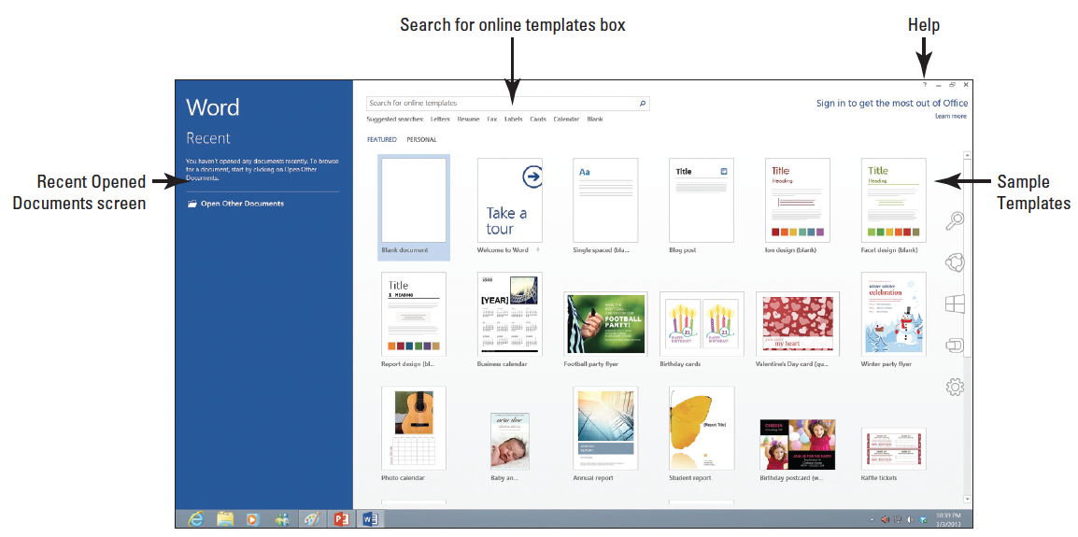
Step by Step: Start Word
The new Word 2013 screen appears (below). On the left side of the screen, you see the recent documents that have been accessed, and the right side displays the blank document page and templates.
PAUSE. LEAVE the Word 2013 screen open to use in the next exercise.
Notes:
Take Note: Windows 8 and Windows 7 are for PC users at home, work, and school. Both are powerful tools that control the user interface, storage devices, other software, peripheral devices, networks/security, system resources, and task scheduling. Windows 8 is the latest operating system standard for computers, laptops, and tablets. Windows 8 also comes in multiple versions, such as Windows 8 Pro and Windows RT to support your personal needs and how you use your device. Windows 8 is an improvement on Windows 7 because it supports touch-capable devices in addition to traditional mouse and keyboard commands. You can get started with Windows 8 by practicing using the Narrator. On the keyboard, press the Windows logo key plus Enter. To Exit the Narrator, press Caps Lock+ESC.
Another Way: For Window 7 users, when Office was installed on your computer, a shortcut icon might have been added to the Start menu or to your desktop. Double-click the shortcut icon on your desktop to start Word without having to go through the Start menu.

Slide 6
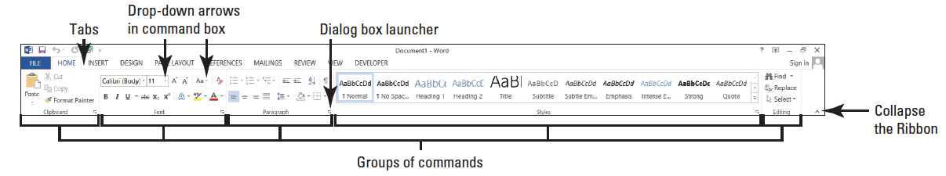
Step by Step: Use the Ribbon
USE the document that is open from the previous exercise.
The Ribbon is located at the top of the Word screen. In your newly opened document, the Home tab is the default tab on the Ribbon, as shown below. Note how the Ribbon is divided into groups: Clipboard, Font, Paragraph, Styles, and Editing.
Review the other tabs on the Ribbon and review each group associated with the tab, and identify the arrow that launches the dialog box.

Slide 7
Step by Step: Use the Ribbon
Click the Page Layout tab to make it the active tab. Notice that the groups of commands change. The Page Layout tab contains three groups: Page Setup, Paragraph, and Arrange. Notice that in the Page Setup and Paragraph group a small arrow appears in the lower-right corner. Clicking on the arrow opens the dialog box with more options to select or complete a command.
Click the Home tab.

Slide 8
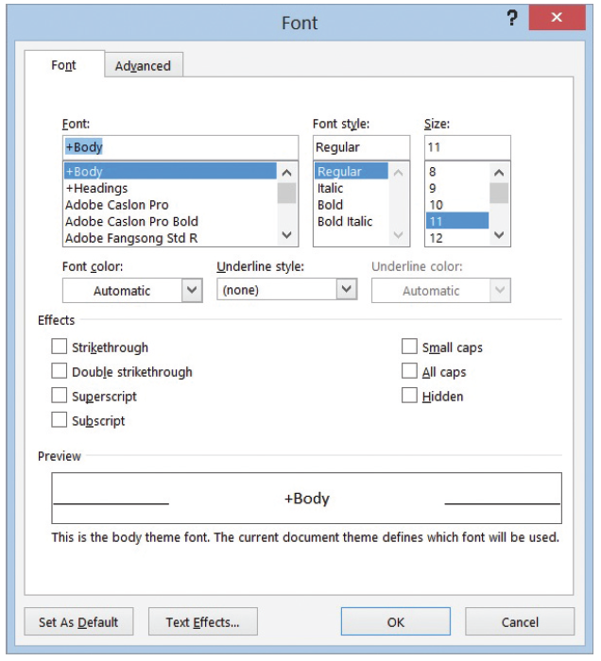
Step by Step: Use the Ribbon
Click the dialog box launcher in the lower-right corner of the Font group. The Font dialog box, as shown at right, appears. The Font dialog box contains two tabs with the Font tab being the active tab. There are many options to select within the Font dialog box. Click Cancel to close the dialog box.

Slide 9
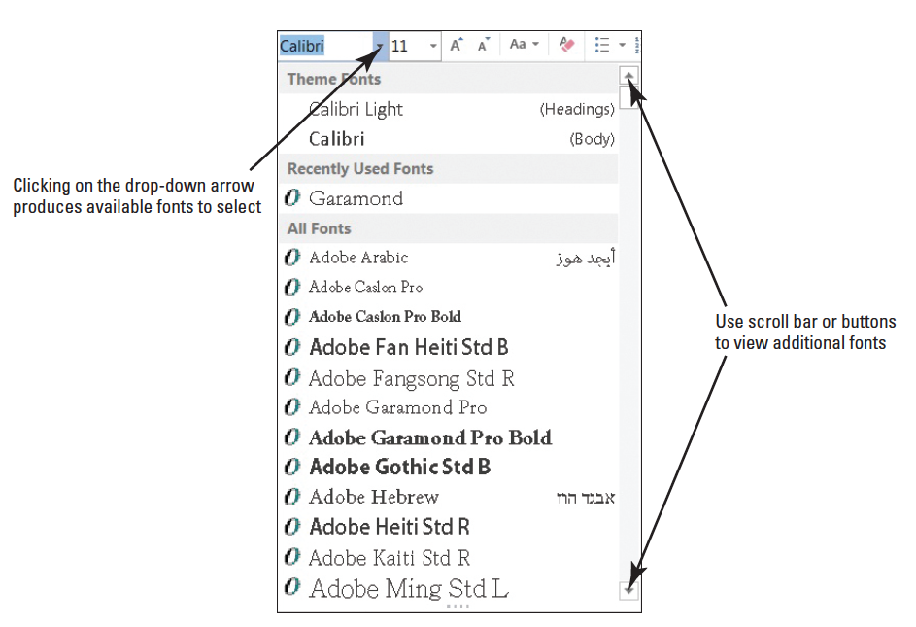
Step by Step: Use the Ribbon
Click the drop-down arrow on the Font command box in the Font group to pro- duce a menu of available fonts, right.
Click the arrow again to close the menu.
Double-click the Home tab. Notice the command groups are hidden to give you more screen space to work on your document.
Double-click Home again to redisplay the groups.
PAUSE. LEAVE the document open to use in the next exercise.
Notes:
Another Way: Also you can locate a font quickly by typing the first three characters of the name in the Font command box.
Another Way: To unclutter the screen, press the ^ key located above the vertical scroll bar in the right corner or press Ctrl+F1. Holding the Ctrl while pressing F1 is a toggle key, which hides the Ribbon and then displayss the Ribbon.

Slide 10
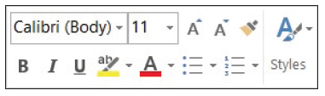
Step by Step: Use the Mini Toolbar
USE the document that is open from the previous exercise.
Type the term mini toolbar onto your blank document. Drag the mouse pointer over the word “toolbar” to select it. The Mini toolbar appears once the word is selected, as shown below.
Point to the Font command on the Mini toolbar.
Click the drop-down arrow on the Font command box. A font menu appears. Press Esc once or click the drop-down arrow again to exit the command box. To close the Mini toolbar, double-click the drop-down menu or click anywhere in a blank area within the document.

Slide 11
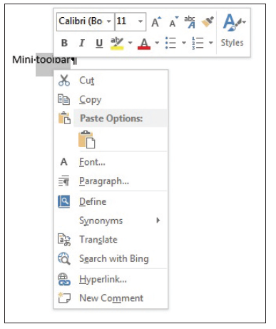
Step by Step: Use the Mini Toolbar
Now, position the insertion point on the selected text and right-click; the Mini toolbar appears, accompanied by a shortcut menu that displays a variety of commonly used commands (right).
Click anywhere in a blank area of the document to close the Mini toolbar. Drag your mouse over the text you typed at the beginning of this exercise to select the text. Press the Delete key to remove the text.
PAUSE. LEAVE the document open to use in the next exercise.

Slide 12

Step by Step: Use the Quick Access Toolbar
USE the document that is open from the previous exercise.
Click the Save button on the Quick Access Toolbar.
If this is the first time you’ve attempted to save this document, the new Save As opens in Backstage. You have three options on where to save your work: SkyDrive, Computer, or +Add a Place. For now, you are just exploring the Save command on the Quick Access Toolbar. Later in the lesson, you learn to save a document using the Save As command.

Slide 13
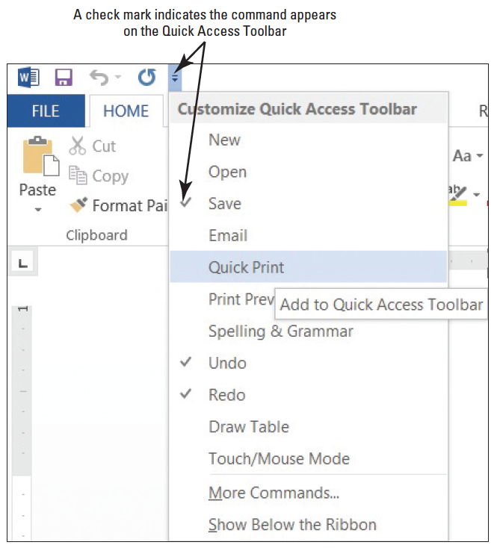

Step by Step: Use the Quick Access Toolbar
Click the Return to Document icon, which is a circled left arrow located in the upper-left corner or press the ESC key to return to the document screen.
Click the drop-down arrow at the Customize Quick Access Toolbar. A menu appears (right). Selecting one of the commands automatically places the command on the Quick Access Toolbar or moves the Quick Access Toolbar to a new location.

Slide 14
Step by Step: Use the Quick Access Toolbar
Click Show Below the Ribbon. Notice that the toolbar is moved below the Ribbon.
Click the drop-down arrow at the Customize Quick Access Toolbar button again. Click Show Above the Ribbon to return the toolbar to its original position.
PAUSE. LEAVE the document open to use in the next exercise.

Slide 15
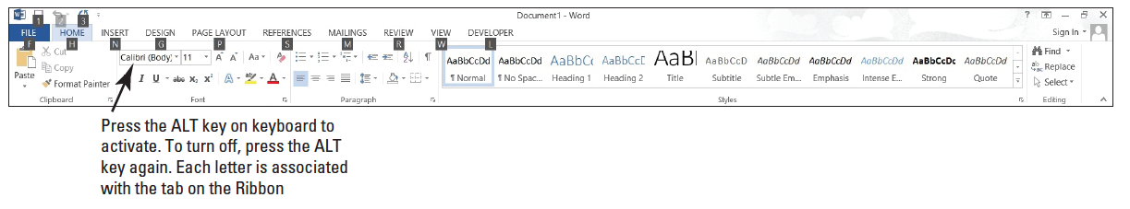
Step by Step: Use Access Keys
USE the document that is open from the previous exercise.
If necessary, Click the Home tab. Press the Alt key. KeyTips appears on the Ribbon and Quick Access Toolbar to let you know which key to use to access specific commands or tabs (below).
Press H to activate the Home tab.
Press PG to open the Paragraph dialog box, and then click Cancel.
Press the Alt key again to display the KeyTips.

Slide 16
Step by Step: Use Access Keys
Press P to activate the Page Layout tab.
Press O to display the options to change the page orientation.
Press the Alt key twice to display the KeyTips again, and then press the Alt key to turn them off.
PAUSE. LEAVE the document open to use in the next exercise.
Notes:
Take Note: Shortcut keys are keys or are a combination of keys pressed together to perform a command. Shortcut keys provide a quick way to give commands without having to take your hands from the keyboard. Keyboard shortcuts from previous versions of Word that began with Ctrl have remained the same, such as Ctrl+C (copy) and Ctrl+P (paste). However, Office 2007 and 2010 introduced Access Keys, which begin by pressing the Alt key. Later in the lesson, you learn to use Help to learn more about keyboard shortcuts.

Slide 17
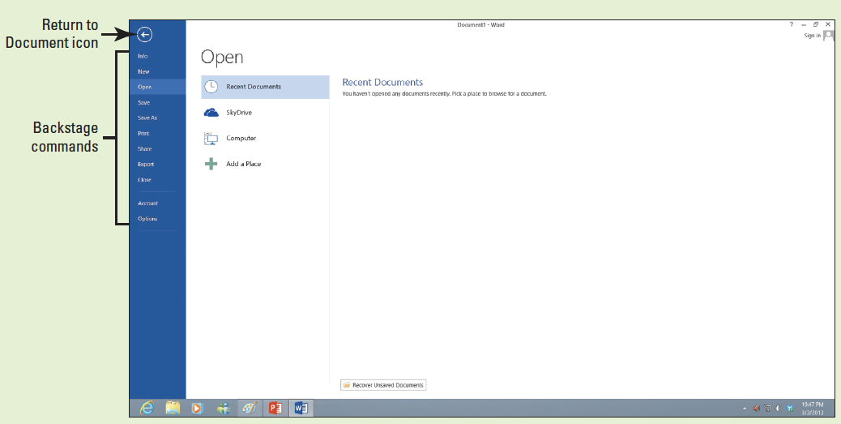
Step by Step: Use Backstage View
Acquaint yourself with the new appearance to Backstage. Access Backstage by clicking the File tab. To return to your document screen, click the Return to Document icon circled left arrow or press the Esc key.
USE the document that is open from the previous exercise.
Click the File tab (below).
The default setting Info screen is automatically displayed.

Slide 18
Step by Step: Use Backstage View
Click each of the other commands to view the options of each one.
Click Return to Document, which is a circled left arrow icon or press the Esc key to exit Backstage. This action returns you to the document screen.
PAUSE. LEAVE the document open to use in the next exercise.
Notes:
Another Way: You can also activate Backstage view by pressing Alt+F. Using this shortcut opens the Access keys in Backstage.

Slide 19

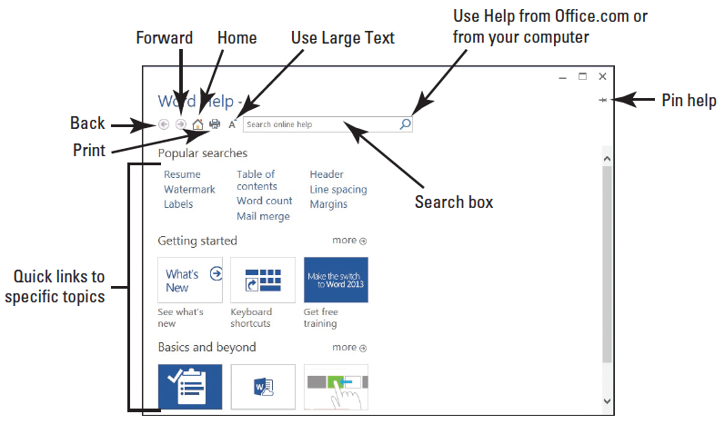
Step by Step: Use the Help Button
USE the document that is open from the previous exercise.
Make sure you are connected to the Internet.
Click the Microsoft Word Help button in the upper-right corner of the screen or press F1. The Word Help window appears, as shown below.

Slide 20



Step by Step: Use the Help Button
Under the section, "Getting started," click the tile See what’s new and review the content. Then click the back arrow to return to the Help menu.
Click the tile Keyboard shortcuts, and then click +Show All and review the information displayed.
Click the Home button and it returns to the main Help screen.
Click the Close button to close Microsoft Word Help.
PAUSE. LEAVE the document open to use in the next exercise.

Slide 21
Step by Step: Display Nonprinting Characters
USE the document that is open from the previous exercise.
On the Home tab, in the Paragraph group, click the Show/Hide (¶) button to display the nonprinting characters in the document.
Click the Show/Hide (¶) button again to hide the nonprinting characters.
Press Ctrl+Shift+* to once again display the nonprinting characters. This time, leave Show/Hide on.
PAUSE. LEAVE the document open to use in the next exercise.

Slide 22
Step by Step: Hide White Spaces
USE the document open from the previous exercise.
Make sure your insertion point is at the beginning of the document. Place the mouse below the Ribbon until you see the ScreenTip Double-click to hide white space. Notice the gray border line representing the white space becoming thinner.
Place the mouse between the gray border line until you see two arrows again and then double-click. This reveals the white space.
PAUSE. LEAVE the document open to use in the next exercise.

Slide 23
Step by Step: Use AutoComplete
USE the document open from the previous exercise.
Type the name of the current month; as you type the first four characters, a ScreenTip appears. Press Enter to accept the suggested text.
Press the Spacebar and the current day and year appears, and then press Enter.
PAUSE. LEAVE the document open to use in the next exercise.
Notes:
Another Way: To use AutoComplete, you can also type the first four characters of the current day of the week, and then press Enter or F3.

Slide 24
Step by Step: Create a Document
USE the document that is open from the previous exercise.
The insertion point should be positioned at the end of the year. Press Enter twice.
Type the delivery address as shown:
Ms. Miriam Lockhart (Press Enter once.)
764 Crimson Avenue (Press Enter once.)
Boston, MA 02136 (Press Enter twice.)
Type Dear Ms. Lockhart:

Slide 25
Step by Step: Create a Document
Press Enter once.
Type the following text and press Enter once after each paragraph.
We are pleased that you have chosen to list your home with Tech Terrace Real Estate. Our office has bought, sold, renovated, appraised, leased, and managed more homes in the Tech Terrace neighborhood than anyone and now we will be putting that experience to work for you.

Slide 26
Step by Step: Create a Document
Our goal is to sell your house quick for the best possible price.
The enclosed packet contains a competitive market analysis, complete listing data, a copy of the contracts, and a customized house brochure. Your home has been input into the MLS listing and an Internet ad is on our website. We will be contacting you soon to determine the best time for an open house.
We look forward to working with you to sell your home. Please do not hesitate to call if you have any questions.
Press Enter once.
Type Sincerely,

Slide 27
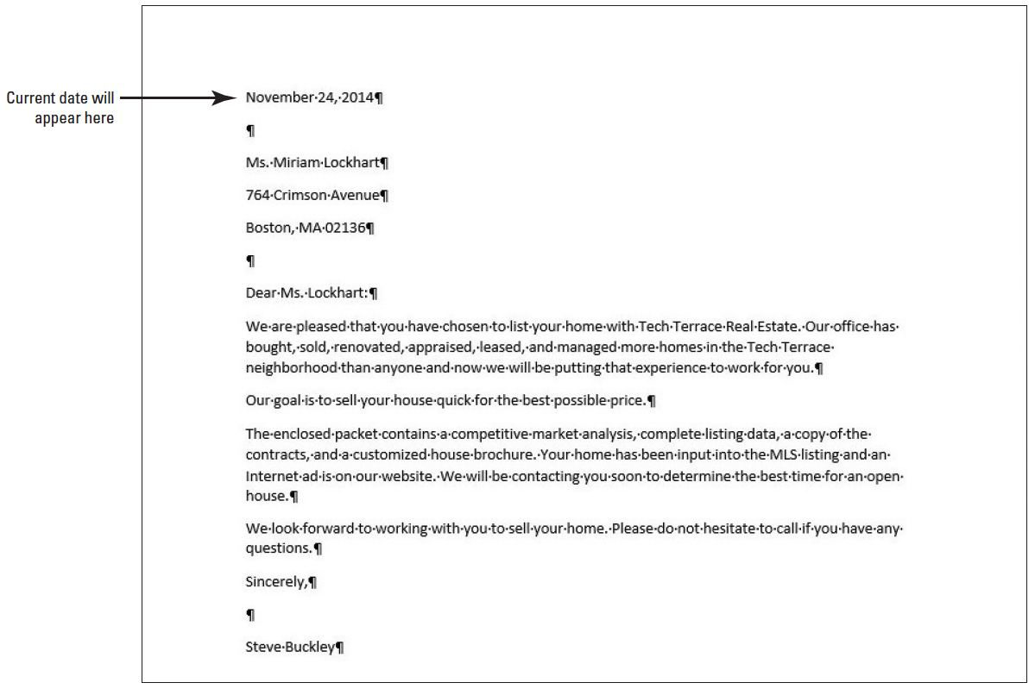
Step by Step: Create a Document
Press Enter twice.
Type Steve Buckley. Your document should appear as shown at right. This letter still needs to be formatted in an accepted mail able format and this is discussed in a later lesson.
PAUSE. LEAVE the document open to use in the next exercise.
Notes:
Take Note: To create a new blank document, click the File tab and then click the New command. Select the first option, Blank document, and Word 2013 automatically opens a new document. You can also open a new blank document using the keyboard shortcut Ctrl+N.
It is always important to save your document before closing the program. However, if you close the document or Word by accident, a prompt appears, asking whether you want to save your document. Choose Yes to save and close, No to close without saving, or Cancel to stop the Close command. The Spelling & Grammar commands are discussed in a later lesson.

Slide 28
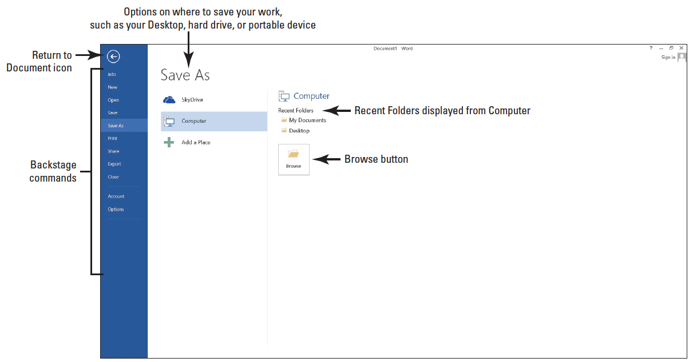
Step by Step: Save a Document for the First Time
USE the document that is open from the previous exercise.
If necessary, connect your flash drive to one of the USB ports on your computer.
Click the File tab, and then click the Save As command. The new Save As screen is shown below. There are three options available to save your document: SkyDrive, Computer, and +Add a Place. Click Computer. The right side of the screen changes and displays Recent Folders that have been opened.

Slide 29
Step by Step: Save a Document for the First Time
Click Browse. The Save As dialog box opens. In the Windows 8 environment, the Documents Library is the default location for saving new files. Change the location from the default to your flash drive by using the vertical scroll bar and scrolling down until you see your flash drive. Storage devices are given a specific letter identified by the operating system. For example, your flash drive might be labeled as TravelDrive (I:).

Slide 30
Step by Step: Save a Document for the First Time
Click the flash drive to open that location to save your document.
Type Tech Terrace Letter in the File name box and click Save. By default, the first few characters that you typed in your document appear in the File name box. Drag the mouse over the text and press Delete or begin typing over the highlighted text.
If a prompt appears to upgrade to the newest format click the OK button. This action allows you to use the new features in Word 2013.
PAUSE. LEAVE the document open to use in the next exercise.
Notes:
Another Way: You can also save a document by clicking the Save button on the Quick Access Toolbar or by pressing Ctrl+S.

Slide 31
Step by Step: Save a Document in a Folder
USE the document that is open from the previous exercise.
Click the File tab, and then click Save As.
Click Computer. Under the Computer heading, you should see your flash drive under Current Folders. Click your flash drive to open—the Save As dialog box opens.
Click New folder located below the address bar and type Word 2013. Press Enter.

Slide 32
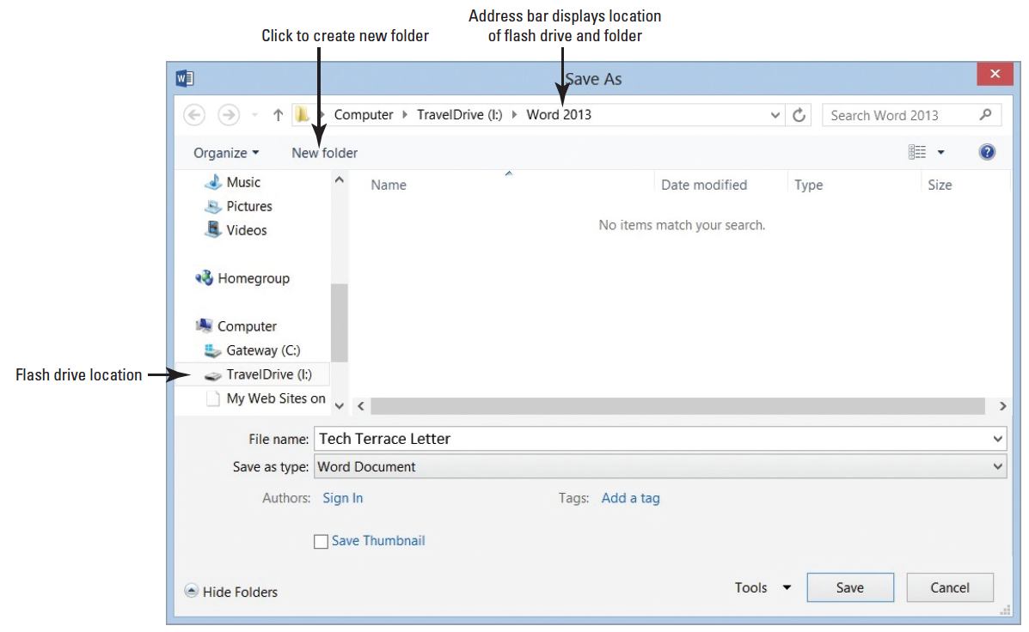
Step by Step: Save a Document in a Folder
In the main pane of the dialog box, double-click the Word 2013 folder; notice the address bar displays your flash drive followed by Word 2013, as shown below.

Slide 33
Step by Step: Save a Document in a Folder
Note also that the flash drive TravelDrive (I :) in the figure above might not appear on your screen; therefore, you need to check with your instructor for the correct path. Tech Terrace letter should already appear in the File name box.
Click Save to close the dialog box.
PAUSE. LEAVE the document open to use in the next exercise.
Notes:
Troubleshooting: AutoRecover is a feature that automatically saves your data at scheduled intervals. Be default, Word 2013 saves your work every 10 minutes. This makes it possible to recover some of your work if a problem occurs. However, this useful option is not a substitute for frequently saving your documents as you work. You should always click the Save button regularly to avoid losing work in case of a power outage or computer crash.

Slide 34
Step by Step: Save Document in a Folder with a Different Name
USE the document that is open from the previous exercise.
Click the File tab, and then click the Save As command. On the right side of the screen under Current Folder, you should see the folder that you created.
Click Word 2013 and the Save As dialog box opens.
Type Tech Terrace2 in the File name box.
Click Save.
PAUSE. LEAVE the document open to use in the next exercise.
Notes:
Another Way: The Save As dialog box can also be opened by pressing F12. To locate your flash drive, click the drop-down arrow beside the address bar at the top of the dialog box, and then scroll through the listings and click the flash drive.

Slide 35
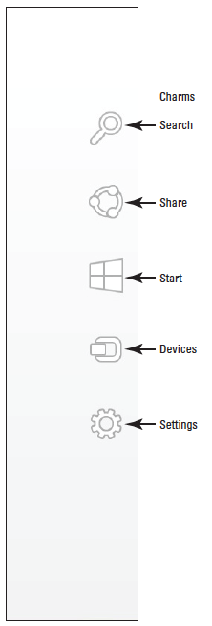
Step by Step: Show File Extensions in Windows 8
USE the document that is open from the previous exercise.
Hover the mouse in the upper-right edge of the screen until Windows 8 Charms Bar appears in the right side of the screen. Another way to display the Windows 8 Charms Bar is to press the keyboard combination Windows logo+C. The Windows logo is located on the keyboard (see figure at right).

Slide 36

Step by Step: Show File Extensions in Windows 8
Click the Settings icon. A command pane appears on the right side.
Under Settings, click Control Panel. The Control Panel opens. The Control Panel contains a menu bar.
Click Tools on the menu bar.
Click Folder options. The Folder Options dialog box opens with the General tab as the active tab.
Make the View tab active by clicking on the tab.

Slide 37
Step by Step: Show File Extensions in Windows 8
Under Files and Folders heading, locate Hide extensions for known files types by clicking in the check box to remove the check mark. By default, the file extensions are hidden. When the check mark is removed, the file extensions will be displayed on the title bar each time you open a new document. Note, the document that is opened, needs to be closed and reopened to see the file extension associated with Word 2013.

Slide 38

Step by Step: Show File Extensions in Windows 8
Click OK to close the Folder Options dialog box, and then click the Close button to close the Control Panel.
PAUSE. The Word program is still open from the previous exercise.
Notes:
Another Way: In Windows 8, file extensions are off. If the file extensions on your computer are hidden, you can show them in Windows 8. On the Windows 8 Charms Bar, click the Search icon. Type Control Panel. Select Control Panel > Tools > Folder options > View tab. Clear the check box by Hide Extension for known file types.

Slide 39
Step by Step: Show File Extensions in Windows 7
USE the document that is open from the previous exercise.
Click Start. In the Search box, type show hidden files and folders.
Click Show hidden files and folder under the Control Panel.
The Folder Options dialog box appears. Click the View tab, and then clear the Hide extensions for known file types check box. In some cases, the System Administrator who manages the lab environment might set up the computers in the lab so that each computer system displays the same. Check with your instructor to see whether the file extensions will display on your computer.
Click OK to close the Control Panel.
PAUSE. The Word program is still open from the previous exercise.
Notes:
Another Way: By default, file extensions are off. If the file extensions on your computer are hidden, you can show them in Windows 7 using two different methods. Either choose Start > Control Panel > Appearance and Personalization > Folder Options or choose Start, type folder options in the Search box, and press Enter.

Slide 40
Step by Step: Choose a Different File Format
USE the document that is open from the previous exercise.
Click the File tab, and then click Save As to open the Save As screen.
Under Current Folder, click Word 2013. The folder you created earlier opens.
In the Save As type box, click the drop-down arrow and choose Word 97-2003 Document (*.doc). You should see the .doc extension in the File name box—the file extension is associated with a previous version of Word. On the title bar, the file extension appears along with Compatibility Mode. In the next exercise, you learn about Compatibility Mode.
Type Tech Terrace2 97-2003 in the File name box. Click Save.
PAUSE. LEAVE document open for the next exercise.

Slide 41
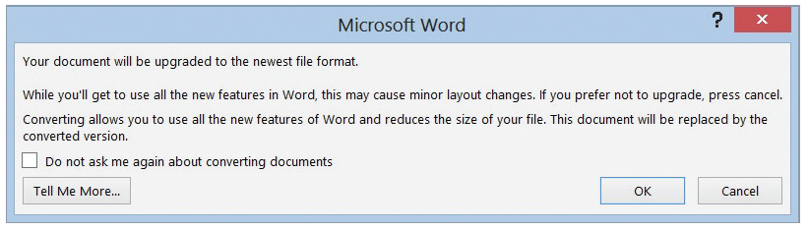
Step by Step: Convert a Document
USE the document that is open from the previous exercise.
With the TechTerrace2 97-2003.doc document open, click the File tab.
In the main pane of the Info command, click Convert, and then click OK to confirm the conversion, as shown below. Converting the document clears the Compatibility Mode on the title bar and upgrades your document to Word 2013 format, which allows you to access Word’s new features.
To save the document in the Word 2013 file format, click the File tab.

Slide 42
Step by Step: Convert a Document
Click Save As, and then click the Word 2013 folder. Then in the File name box, type Tech Terrace Update. The filename displays the .docx extension in the title bar after the file name.
PAUSE. LEAVE the document open for the next exercise.

Slide 43
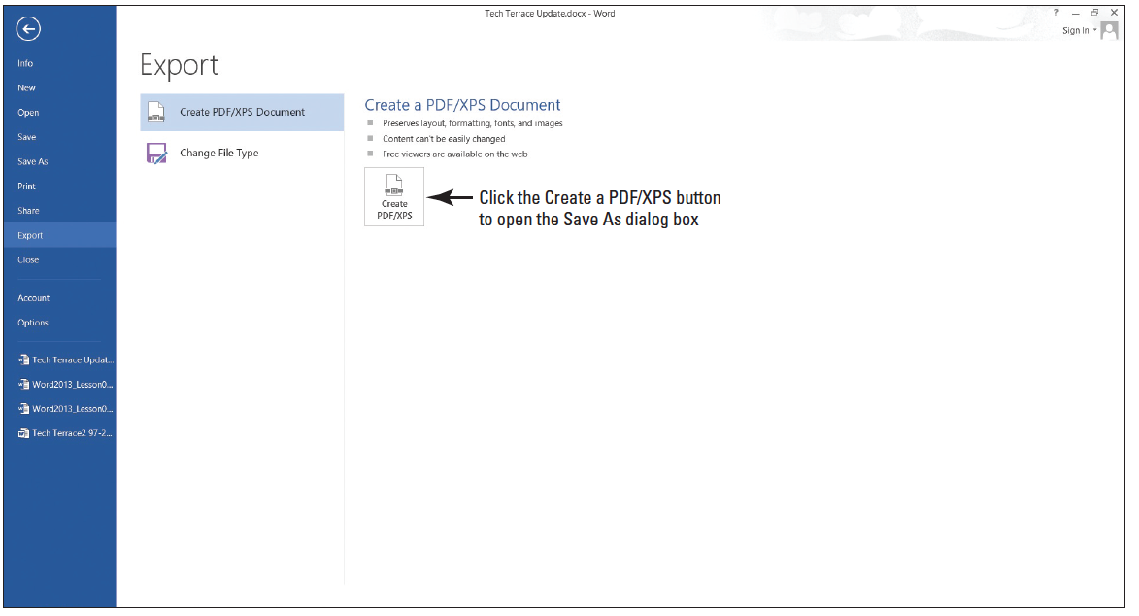
Step by Step: Export a Document to a PDF
USE the document that is open from the previous exercise.
. Click the File tab and click Export command. The Export screen opens (see below). You use the Export command to share your documents with others. Publishing the document as a PDF file preserves the formatting. You can also select what you want to share before exporting.

Slide 44
Step by Step: Export a Document to a PDF
Click create the PDF/XPS button. The Publish as PDF or XPS dialog box opens, and the Word 2013 folder automatically opens.
In the File name box, type Tech Terrace 3. In the Save as type box, notice that the PDF (*.pfd) is showing. The file extension is automatically selected when using Export.
Click Publish. By default, the document will not open after the file is published. To open the document in a reader format, enable the Open file after Publishing check box.
Click File, and then Close to close the document.
PAUSE. LEAVE Word open for the next exercise.
Notes:
Take Note: PDF is a popular Save As format for documents and preserves document formatting for viewing. Word 2013 now allows editing documents that are saved in a PDF format. In a later lesson, you learn to edit a PDF document. To save in PDF format, you must download the appropriate add-in from microsoft.com.

Slide 45
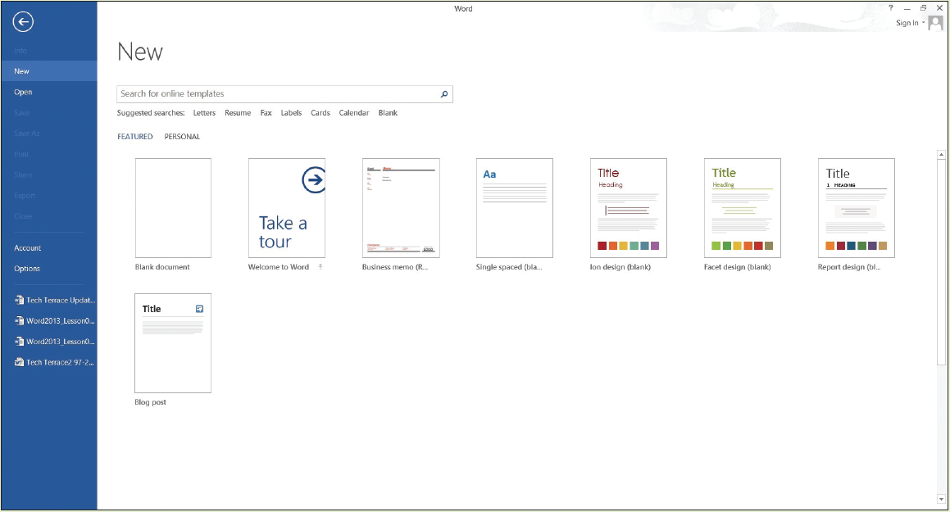
Step by Step: Locate a Template Installed on Your Computer
Click the File tab, and then click New. The New screen displays the available templates as shown below. Scroll down and review the accessible templates. First determine what type of document needs to be created. For this exercise, you select a blank template.

Slide 46
Step by Step: Locate a Template Installed on Your Computer
Click the Single spaced (blank) document, and then click the Create button.
Display the Show/Hide button (¶) to show paragraph marks.
PAUSE. LEAVE the document open to use in the next exercise.

Slide 47
Step by Step: Create a Single-Spaced Document Using a Template
Click the File tab, and then click Save As. In the Save As screen, click Computer. Under Recent Folders, click the Word 2013 folder to open that location. In the File name box, type Welcome Memo. Click Save.
Type the document as follows and press the Tab or Enter key as indicated. By pressing the Tab key twice, you are aligning the text at the one-inch marker on the ruler.
Forest Hills Home Owner’s Association [Press Enter three times.]

Slide 48
Step by Step: Create a Single-Spaced Document Using a Template
To: [Press Tab twice.] New Neighbor Welcoming Committee Members [Press Enter twice.]
From: [Press Tab twice.] Committee Chair [Press Enter twice.]
Date: [Press Tab twice.] December 15, 20XX [Press Enter twice.]
Subject: [Press Tab twice.] Meeting and Refreshment Schedule [Press Enter twice.]

Slide 49
Step by Step: Create a Single-Spaced Document Using a Template
Thank you for volunteering to be on the New Neighbor Welcoming Committee. Enclosed please find the meeting and refreshment schedule for the next six months. See you in January! [Press Enter twice.]
SAVE the document leave open for the next exercise.
PAUSE. LEAVE the document open to use in the next exercise.

Slide 50

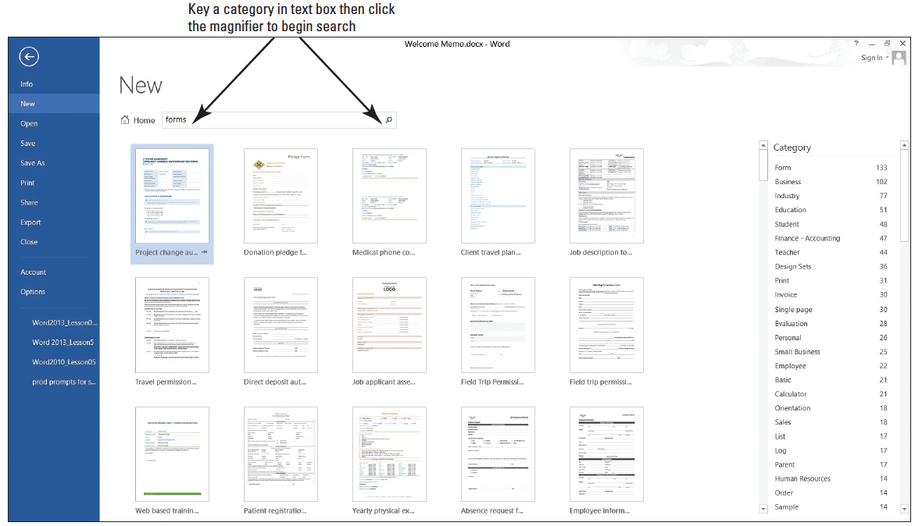
Step by Step: Find Templates on the Internet
Click the File tab, and then click New.
In the Search online templates box, type forms, and then click the Start Searching button. Additional templates are displayed as below. You can also filter the templates by category to narrow your search. Preview by using the scroll bar and select any template. Click Create.

Slide 51
Step by Step: Find Templates on the Internet
CLOSE the forms template and do not save.
As the assistant to the Tech Terrace Real Estate manager, you are in the beginning stages of gathering the materials together for the annual report. You decide to use one of the available templates in Word 2013. Click the File tab, and then select New.
In the Search online templates box, type Annual Report (Timeless design), and then click the Start Searching button. Select the template with the image, and then click Create. The template will download.

Slide 52
Step by Step: Find Templates on the Internet
Complete the placeholders with the following text: type text inside the brackets, [FY] [Year]. Click the drop-down arrow by the year and select the current date—note the year displays in the placeholder. As you gather information for the report, you begin entering data into the document.
Click File, and then click Save As. In the Save As dialog box, click Computer. Under Current Folders, select the Word 2013 folder.
In the File name box, type Annual Report.

Slide 53
Step by Step: Find Templates on the Internet
Change the file type by clicking the drop-down arrow and select Word template (*.dotx). Note that you might need to select your flash drive again because Word automatically saves templates to the Templates folder located on the computer.
Click SAVE.
PAUSE. LEAVE the document open for the next exercise.
Notes:
Another Way: You can double-click on a template to open it.
Take Note: You must be connected to the Internet to view online templates.
Take Note: To find additional information on templates, use the Help feature by pressing the F1 button or click the Help button.

Slide 54
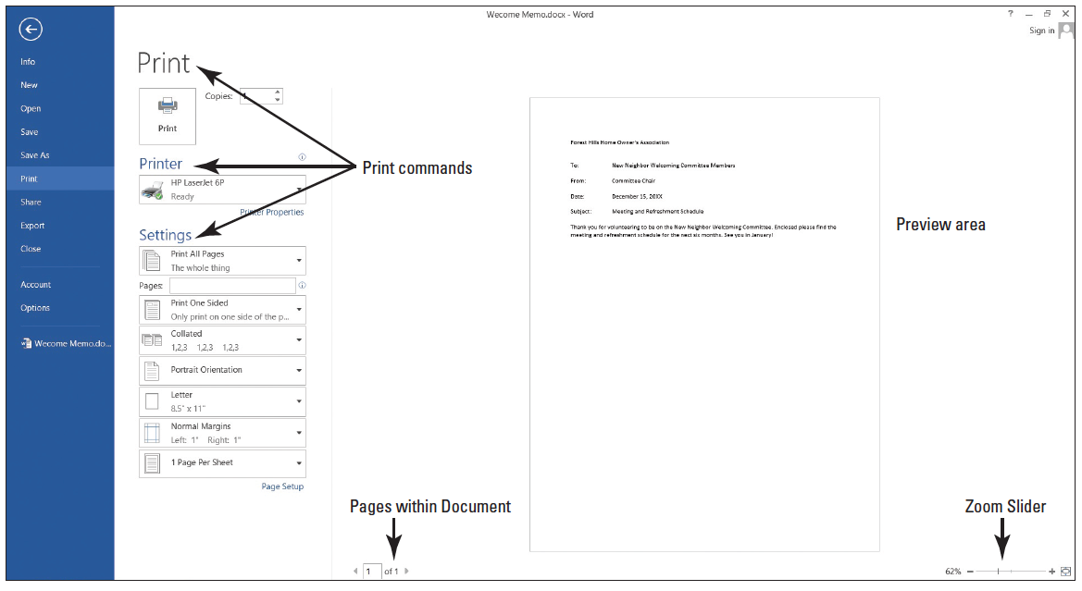
Step by Step: Use Print Preview
USE the Welcome Memo that is open from the previous exercise.
Click the File tab, and then click Print. The Print screen opens with the Print options on the left and the Print Preview on the right, as shown below.

Slide 55
Step by Step: Use Print Preview
Click the plus symbol (+) on the Zoom slider located on the bottom-right of your screen until the zoom level changes to 100%.
Press the Return to Document icon or press the Esc key to close Backstage.
Click the File tab, and then click Save. Your document will be saved with the same filename on your flash drive, and then CLOSE the file.
PAUSE. LEAVE the document open to use in the next exercise.

Slide 56
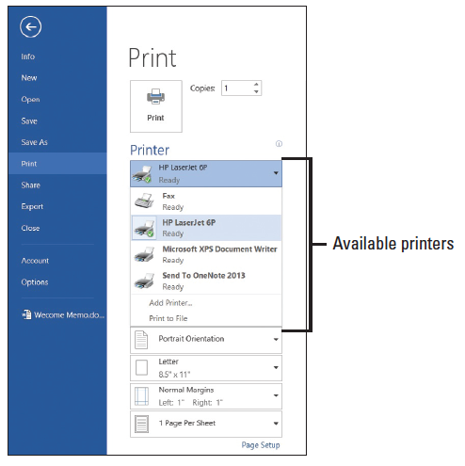
Step by Step: Choose a Printer
USE the document that is open from the previous exercise.
Click the File tab, and then click Print.
In the Printer selection area, click the drop-down arrow to produce a list of all printers connected to your computer (right).
Select a printer, and then click the Print icon.
PAUSE. LEAVE the document open to use in the next exercise.

Slide 57
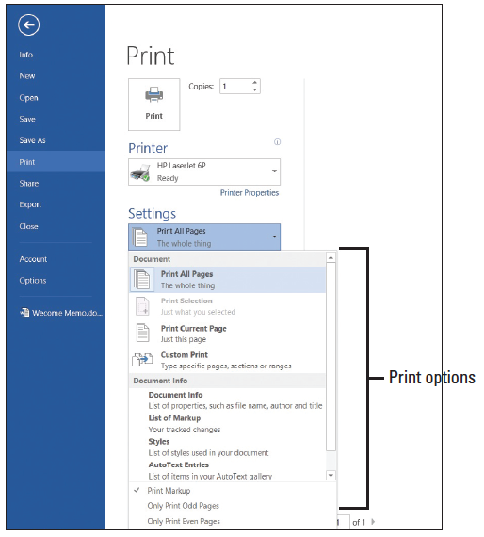
Step by Step: Set Print Options
USE the document that is open from the previous exercise.
Click the File tab, and then click Print. Click the drop-down arrow on Print All Pages to produce the menu shown at right.

Slide 58
Step by Step: Set Print Options
Select Print Current Page, and then click the Print icon. Selecting this option prints the current page.
Return to the Print screen area. In the Copies section of the Print options area, click the up arrow to select 2, and then click the Print icon.
Place your insertion point at the beginning of the first paragraph, and then hold down the left mouse button and drag to the end of the paragraph to select it.
Click the File tab, and then click Print. Click the Print Selection drop-down arrow, and then change the number of copies from 2 to 1 by clicking the down arrow. Next, click the Print icon. The selected paragraph is printed.

Slide 59
Step by Step: Set Print Options
Click the File tab, and then click Close to close the document.
The Annual Report document should still be open from a previous exercise. Click the File tab, and then click Print. Under Settings, click the drop-down arrow by 1 Page Per Sheet and select 2 Pages Per Sheet, and then click the Print icon. This eight-page document is now printed on four pages with two pages per sheet.
PAUSE. LEAVE the document open to use in the next exercise.

Slide 60
Step by Step: Close a Document and Close Word
USE the document that is open from the previous exercise.
Click the Close [insert MA14.jpg here] button to close both the document and Microsoft Word.
STOP.

Slide 61
Skill Summary

