Slide 1
Managing Text Flow
Microsoft Word 2013
Lesson 5

Slide 2
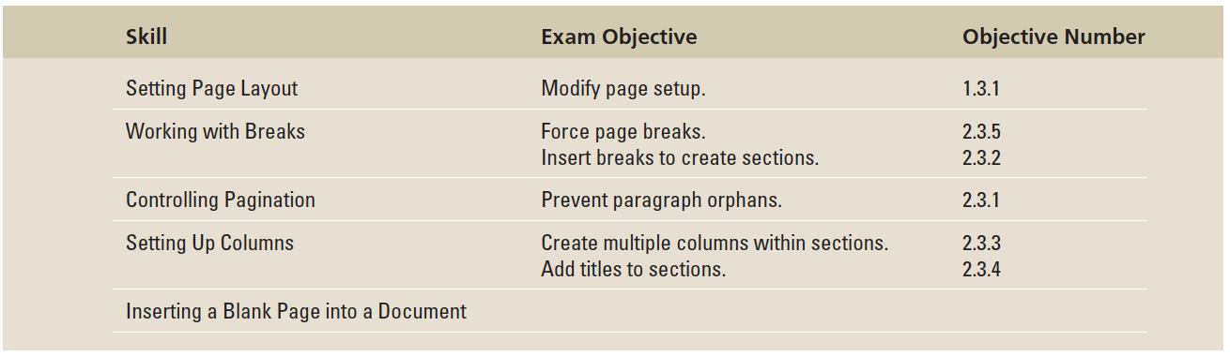
Objectives

Slide 3
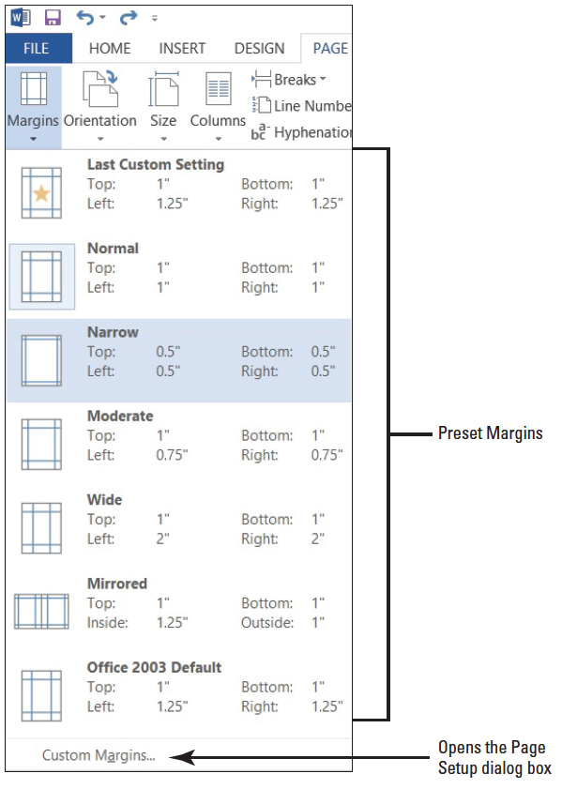
Step by Step: Set Margins
GET READY. Before you begin these steps, be sure to launch Microsoft Word.
OPEN the Proposal file for this lesson.
Delete the extra blank lines above USA Health Resources. On the Page Layout tab, in the Page Setup group, click the drop-down arrow to display the Margins menu.
Choose Narrow, as shown at right. The margins are set to 0.5" from top, bottom, left, and right.

Slide 4
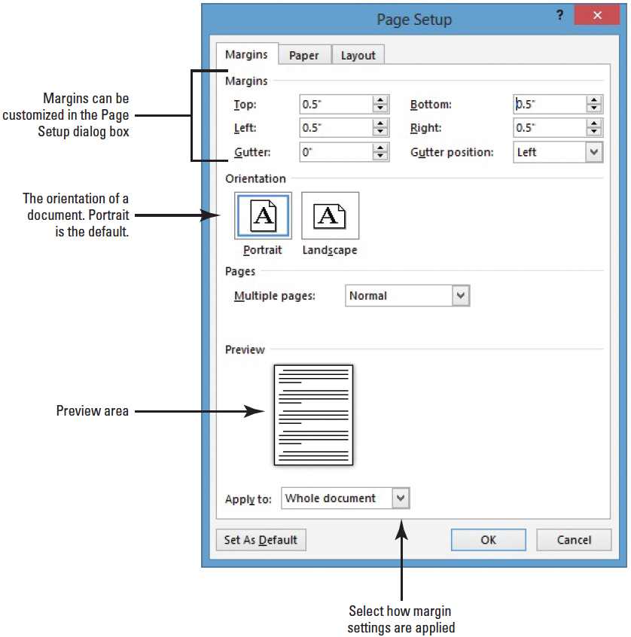
Step by Step: Set Margins
In the Page Setup group, click the drop-down arrow to display the Margins menu.
Click Custom Margins to open the Page Setup dialog box shown at right.

Slide 5
Step by Step: Set Margins
Change the bottom, left, and right margins to 1" and the top margin to 2". Changing the margins affects all pages within the document. Click OK.
SAVE the document as Draft Proposal in the lesson folder on your flash drive.
PAUSE. LEAVE the document open to use in the next exercise.

Slide 6
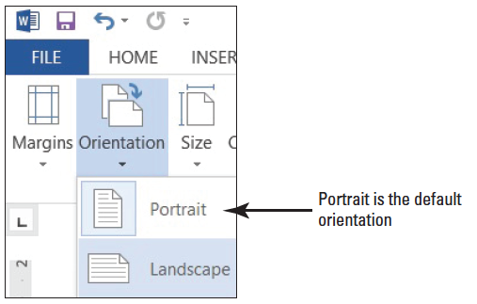
Step by Step: Select a Page Orientation
USE the document that is open from the previous exercise.
In the Page Setup group of the Page Layout tab, click the drop-down arrow to display the Orientation menu.
Select Landscape, as shown below. The page orientation changes to Landscape.

Slide 7
Step by Step: Select a Page Orientation
Click the File tab, and then click Print, to preview the document in Backstage view. On the right side of the pane, the document displays in landscape and under Settings, you see Landscape Orientation as the set setting. Also, notice you can access Page Setup dialog box from the Print screen. It is good practice to preview your document before printing to ensure the text will print correctly.
SAVE document as Draft1 Proposal in the lesson folder on your flash drive.
PAUSE. LEAVE the document open to use in the next exercise.

Slide 8
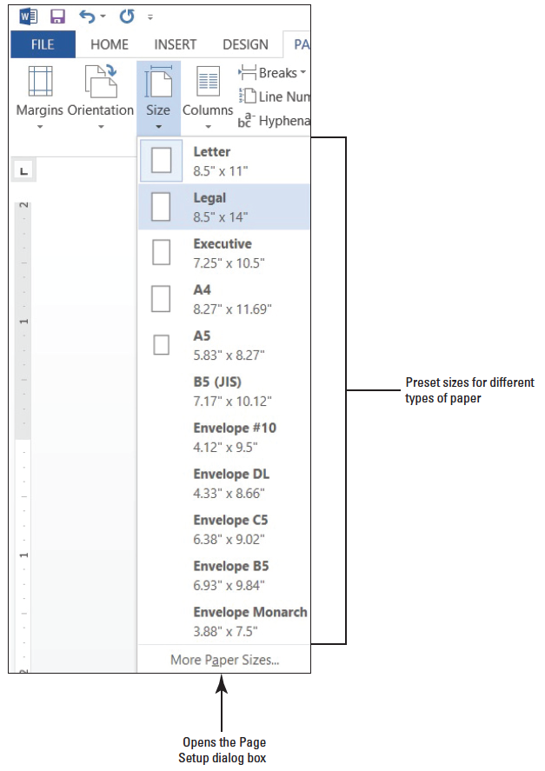
Step by Step: Choose a Paper Size
USE the document that is open from the previous exercise.
In the Page Setup group of the Page Layout tab, click the drop- down arrow to display the Orient- ation menu, and then select Portrait. The orientation is changed back to portrait from the previous exercise.
From the Page Setup group of the Page Layout tab, click the drop- down arrow to display the Size menu, and then select Legal, as shown at right.

Slide 9
Step by Step: Choose a Paper Size
On the File tab, click Print to preview your document in Backstage view. On the right side of the pane, the document displays in portrait orientation and legal size.
Return to the document by clicking on the Return to Document button.
Click the Page Layout tab, and then click the drop-down arrow to display the Size menu; next, select Letter.
SAVE document as Draft2 Proposal in the lesson folder on your flash drive.
PAUSE. LEAVE the document open to use in the next exercise.

Slide 10
Step by Step: Insert and Remove a Manual Page Break
USE the document that is open from the previous exercise.
Delete all blank lines above Proposal Description. The insertion point should be positioned before P in the Proposal Description heading.
On the Insert tab, in the Pages group, click the Page Break button. A manual page break is inserted and the Proposal Description paragraph is forced to the next page.

Slide 11
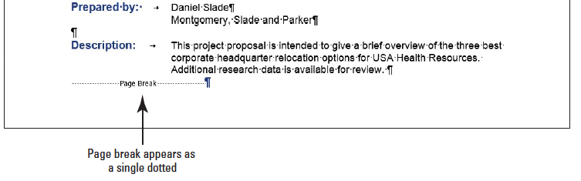
Step by Step: Insert and Remove a Manual Page Break
Scroll up to the first page and notice the page break marker that has been inserted and that displays as a single dotted line, as shown below. If you cannot see the page break marker, make sure the command Show/Hide is turned on.
Scroll down and position the insertion point before the O in the Option 1 heading.

Slide 12
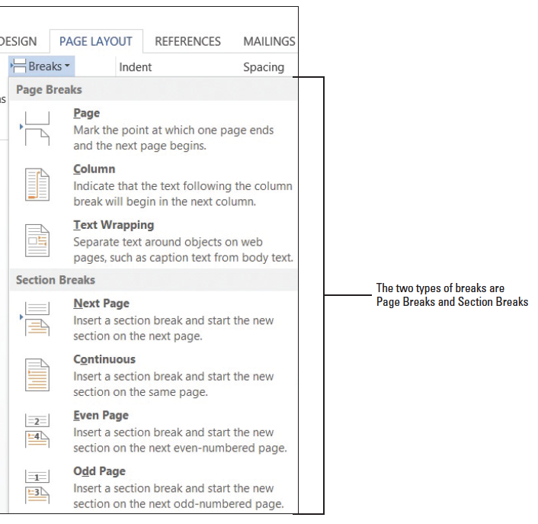
Step by Step: Insert and Remove a Manual Page Break
On the Page Layout tab, in the Page Setup group, click the drop-down arrow to display the Breaks menu. The Breaks menu appears, as shown at right.
Select Page from the menu and a manual page break is inserted, and text is forced to the next page.

Slide 13
Step by Step: Insert and Remove a Manual Page Break
Position the insertion point before the O in the Option 2 heading and repeat steps 5 and 6.
Position the insertion point before the O in the Option 3 heading and press Ctrl+Enter to enter a manual page break using the keyboard shortcut.
SAVE the document as Draft3 Proposal in the lesson folder on your flash drive.

Slide 14
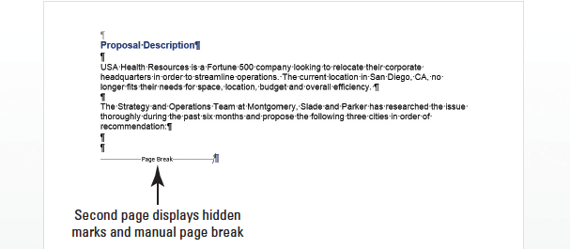
Step by Step: Insert and Remove a Manual Page Break
Click the View tab, change the view to Draft, and review the page breaks in your document.
Return to the Print Layout view.
Scroll to the second page and notice the manual page break marker, shown below.

Slide 15
Step by Step: Insert and Remove a Manual Page Break
On page 2, select the Page Break marker.
Press the Backspace key. The page break is deleted, and text from the previous page is moved to page 2.
Scroll up to page 1, select the Page Break marker below the last paragraph in Description, and press the Backspace key. The Proposal Description heading is moved to page 1.

Slide 16
Step by Step: Insert and Remove a Manual Page Break
Select the remaining Page Break markers and press Delete.
Keep the document open without saving the changes made in the last three steps.
PAUSE. LEAVE the document open to use in the next exercise.
Notes:
Take Note: Click the Show/Hide button to view page breaks and section breaks for editing purposes.

Slide 17
Step by Step: Insert a Section Break
USE the document that is open from the previous exercise.
Press Ctrl+Home to move to page 1 and position the insertion point after Relocation Proposal.
On the Page Layout tab, in the Page Setup group, click the Breaks menu.
Under Section Breaks, select Continuous. A Continuous Section Break is inserted, which begins a new section on the same page.
Position the insertion point on the blank line before P in Prepared for. . .
On the Page Layout tab, in the Page Setup group, click the Breaks menu.

Slide 18
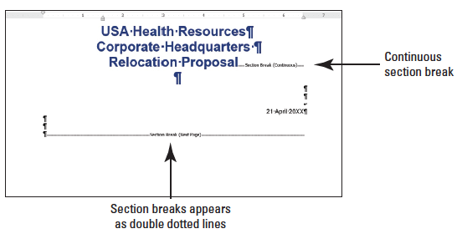
Step by Step: Insert a Section Break
In the Section Breaks section of the menu, select Next Page. A next page section break is inserted in your document, as shown below. Inserting a section break allows you to format the page without affecting the other pages in the document.

Slide 19
Step by Step: Insert a Section Break
Position the insertion point before the O in the Option 1 heading.
On the Page Layout tab, in the Page Setup group, click the Breaks menu.
Under Section Breaks, select Next Page. The Next Page break begins a new section on the following page.
Place the insertion point on page 1 and select the three line headings to include the blank line below.

Slide 20
Step by Step: Insert a Section Break
Click the dialog box launcher in the Page Setup group to display the Page Setup dialog box.
In the Margins tab using Custom Margins, change the top margin from 2" to 1". In the lower-left corner of the dialog box, notice the Apply to section displays as Selected sections.
Click the Layout tab and under the Page section, Vertical alignment, select Center, and then click OK. The changes made in the Layout tab are applied to this section.

Slide 21


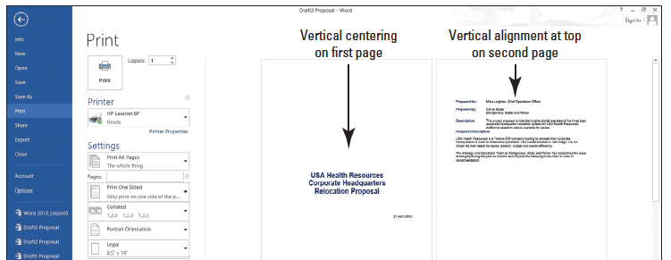
Step by Step: Insert a Section Break
Click the File tab, and then click Print to preview your document in Backstage view. The first page is vertically centered, as shown in Figure 5-10; whereas the remaining pages are vertically aligned at the top with a 2" margin. Use the Next Page button in Backstage to go to the next page. Then use the Previous Page button to return to page 1.

Slide 22
Step by Step: Insert a Section Break
Press the Return to Document button.
Position the insertion point anywhere on page 3.
In the Page Setup group, click the dialog box launcher to display the Page Setup dialog box.
In the Margins tab, change the top margin from 2" to 1".
Click OK. The margins for pages 3 and 4 are set to 1".
SAVE the document as Draft4 Proposal in the lesson folder on your flash drive.

Slide 23
Step by Step: Insert a Section Break
Remove each of the section breaks that you have applied.
On the first page, position the insertion point before the P in Prepared for.
On the Page Layout tab, in the Page Setup group, click the Breaks menu.
Under Section Breaks in the Breaks menu, select Even Page to start a new section on the next even-numbered page. The status bar reads PAGE 2 of 3.

Slide 24
Step by Step: Insert a Section Break
Position the insertion point before O in Option 1 heading.
On the Page Layout tab, in the Page Setup group, click the dialog box launcher to display the Breaks menu.
Select Odd Page to start a new section on the next odd-numbered page. The status bar reads PAGE 3 of 4. Section breaks have been inserted for both even and odd pages.
SAVE the document as Draft5 Proposal in the lesson folder on your flash drive, and then CLOSE the file.
PAUSE. LEAVE Word open to use in the next exercise.

Slide 25
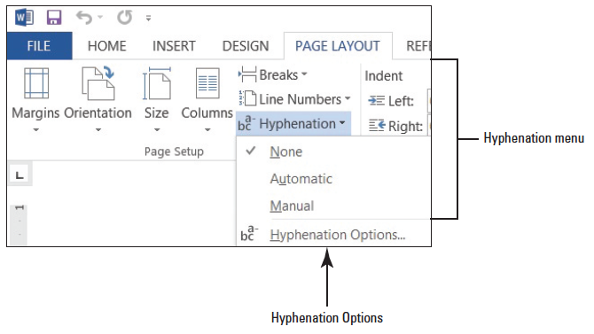
Step by Step: Insert Hyphens in a Document
OPEN Relocation Proposal from the data files for this lesson.
On the Page Layout tab, in the Page Setup group, click the Hyphenation drop-down arrow.
Select Automatic; review your document.
Click the drop-down arrow to display the Hyphenation menu and select None, as shown below.

Slide 26
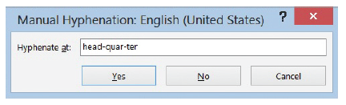
Step by Step: Insert Hyphens in a Document
Click the Hyphenation drop-down arrow again, and select Manual. The Manual Hyphenation dialog box stops at the first suggested text for hyphenation (headquarter), as shown below.
Click Yes. Manual Hyphenation allows you to determine where to hyphenate the word by clicking Yes, No, or Cancel, and you can decide where to position the insertion point.

Slide 27
Step by Step: Insert Hyphens in a Document
Click No to review.
Click Yes to headquarters.
Click No to issue, seeking, and ample.
Click Yes to technology and location.
When Word stops at transportation, move the insertion point to the third hyphen (after “ta”) and click Yes.
Click No to proximity and Yes to business.
The Hyphenation prompt appears when Word has completed the process of searching for words to hyphenate within the document. Click OK.

Slide 28
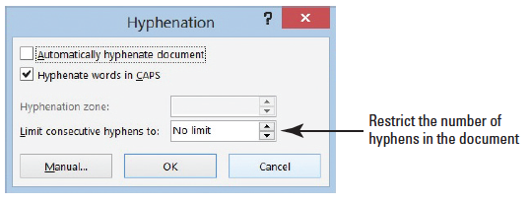
Step by Step: Insert Hyphens in a Document
SAVE the document as Relocation1 Proposal in the lesson folder on your flash drive.
Click the Hyphenation drop-down arrow and select Hyphenation Options to open the Hyphenation dialog box, as shown below.

Slide 29
Step by Step: Insert Hyphens in a Document
Click the check box to Automatically hyphenate document.
Click OK. The document is automatically hyphenated.
Click the Hyphenation drop-down arrow and select Hyphenation Options to open the Hyphenation dialog box.
Click the up arrow to set the Limit Consecutive Hyphens to 2. Click OK. The number of hyphens in the document is restricted once the default is changed from No Limit.
SAVE the document as Relocation2 Proposal in the lesson folder on your flash drive.
PAUSE. LEAVE Word open to use in the next exercise.

Slide 30
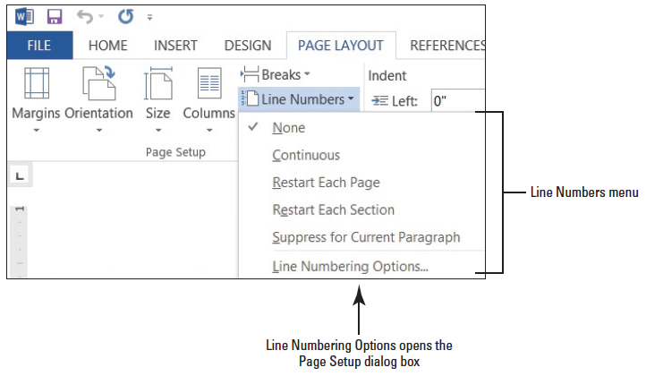
Step by Step: Insert Line Numbers
USE the document that is open from the previous exercise.
On the Page Layout tab, in the Page Setup group, click the Line Numbers drop-down arrow to display the menu as shown below. By default, None is selected.
Select Continuous. The line numbering is now turned on and each line where text appears is numbered.

Slide 31
Step by Step: Insert Line Numbers
Press Ctrl+G to use the Go To command. Select Line in the Go to What section, and then type 25 in the Enter line number box.
Click the Go To button. The insertion point is now placed at the beginning of line 25.
Click Breaks and insert a Next Page section beak. Notice that line 25 is now on page 2.
The insertion point is resting on page 2 on line 25.
Click the Line Numbers to display the menu and select Restart Each Section. The line numbering begins at 1.
SAVE the document as Relocation3 Proposal in the lesson folder on your flash drive, and then CLOSE the file.
PAUSE. LEAVE Word open to use in the next exercise.

Slide 32

Step by Step: Insert a Nonbreaking Space
OPEN the document Employment Offer Letter from the lesson folder.
On the Home tab, in the Paragraph group, click the Show/Hide button to display hidden marks on the page.
In the first paragraph of the body of the letter at the end of the second line, the month and day are in two separate lines.
Place your insertion point after the r in November. Select the nonprinting space mark between “November.”

Slide 33
Step by Step: Insert a Nonbreaking Space
Click the Insert tab, and in the Symbols group, click drop-down arrow on Symbols, and then click More Symbols to open the Symbols dialog box.
Click the Special Characters tab, and then select the Nonbreaking Space option in the Character list. Click Insert, and then click Close. Inserting a nonbreaking space prevents the month and date from separating.
SAVE the document as Employment Confirmed in the lesson folder on your flash drive, and then CLOSE the file.
PAUSE. LEAVE Word open to use in the next exercise.
Notes:
Another Way: Using the shortcut keys Ctrl+Shift+Space is a quick way to insert a nonbreaking space.
Troubleshooting: To keep text together, you must select all spaces between words and insert the nonbreaking space option in the Symbol dialog box.

Slide 34
Step by Step: Insert a Line Break
OPEN a blank document and turn on the Show/Hide.
Type USA Health Resources.
Press Shift+Enter to insert a line break. Notice the left arrow appears at the end of the line instead of the paragraph mark, and the insertion point is moved to the next line.
Type Corporate Headquarters.
Press Shift+Enter to insert a line break.
Type Relocation Proposal.

Slide 35
Step by Step: Insert a Line Break
Press Enter. Notice a paragraph mark appears at the end of this line indicating the start of a new paragraph.
Place the insertion point in the second heading, and then center. Notice how all lines move together. Change the alignment to align right then to align left, then center.
SAVE the document as Title with Line Breaks in the lesson folder on your flash drive, and then CLOSE the file.
PAUSE. LEAVE Word open to use in the next exercise.

Slide 36
Step by Step: Turn on Widow/Orphan Control
OPEN the Checking document from the data files for this lesson.
Scroll to the top of page 2 and notice the widow experience . . . at the top of the page.
On page 1 of the document, place the insertion point anywhere in the paragraph under Preferred Checking.
On the Home tab, in the Paragraph group, click the dialog box launcher. The Paragraph dialog box appears.
Notes:
Another Way: The Paragraph dialog box can be opened in the Page Layout tab, in Paragraph group.

Slide 37
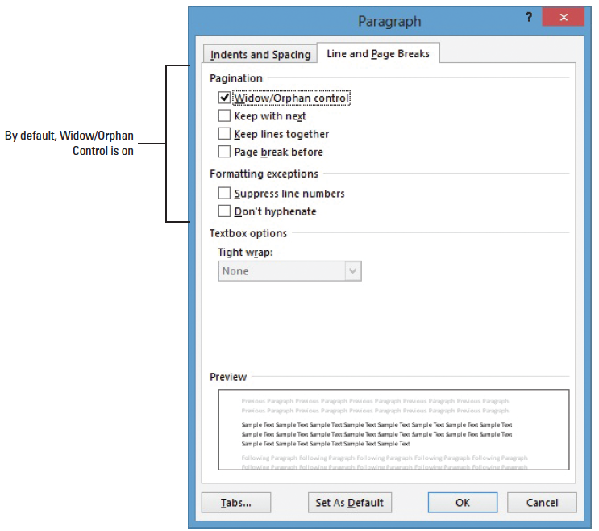
Step by Step: Turn on Widow/Orphan Control
Click the Line and Page Breaks tab, as shown at right.
In the Pagination section, click the check box to select Widow/Orphan Control; then click OK. Notice that another line of the paragraph moves to the second page.
SAVE the document as Checking Choices in the lesson folder on your flash drive.
PAUSE. LEAVE the document open to use in the next exercise.

Slide 38
Step by Step: Keep Lines Together
USE the document that is open from the previous exercise.
Place the insertion point anywhere in the two-lines under Preferred Checking.
In the Home tab, in the Paragraph group, click the dialog box launcher. The Paragraph dialog box appears.
On the Line and Page Breaks tab, in the Pagination section, click to select the Keep Lines Together box; then click OK. Notice that the two lines that were at the bottom of page one moved to page 2.
SAVE the document with the same filename in the lesson folder on your flash drive.
PAUSE. LEAVE the document open to use in the next exercise.

Slide 39
Step by Step: Keep Two Paragraphs on the Same Page
USE the document that is open from the previous exercise.
Place the insertion point in the Preferred Checking heading.
Launch the Paragraph dialog box. The Paragraph dialog box appears.
On the Line and Page Breaks tab, in the Pagination section, click to select the Keep with Next box; then click OK. Notice that the two paragraphs (the heading and paragraph that follows) are together and have moved to page 2.
SAVE the document with the same filename in the lesson folder on your flash drive.
PAUSE. LEAVE the document open to use in the next exercise.

Slide 40
Step by Step: Force a Paragraph to the Top of a Page
USE the document that is open from the previous exercise.
Position the insertion point before the S in the Senior Preferred Checking heading.
On the Home tab, in the Paragraph group, click the dialog box launcher. The Paragraph dialog box appears.
On the Line and Page Breaks tab, click to select the Page Break Before box; then click OK. Using this command forces text to the top of a new page. Notice that you cannot actually see a page break in the document.
SAVE the document with the same filename in the lesson folder on your flash drive.
PAUSE. LEAVE the document open to use in the next exercise.

Slide 41
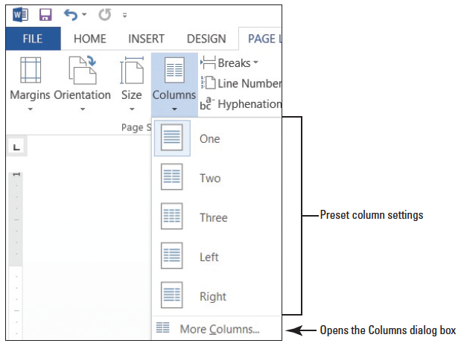
Step by Step: Create Columns
USE the document that is open from the previous exercise.
Change the left and right margins to 1”.
Place the insertion point in front of F in Free Checking on page 1.
On the Page Layout tab, in the Page Setup group, click the drop- down arrow to display the Columns menu. The Columns menu appears, as shown at right.

Slide 42
Step by Step: Create Columns
Select Two. The text in the document following the Personal Checking Choices heading is formatted into two columns. Notice that Senior Preferred Checking starts at the top of a new page because it is still formatted with a page break before.
SAVE the document as Checking Draft in the lesson folder on your flash drive.
PAUSE. Leave the document open to use in the next exercise.
Notes:
Troubleshooting: When formatting existing text into columns, avoid selecting the document’s title heading if you want to keep it as a single column.

Slide 43
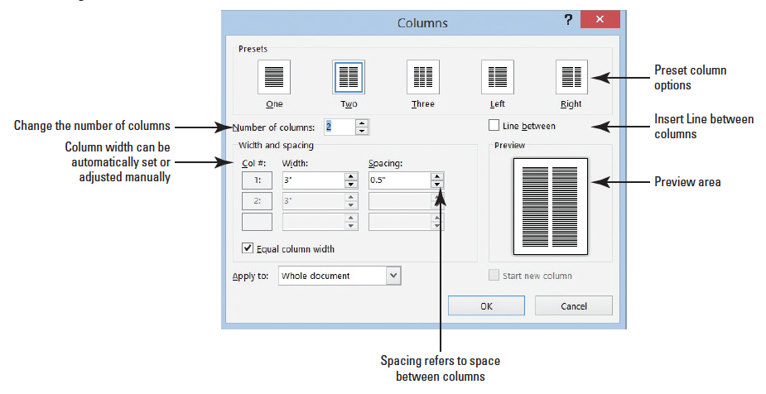
Step by Step: Format Columns
USE the document that is open from the previous exercise.
The insertion point should be positioned in front of Free Checking.
On the Page Layout tab, in the Page Setup group, click the drop-down arrow to display the Columns menu.
Select More Columns. The Columns dialog box appears, as shown below.

Slide 44
Step by Step: Format Columns
In the Number of columns box, type 3 or click the up arrow once. By changing the number of columns, the width automatically changes.
Click the Line between check box to add a check mark. This option places a vertical line between the columns.
Click OK. Notice that the document is now formatted in three columns.
Position the insertion point before the S in the Senior Preferred heading. The page break before that was added previously in this lesson will be removed in the next step.

Slide 45
Step by Step: Format Columns
Open the Paragraph dialog box. In the Line and Page Breaks tab of the dialog box, click to deselect the Page break before box and click OK. The Page Break Before command is removed from the document and the text moves to the previous page.
In the Page Layout tab, change the Orientation option to Landscape.
Change the paper size to Legal.

Slide 46
Step by Step: Format Columns
Click Margins, and then click Custom Margins to open the Page Setup dialog box. Change the Left and Right margin settings to 0.5", and in the Apply To selection box at the bottom of the Margins tab, notice that this affects the Whole Document.
Click OK. The document now fits to one page.
Place the insertion point in front of the V in Value Checking. Click the drop-down arrow to display the Breaks menu; then select Columns to insert a column break. Value Checking and the text below move to the second column.

Slide 47
Step by Step: Format Columns
Place the insertion point in front of the P in Preferred Checking and click the drop-down arrow to display the Breaks menu, and then select Column break. Preferred Checking and the text below move to the third column.
Place the insertion point in front of the S in Senior Preferred Checking and click the drop-down arrow to display the Breaks menu, and then select Column. The text is moved to the top of the next page.
Select the two headings beginning with First Bank . . . Personal Checking Choices.

Slide 48
Step by Step: Format Columns
Click the drop-down arrow in Columns and select One. The first two headings are now single columns.
Press the Enter key after the s in Choices. Notice the Continuous Section Break separating the heading in one column and the text formatted in three columns.
Click Undo.

Slide 49
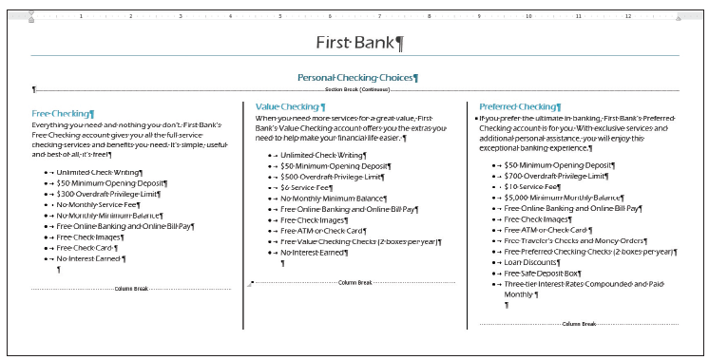
Step by Step: Format Columns
Select the two headings and on the Home tab, and in the Paragraph group, click the Center button. Applying the Center feature does not affect the text in the columns as shown below.
SAVE the document with the same filename in the lesson folder on your flash drive.
PAUSE. LEAVE the document open to use in the next exercise.

Slide 50
Step by Step: Change Column Widths
USE the document that is open from the previous exercise.
Place your insertion point anywhere in the first column.
On the Page Layout tab, in the Page Setup group, click the drop-down arrow to display the Columns menu.
Select More Columns. The Columns dialog box appears.
Type 4 in the Number of Columns box or click the up arrow. Changing the columns automatically changes the width of the column. This two-page document is now a one-page document.
Select the text in the Width box and type 2.75.
Press the Tab key to move to the Spacing box. Notice that the spacing adjusted automatically to .33".
Click OK. The Apply to section affects only the columns.

Slide 51
Step by Step: Change Column Widths
Review the document in Backstage using the Print screen. Notice the heading, Free Checking, is not aligned vertically with the other headings. To correct this, decrease the Spacing Before to zero. Review the document again, and notice the headings are aligned evenly to create a balance appearance in the document.
SAVE the document with the same filename in the lesson folder on your flash drive.
PAUSE. LEAVE the document open to use in the next exercise.
Notes:
Take Note: To change the paragraph spacing, click the Page Layout tab, and then change the spacing in the Paragraph group.

Slide 52
Step by Step: Add a Single Column to an Existing Document with Multiple Columns
USE the document that is open from the previous exercise.
Change the left and right margins to .5" and apply it to the whole document.
In the fourth column, in the last bulleted point, place your insertion point after e in Guarantee and press Enter.
Remove the bullet by selecting None in the Bullets Library.
Type WE VALUE YOUR BUSINESS! Then select the text.
In the Paragraph group of the Page Layout tab, change the Left indent to 0".
Change the Spacing After to 0 pt to reduce the spacing.
In the Page Setup group, click the drop-down arrow to display the Columns menu and select One.

Slide 53
Step by Step: Add a Single Column to an Existing Document with Multiple Columns
Center, bold, increase the font size to 22 pt and change the font color to dark blue. The final document should remain on one page.
SAVE the document as Checking Final in the lesson folder on your flash drive.
PAUSE. LEAVE the document open to use in the next exercise.

Slide 54
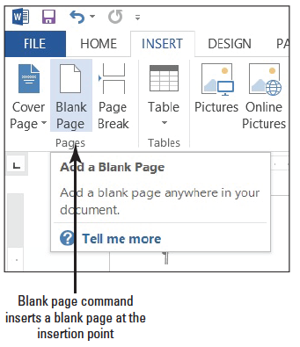
Step by Step: Insert a Blank Page
USE the document that is open from the previous exercise.
Position the insertion point before the F in Free Checking.
On the Insert tab, in the Pages group, click Blank Page (right). Page 2 is a blank page. The headings are left on page 1. Page 2 is a blank page and the text is moved to page 3. Notice that Word inserted two page breaks to create the blank page.

Slide 55
Step by Step: Insert a Blank Page
Click the Undo [Prod: insert MA0502.jpg here] button on the Quick Access Toolbar.
SAVE the document with the same filename in the lesson folder on your flash drive, and then CLOSE the file.
STOP. CLOSE Word.

Slide 56
Skill Summary

