Slide 1

STOREY
SITE OPERATIONS · GUWAHATI
Arijit Sarmah
Advisor
WhatsApp +91 99786 70073
storeyinfra.com

Slide 2
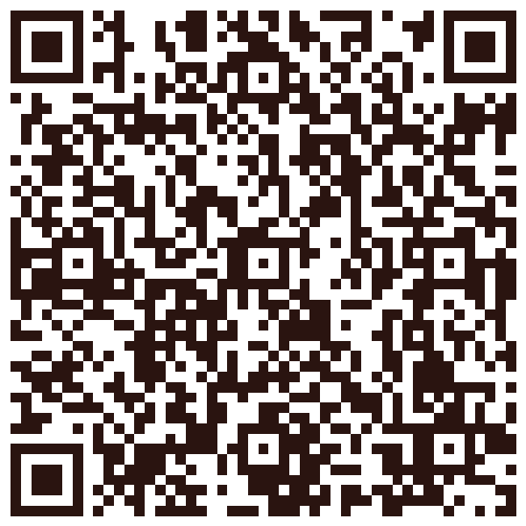
Scan to save contact
Point your camera at the code — your phone adds the contact.
storeyinfra.com

