Slide 1

STOREY
SITE OPERATIONS · GUWAHATI
Karun Roongta
Founder
WhatsApp +91 98640 66898
help@storeyinfra.com · storeyinfra.com

Slide 2
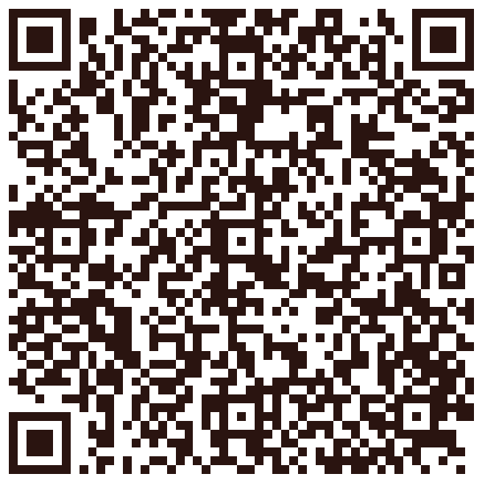
Scan to save my number
Point your camera at the code — your phone adds me as a contact.
storeyinfra.com

