Slide 1
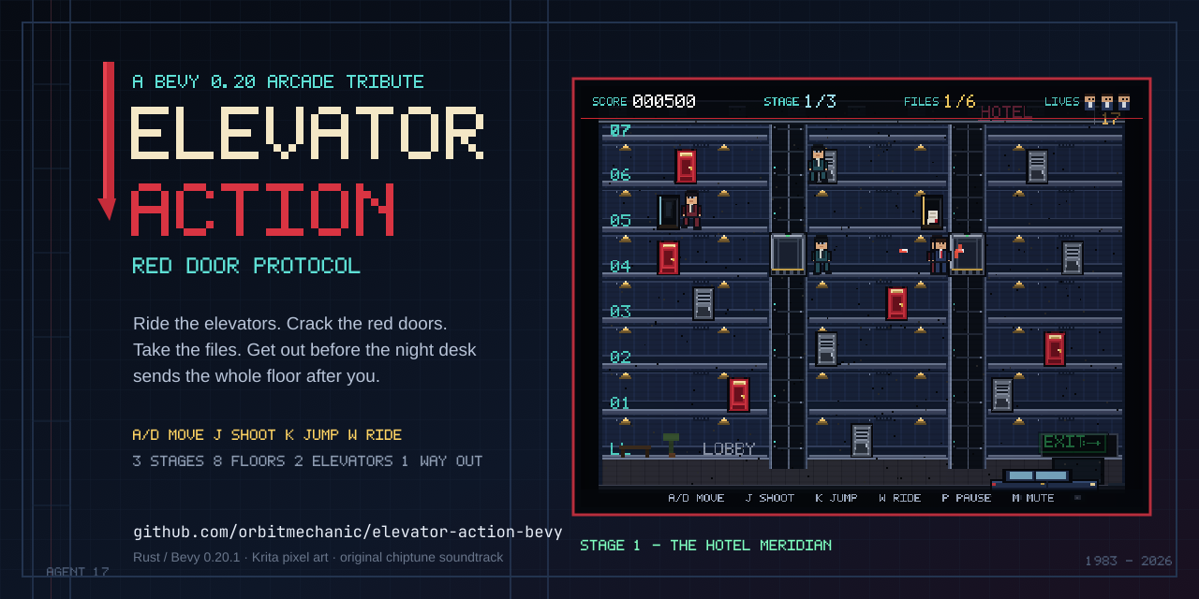
PLAYABLE BUILD / RUST + BEVY 0.20.1 / 2026
01 / 10

Slide 2
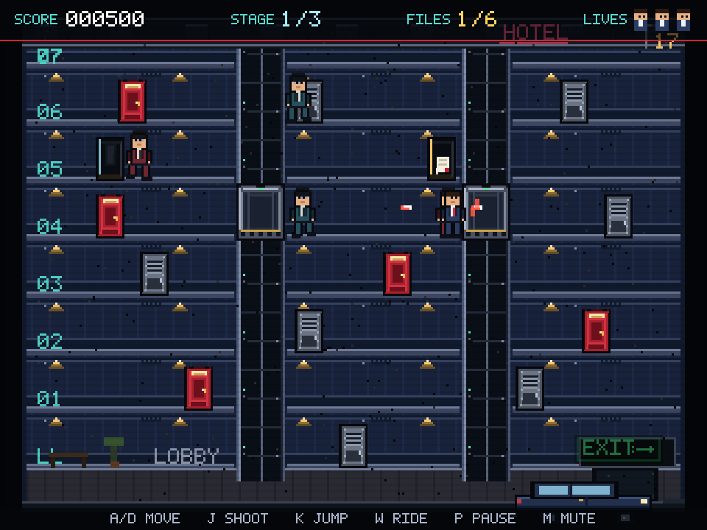
RED DOOR PROTOCOL // BEVY 0.20.1
ELEVATOR ACTION
THE BRIEF
A COMPLETE ARCADE GAME
Rebuild the 1983 elevator-spy loop as a complete,
playable 2D arcade game — not a tech demo.
Descend a cutaway hotel. Call and ride two elevators.
Crack the red document doors. Dodge the night desk's
agents. Collect every file, then reach the getaway car.
3
8
2
STAGES
FLOORS
ELEVATORS
One screen. Three escalating assignments.
No save points, no continues — just three lives.
STAGE 1 — THE HOTEL MERIDIAN
ORIGINAL ART / ORIGINAL AUDIO / NO ARCADE ROMS
02 / 10

Slide 3
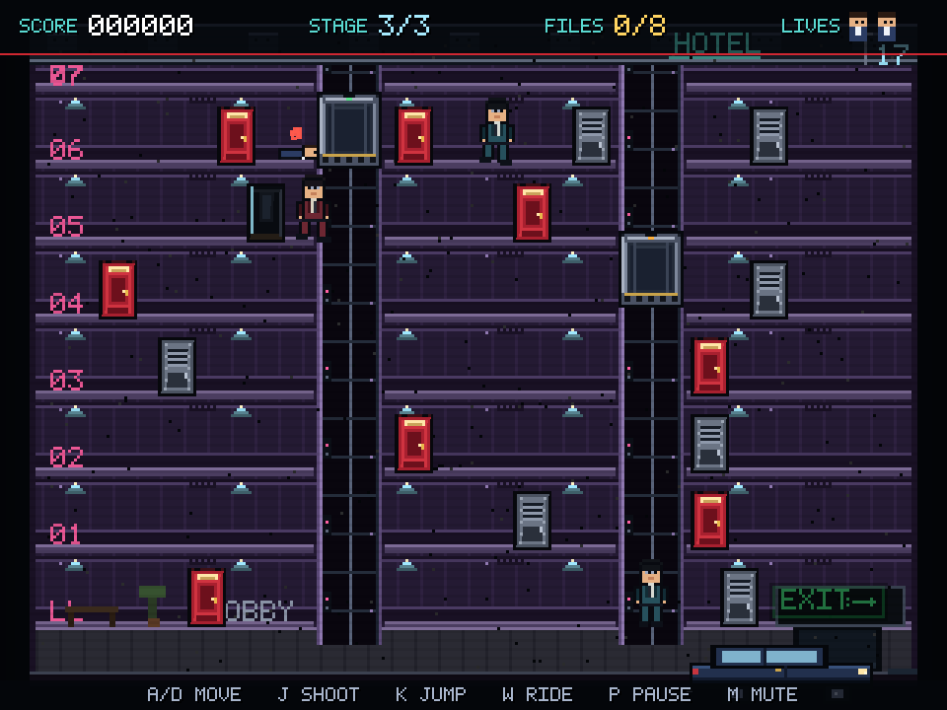
RED DOOR PROTOCOL // BEVY 0.20.1
ELEVATOR ACTION
THE LOOP
SIX FILES. NO EXIT.
01
CALL THE CAR
W at a shaft summons an elevator. W again boards it once it docks.
02
RIDE THE FLOORS
W/S picks the next stop. A/D steps off when the car is docked.
03
CRACK THE RED DOORS
Walk into a red door to take its file: +500. Collect them all to open the exit.
04
REACH THE CAR
Walk into the getaway car at the bottom right. Bonus scales with lives.
STAGE 3 — THE RED DOOR PROTOCOL
RED = FILES. GRAY = AGENTS. THE CAR OPENS ONLY WHEN EVERY FILE IS YOURS.
03 / 10

Slide 4
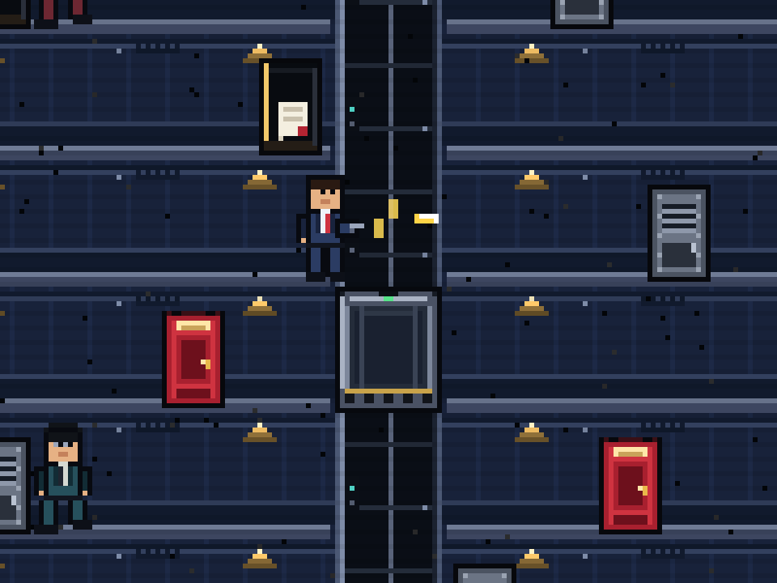
RED DOOR PROTOCOL // BEVY 0.20.1
ELEVATOR ACTION
FEEL
DUCK. JUMP. SHOOT.
MOVE
A / D or ← / →
SHOOT
J / X (hold to autofire)
JUMP
K / Space
DUCK
S / ↓ (dodges chest shots)
ELEVATOR
W / ↑ call, board, next floor
PAUSE / MUTE
P or Esc / M
THE FEEL
One-hit deaths with 2.4 s of spawn protection keep
mistakes legible. Ducking swaps to a 10 px hitbox
at the feet, so chest-height bullets pass overhead.
Agents telegraph for 0.55–0.9 s before firing.
MUZZLE FLASH, TWO ROUNDS, AN OPEN RED DOOR
04 / 10

Slide 5
RED DOOR PROTOCOL // BEVY 0.20.1
ELEVATOR ACTION
UNDER THE HOOD
BEVY ECS, TOP TO BOTTOM
STATES
PLAYER
ENEMY
ELEVATOR
Title · InGame
GameOver · Victory
move · jump · duck
shoot · ride · respawn
floor-aware chase
call · board · shoot
CarState resource
position · target · riders
COMBAT
LEVEL
UI
WORLD
bullets · particles
hits · doors · exit
spawn · waves
transitions
HUD · banners
pause · screens
layout · levels
pure math
COMPONENTS Player · Enemy · Door · Bullet · ElevatorCar
RESOURCES RunState · Elevators · Fx · PendingLevel
MESSAGES PlaySfx
SCHEDULES Startup · Update · OnEnter(state)
ONE PLUGIN · 8 MODULES · NO unsafe · NO CUSTOM RENDERER
Systems are chained in a single Update schedule, gated by state
and by a Normal-phase run condition. Commands, messages and
despawn-on-exit markers keep level teardown and restarts clean.
05 / 10

Slide 6
RED DOOR PROTOCOL // BEVY 0.20.1
ELEVATOR ACTION
SIMULATION
THE ELEVATOR IS THE LEVEL
pub struct CarState {
pub bottom: f32,
pub target_floor: usize,
pub moving: bool,
pub riders: u32,
}
fn update(&mut self, dt: f32) -> Option<usize> {
let target = car_bottom_for_floor(self.target_floor);
let delta = target - self.bottom;
let step = CAR_SPEED * dt;
if delta.abs() <= step {
self.bottom = target; // dock
self.moving = false;
Some(self.target_floor)
} else {
self.bottom += delta.signum() * step;
None
}
}
WHAT MAKES IT WORK
▸
request() retargets a moving car, so a rider can change floors mid-trip.
▸
44 px/s and a 26 px floor pitch: the ride reads as deliberate, not floaty.
▸
docked_floor() is the single truth for boarding, stepping off, and enemy AI.
▸
A riders counter stops agents from calling a car out from under the player.
▸
Agents walk to a shaft, call, board, retarget, and dismount — the same rules as the player.
src/world.rs
TESTS car_rides_and_docks · car_does_not_move_when_already_there
IDLE
MOVING
06 / 10

Slide 7
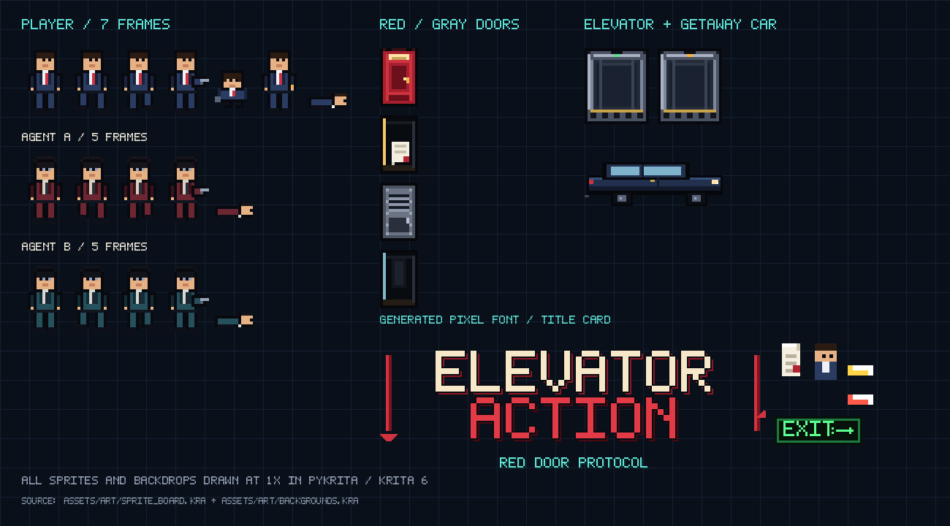
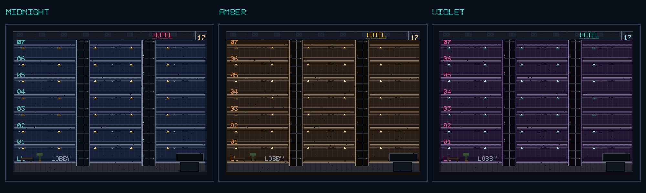
RED DOOR PROTOCOL // BEVY 0.20.1
ELEVATOR ACTION
ART PIPELINE
PIXELS FROM SCRATCH
KRITA 6 / PYKRITA
Every sprite and all three backdrops are drawn at 1× into QImages, pushed through Krita layers, and exported as PNG. Editable .kra sources ship in assets/art/.
A 5×7 FONT, TYPESET IN CODE
A hand-built glyph table is expanded to a real TTF with fontTools, then loaded by Bevy for crisp HUD and menu text.
INKSCAPE
The README banner and social preview are vector SVG, rendered to a 1280×640 PNG.
NO EXTERNAL ART
No arcade rips, no stock sprites, no sample packs. Backgrounds are midnight, amber, and violet themes built from the same floor plan.
1× SOURCE ART — 7 PLAYER FRAMES, 2 AGENT SHEETS, DOORS, CARS, HUD
THREE BUILDINGS, ONE FLOOR PLAN
07 / 10

Slide 8
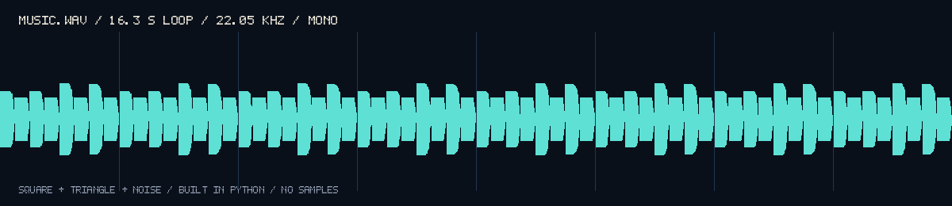
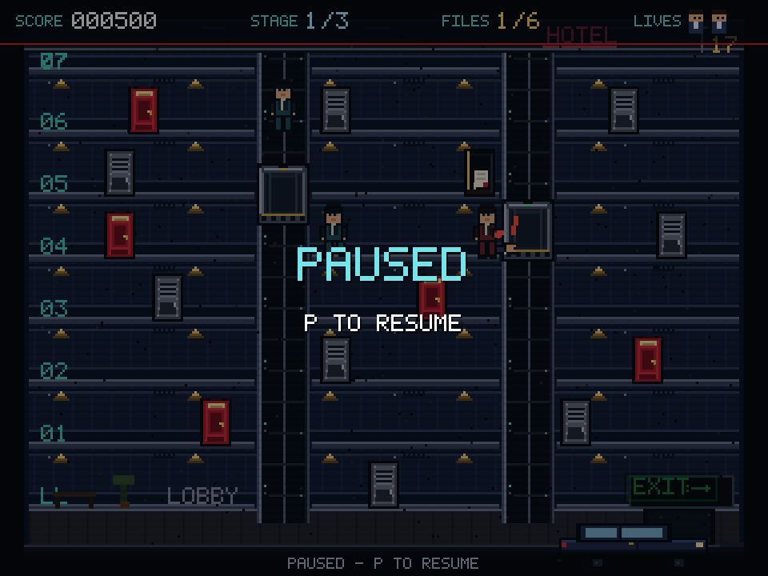
RED DOOR PROTOCOL // BEVY 0.20.1
ELEVATOR ACTION
SOUND + PRESENTATION
A 16-SECOND SPY LOOP
320 × 240
VIRTUAL ARCADE SCREEN
rendered at 3× in a fixed 960×720 window
NEAREST
ORIGINAL CHIPTUNE — SQUARE, TRIANGLE AND NOISE, RENDERED TO WAV
SAMPLING + INTEGER SNAP
▸
11 cues plus the loop: pistol, enemy shot, hit, pickup, death, ding, door, call, clear, game over, victory.
no blurry pixels, ever
▸
22.05 kHz mono; all synthesized in pure Python with the standard library.
▸
One GlobalVolume resource handles mute without touching individual sinks.
CRISP HUD AT 3× — CUSTOM FONT, NO ANTIALIASING
08 / 10

Slide 9
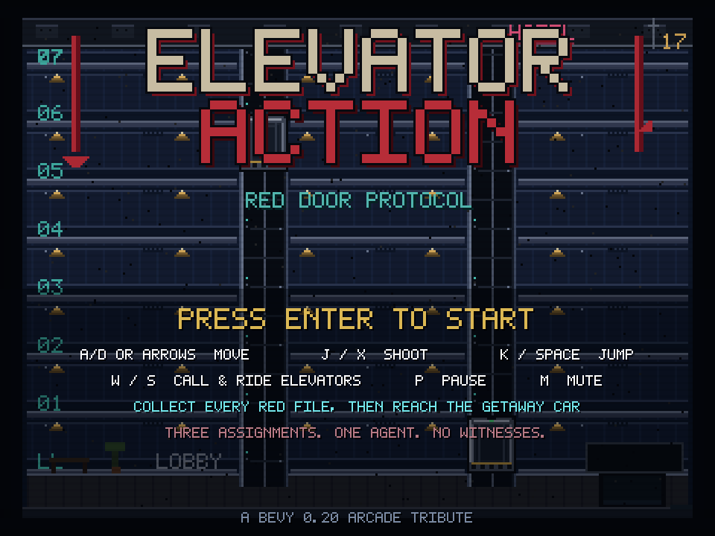
RED DOOR PROTOCOL // BEVY 0.20.1
ELEVATOR ACTION
VERIFICATION
TRUST, BUT VERIFY
TITLE
STAGE 1
STAGE 3
PAUSE
EVERY IMAGE IN THIS DECK WAS CAPTURED FROM THE RUNNING BINARY.
FMT
LINT
TESTS
CAPTURE
DEMO
cargo fmt --check
clippy -D warnings
15 passing
self-screenshot
scripted input
Unit tests cover pure elevator/collision math and every level layout. Integration tests
drive full ECS apps for document pickup, damage/life loss, respawn, stage advance,
victory transition, and the complete level-spawn pipeline. Screenshot mode waits for
the scene to settle, saves the framebuffer, and exits — the loop that caught UI
overlaps, font fallback squares, and HUD/playfield collisions.
09 / 10

Slide 10

RED DOOR PROTOCOL // BEVY 0.20.1
ELEVATOR ACTION
SHIP
PLAY IT
A complete, original arcade game in Rust.
Clone it, build it, crack some red doors.
git clone https://github.com/orbitmechanic/elevator-action-bevy
cd elevator-action-bevy
cargo run
cargo test
cargo clippy --all-targets -- -D warnings
MIT LICENSE · ORIGINAL ART + AUDIO · BEVY 0.20.1
Built with Krita, Inkscape, LibreOffice and a lot of
pixel counting. Thanks for playing.
SCAN TO PLAY
github.com/orbitmechanic
PRESS ENTER TO START
10 / 10

