Slide 1
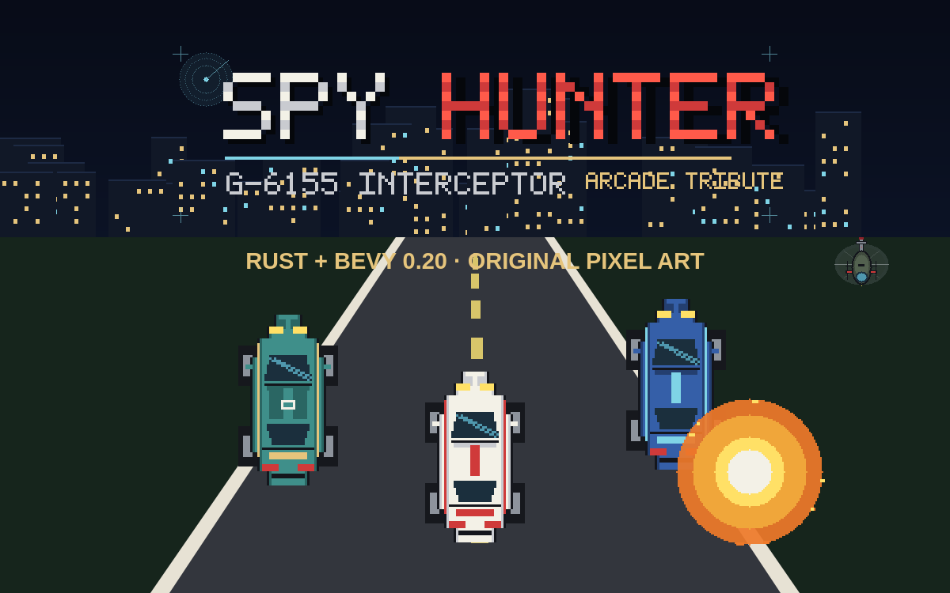
MISSION DEBRIEF · NOVEMBER 2026
orbitmechanic.github.io/spy-hunter-web
A playable Rust + Bevy tribute, built and shipped in one session.

Slide 2
01 / BRIEF
From a 1983 arcade memory
to a shipped browser game
The assignment was deliberately broad: research the original, build an original game in the same spirit, generate the art and audio, test it, publish it, and dock it on the station.
4
RESEARCH
Deconstruct Spy Hunter's top-down chase, weapons van, civilian rule, car-to-boat switch, and Peter Gunn-era sound.
TERRAINS
FOUNDATION
23.7 s
New project at games/bevy/spy-hunter, Cargo + Bevy 0.20.1, public GitHub repo from the first commit.
ORIGINAL LOOP
ASSETS
6 / 6
Original Krita pixel art, a 5×7 pixel TTF, a 23.7 s chiptune loop, and ten SFX — no ripped assets.
SIM TESTS
SHIP
Native + wasm builds, screenshot harness, GitHub Pages deployment, landing-page dock, and this deck.
0
RIPPED ASSETS
SPY HUNTER: INTERCEPTOR / MISSION DEBRIEF
02

Slide 3
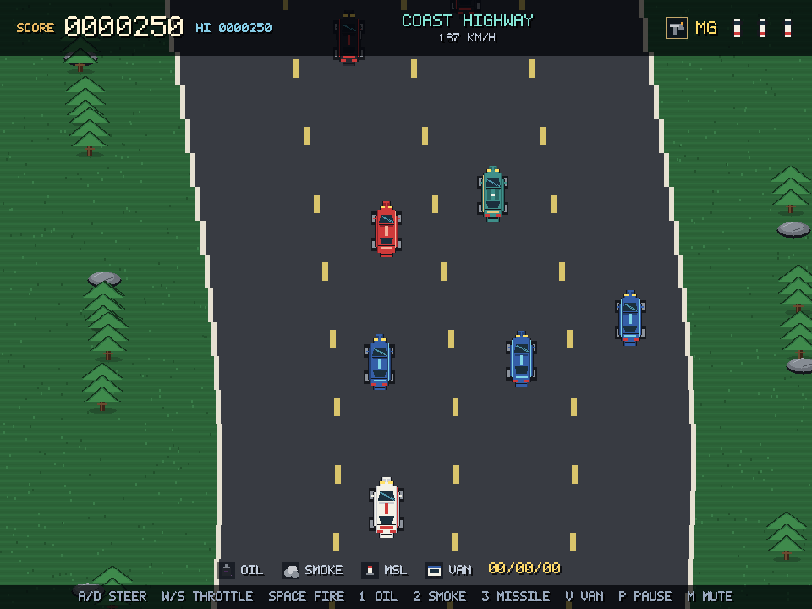
02 / RESEARCH
The target: Spy Hunter, Bally Midway, 1983
A vertical-scrolling vehicular-combat game. The player drives the G-6155 Interceptor, destroys enemy traffic, protects civilians, and collects special weapons from a van. The road forks into new weather and terrain; at water, the car becomes a speedboat.
GAMEPLAY
Top-down, 4-lane road, machine gun, oil / smoke / missiles, helicopter bombs, off-road and civilian penalties.
LOOK
Chunky sprite cars, hard lane lines, bold roadside colour blocks, a compact dashboard HUD.
SOUND
An electronic arrangement of Henry Mancini's Peter Gunn theme; engine and weapon cues under it.
RULES
Score accrues while moving on-road. Civilian hits freeze scoring. Extra cars at score thresholds. No ending.
The Peter Gunn theme is copyrighted. This tribute writes an original spy-surf cue instead of reproducing it.
SPY HUNTER: INTERCEPTOR / MISSION DEBRIEF
03

Slide 4
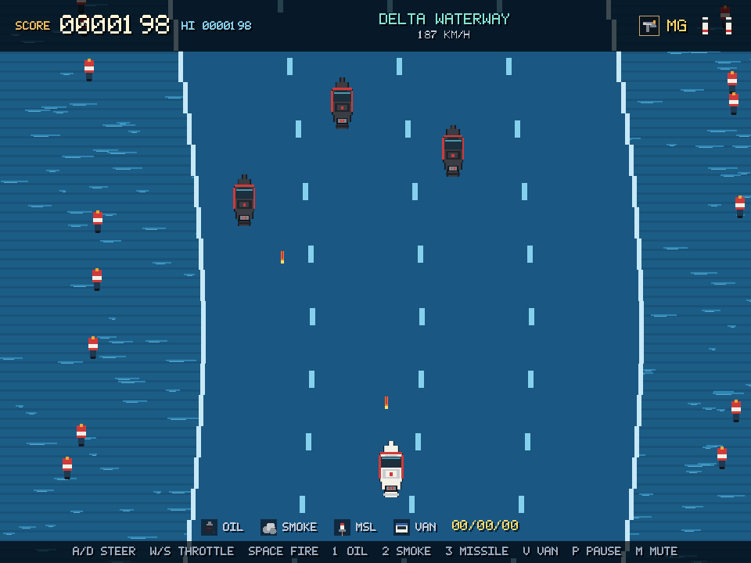
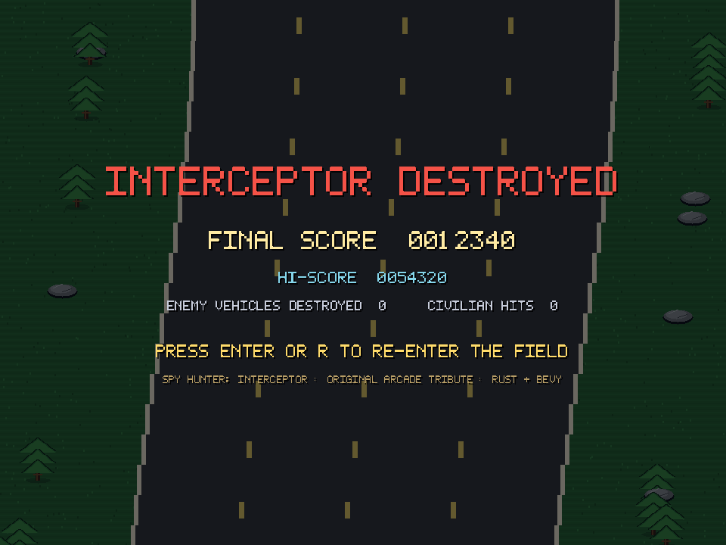
03 / WHAT SHIPPED
One Interceptor, four terrains, endless pursuit
01
02
03
DRIVE & SURVIVE
FIGHT
ARCADE SHELL
Curving four-lane highway, coast / snow / water / night cycle, off-road timer, craters, helicopter bombs, extra lives.
Hold-fire machine gun, oil slick, smoke screen, homing missile, weapons van, switchblade cars, pursuing boats.
Title, HUD, pause veil, game-over stats, hi-score, touch controls, and a browser-first canvas.
Delta Waterway: car becomes boat, oil becomes flamethrower.
SPY HUNTER: INTERCEPTOR / MISSION DEBRIEF
04

Slide 5
04 / UNDER THE HOOD
A small ECS with a very clear loop
Bevy 0.20.1 · edition 2024 · fixed 960 × 720 logical canvas · one 2D camera
TITLE
→
IN GAME
→
GAME OVER
Enter starts a run; death with zero cars ends it; Enter redeploys.
INPUT
ROAD
SPAWN
MOVE
FIRE
COLLIDE
HUD
Update systems run in a chain; gameplay pauses with one resource flag.
Game
Weapons
Road
Rng
Fx
score · lives · terrain · timers
oil · smoke · missiles · van
scroll distance
deterministic xorshift
shake + particles
CONTENT PIPELINE
Krita 6
make_font.py
make_audio.py
wasm-bindgen
PNG sprites
+ terrain
→
5×7 pixel
TTF
→
WAV music
+ 10 SFX
→
WebGL 2
bundle
SPY HUNTER: INTERCEPTOR / MISSION DEBRIEF
05

Slide 6
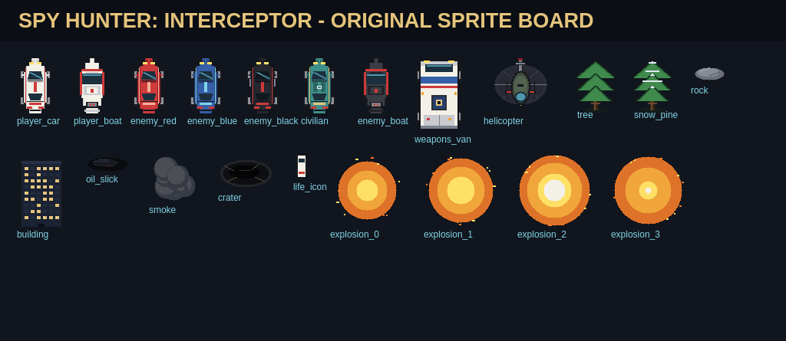
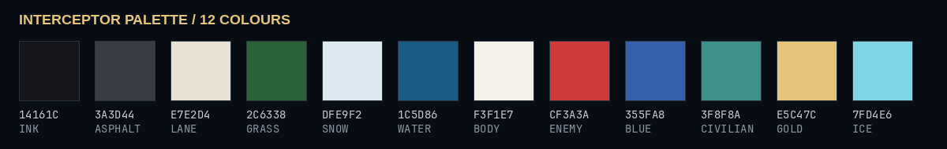
05 / ART PIPELINE
Original pixel art, drawn through Krita's Python API
PALETTE
Twelve fixed colours: ink, asphalt, lane cream, grass, snow, water, body, enemy red, blue, civilian teal, gold, ice.
SPRITES
Cars, boats, helicopter, van, pickups, explosions, trees, rocks, buoys, buildings, icons, and a 21-sprite editable board.
TERRAIN
Four 960×720 fields: grass, snow, water, night city. The four-lane road itself is built from recycled Bevy sprites.
FIX
Krita creates an opaque white Background layer. The export script hides it before writing pixels so alpha survives.
SPY HUNTER: INTERCEPTOR / MISSION DEBRIEF
06

Slide 7
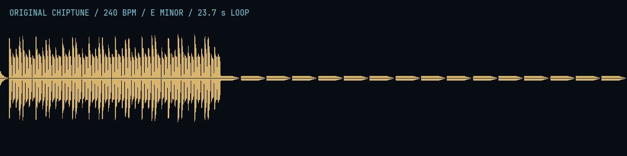
06 / SOUND
An original spy-surf cue, synthesized from scratch
FORM
SFX
8-bar loop at 240 BPM in E minor. Walking square bass, tremolo square lead, triangle pad, noise drums.
Ten cues: machine gun, enemy shot, explosion, missile, pickup, civilian penalty, death, extra life, terrain, UI.
FORMAT
WHY ORIGINAL
22.05 kHz mono 16-bit WAV; one 1.0 MB music loop, 1.2 MB total audio. No samples from the arcade machine.
Peter Gunn is owned by its composers/publishers. A bespoke cue keeps the tribute legally clean and gives the game its own identity.
SPY HUNTER: INTERCEPTOR / MISSION DEBRIEF
07

Slide 8
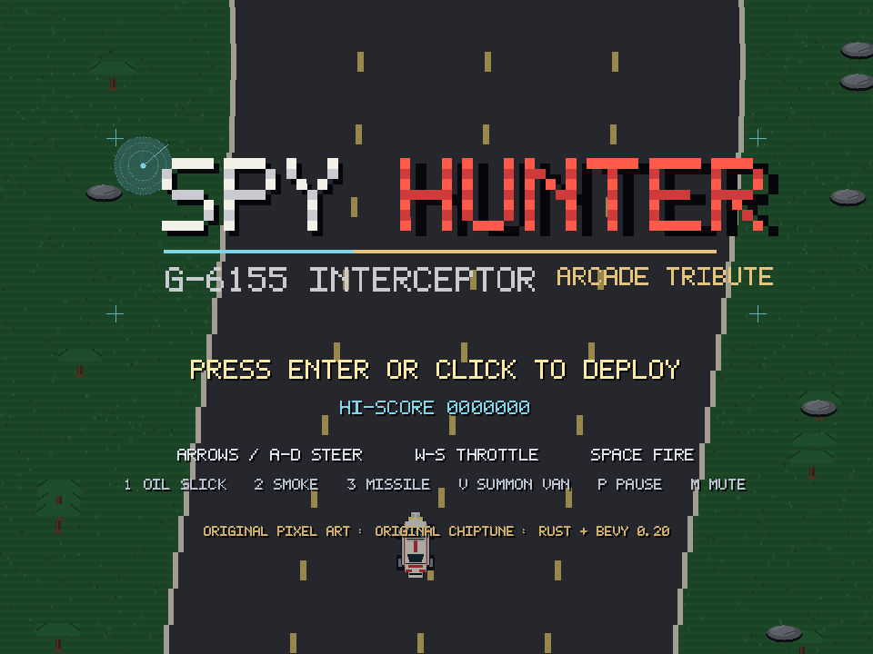
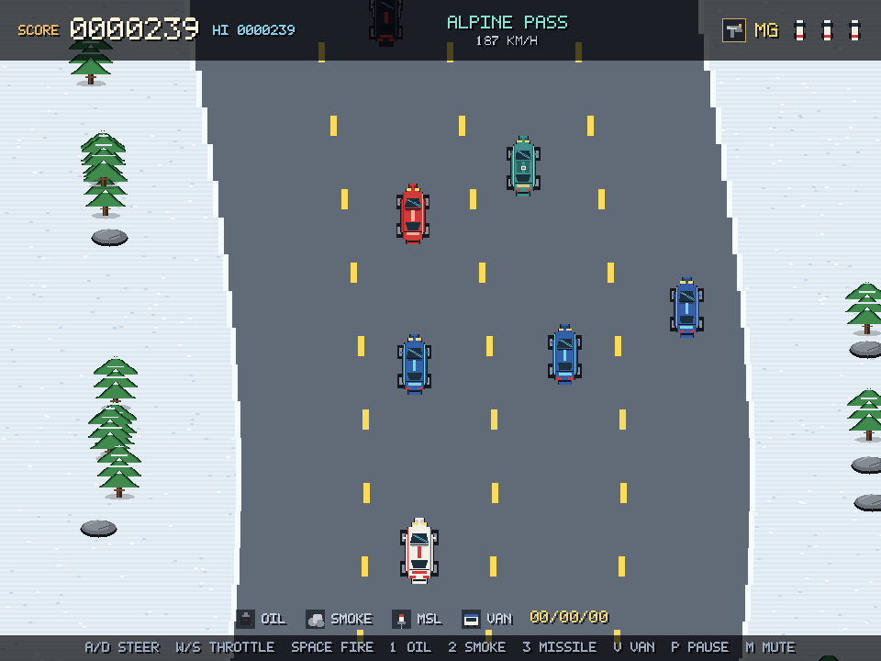
07 / VERIFICATION
Compiling is not proof. Every claim has a check.
TITLE
HIGHWAY
ALPINE PASS
GAME OVER
cargo test: 6/6 pass · cargo check: clean · native capture at frames 120–520 · web smoke test in headless Chromium
SPY HUNTER: INTERCEPTOR / MISSION DEBRIEF
08

Slide 9
08 / CHALLENGES & FIXES
Four bugs worth remembering
SCORE STUCK AT 4
Score was added as (speed × dt × 0.11) as u64. At 60 fps the fraction truncated to zero every frame. Fix: keep a fractional accumulator and add whole points only.
BEVY B0001
Two queries touched Transform — one mutably — without disjoint filters, so the app panicked on the first frame. Fix: Without<Player/Enemy/Missile> filters.
WHITE SPRITE CARDS
Every Krita export had an opaque white background because createDocument adds a Background layer. Fix: hide that layer before merge-exporting.
WEB AUDIO + SIZE
Browsers suspend AudioContext until a trusted gesture, and the raw wasm was over 100 MB. Fix: capture/resume contexts in the shell, wasm-bindgen + wasm-opt -Oz.
SPY HUNTER: INTERCEPTOR / MISSION DEBRIEF
09

Slide 10
09 / DEPLOYMENT
Source, static build, Pages, and a new docking bay
SOURCE
BUILD
WEB REPO
PAGES
DOCK
github.com/orbitmechanic/
spy-hunter
→
tools/build_web.sh
wasm-bindgen + wasm-opt
→
github.com/orbitmechanic/
spy-hunter-web
→
orbitmechanic.github.io/
spy-hunter-web
→
Gallifrey Station
Bay 08
The game repo carries source, art boards, tests, and the build/deploy scripts.
The web repo carries only the staged runtime: index.html, CSS, JS glue, wasm, assets, .nojekyll.
LIVE URLS
PLAY https://orbitmechanic.github.io/spy-hunter-web/
SOURCE https://github.com/orbitmechanic/spy-hunter
BUILD https://github.com/orbitmechanic/spy-hunter-web
STATION https://orbitmechanic.github.io/ (Bay 08)
SPY HUNTER: INTERCEPTOR / MISSION DEBRIEF
10

Slide 11
10 / RECOMMENDED NEXT STEPS
What I would build next, in order
01
GAMEPAD + MOBILE POLISH
02
MORE ROAD STORIES
Wire gamepad axes and tune the touch hit targets. Add haptics and a rotate-to-landscape hint.
Branching forks, a boathouse choice, motorcycles, limousines, and a second helicopter pattern.
03
RENDER BUDGET
04
PERSISTENCE
Bake the sprite set into an atlas and batch the 100+ road parts. Target a stable 60 fps on integrated GPUs.
Local high-score table and per-terrain bests; optional serverless leaderboard.
05
AUDIO MIX
06
ACCESSIBILITY
Duck the music under explosions, add engine pitch tied to speed, and a mute toggle on the title screen.
Remap keys, reduce screen shake, high-contrast HUD, and a slower starting difficulty.
SPY HUNTER: INTERCEPTOR / MISSION DEBRIEF
11

Slide 12
MISSION COMPLETE
A new arcade cabinet
is docked at the station.
Play it: orbitmechanic.github.io/spy-hunter-web
Source: github.com/orbitmechanic/spy-hunter
Original pixel art · original chiptune · Rust + Bevy 0.20.1 · GitHub Pages
Original work. No ROM, cabinet, or arcade asset is included.
SPY HUNTER: INTERCEPTOR / MISSION DEBRIEF
12

