Slide 1
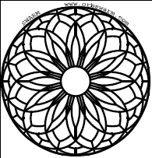
Kalman Filters for Robotics:
Getting the Most from your Sensors
  Michael Prados
  mpradosNOSPAM@gmail.com
  The SWARM Project
  http://orbswarm.com

Slide 2
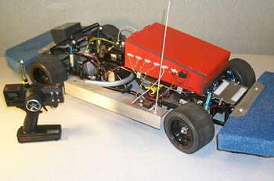
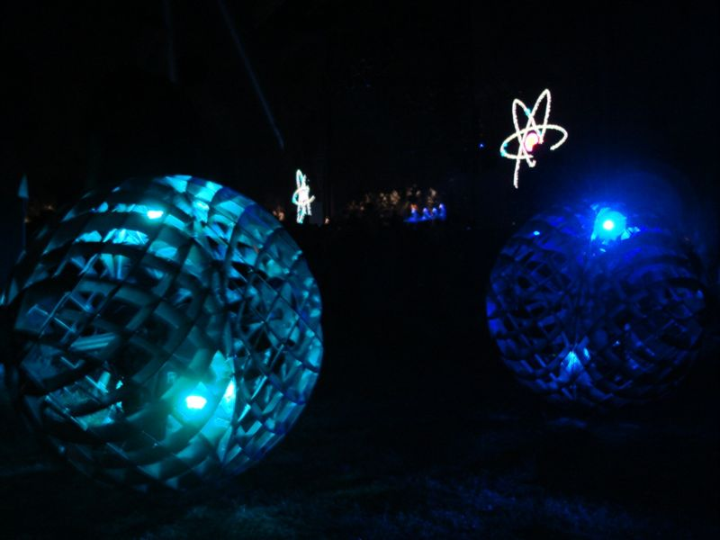
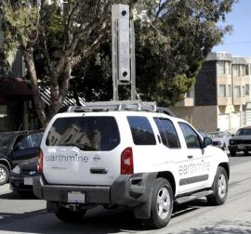
What's Wrong With Me?
Vehicle Dynamics Research
SWARM
earthmine

Slide 3
SWARM – Positional Robotic Art
Six Spherical Robots
  760mm (30in) Diameter, 40kg (90lbs) each
Consumer Grade GPS- 3m accuracy
Sparkfun 5-DOF IMU
  ADXL330 3-DOF Accelerometer
  IDG300 2-DOF Rate Gyro
Wheel Encoder, Kinematic Model
All Open Source!

Slide 4
Some Positional Sensors for Robotics
Sensors are a robot's window to the world!
Inertial sensors
  Accelerometers
  Rate Gyros
  Electrolytic Tilt Sensors
Position Sensors
  GPS
  Wheel Encoders
  Sonar

Slide 5
Problems with Positional Sensors
Inertial sensors – DC Bias, Noise
Position Sensors
  GPS – outages, low frequency, noise
  Wheel Encoders – relative position, slip
  Sonar – limited range, noise

Slide 6
What is a Kalman Filter?
(aka Kalman Estimator, Kalman Observer)
A Kalman filter is an optimal observer
  It will trade off the relative strengths of your sensors, in order to provide an optimal estimate of your system states
Always applied to a state space model of a system
  Must derive a system model, but can often be simple
Either discrete time or continuous
  Usually must go to discrete time for implementation

Slide 7
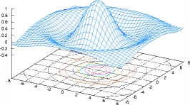
Octave and Matlab
Matlab is an expensive commercial product for matrix algebra and numerical processing
  Great estimation and control system support
Octave is a very similar, free open source alternative
  Almost as good
  Easier to share

Slide 8
What is a State Space Model?
A model of a dynamic system, using a system of differential equations
In general:
An example:

Slide 9
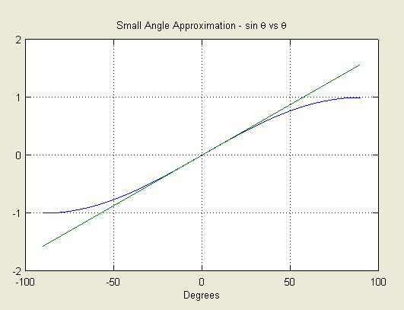
Small Angle Approximation
Pretty good up to +/- 30 degrees
Remember to implement using radians!

Slide 10
Continuous vs Discrete
Continuous time is a mathematically elegant representation using derivatives
  Relatively hard to code!
Discrete time representation tells you directly how to get the next step from the current one
  For most systems, octave will do the conversion!
    discrete_sys = c2d(continuous_sys, T);

Slide 11
The Observer
For a system-
We estimate the states like this-

Slide 12
Inverted Pendulum
Inverted pendulum model
Rate gyro, and accelerometer tilt sensor
a

Slide 13
In Octave...
A
B
Create system
with A,B,C,D
Use c2d
Set QW, RV
Invoke dkalman
Presto, optimal observer!
C

Slide 14
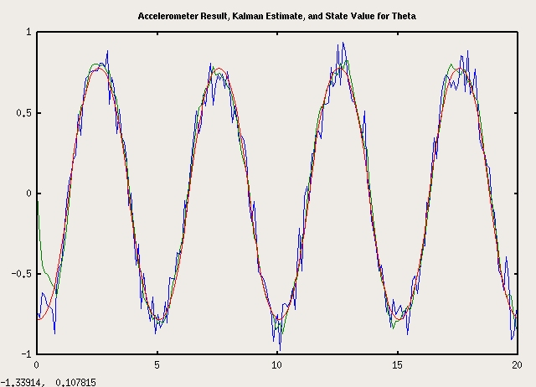

Slide 15
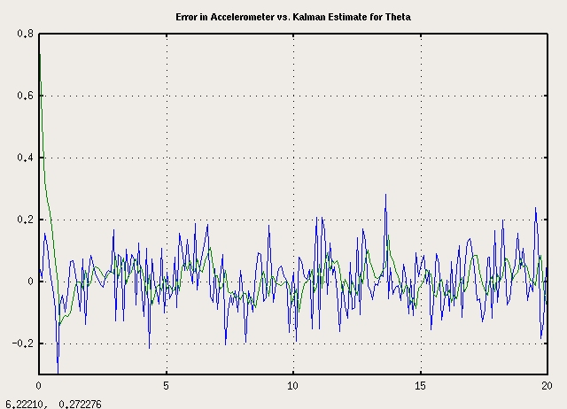

Slide 16
Limitations of the Kalman Filter
For Good Performance
  No strong nonlinearities
    Definitely no trig with greater than +/- 90 degree motion!
  Zero-mean noise – No DC offset
Necessary conditions to be optimal,
but often less important-
  Noise has gaussian distribution
  Noise is white
  Noise is not auto-correlated

Slide 17
DC Offset
Common for inertial sensors
  Rate Gyro's and accelerometers
  Need to debias
Add state to system-

Slide 18
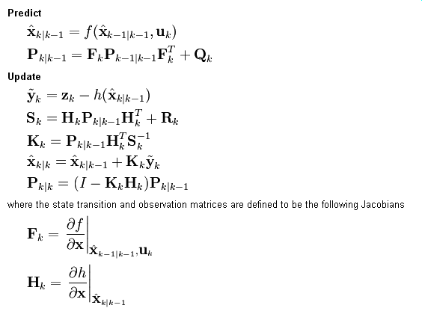
Extended Kalman Filter
Necessary for systems with strong nonlinearity
  Large angle motion- certainly greater that 180 degrees
  Squares, cubes, exponentials

Slide 19
SWARM Extended Kalman Filter
13 states
10 sensors
Kinematic model – too big for slide.
Work in progress! info@orbswarm.com

Slide 20
Implementation
Translation to C code
  Easier with some matrix manipulation libraries
Fixed vs floating point
  Usually possible in fixed point, but often quite laborious
  For more than 2-4 states, probably worth floating point
    Emulation – 8 bit micro, ARM
    FPU – x86, PPC, some ARM (caution!)
    DSP – great platform, steep learning curve

Slide 21
Where to Go
Good Optimization and Control Texts:
Design of Feedback Control Systems
  Stefani, Shahian, Savant, Hostetter – Oxford University Press
Digital Control of Dynamic Systems
  Franklin, Powell, and Workman – Addison Wesley
More advanced:
Applied Optimal Estimation
  Gelb – M.I.T. Press
Optimal Control and Estimation
  Stengel – Dover Publications

Slide 22
Thanks!
?

