Slide 1
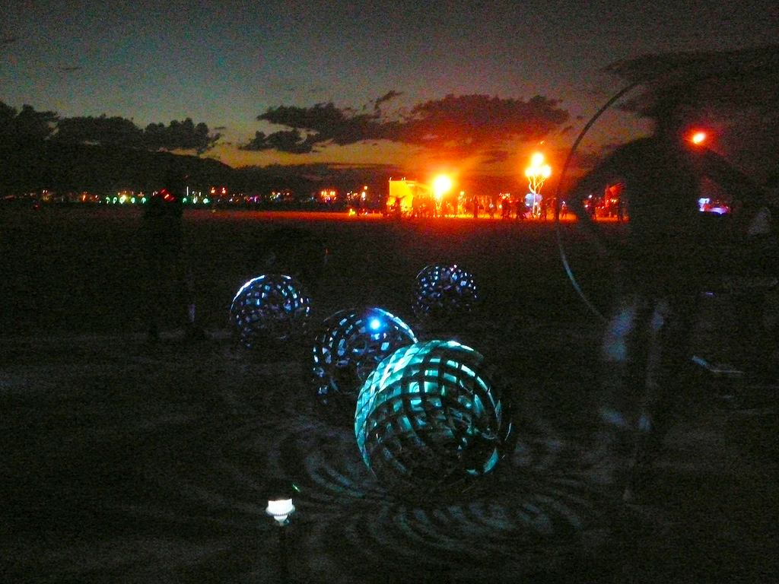
They're baa-ack...
SWARM 2.1

Slide 2
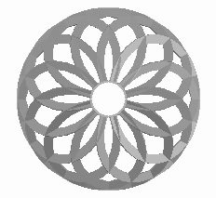
SWARM
A KINETIC LARGE SCALE ARTWORK
FOR BURNING MAN 2008
Primary Contact: Michael Prados
email: mprados@gmail.com phone: (650) 823-3724
630 Connecticut Street, San Francisco, CA 94107
project web site: www.orbswarm.com

Slide 3
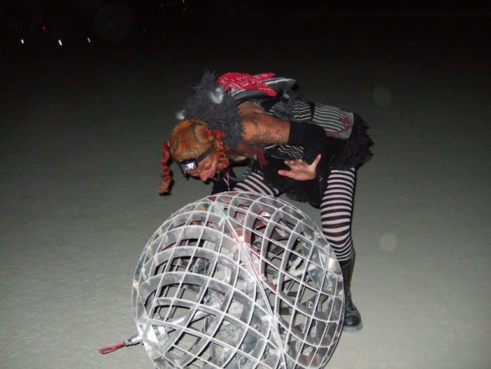
wtf?
“A motion and a spirit, that impels
All thinking things,
all objects of all thought
And rolls through all things.”
Wordsworth
Orbs roll
Orbs flock
Orbs play sound and music
Orbs light colors in response to the environment
A SWARM of rolling robot ORBS
evolving complex dances of LIGHT and PATTERN.

Slide 4
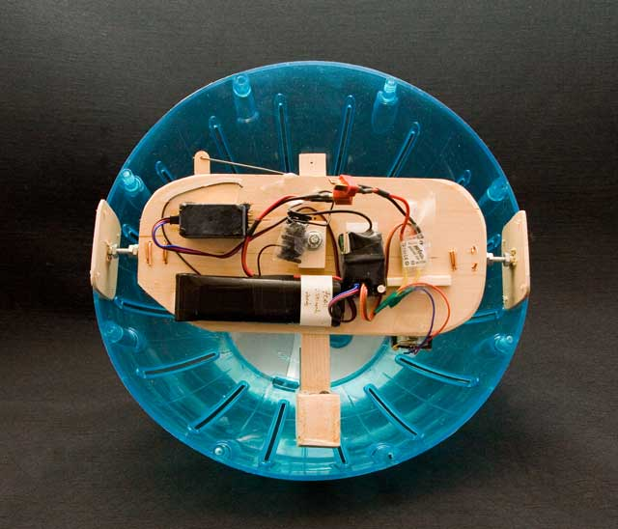
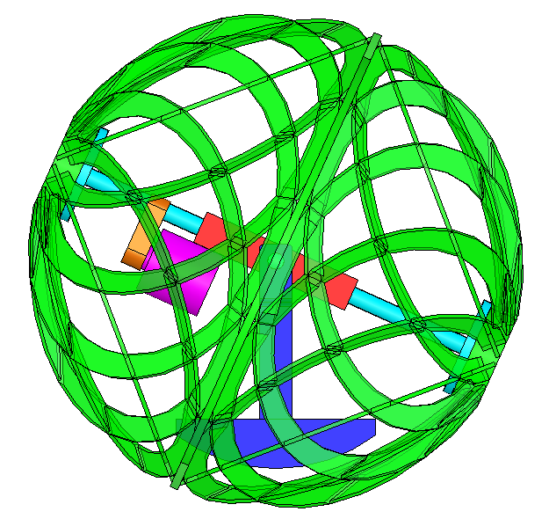
how they work
shell
hamster ball prototype
by Pete Burnight
A heavy battery pack provides a reactive ballast.
A drive motor spins the shell against the ballast, causing the orb to roll
A steering motor tilts the ballast, allowing the orb to steer
motor
battery ballast
CAD by Michael Prados

Slide 5
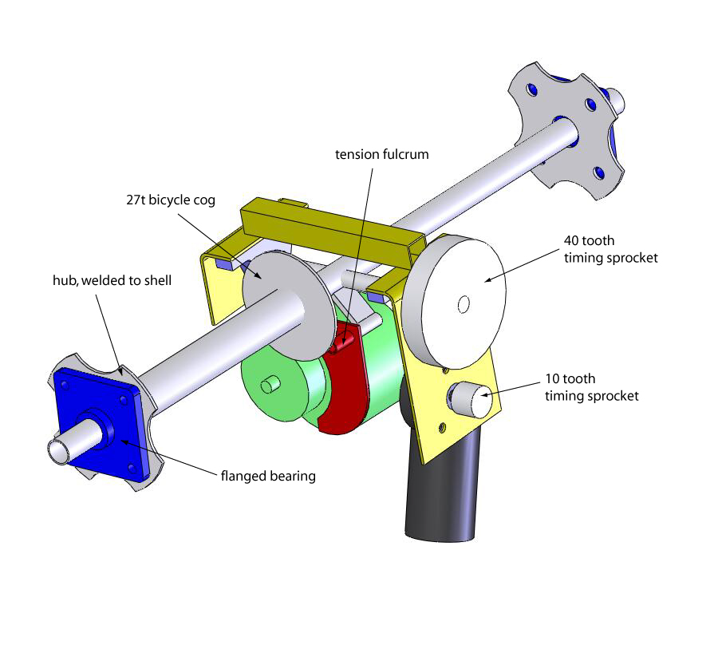
drive mechanics
steering motor:
24V worm gear DC motor
drive motor:
24V electric scooter motor

Slide 6
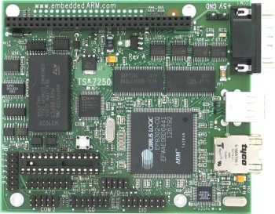
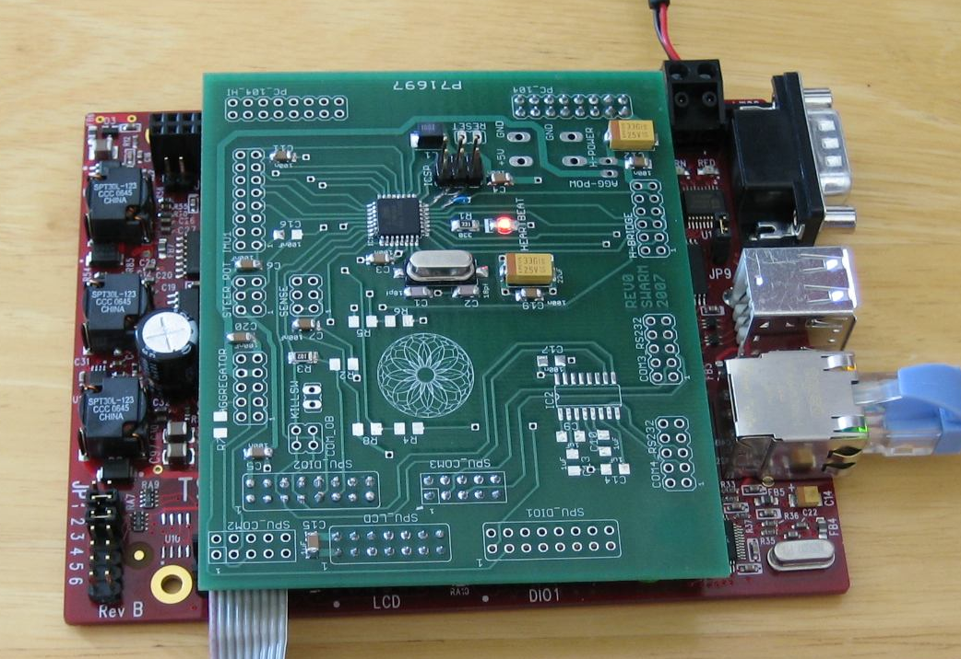
the brains of the operation
SPU – Swarm Processing Unit
200 MIPS Linux ARM processor
less than1 watt power consumption
embeddedarm.com
Custom AVR daughterboard
for motor control, plus custom
H-bridge motor drivers
P.S. All our software is open source: www.orbswarm.com

Slide 7
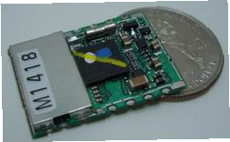
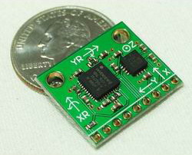
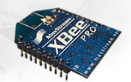
sensors working overtime
Global Positioning System (GPS) modules
Micro Electromechanical (MEMS) accelerometers and yaw rate gyros
(sparkfun.com)‏
Zigbee radio for serial digital
communication
xbee.com

Slide 8
What's New in 2008:
More and better lighting
(twice as many light pods, individually addressable)‏
Enhanced sound
(new enclosure and algorithms, higher fidelity)‏
More powerful on-board computer
(more capabilities, better navigation)‏
Enhanced algorithms
(more responsive to location and proximity)‏
Enhanced controls
(individual controls for untethered operation)‏
Enhanced reliability and rollability
(more Orbs, more often, more places)‏

Slide 9
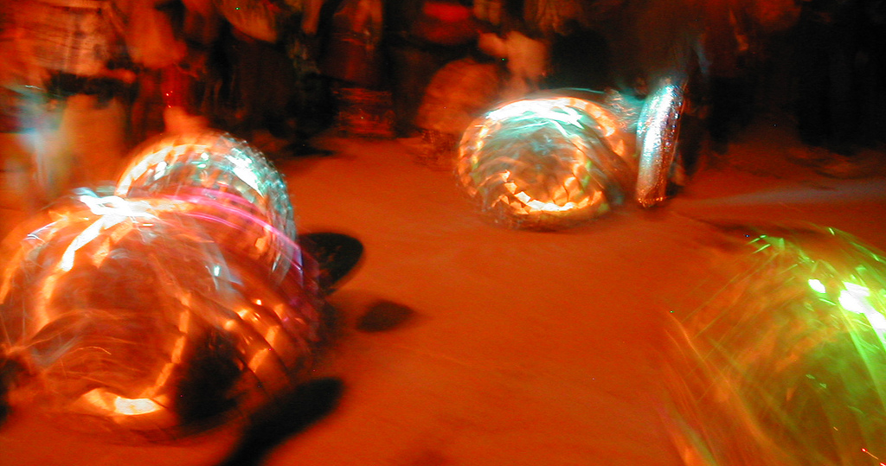
Why you should fund us again:
We are still working towards fully autonomous SWARM behaviour. This is an extremely challenging project. Support from Burning Man was critical to the initial project as well as our continuing progress.
We are self-funding major hardware upgrades, and this year we request only reasonable transportation costs
We will use our time on the playa to capture data and benchmark algorithms towards autonomy.
Getting operational high technology to the playa is not easy. We were proud to deliver last year, and we will do so again.
You understand our vision like few other organizations. Whether our application is successful or not, we thank you for that!

Slide 10
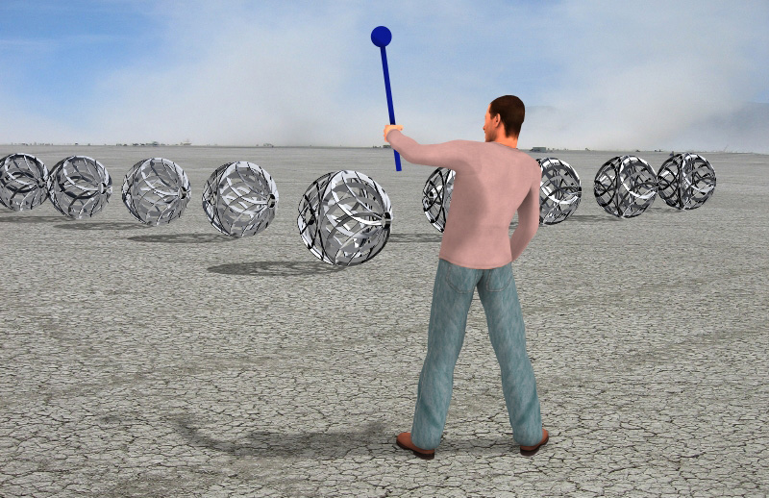
vision: interactivity
What represented hope in the daylight morphs into fear at night.
The Magic Wand allows participants to
control SWARM and direct formations like a sorcerer.
Rendering by Stefano Corazza and Phil Spitler

Slide 11
Budget:
Six Orbs based at Illumination Village
transportation (truck rental, loading, and fuel): $1500
consumables (power, tools, shop rent, etc.): $500
total: $2000
Six Orbs with Mothership pedal-powered carrier
transportation: $2000
consumables: $750
Total: $2750

Slide 12
Clean Up
Most elements of our installation are mobile. Playa impact is negligible beyond area demarcation and nighttime anti-collision lights. Nothing is burned. Clean-up is therefore straightforward:
Monday Sept 1st:
All Orbs are collected and packed for transport.
Mothership is broken down for loading.
Tuesday Sept 2nd:
Truck loaded. Any playa impact (stake holes, etc.) is remediated.
Installation area and surrounding area swept for MOOP.
Artery staff inspect area and check off Swarm project.
No trace will be left. We will Leave No Trace.

Slide 13
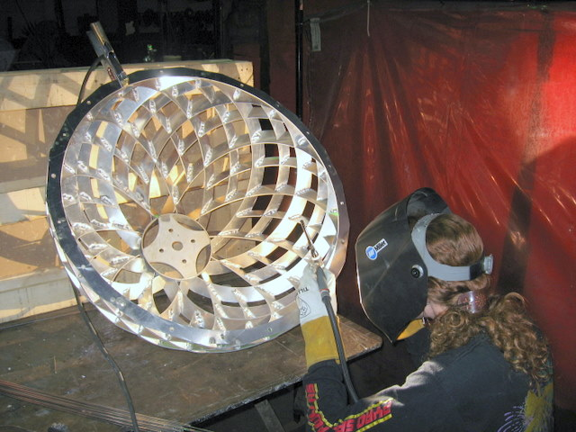
Our gang
SWARM is a collaborative project featuring members of the Flaming Lotus Girls, the Sunflower Robots Project, members of the robotics, kinetic art, and Linux/open source communities. We are particularly proud of our unhierarchical collaboration style, and we were pleased to introduce several new burners to the playa last year. All SWARM designs and code is open-source and freely available to help or inspire other artists. We hope to continue our tradition of bringing high technology to the playa, on time, on budget, and operational.
We have an experienced, diverse, and technically sophisticated crew featuring many veteran Burning Man artists and engineers. In past years, crew members have made major contributions to the following Burning Man artworks:
A Field of Sunflower Robots (2006)
The Flaming Lotus Girls’ Serpent Mother (2006), Angel of the Apocalypse (2005), Seven Sisters (2004), Hand of God (2003)
The Mad Scientist's L3K (2006) and STS (2004)
Al Honig's Hope/Fear Gauge (2006)

Slide 14
SWARM
Crew
Aerin Heinemeyer
Charlotte Sanford
Chris Gerbik
Corey McGuire
Dawn Ryan
'Dillo Okay
Erik Swedberg
Jonathan Foote
Jesse Zbikowski
Lee Sonko
Lisa Schile
Marc Hertlein
Mark Alexander
Marnia Johnston
Melissa Mayer
Michael Prados
Niladri Bora
Ray Sykes
Robert Harris
Rick Taylor
Rick Lellinger
Simran Gleason
Stefano Corazza
Tad Rollow
With special thanks to:
Aimee E
Anne Geluardi
Baba Frey
Barry Cogbill
Ben Thompson
Caroline Miller
Charlie Gadeken
Dan Sandberg
David Fine
Drago Anguelov
James Stauffer
Jessica Hobbs
Jill Manthei
John Humphrey
Josh Hunter
Lee Chubb
Lemuel
Liam McNamara
Mark Farrier
Matthew Cline
Michelle Palmer
Naemi Frey
Nate
Olivia G. Sawi
Olivier Bonin
Olya Myhaylovska
Paul Rowan Walker
Pete Burnight
Peter Luka
Phil Spitler
Pouneh Mortazavi
Rebecca Anders
Rich Humphrey
Sameer Al-Sakran
Stella Rubenstein
Steven Nelson
Tasha Berg
Tom Kennedy
Vanessa Montiel

Slide 15
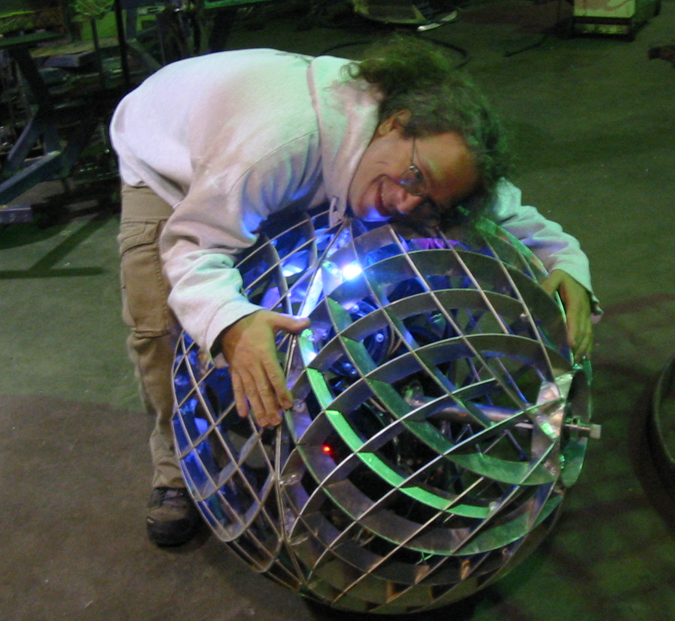
thank you
www.orbswarm.com

