Slide 1
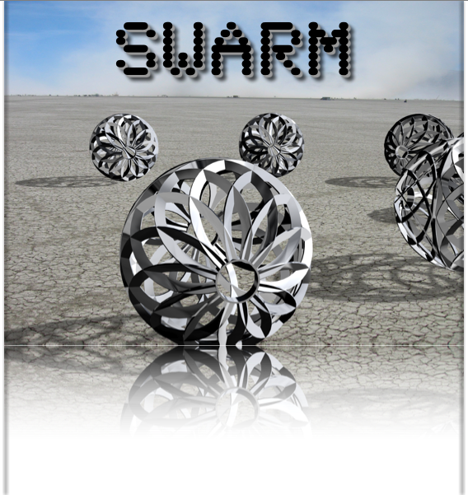
SWARM, A KINETIC LARGE SCALE ART INSTALLATION
PROPOSAL FOR YURI’s NIGHT 2008
Contact: Lisa Schile
email: lmschile@gmail.com Phone: (415) 378-2903
project web site: www.orbswarm.com

Slide 2

SWARM MANIFESTO
Nothing escapes the ineluctable embrace of entropy, the one-way trip of our Universe toward chaos and heat death. Yet at least on one small sphere, our planet, there is a rude and surprising exception: LIFE.
As time progresses, everything becomes less organized, but LIFE is an exception. It grows more complicated, and more interesting. Schroedinger calls this organizational drive negentropy - when things want to be ALIVE. Negentropy is a honeybee colony and a night at the opera. Negentropy is a Bronx cheer in the face of Death.
The SWARM of autonomous beings by their very nature will have emergent and complex behavior. They will flock, flirt, dance and interact, and their actions will surprise and astonish even us, their creators. They are simple, but together they will behave in ways more complex than we can predict. A lot like LIFE.

Slide 3
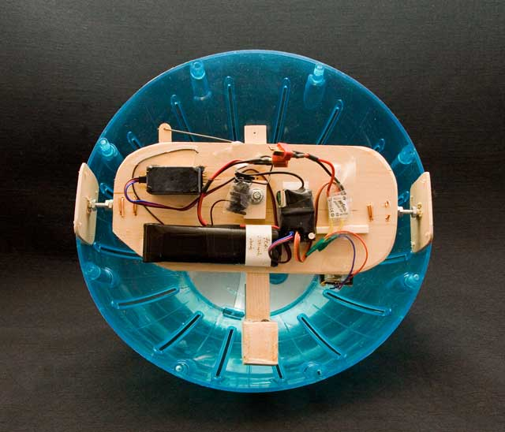
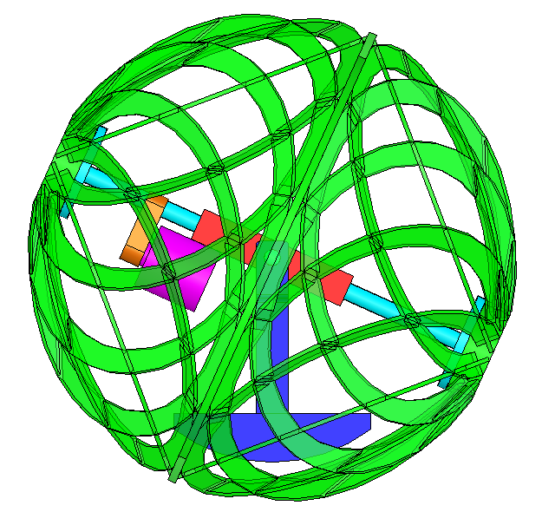
SWARM DESIGN
shell
hamster ball prototype
by Pete Burnight
A heavy battery pack provides a reactive ballast.
A drive motor spins the shell against the ballast, causing the orb to roll
A steering motor tilts the ballast, allowing the orb to steer
motor
battery ballast
CAD by Michael Prados

Slide 4
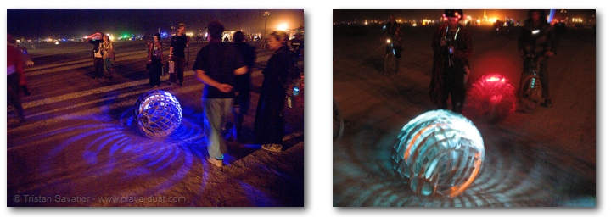
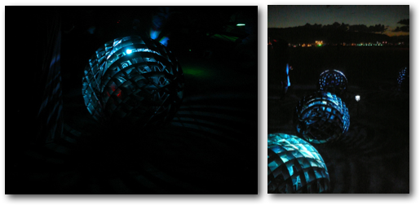
SWARM IN ACTION
''A motion and a spirit, that impels
All thinking things,
all objects of all thought
And rolls through all things.''
W. Wordsworth
Video clips:
http://nitelite.blip.tv/#378277
http://blip.tv/file/380282
Photos from Burning Man 2007

Slide 5
SWARM - SUSTAINABILITY
The SWARM project was designed to be efficient, including the fabrication, electrical system design, and operation of the project.
All of the batteries used to power the orbs were obtained from a recycled battery source.
The battery charging system was specifically designed to be powered by solar energy, but can be run off of any power source.
At Burning Man 2007, the orbs were transported using a four person pedal-powered vehicle.
Throughout our previous installations at Burning Man 2007, Burning Man Decompression 2007, and multiple public and private events, we have maintained our goal to be as efficient as possible and have incorporated sustainable practices to the greatest extent.

Slide 6
SWARM INSTALLATION AT YURI’S NIGHT
4-6 ORBS, Mobile with Remotely Controlled Behaviors.
Light emitting and Sound emitting, Interactive Motion.
Interactive Mobile Performances

Slide 7


SPACE REQUIREMENTS
Space for the Interactive Mobile Orb Performances:
Min Requirement: 40x40ft
Optimal Requirement: 60x60 ft
No furniture needed
Orb Size

Slide 8
PERFORMANCES, STAFF, AND TRANSPORTATION
Performances:
Multiple 20 minute performances will occur throughout the event.
Orbs will be spinning and interacting on stands in between performances
Staff:
Three SWARM crew members will facilitate setup and teardown in under an hour each. Only on-site vehicle access is needed.
Six to eight SWARM crew members will supervise performances and interact with participants throughout the event at any given time.
Transportation:
Two to three personal vehicles will be used to transport the orbs to the event
SWARM is a San Francisco – based project; round-trip transportation costs are included in the budget

Slide 9
SWARM SPECIFICATIONS
Energy Requirements:
One 15 amp line for orb battery recharging is necessary.
Radio Frequency:
The orbs communicate using ZigBee digital radios, which transmit at a radio frequency of 2.4 GHz. The radios are designed to not interfere with WIFI signals.
Sound:
Each orb is equipped with two low power audio amplifiers, which play sound bits when cued.
Fire and Lasers:
There are no flame effects or lasers associated with SWARM.

Slide 10
SWARM SAFETY, SECURITY, AND STRUCTURE
Safety:
The SWARM orbs are currently operated by remote controls. Each orb operator is experienced with orb control and can maneuver an orb to avoid collisions with other orbs, people, and infrastructure. Orb operators can adapt to any situation to maximize the safety of participants while maintaining the interactive nature of the project.
Security:
No additional security is needed outside of the SWARM crew members
Structure:
Other than the orbs themselves, no structural or load-bearing elements are involved.

Slide 11
SWARM BUDGET
The SWARM project currently has six remotely-controlled orbs. We can provide four to six orbs for the event. Below is a breakdown of the total costs:
Four Orbs:
$ 750
Transportation: Two vehicles
Supplies: Two orb stands ($100 each), consumables (TIG welding supplies), spare supplies for the performances
Tickets: 10 (two groups of 5 orb operators)
Five Orbs:
$ 850
Transportation: Two vehicles
Supplies: Three orb stands ($100 each), consumables (TIG welding supplies), spare supplies for the performances
Tickets: 12 (two groups of 6 orb operators)
Six Orbs:
$ 950
Transportation: Three vehicles
Supplies: Four orb stands ($100 each), consumables (TIG welding supplies), spare supplies for the performances
Tickets: 14 (two groups of 7 orb operators)

Slide 12
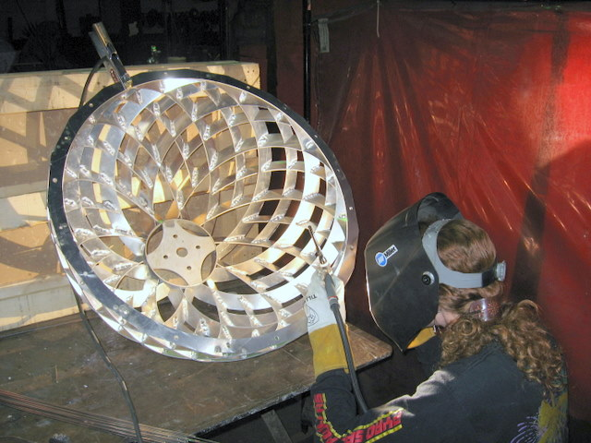
SWARM CREW
Aerin Heinemeyer
Charlotte Sanford
Chris Gerbik
Corey McGuire
Dawn Ryan
'Dillo Okay
Erik Swedberg
Jonathan Foote
Jesse Zbikowski
Lee Sonko
Lisa Schile
Marc Hertlein
Mark Alexander
Marnia Johnston
Melissa Mayer
Michael Prados
Niladri Bora
Ray Sykes
Robert Harris
Rick Taylor
Rick Lellinger
Simran Gleason
Stefano Corazza
Tad Rollow
SWARM is a collaborative project featuring members of the Flaming Lotus Girls, the Sunflower Robots Project, members of the robotics, kinetic art, and Linux/open source communities. We are particularly proud of our unhierarchical collaboration style. All SWARM designs and code is open-source and freely available to help or inspire other artists.

Slide 13
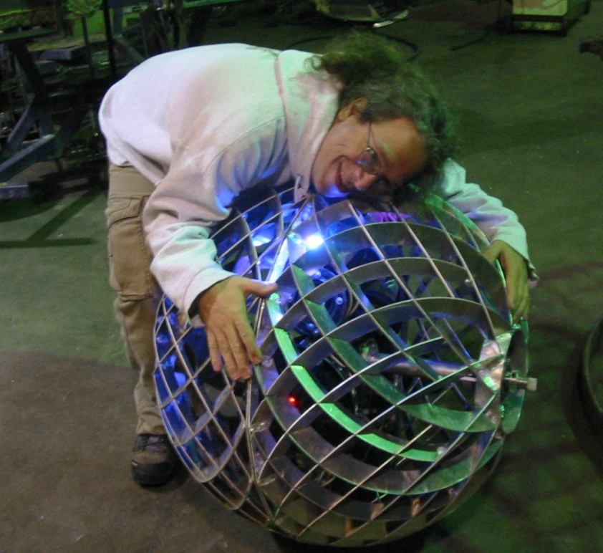
thank you
www.orbswarm.com

