Slide 1
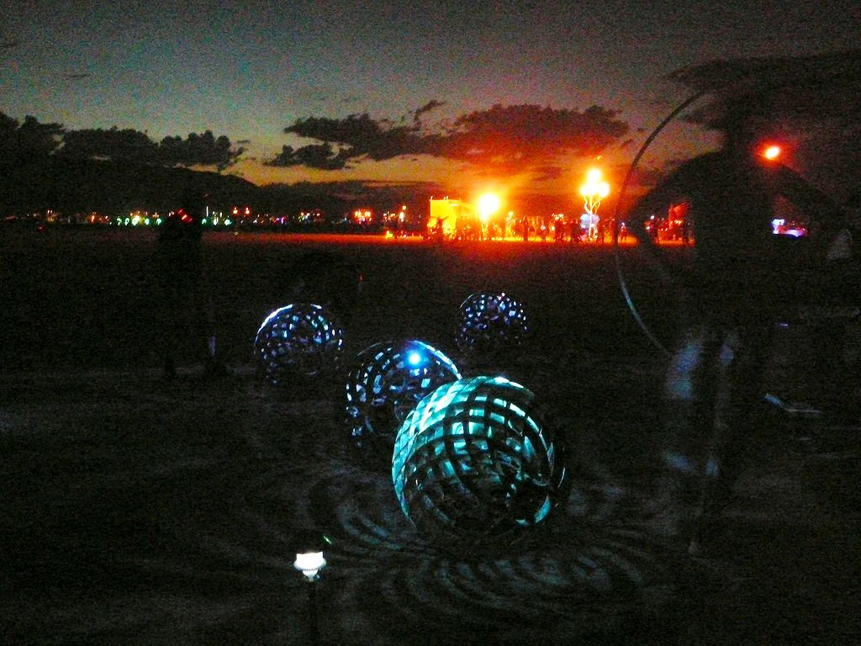
SWARM
thanks you
SWARM
thanks you
www.orbswarm.com
www.orbswarm.com
SWARM
thanks you
SWARM
thanks you
www.orbswarm.com
www.orbswarm.com
SWARM
thanks you
SWARM
thanks you
www.orbswarm.com
www.orbswarm.com

