Slide 1
SWARM

Slide 2
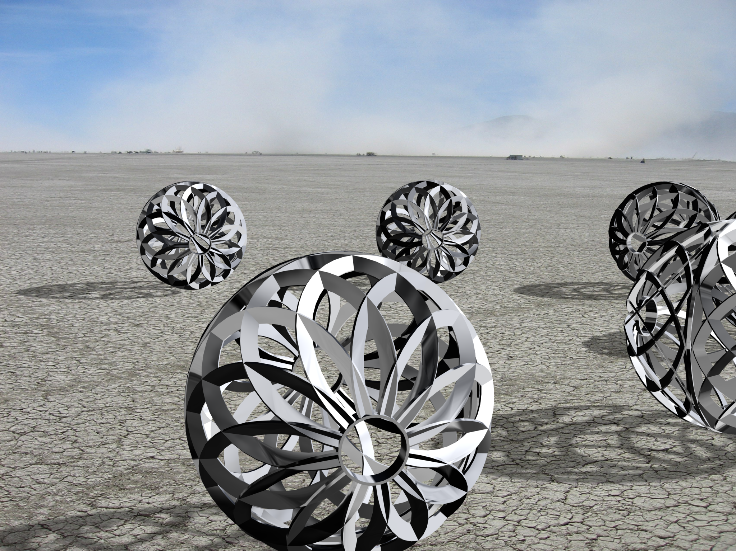

Slide 3
What is SWARM?
''A motion and a spirit, that impels
All thinking things,
all objects of all thought
And rolls through all things.''
W. Wordsworth
A SWARM of rolling robot orbs
evolving complex dances of LIGHT and PATTERN.

Slide 4
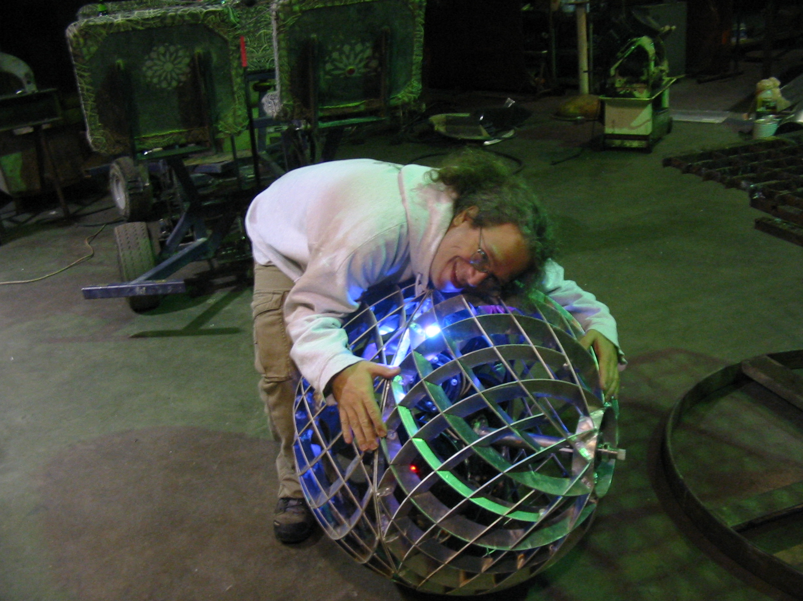
who are we?

Slide 5
SWARM is an open-source collective of artists, scientists, engineers and volunteers

Slide 6
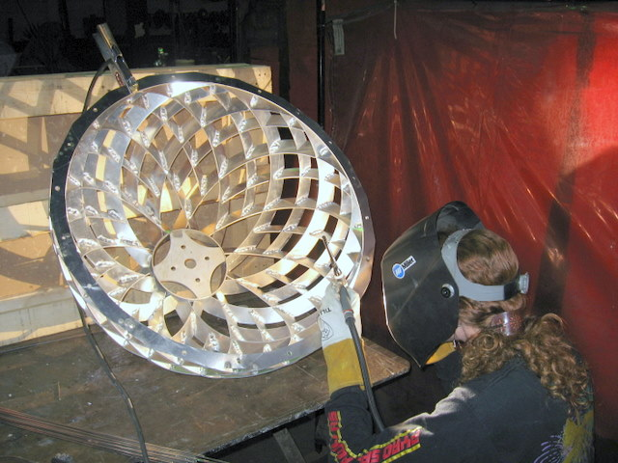
There are founders, but no boss

Slide 7
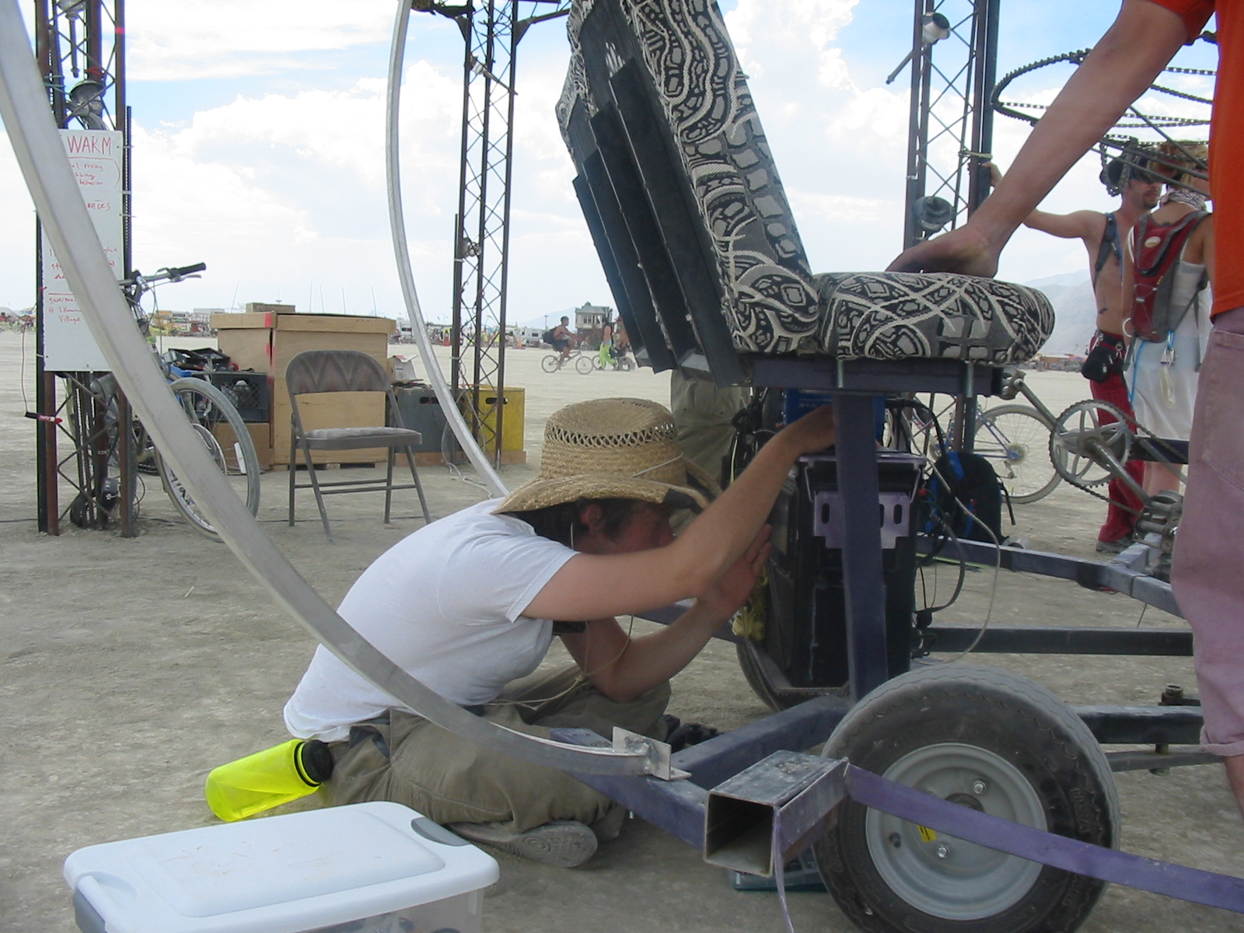
We are a
“do-ocracy”

Slide 8
We do this for everything but money

Slide 9
Funding:
•Art Festivals (Burning Man, Coachella)
•Tech Festivals (Maker Faire, Techkriti)
•Corporate Functions (Google, etc.)
• Self-funding

Slide 10
what they are:

Slide 11
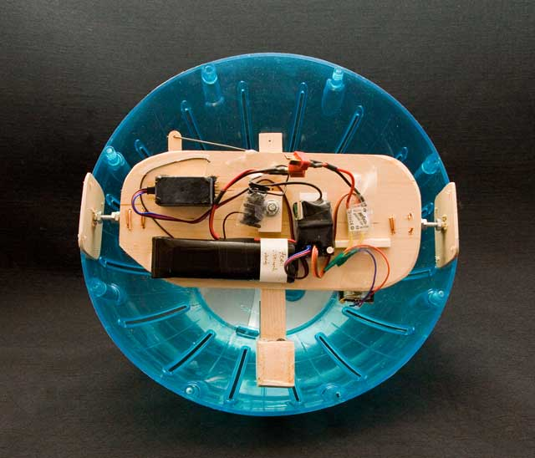
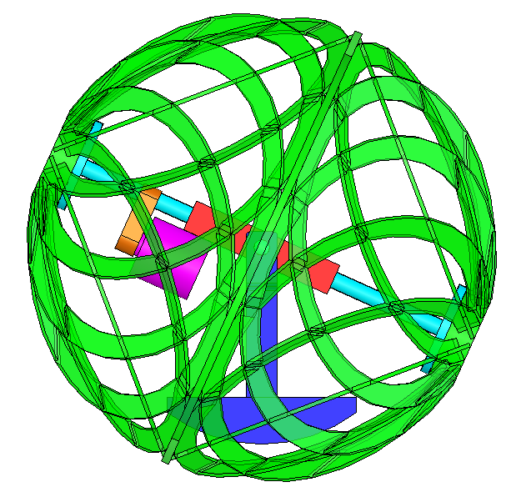
how they work
shell
hamster ball prototype
by Pete Burnight
A heavy battery pack provides a reactive ballast.
A drive motor spins the shell against the ballast, causing the orb to roll
A steering motor tilts the ballast, allowing the orb to steer
motor
battery ballast
CAD by Michael Prados

Slide 12
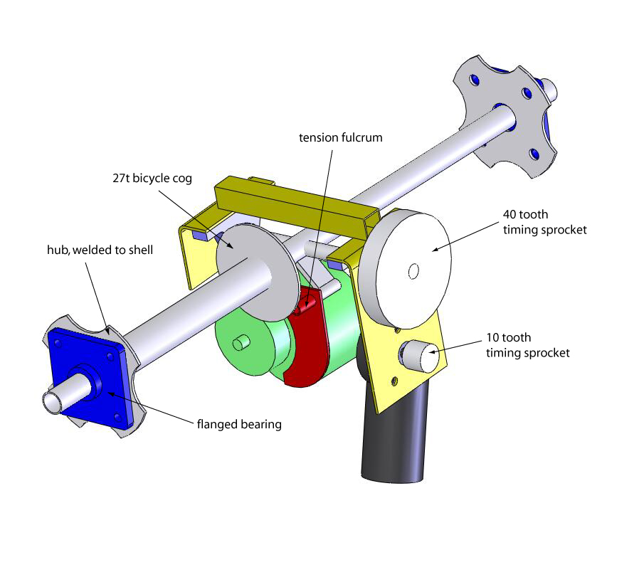
drive mechanics
steering motor:
24V worm gear DC motor
drive motor:
24V electric scooter motor

Slide 13
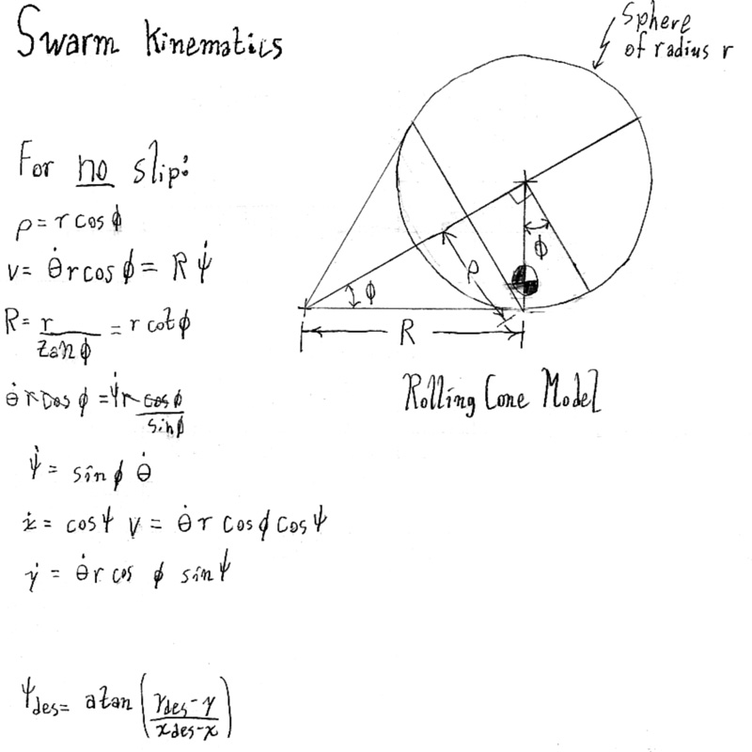

Slide 14
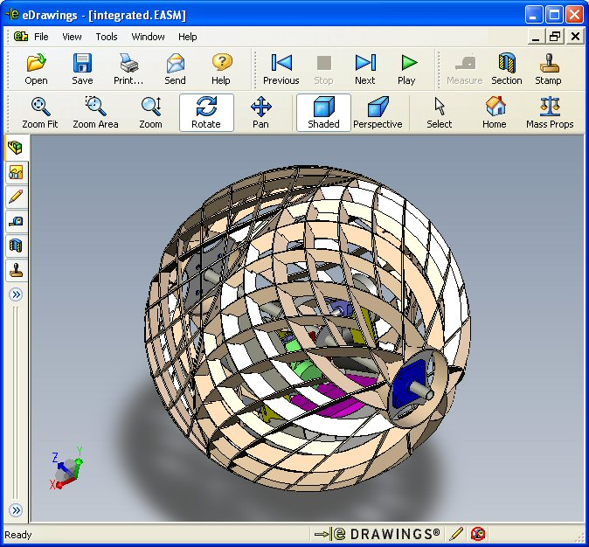
from design...

Slide 15
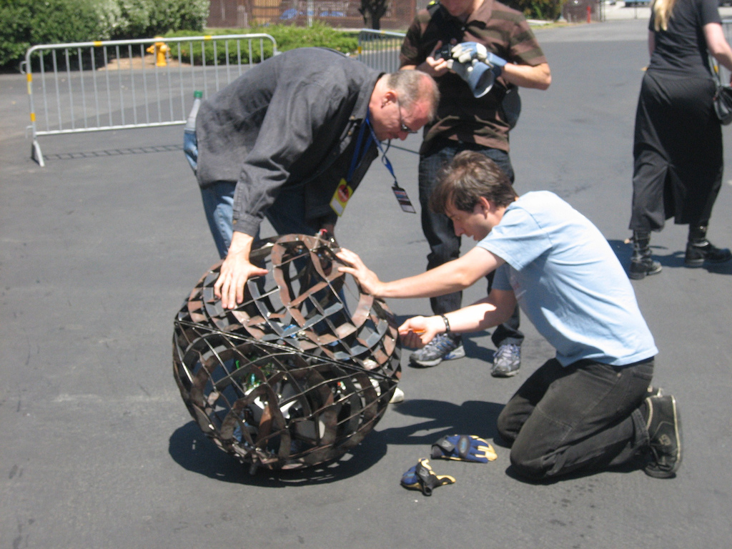
...an early prototype

Slide 16
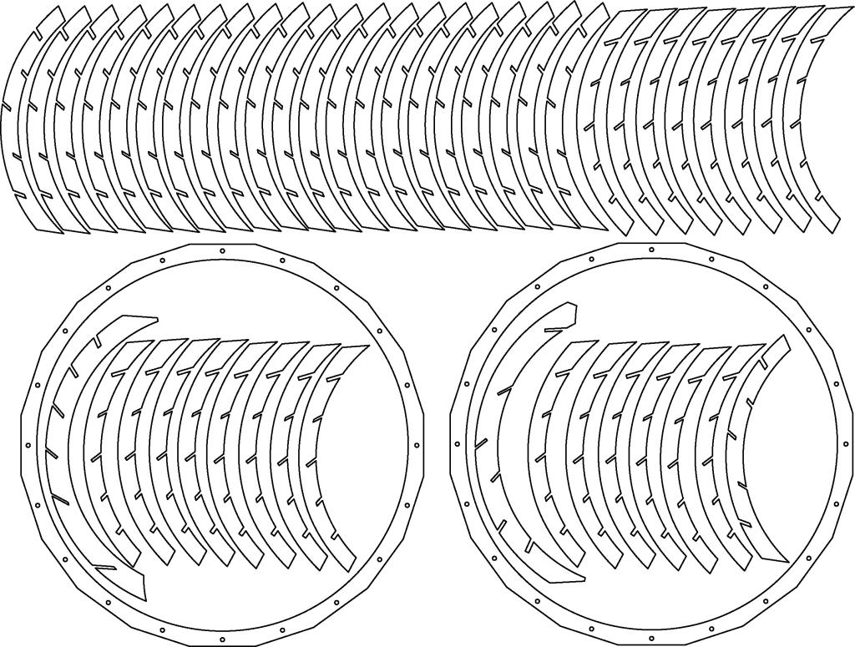
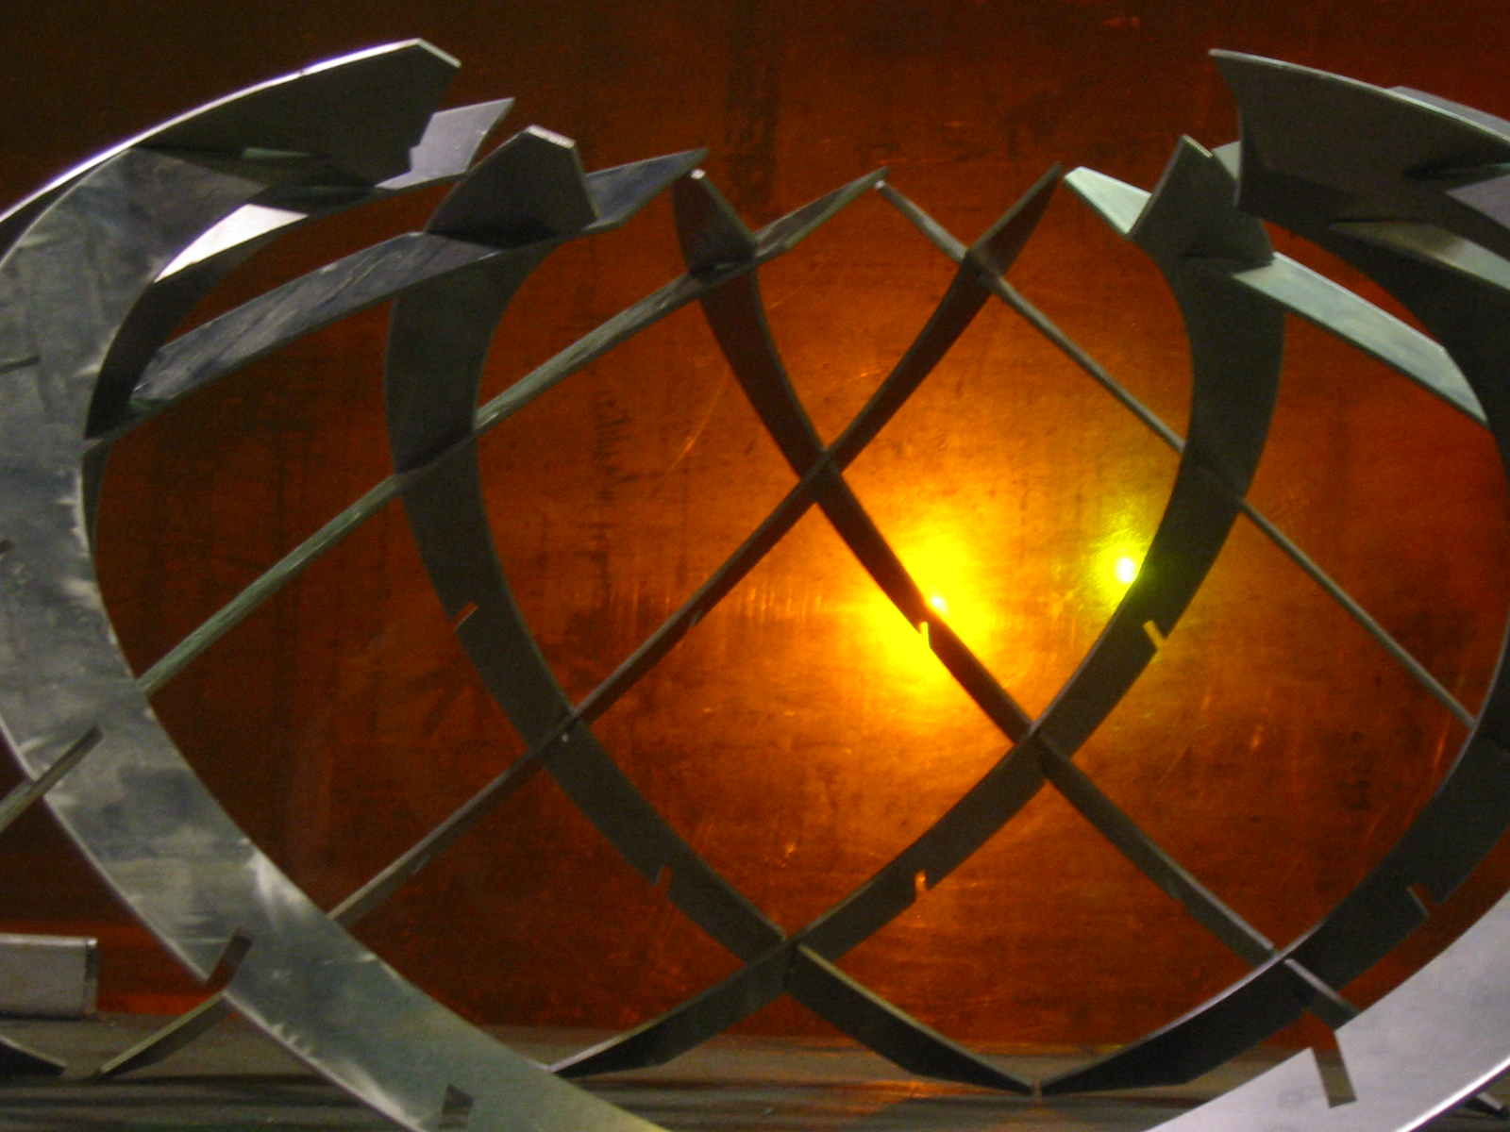
finally...
waterjet cut 1/8 inch
aluminum sheet

Slide 17
Shells:

Slide 18
Chassis
Zigbee RF/Aggregator
LED illuminators
Sound module
CPU dome
Drive shaft and motor
Steering servo
Motor controllers
Battery pack

Slide 19
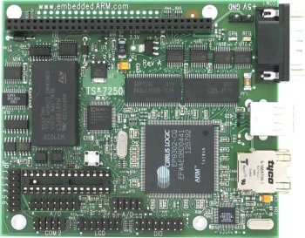
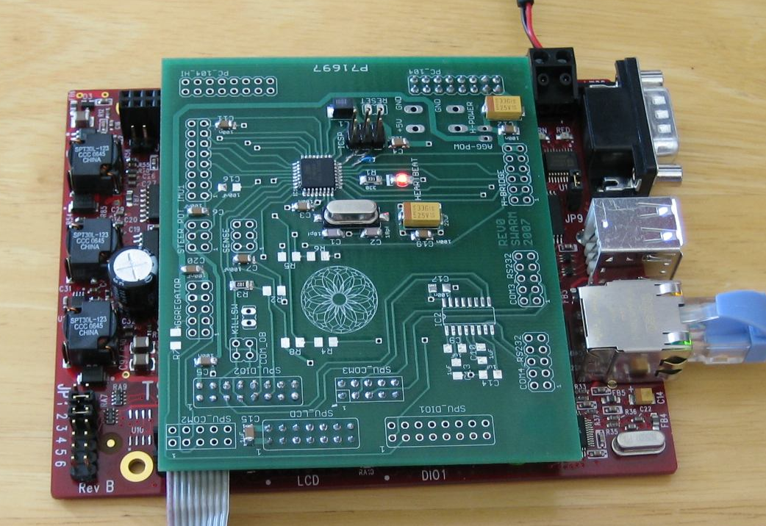
the brains of the operation
SPU – Swarm Processing Unit
200 MIPS Linux ARM processor
less than1 watt power consumption
embeddedarm.com
Custom AVR daughterboard
for motor control, plus custom
H-bridge motor drivers
P.S. All our software is open source: www.orbswarm.com

Slide 20
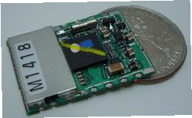
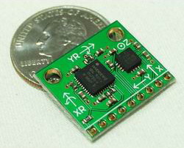
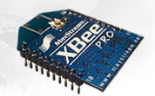
sensors working overtime
Global Positioning System (GPS) modules
Micro Electromechanical (MEMS) accelerometers and yaw rate gyros
(sparkfun.com)
Zigbee radio for serial digital
communication
xbee.com

Slide 21
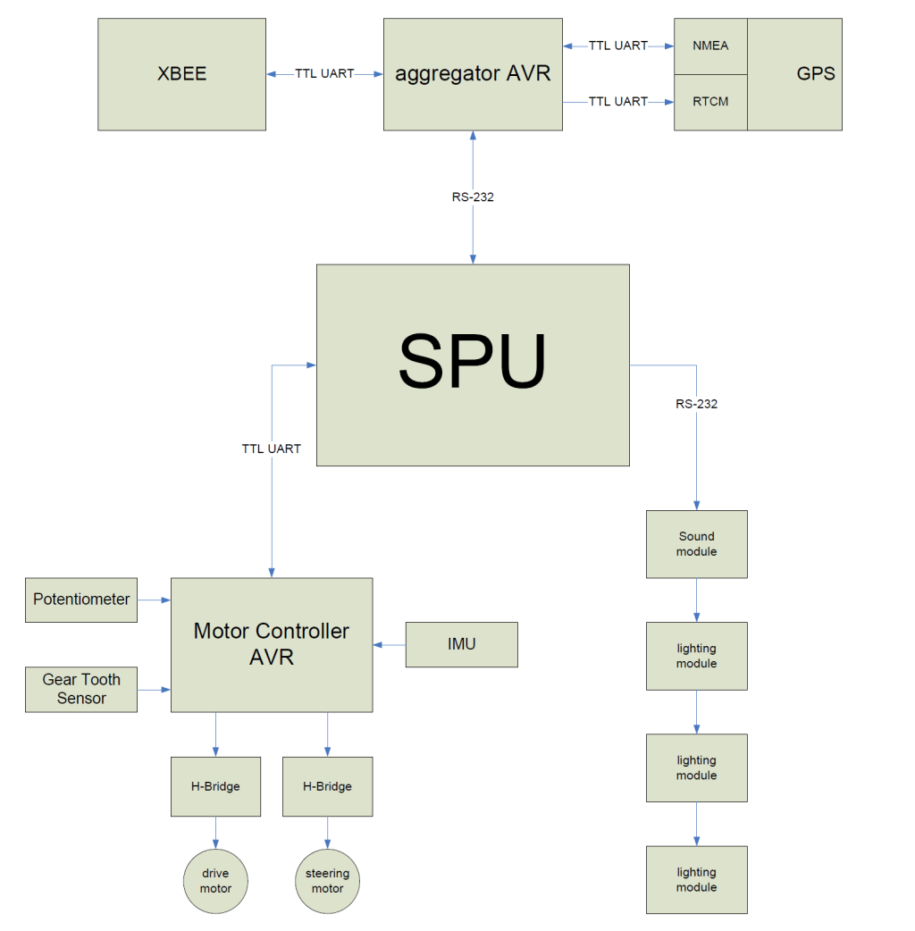
artistic payload:
serially-controlled MP3 player and amplifier
fully controllable color LED modules

Slide 22
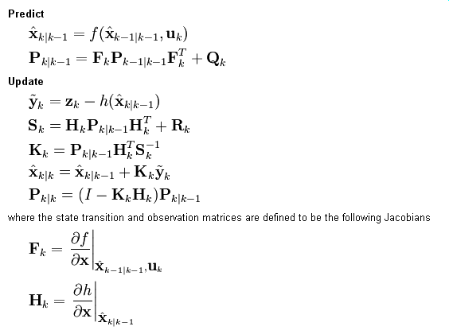
Extended Kalman Filter
Necessary for systems with strong nonlinearity
  Large angle motion- certainly greater that 180 degrees
  Squares, cubes, exponentials

Slide 23
SWARM Extended Kalman Filter
13 states
10 sensors
Kinematic model – too big for slide.
Work in progress! info@orbswarm.com

Slide 24
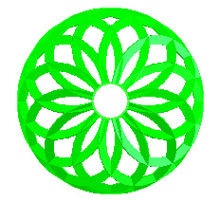
network topology
network topology
Mother Node
star network with round-robin polling
Mother Node is any PC (playa-proofed)
Orbs controlled with simple serial API

Slide 25
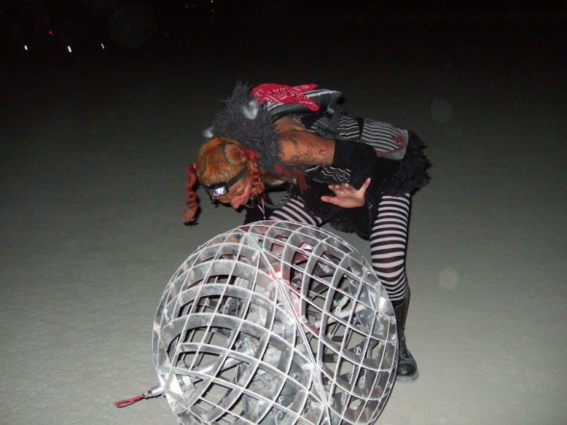
right... so how did they work?

Slide 26
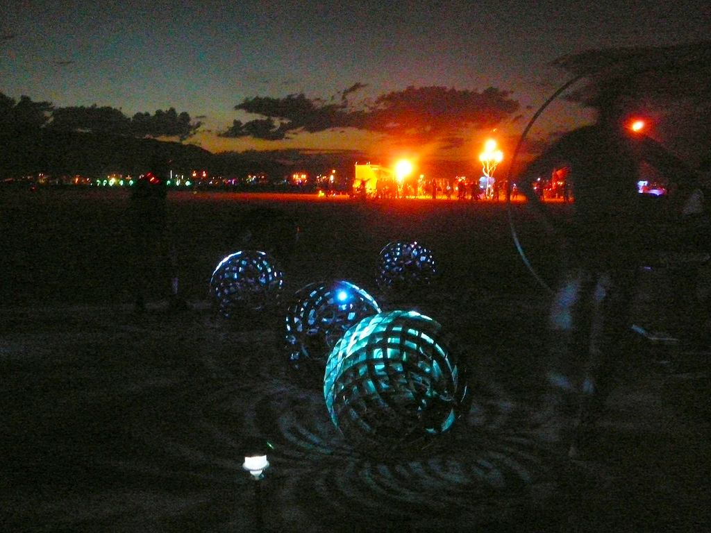
they worked pretty great, actually

Slide 27
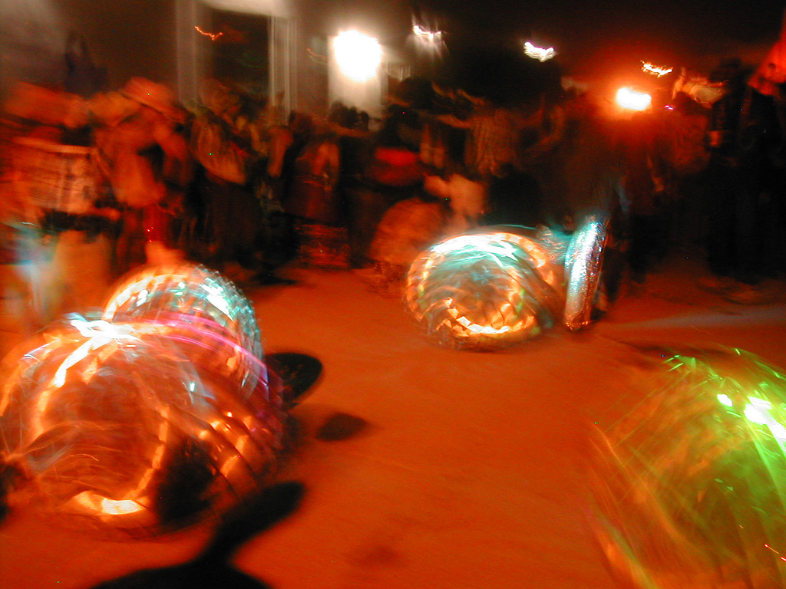
current capability: remote control

Slide 28
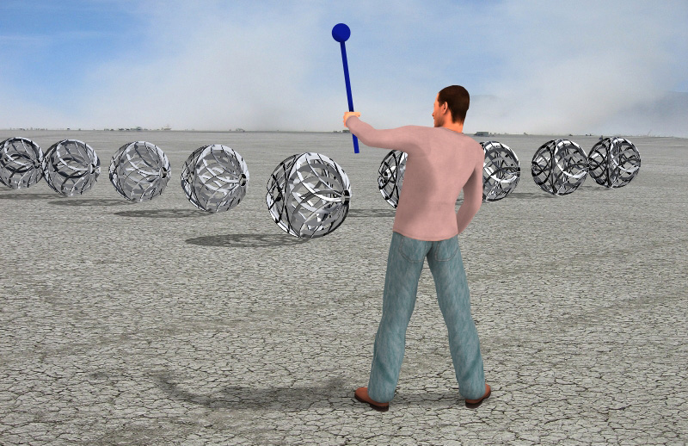
future vision: interactivity
What represented hope in the daylight morphs into fear at night.
The Magic Wand allows participants to
control SWARM and direct formations like a sorcerer.
Rendering by Stefano Corazza and Phil Spitler

Slide 29
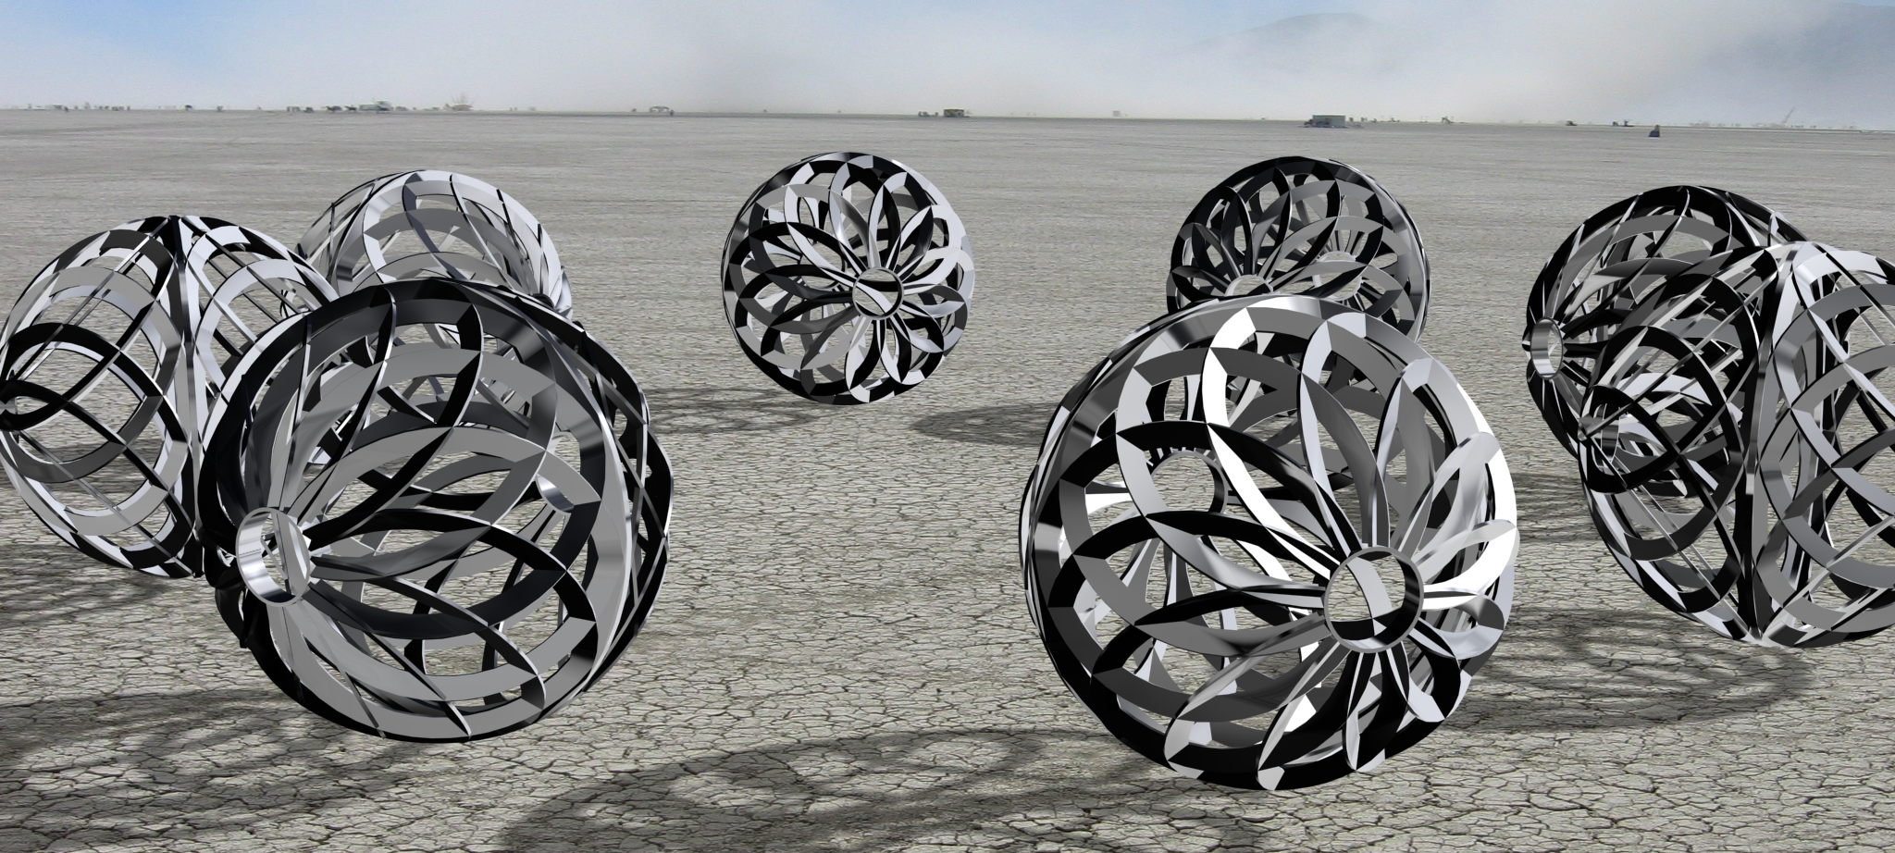
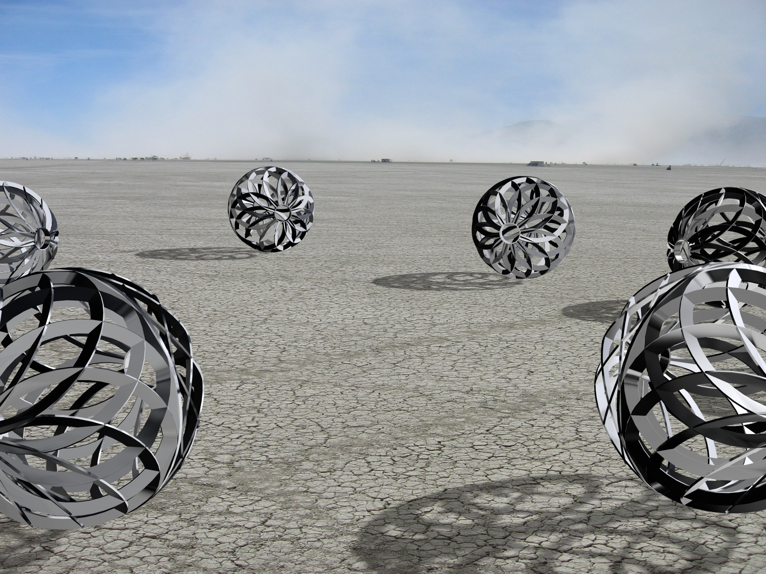
future vision: autonomy
location-aware orbs from GPS and inertial sensor fusion, permitting:
interactive synchronized choreography
autonomous and evolutionary behaviour
An art form for the 21st century

Slide 30
thank you
www.orbswarm.com

