Slide 1
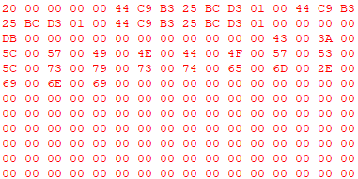
Signature
( 32 byte )
Size Of File
4 byte
Padd
File Name <utf-16le>
(548 byte)
File Contents

Slide 2
Signature
( 32 byte )
Size Of File
4 byte
Padd
File Name <utf-16le>
(548 byte)
Signature
( 32 byte )
Size Of File
4 byte
Padd
File Name <utf-16le>
(548 byte)
File Contents

