Slide 1

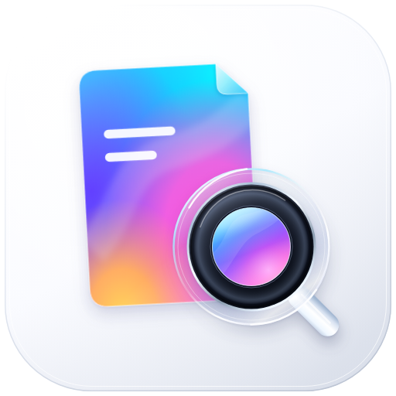


File Lens · filens
DeepSeek Harness
by
FILE LENS · FILE NATIVE SERVICES
File intelligence
on your device
Parse and render 450 complex formats locally. Give your Agent the same file capabilities, with no uploads or conversion server.
450
349
≈ 92 ms
MIT
preview formats
CLI formats
open an 11 MB PPTX
open-source license
github.com/orca-zhang/filens
Notes:
Opening: filens is a local-first runtime for understanding files. Files stay on the device; browsers and Agents share the same core.

Slide 2

02 · WHAT IT IS
Let your app understand files
Powered by WebAssembly, filens brings file parsing back to the device.
Browsers, desktop and mobile apps, CLI, edge nodes and backend services share one core.
01
02
03
Local-first
One core
Reuse everywhere
Files stay on the device. No upload, queue or conversion wait; private files stay local for preview.
WASM holds the parsing and conversion algorithms. Hosts handle requests, temporary files and result mapping.
The same core produces previews, searchable text, thumbnails, metadata and structured evidence for Agents.
The Chinese name means exploring the details. File Lens reveals content; File Native Services brings format-native capabilities to apps and Agents.
filens · File Lens
DeepSeek Harness
02 / 14
Notes:
Three benefits: local-first for experience and privacy; one core for lower engineering cost; reuse across previews, search and Agents.

Slide 3
03 · WHY IT MATTERS
A file preview should not take this long
A 10 MiB PPTX: from choosing a new file to seeing its content for the first time.
ONLINE PREVIEW
7–32 s
Choose file
Upload
Queue
Convert
Download
Display
5–12 s
2–10 s
f i l e n s
≈ 0.09 s
Choose file
Parse locally
Display
≈ 92 ms
91.7 ms: median of 7 runs on Apple M4 Pro, 11.12 MB / 13 slides; 347.9 ms at 4× CPU slowdown, ~25 MiB extra JS heap. Online estimates depend on upload bandwidth and queueing; uploaded or cached files can open in under a second.
filens · File Lens
DeepSeek Harness
03 / 14
Notes:
Compare the time from selecting a new file to first content. Upload bandwidth and queueing vary; the comparison is illustrative, not universal.

Slide 4
04 · ARCHITECTURE
Two paths, one runtime
Render native formats directly; load WASM on demand for normalization. Reuse the algorithms across hosts.
HOSTS
OUTPUT
Browser
Desktop apps
Native preview and rendering
Previews
Mobile apps
CLI
PPTX · DOCX · XLSX · PDF · iWork · DXF · STEP · 3D · RAW · 360° · Media
Slides, documents, sheets, drawings, interactive 3D and 360° views
Edge nodes
Backend services
Direct parsing, no upload or PDF step
AI Agent
WASM conversion core
Structured results
Legacy Office / WPS, text and icon extraction, rendering
Text, images, metadata and scenes; evidence with page references and structure for search and Agents
On demand; chunks start at tens of KB
Go is a thin CLI/HTTP shell for validation, temporary files and result mapping. Format algorithms stay in the shared core.
filens · File Lens
DeepSeek Harness
04 / 14
Notes:
AGENTS.md requires parsing and conversion in the frontend WASM core. Backend wrappers must not add format algorithms; this enables reuse across hosts.

Slide 5
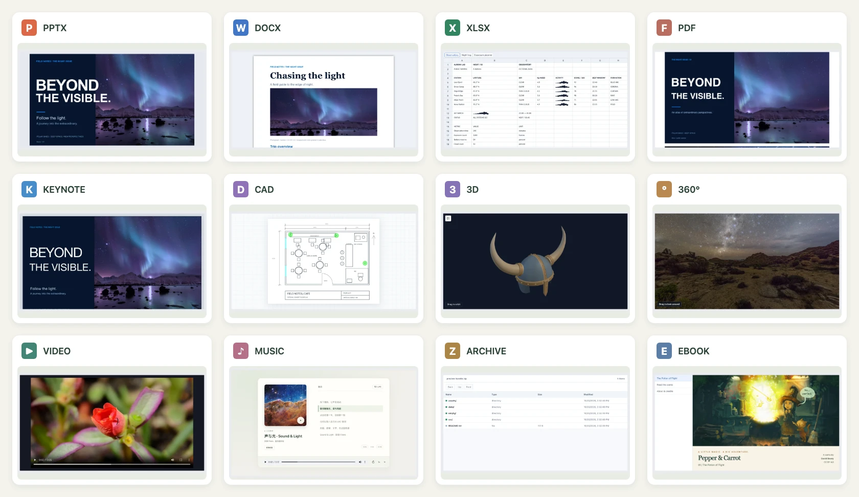
05 · FORMAT COVERAGE
450 formats, one preview container
450
Browser formats, unique extensions
349
formats
Agent CLI
Documents
PPTX · DOCX · XLSX · PDF · Keynote · Pages · Numbers
Media
RAW · HEIC/HEIF · 360° · Live Photos · Icons
Archives & books
ZIP · TAR · RAR · 7z · EPUB · CBZ
Design & 3D
DXF · DWG · STEP · STL · OBJ · GLB · 3MF · Mind maps
Twelve real files in one container: Office, PDF, iWork, CAD, 3D, 360°, media, archives and books.
Text & code
Plain text · Source code · Markup · Config · Logs
See the support matrix for coverage and fidelity limits.
filens · File Lens
DeepSeek Harness
05 / 14
Notes:
450 counts unique extensions, including direct previews and local WASM conversion. Fidelity varies by format.

Slide 6
06 · WHAT SETS IT APART
More than a file previewer
A rare open-source combination: native PPTX, on-device iWork and CAD in the browser.
01
02
03
Native PPTX, beyond screenshots
iWork, without Apple cloud services
CAD drawings in your browser
Read slides, text, images, tables, themes and shapes, then render with HTML / SVG. Preserved structure supports search, element location and Agent understanding.
Decode current Keynote, Pages and Numbers formats on-device, without native macOS components or uploading to iCloud.
DXF renders to SVG locally: lines, arcs, splines, hatches, text, blocks, dimensions, layers, colors and line types. A dedicated WASM reader maps DWG directly to a drawing model.
To our knowledge, the broadest open-source native PPTX preview implementation; still not a PowerPoint replacement.
Built on early protocol research by dunhamsteve/iwork, with attribution and further extensions.
Conversion builds on cad2x-converter. DWG reader: 443 KB gzip, covering R14–AC1032.
filens · File Lens
DeepSeek Harness
06 / 14
Notes:
All three preserve native file structure rather than flattening pages into screenshots.

Slide 7
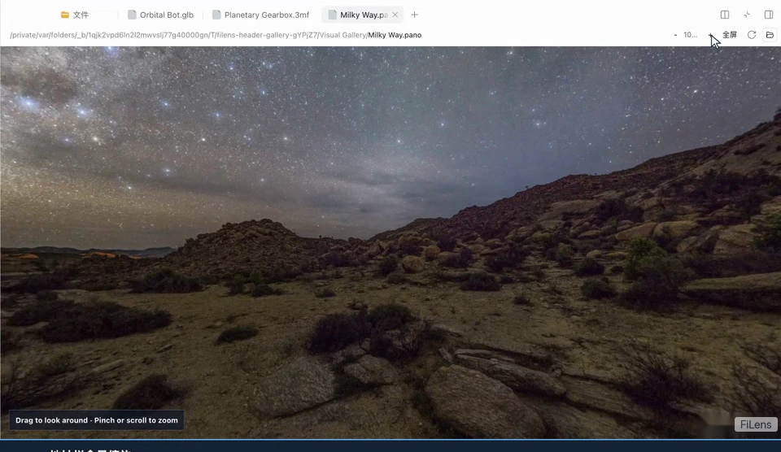
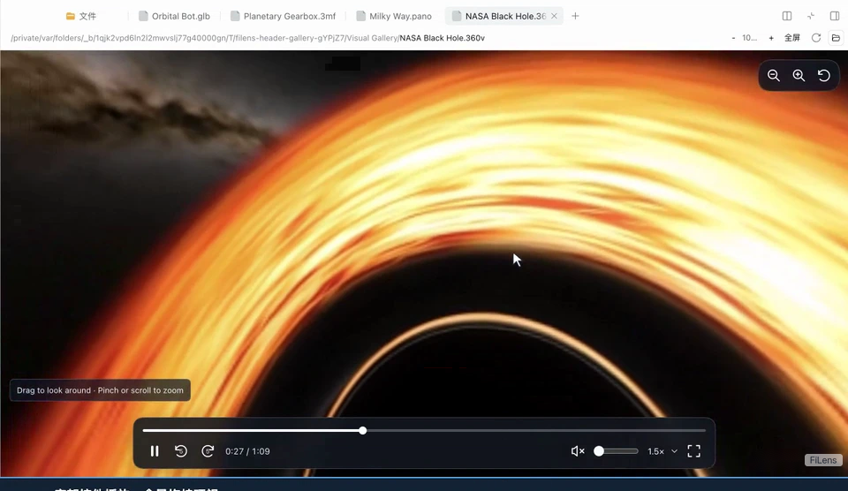
07 · REAL FILES
From contracts to black holes
360° photo: drag to look, scroll to zoom
360° video: playback controls, 1.5× speed
Real previews across twelve formats, all local in the browser, with no upload or conversion service.
filens · File Lens
DeepSeek Harness
07 / 14
Notes:
These are frames from recordings of real samples. The 360° and 3D previews are interactive, not prerendered video.

Slide 8
08 · CAPABILITIES
Preview is only the beginning
The same core converts, decrypts, extracts, searches and recognizes. Index its results or pass them to an Agent.
CONVERT
EXTRACT
Convert & decrypt Office / WPS
Text, images and metadata
DOC / WPS / ET / DPS normalize to OpenXML; macros are removed. Password-protected Office / PDF and encrypted archives decrypt locally. Hosts supply passwords securely, outside arguments and logs.
Export text or structured JSON with page references and coordinates, plus thumbnails, icons and document metadata for indexing and search.
SEARCH
OCR
Folders and nested archives
Optional, local OCR
Search names, paths or full text, including files inside archives. Parse 10,000 entries in about 55 ms.
RapidOCR NCNN runs locally to make scans searchable. OCR is an optional app component; the core stays independent of any provider.
Conversion exports text, images and icons. Use a dedicated engine for high-fidelity layout conversion.
filens · File Lens
DeepSeek Harness
08 / 14
Notes:
Conversion, extraction, search and OCR share the same core. Their output can be indexed or used directly by an Agent.

Slide 9
09 · PERFORMANCE
Speed you can measure
Same machine and files, alternating runs, median times. Speedup = baseline time ÷ filens time.
WORKLOAD
BASELINE
FiLens (ms)
Baseline (ms)
SPEEDUP
PPTX · 11.1 MB, 13-slide full parse
pptx-preview 1.0.7
28.5
56.6
1.99×
NEF · Nikon D3S sensor → canvas
LibRaw-Wasm 1.6.0, half size
152.7
326.7
2.14×
STEP · as1_pe_203 assembly import
occt-import-js 0.0.23
61.2
195.0
3.19×
XLSX · 8,000 × 64, 512,000 cells
SheetJS CE 0.20.3
213.50
615.71
2.88×
ZIP · 10,000 entries, 18.34 MiB expanded
JSZip 3.10.1
55.52
700.55
12.62×
2 warmups, 9 measured rounds, alternating order; verified cell values or full entry text. Parsing excludes rendering, loading and network time. Browser measurements, Oct–Nov 2026.
filens · File Lens
DeepSeek Harness
09 / 14
Notes:
Each scenario uses an established peer library as a baseline. Speedups apply to that workload, not to every file format.

Slide 10
10 · BUNDLE SIZE
Small enough to load on demand
Brotli size per chunk. Download a module only when its format is opened.
INITIAL LOAD
459.5 KiB
Entry, preloaded JS and CSS combined, Brotli. WASM modules load on demand.
OPTIONAL MODULES
HEIC / HEIF decoding
344.5
RAR / 7z extraction
332.3
Office decryption
127.6
Downloaded only when needed, outside the initial load budget.
Brotli-compressed artifacts. Chunks share dependencies, so a single format downloads less than the sum of all chunks.
filens · File Lens
DeepSeek Harness
10 / 14
Notes:
Bundle size drives the on-demand design: users download only what their files need.

Slide 11
11 · AGENT CLI
Let Agents ask the file
One executable turns reading, search, OCR, excerpts and conversion into operations an Agent can call.
CAPABILITIES
filens · local WASM
349 formats
PDF, Office, sheets, scans, images
$ filens read "report.pdf" --json
$ filens 'Search ./documents for "budget risk"'
Citable evidence
Pages, coordinates, structure
$ filens summarize report.pdf --query 'budget risk'
OCR
RapidOCR NCNN, local
$ filens similar-images ./photos --threshold 8
$ filens capacity --json
Folders & archives
Search nested archives too
Export text, JSON, Markdown, HTML or CSV with page coordinates and document structure. The calling Agent handles rewriting, translation and Q&A.
Duplicates & similarity
SHA-256 and perceptual hashes
Lite 9.27 MiB · Full 32.49 MiB with OCR · executable 2.20 MiB.
filens · File Lens
DeepSeek Harness
11 / 14
Notes:
The CLI gives Agents verifiable tool calls for opening and understanding files.

Slide 12
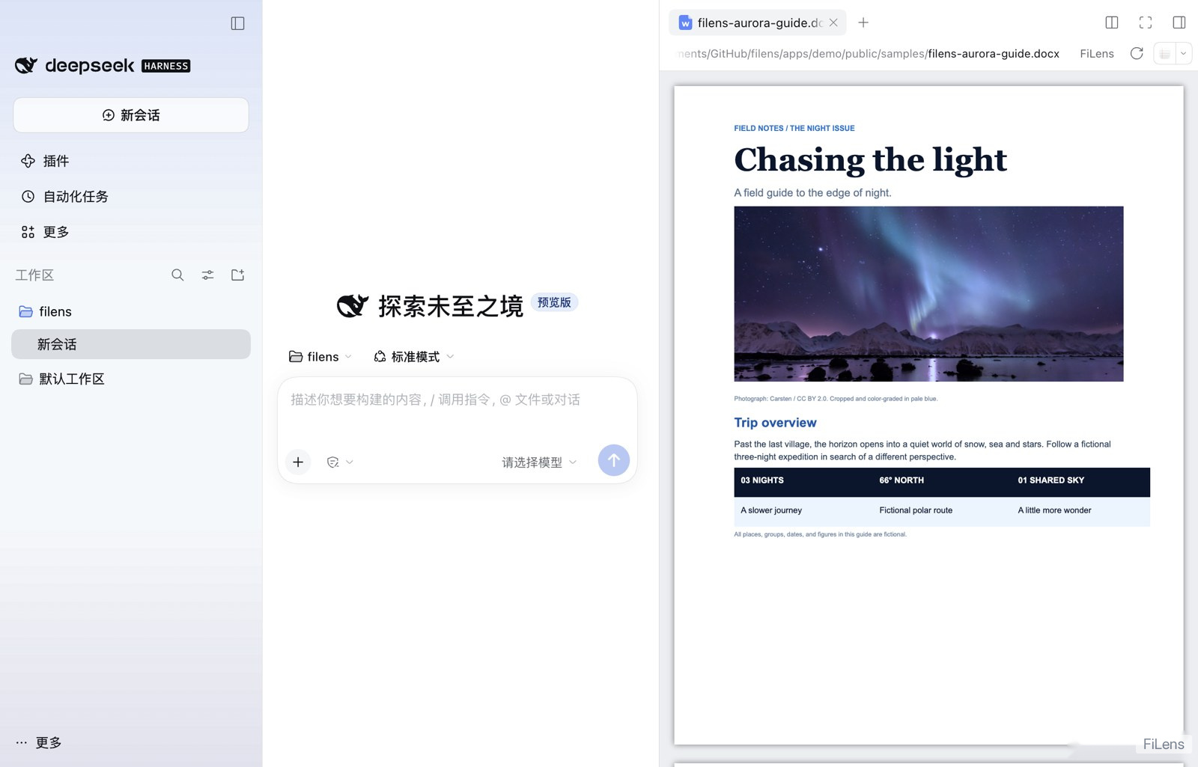
12 · INTEGRATION
Add it to your product
From a script tag to a system app, the preview and conversion core stays the same.
ONE EXAMPLE
Browser
Single-file filens.js or lazy chunks; no Vue installation required in the host
Vue apps
@filens/vue Preview component: pass src and name
CLI offline preview
filens preview creates self-contained HTML for local viewing
iOS / Android
Swift Package and Android Library with callbacks and cleanup
ZimaOS
sudo zpkg install filens; offline preview built into ModStore
DeepSeek Harness plugin dsh-filens@0.1.6
Preview Office, PDF and 3D in the sidebar, with no separate preview service.
filens · File Lens
DeepSeek Harness
12 / 14
Notes:
Integration options scale from script tags and components to CLI, native SDKs and system apps. DeepSeek Harness is one host for the same core.

Slide 13
13 · SCOPE AND LIMITS
Clear limits are part of the design
The support matrix states what each format can do, including deliberate scope choices and current limits.
DELIBERATE SCOPE
CURRENT LIMITS
Product choices, not pending work.
Capability limits documented in the support matrix.
Read-only preview
Office / iWork / CAD / diagrams are read-only; edit in the original app
SmartArt & styles
Partial support; complex charts and embedded objects may use fallbacks
Focused conversion
Exports text, images and icons, without arbitrary format-to-format conversion
STEP
Keeps geometry and instance placement; omits source colors, names and assembly trees
Fidelity boundaries
Exact layout and calculation behavior are not guaranteed; use specialist engines
No native path
BIM（Revit、IFC）、ECAD（Gerber）、DGN、IGES
No bundled font library
Missing fonts use fallbacks and notices instead of shipping a full font collection
Streaming & DRM
No HLS/DASH or general transcoding; enterprise DRM / IRM needs a separate solution
Real files expose fonts, layout, encodings and legacy variants that tiny generated samples miss. Everyday files that fail to open make the most useful test set.
DeepSeek Harness
DeepSeek Harness
13 / 14
filens · File Lens
13 / 14
filens · File Lens
Notes:
Distinguish deliberate product scope from current capability limits. Refer to the repository for the roadmap.

Slide 14

DeepSeek Harness
Your files stay on your device.
Your Agent understands them.
ABOUT
filens · File Lens
deepseek
HARNESS
An open-source, local-first runtime for file understanding: previews for people, evidence for Agents.
Created with DeepSeek Harness
github.com/orca-zhang/filens
Source · Support matrix · Benchmarks
npm dsh-filens@0.1.6
DeepSeek Harness plugin
MIT License
Free to use and distribute
Notes:
Closing: local-first file understanding for both people and Agents.

