Slide 1

Design and Simulation of an Automatic Street Light
Control System Using Combinational Logic
Group Project Presentation

Slide 2

Introduction and Objectives
The Problem
Manual street lighting causes significant energy waste and drives up maintenance costs — a systemic inefficiency demanding a smarter solution.
The Objective
Design a fully automated control system using fundamental combinational logic gates — no microcontrollers, no software overhead.
Core Advantage
Zero manual intervention with real-time, sensor-driven responsiveness
— lights react instantly to ambient conditions and traffic presence.

Slide 3
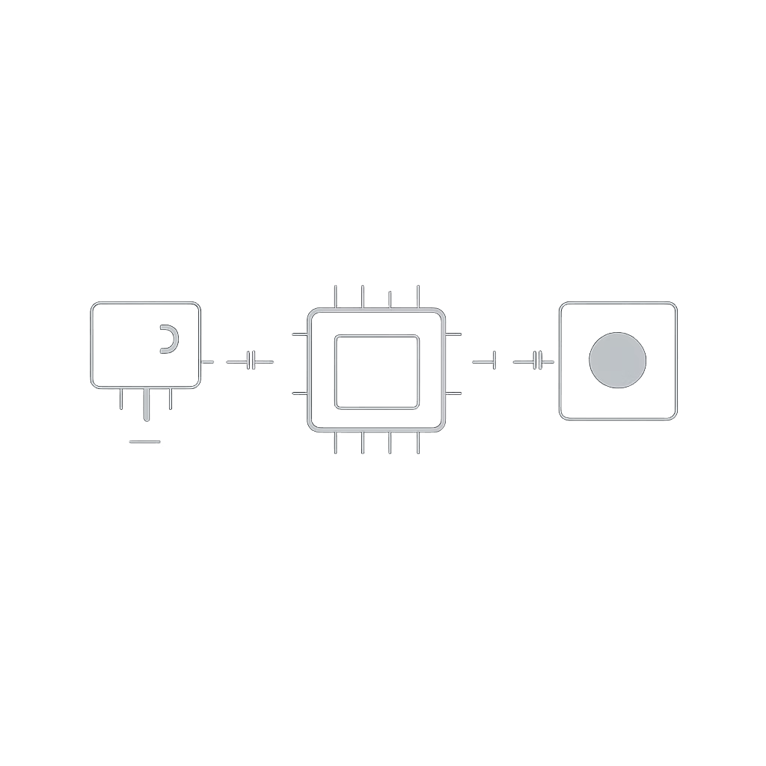
System Architecture
Input Sensors
LDR (Light Dependent Resistor) — detects ambient light levels, distinguishing day from night
IR / Motion Sensor — detects vehicle or pedestrian presence in real time
Processing Unit
Combinational logic circuit using AND, OR, NOT gates
No clock or memory elements — pure combinational design
Output Stage
LED street light array with dimming and switching control Relay-based driver for high-power load switching

Slide 4

Combinational Logic Design
Input / Output Definitions
Input A — Ambient Light: 0 = Dark, 1 = Bright Input B — Motion Detected: 0 = No, 1 = Yes Output Y — Light Status: 0 = OFF, 1 = ON
Derived Logic Expression
Using Karnaugh Map (K-Map) simplification:
Y = Ā · B
The street light turns ON only when it is dark (A = 0) AND motion is detected (B = 1). All other conditions keep the light OFF.
Truth Table
A (Light) | B (Motion) | Y (Output)
0 | 0 | 0
0 | 1 | 1 ✓
1 | 0 | 0
1 | 1 | 0
Only when dark AND motion detected does Y = 1 (Light ON)

Slide 5
Circuit Design
Input Stage
LDR and motion sensor with transistor drivers
IC Components Used Design Considerations
Sensor Integration: LDR and motion sensor interfaced with transistor drivers or relay modules
Safety Protocols: Voltage clamping and current limiting resistors
Power Efficiency: Low-power TTL logic family, relay-based high-power switching
Reliability: Debounce circuits on sensor inputs for stable logic levels
Circuit Signal Flow
Output Stage
Relay switches LED array
Logic Processing
7404 inverts A; 7408 ANDs Ā and B
Signal flows from sensors through logic ICs to the relay-driven LED output stage.
7408
Quad AND Gate
7432
Quad OR Gate
7404
Hex NOT Gate (Inverter)

Slide 6
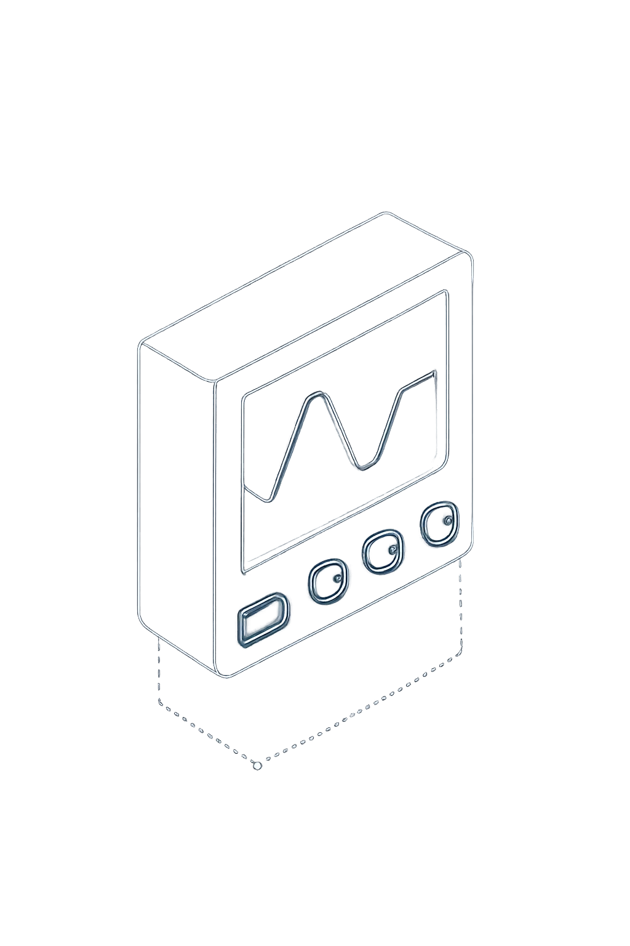
Simulation Phase
Day Mode
A=1, B=0/1
1
Lights remain OFF regardless of motion — sufficient ambient light detected
Night, No Traffic
A=0, B=0
Lights DIM or OFF — dark conditions but no movement detected
2
Night with Traffic
A=0, B=1
Lights BRIGHT ON — dark conditions with motion confirmed
3
Simulated using Proteus, Multisim, or Tinkercad — output waveforms verified to match truth table specifications across all test scenarios.

Slide 7



Benefits and Future Enhancements
Key Advantages
Power Reduction
Significant energy savings by switching lights only when needed
Fully Automated
Zero manual intervention — system self-manages in real time
Extended Bulb Life
Optimized switching cycles reduce thermal stress and wear
Future Scope
IoT Integration
Remote monitoring and control via cloud dashboard
Solar Power Harvesting
Sustainable, off-grid operation using photovoltaic panels
Smart MCU Implementation
Arduino or ESP32 for adaptive, programmable control logic
Traffic Data Analytics
Pattern recognition for predictive, optimized illumination

Slide 8
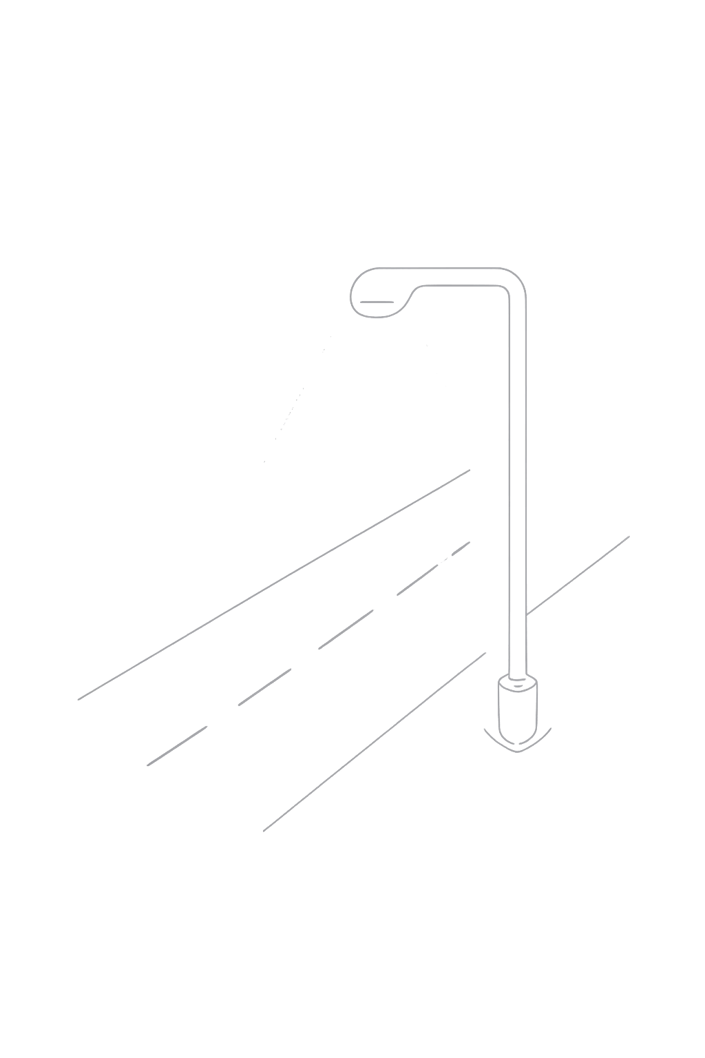
Conclusion
✅ Successfully Designed
Efficient combinational logic-based street light controller built from fundamental AND, OR, NOT gate principles
⚡ Real-Time Responsiveness
Demonstrated instant sensor-to-output reaction with measurable energy optimization across all operating conditions
🔬 Fully Validated
System performance confirmed through comprehensive simulation testing — all outputs match truth table specifications
Questions S Feedback Welcome

