Slide 1
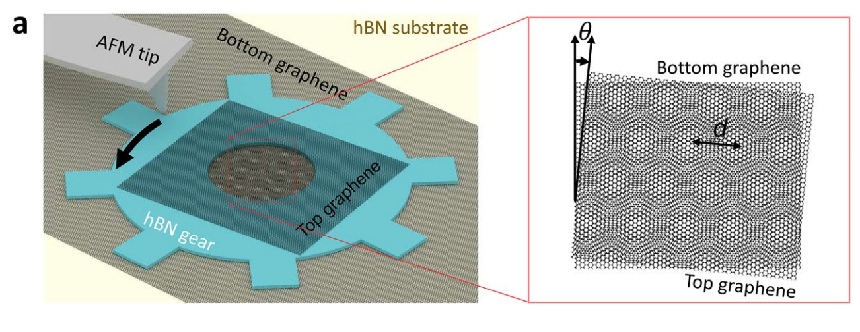
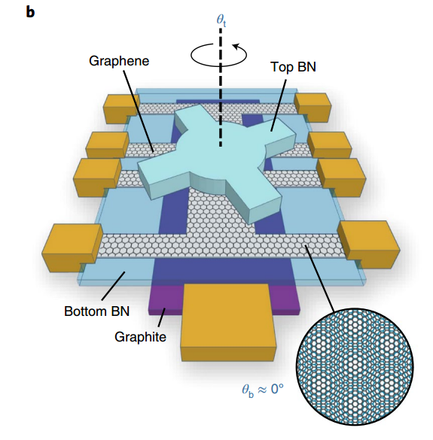
工作进展与计划
1/5
1、文献阅读
In‑situ twistable bilayer graphene
Tunable crystal symmetry in graphene–boron nitride heterostructures with coexisting moiré superlattices
Moire-Pattern Evolution Couples Rotational and Translational Friction at Crystalline Interfaces
An on-chip platform for multi-degree-of-freedom control of two-dimensional quantum and nonlinear materials
……

Slide 2
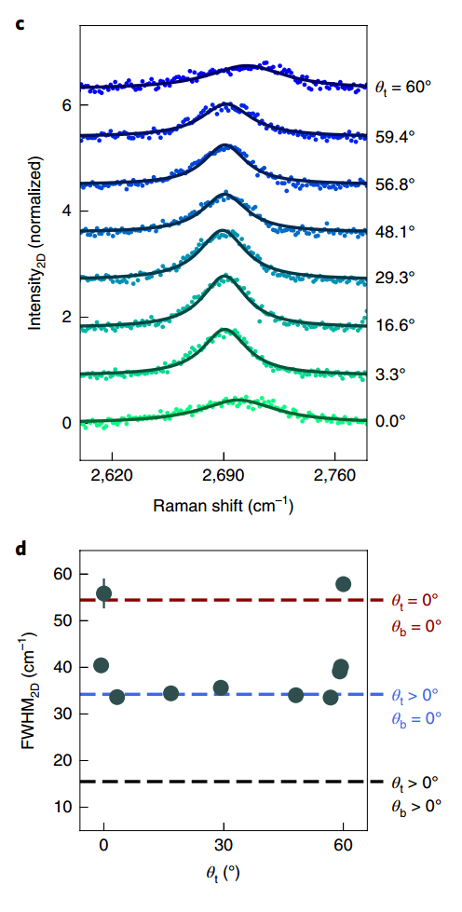
工作进展与计划
2/5
1、文献阅读
In‑situ twistable bilayer graphene
Tunable crystal symmetry in graphene–boron nitride heterostructures with coexisting moiré superlattices
Moire-Pattern Evolution Couples Rotational and Translational Friction at Crystalline Interfaces
An on-chip platform for multi-degree-of-freedom control of two-dimensional quantum and nonlinear materials
……

Slide 3
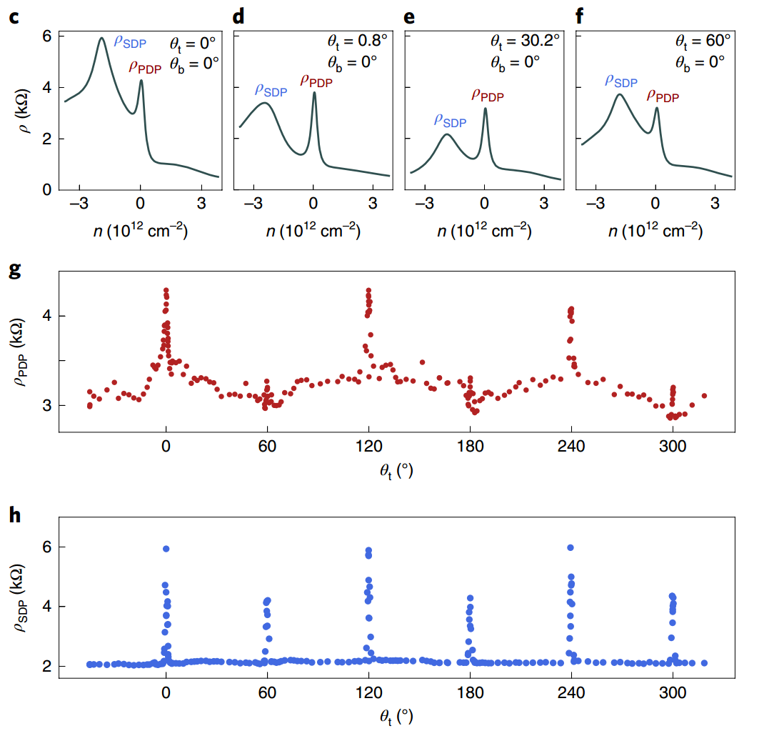
工作进展与计划
3/5
1、文献阅读
In‑situ twistable bilayer graphene
Tunable crystal symmetry in graphene–boron nitride heterostructures with coexisting moiré superlattices
Moire-Pattern Evolution Couples Rotational and Translational Friction at Crystalline Interfaces
An on-chip platform for multi-degree-of-freedom control of two-dimensional quantum and nonlinear materials
……

Slide 4
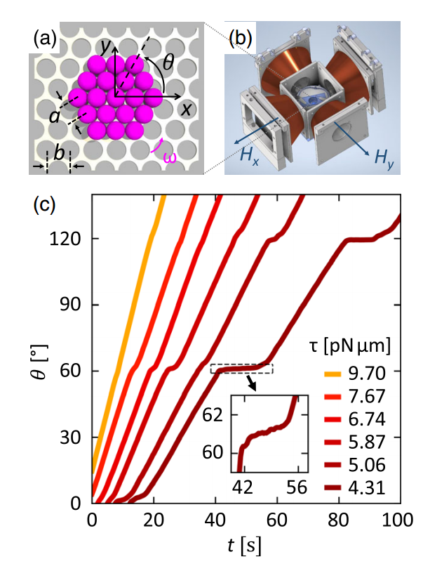
工作进展与计划
4/5
1、文献阅读
In‑situ twistable bilayer graphene
Tunable crystal symmetry in graphene–boron nitride heterostructures with coexisting moiré superlattices
Moire-Pattern Evolution Couples Rotational and Translational Friction at Crystalline Interfaces
An on-chip platform for multi-degree-of-freedom control of two-dimensional quantum and nonlinear materials
……

Slide 5
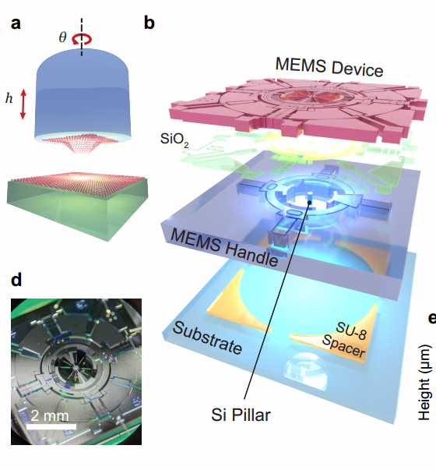
工作进展与计划
5/5
1、文献阅读
In‑situ twistable bilayer graphene
Tunable crystal symmetry in graphene–boron nitride heterostructures with coexisting moiré superlattices
Moire-Pattern Evolution Couples Rotational and Translational Friction at Crystalline Interfaces
An on-chip platform for multi-degree-of-freedom control of two-dimensional quantum and nonlinear materials
……
2、学习计划
动态调控异质结构的方式
Landau fan diagram
拉曼光谱
……

