Slide 1
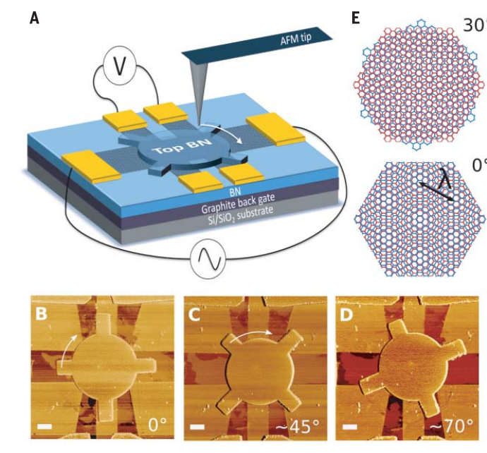
工作进展与计划
1/3
1、Dynamic heterostructure相关文献阅读
Twistable electronics with dynamically rotatable heterostructures
Twisted van der Waals Quantum Materials: Fundamentals, Tunability and Applications
Magnetic Propulsion of Self-assembled Colloidal Carpets:
Efficient Cargo Transport via a Conveyor Belt Effect
…… 2、转台选型及资料阅读
3、准备期末考试

Slide 2
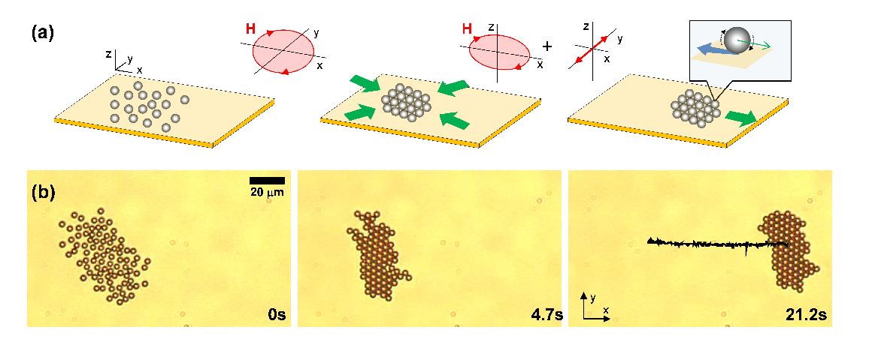


工作进展与计划
2/3
1、Dynamic heterostructure相关文献阅读
Twistable electronics with dynamically rotatable heterostructures
Twisted van der Waals Quantum Materials: Fundamentals, Tunability and Applications
Magnetic Propulsion of Self-assembled Colloidal Carpets:
Efficient Cargo Transport via a Conveyor Belt Effect
…… 2、转台选型及资料阅读
3、准备期末考试

Slide 3
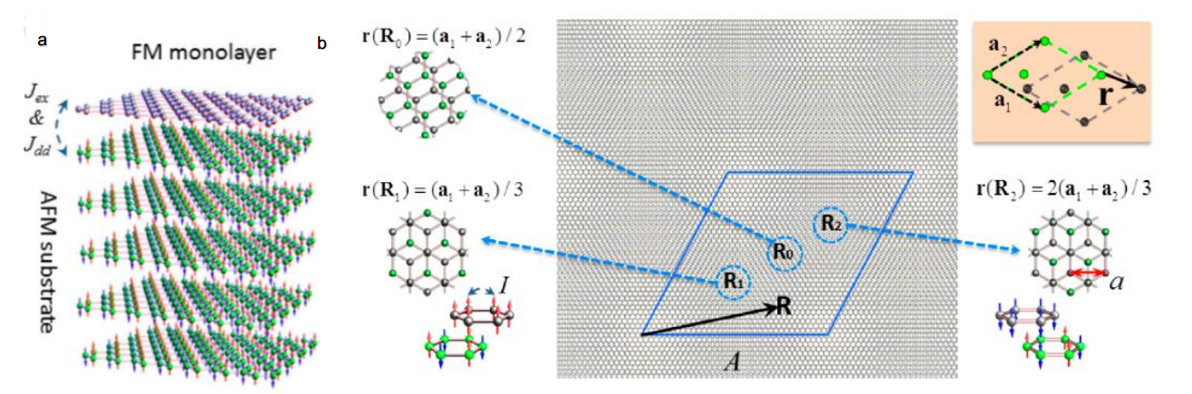
工作进展与计划
3/3
1、Dynamic heterostructure相关文献阅读
Twistable electronics with dynamically rotatable heterostructures
Twisted van der Waals Quantum Materials: Fundamentals, Tunability and Applications
Magnetic Propulsion of Self-assembled Colloidal Carpets:
Efficient Cargo Transport via a Conveyor Belt Effect
…… 2、转台选型及资料阅读
3、准备期末考试
By exploiting the moiré pattern (Figure 13b), skyrmions are formed through the manipulation of magnetic interaction between layers
研究者已经研究了单层tmd通过谷退化的提升而产生谷分裂的过程。他们证明了由电荷转移和层间库仑相互作用驱动的磁邻近影响的效力与基于TMDs的vdW异质结构中的谷分裂程度之间的相关性。

