Slide 1
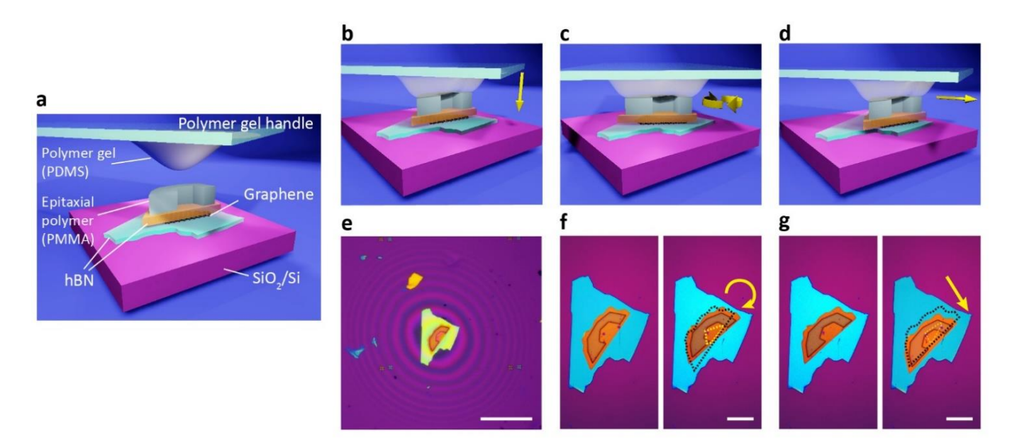
工作进展与计划
1/3
1、Dynamic heterostructure相关文献阅读
In situ manipulation of van der Waals heterostructures for twistronics
Effects of lattice geometry on the dynamic properties of dipolar-coupled magnetic nanodisk arrays
Spin dynamics and mode structure in nanomagnet arrays: Effects of size and thickness on linewidth and damping
Applications of nanomagnets as dynamical systems
……
2、准备夏令营面试
《Semiconductor Physics and Devices》Donald A.Neamen
3、准备期末考试
通过标准电子束光刻(EBL)工艺在目标薄片上沉积一个外延聚甲基丙烯酸甲酯(PMMA)贴片

Slide 2
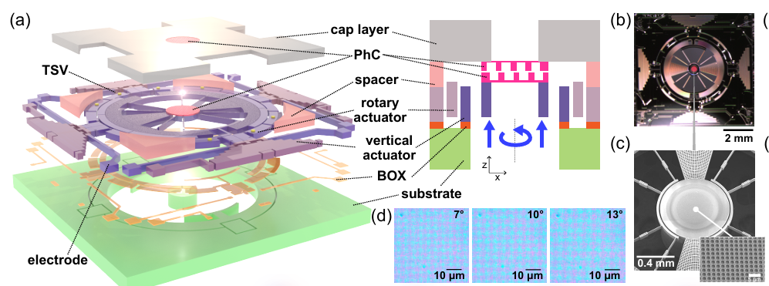
工作进展与计划
1/3
1、Dynamic heterostructure相关文献阅读
In situ manipulation of van der Waals heterostructures for twistronics
Effects of lattice geometry on the dynamic properties of dipolar-coupled magnetic nanodisk arrays
Spin dynamics and mode structure in nanomagnet arrays: Effects of size and thickness on linewidth and damping
Applications of nanomagnets as dynamical systems
……
2、准备夏令营面试
《Semiconductor Physics and Devices》Donald A.Neamen
3、准备期末考试

Slide 3
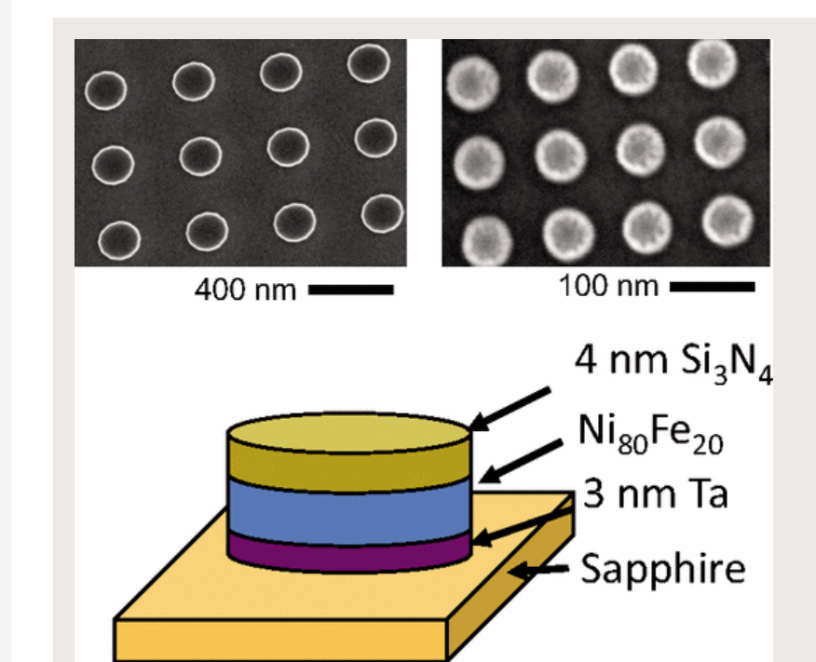
工作进展与计划
2/3
1、Dynamic heterostructure相关文献阅读
In situ manipulation of van der Waals heterostructures for twistronics
Effects of lattice geometry on the dynamic properties of dipolar-coupled magnetic nanodisk arrays
Spin dynamics and mode structure in nanomagnet arrays: Effects of size and thickness on linewidth and damping
Applications of nanomagnets as dynamical systems
……
2、准备夏令营面试
《Semiconductor Physics and Devices》Donald A.Neamen
3、准备期末考试

