Slide 1
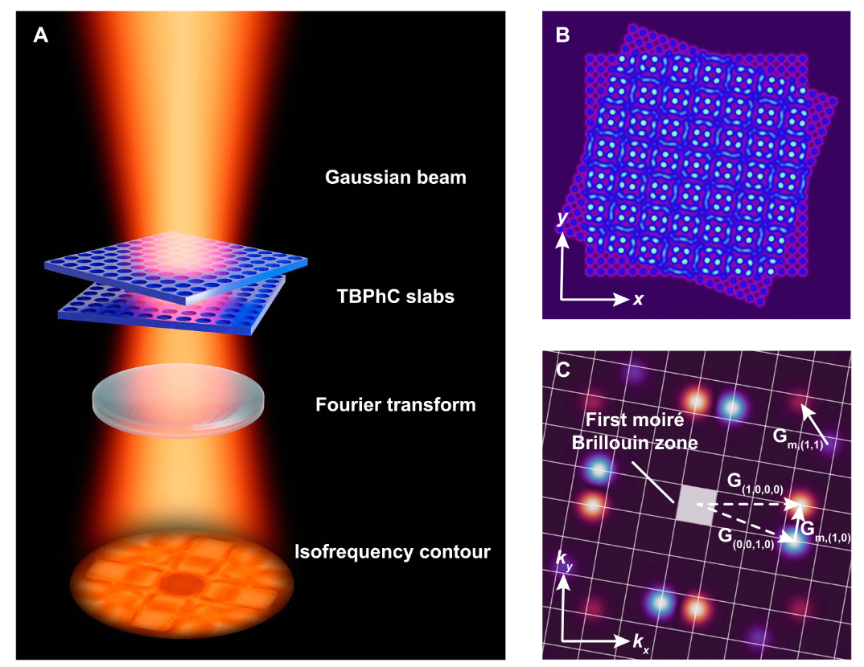
工作进展与计划
1、Dynamic heterostructure相关文献阅读
Miniaturized spectrometers with a tunable van der Waals junction
Intelligent infrared sensing enabled by tunable moir´e quantum geometry
Tunable guided resonance in twisted bilayer photonic crystal
……
2、准备夏令营面试
半导体器件物理 施敏
《Semiconductor Physics and Devices》Donald A.Neamen
3、准备期末考试

