Slide 1

CSDocs Sketch
AIIM DMA Technical Committee
CSDocs Subcommittee
June 29, 1999
Working Notes

Slide 2
Overview
CSDocs Sketch
Goals of TC Session
CSDocs Foundation
CSDocs Advanced Functions
Road Map to Completion

Slide 3
CSDocs Sketch
Provides simplified description for confirming understanding and areas of agreement
Divides CSDocs into Foundation and Extended Features
Foundation represents minimum common agreement supporting all CSDocs application
Notes:
Based on June 16 DMA TC discussions:
Foundation chosen because other proposals depend on it already-being established and providing fundamental principles that extended features are consistent with
There is consensus that there is no CSDocs model without the foundation being covered.
The CSDocs foundation is enough for introducing compound-structured documents, without any reliance on extended features.
The CSDocs model will rely on the existing DMA Relationship model for representing relationships among compound-structured documents and the DMA objects that represent their components.
The CSDocs model will be independent of the DMA Containment model and it will not be confused with the containment model.

Slide 4
Goals of TC Session (Draft)
Consensus on Direction
Clear Agreement on Foundation
Exploration of extended features
Agreement on Roadmap

Slide 5
CSDocs Foundation
Basic CSDoc: CSRelationship Objects Carry Connection between CSRoot and CSComponent DocVersion
Specific Elements that participate in CSRelationship are identifiable
CSRoot Renditions are all at same level of abstraction, and that is level of the CSRoot

Slide 6
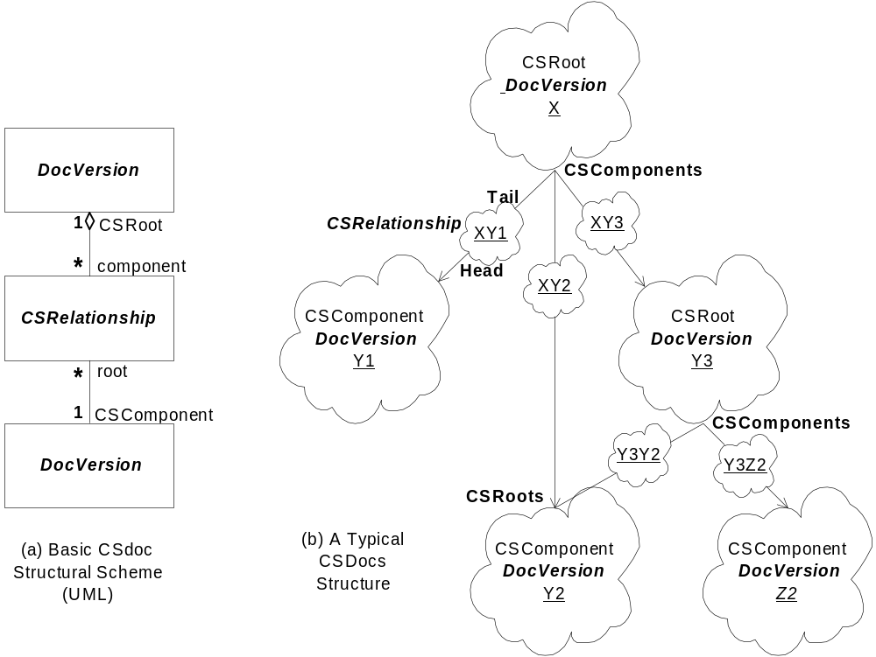
CSDocs Foundation:
Fundamental Structure
Notes:
The UML Notation used (corrected 1999-06-29)
See “The Unified Modeling Language User Guide” and “The Unified Language Reference Manual.”
DMA specifies the scheme which any CSDocs structures will follow in a specific metadata space. It is a pattern that will have one or more concrete metamodels in a given DMA metadata space.
The box represents a DMA conceptual class
The bold-italic class name corresponds to the name of a DMA conceptual class. E.g., DocVersion and CSRelationship.
There can be any subclasses in those roles in a CSDocs structure, so long as all class restrictions on the relationships are satisfied.
Metadata spaces will specify the actual class hierarchy and their constraints on CSDocs
The lines represent relationships among DMA conceptual classes
The name adjacent to a line end identifies the role that the adjacent object takes in the exhibited relationship
The numbers represent multiplicities. “*” stands for none or more.
The multiplicity value adjacent to an object specifies how many occurrence of the adjacent object there will be for one occurrence of the other object in the relationship.
For example, a CSRelationship object will have only one DocVersion in the role of CSRoot and one DocVersion in the role of CSComponent. A CSComponent DocVersion will have none or more CSRelationship objects in the role of root for it.

Slide 7
CSDocs Foundation:
Relating Specific Elements
Optional InstanceId available for Persistent Elements
CSRelationship can specify path to element via InstanceIds of elements on the path
You can tell from the CSRelationship what the game is:
  the level of identified element gives specific information about how much is determined or depended on
  the CSRelationship subclass can convey specific semantics about the nature of the compounding
  additional properties of the CSRelationship subclass can provide further details on the compounding principle being applied
Notes:
Notes on optional InstanceId (99-06-29):
The InstanceId will be a DmaId and will be unique as a DmaId.
InstanceId’s are generated in a way that that is statistically improbably to ever generate duplicates
InstanceId’s are not reused. Any newly-created object having an InstanceId will receive a previously unissued DmaId value.
The rules for generating DmaId values will be obtained, correctly referenced, and sources available as backup to the DMA specification. Public software for generating DmaId will be located and made available.
The rules for reserving blocks of DmaId values for a DocSpace to use in mapping internal identifications to DmaIds will be verified and provided as supplemental information.
So long as this approach provides sufficient capability for mapping locally-unique, implementation-specific identifiers, we need not consider anything but DmaId for this property.
The InstanceId will be introduced on the dmaClass_DMA as a support-optional, read-only, system-derived property. The property is not required to be searchable nor is it required to be selectable.
The rules for comparison of InstanceId’s follow the rules specified in the OSF DCE RPC specification (Open Group RPC specification). The appropriate specification will be obtained and kept available as backup to this extension.
A DMA object that has no InstanceId can only take on a role at the head or tail link of a DMA Relationship if it is independently-persistent and all other conditions of the relationship are satisfied.

Slide 8
CSDoc Foundation:
CSRoot-Rendition Consistency
CSRoot can have Renditions
Renditions are all at the same level of abstraction
  all render the compound document, or
  none render the compound document
The level of abstraction can be determined by inspection
Notes:
The level of abstraction for DocVersions eligible to be CSRoots can be constrained by DocVersion subclass
The level of abstraction for DocVersions eligible to be CSRoots can be represented in a property of the DocVersion
Will we use the “overall renditions” property as a way to indicate that the ordinary renditions are not of the overall object?
Although the level of abstraction of renditions of the same DocVersion is consistent, is there any basis for assuming that all DocVersions are at the same level of abstraction? Can we ignore that and let practice be the guide?

Slide 9
CSDocs Advanced Features
Direct Navigation to Any Persistent Element
  via object-valued property
  via URL
Virtual Derivation / Dependency
Tracking Versions of a CSComponent
Miscellaneous Extensions
  Insert-Delete-Update rules for (CS)Relationships
  Policy and Constraint Metadata Information

Slide 10
CSDocs Advanced Features:
Direct Navigation to Elements
via Object-Valued Property
  lands directly on identified element
  semantically the same as manually following path
via URL
  scheme for OIID-like reference to identify elements?
    Avoid confusion with current OIID-specific methods
  Method to instantiate object at an element
  HTTP URL for direct reference to element as resource
    supports use of DMA repositories via WebDAV
    complete as part of DMA-WebDAV convergence work?

Slide 11
CSDocs Advanced Features:
Virtual Derivation / Dependency
Virtual Derivation Relationship establishes a virtual element that is a shared usage of another element.
A CSRelationship may be a Virtual Derivation Relationship
Virtualizable elements provide interface IdmaVirtualElement used to set the relationship and the target used by virtual implementation

Slide 12
CSDocs Advanced Features:
Tracking CSComponent Versions
Version-Tracking Relationship has a Versioning object in addition to a target element
  e.g., specifies version series or version description that is the versioning to follow
  e.g., could specify configuration history and imply current series and latest in series
Relationship follows changes in versioning
  versioning object knows what is tracking it
  change of versioning state followed by trackers
  failure modes are well-defined
Notes:
The CSRelationship object has a navigational property whose value is the Version Series that is being tracked
The Version Series has an enumeration property that is the reflective property of the CSRelationship link
The CSRelationship target element path, if any, has all read-only and system-derived properties for its relationship.
Any change of the recognized current version of a Version Series updates the CsRelationships that are tracking versions of this series..
When a new version is checked in, the CSRelationship is updated to provide the location of the new target element
There must be a way to track the target element by *other* than any path, since InstanceId values will generally be different and it will not be absolutely clear what the new target element is.
The behavior when the new version doesn’t have an appropriate target needs to be well-defined and as benign as possible.

Slide 13
CSDocs Advanced Features:
Miscellaneous
Insert-Delete-Update rules for (CS)Relationships
  ownership of relationship and conditions on deletion and modification specifiable
  limited to operation without authorization model
Constraint and Policy Metadata Information
  new Constraint metadata subclass for descriptors of constraint conditions
  list of constraints optional on any metadata object
  well-known constraints defined for existing cases
    e.g., when property requires independently-persistent object

Slide 14
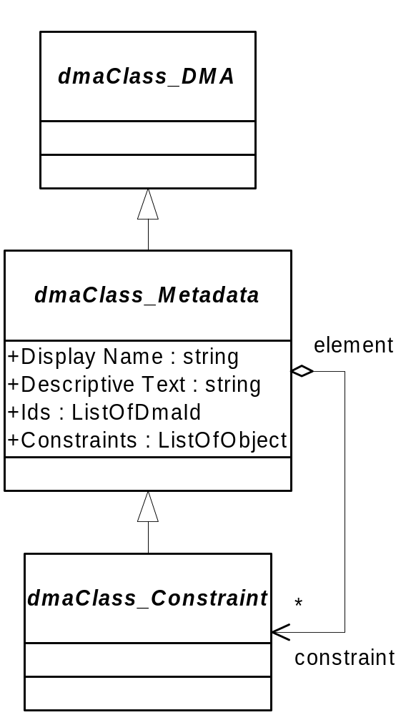
CSDocs Advanced Features:
Constraint and Policy Metadata
Constraints Property Added
  optionally-supported on Metadata class
Constraint Object
  Has the properties of any metadata.
  Descriptive text provides operator-readable information
  foundation case describes registered constraints
Notes:
The constraint objects provide at least descriptive information.
Constraints have DmaIds and can be registered in a metadata repository system
Constraints can be aliased, just like any metadata
It does not seam to be meaningful for a Constraint object to have a Constraints property. Subclassing of Constraint objects is more interesting.
If a metadata object has no Constraints property, nothing is known about constraints that apply to instances of the element
If a metadata object has an empty Constraints property, there are no constraints
the Constraints properties appears as read-only and system-derived, the same as all metadata properties.
For a merged scope, constraints properties can be dropped as not understood.
For a merged scope, new constraints can be introduced and expressed by the merged scope. These may but need not be a reflection of the constraints found in the component-scope metadata spaces.

Slide 15
Agreement on Roadmap
Sense of the group
Sources of more information
  ftp.aiim.org/dma/csdocs/workingpapers/sketch
  http://www.infonuovo.com/dma/csdocs/sketch

Slide 16


