Slide 1
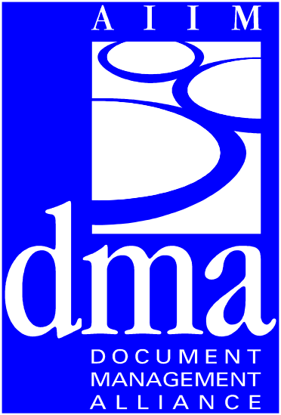
MNCS: DMA Extensions for Multinational Character Strings
DMA Technical Committee
Integration Subcommittee
June 16, 1999
[99-06-20 notes]
Notes:
Presented on the second day of the June 15-17, 1999, DMA Technical Committee meeting, Costa Mesa, CA.
The June 20 notes reflect the comments in that presentation, along with other elements to be attentive to. The information is mostly in the notes pages of these slides.
This information was provided by Dennis E. Hamilton of InfoNuovo on behalf of InfoNuovo and Xerox, who will provide the effort to integrate this proposal into the reference implementation and place it into trial usage.
The authors of the proposal are
Hitoshi Tanaka, Hitachi, mailto:tana_hi@soft.hitachi.co.jp
Dennis E. Hamilton, InfoNuovo, mailto:infonuovo@email.com
Larry Bonham, Xerox Corporation, mailto:lbonham@pahv.xerox.com

Slide 2
MNCS String Format Extensions:
Outline
MNCS Purpose
MNCS Approach
MNCS Sketch
Next Steps
Resources and More Information

Slide 3
MNCS String Format Extensions:
MNCS Purpose
Extend the DMA Multinational character-set support to 8-bit as well as 16-bit string formats.
Allow native character-string forms (e.g., octets for ASCII, EBCDIC, shift-JIS) that are important for high-performance use with legacy repositories, databases, and platforms.
Preserve the default BSTR and Unicode cases of DMA while tolerating special-purpose character set encodings and formats.
Notes:
We reviewed the history of this a bit. Dan Whelan, who created the first Internationalization proposals for DMA provided background.
In DMA 0.9 for trial-use, there was a form of DmaString that was a parameterized indirect structure
In the trial-use period prior to DMA 1.0 creation, we reverted to BSTR and Unicode as the default DmaString format and character-set-encoding. (This is UCS-2, the base 16-bit subset of Unicode, not UTF-16, the multi-element scheme for encoding all of Unicode using 16-bit elements.)
DMA 1.0 defines only DmaString as BSTR, although alternative character-set encodings to UCS-2 are defined and given constant identifications based on IANA numbers. [Larry Masinter points out that we need to be careful with our language and use of identifiers here.]
We also discussed the productivity that is obtained by using a single character-string format for a complete DMA session.
This satisfies the 99.99% use case with highly-productive movement and usage of string-carried text information.
Most programs are written to use a single string format and character-set encoding for the duration of an execution
Simple applications written in scripting languages (VBScript and Python), in Java, and in Visual Basic will work best with a single string case consistent with the programming model used.
We also recognized that language (locale) can be bound lower, although there is no provision for language-tagging on individual strings at this point.

Slide 4
MNCS String Format Extensions:
MNCS Approach
Tighten Principles of Character Set Encoding
  Separation of string format, character-set repertoire and encoding principles
  Levels at which character-set-encoding details are bound in conjunction with API
Two proposals
  Integration Model and Interfaces for MNCS
  Portability Library for MNCS-capable applications and services
Notes:
The separation of string format, character code, and character-set encoding is fine, but we need to tighten our language and be consistent with the language used in the IETF and international community. [Larry Masinter.]
The binding of individual strings to languages, or use of some sort of language trigger on individual strings needs to be considered for working into the XML and WebDAV case. This proposal does not address that part.
WebDAV material is currently transported in octet-based string formats (e.g., UTF-8 for ISO 10646) and there are ways to specify language at an individual property-value level. WebDMA needs to explore this.
It is not proposed to do anything about by-string language variation in MNCS, which operates higher than language, generally. Having by-string language variation applies to the DMA Object Model for property values and needs to be dealt with there. [It could be handled by additional String-valued property methods, for example.]

Slide 5
MNCS Sketch:
Integrating Octet-String Formats
Define octet-string datatype
  supplement DmaString with DmaString_A
Bind to octet-string usage
  dmaConnectSystemManager_A entry
  DMA_ConnectServiceObject_A option
Extend DMA Interfaces for octet-strings
  IdmaMumble -> IdmaMumble_A
Clarify IdmaServiceRegistry and IdmaServiceRegistry_A use of encodings
  conditions on returning a string when request is not using the original character-set-encoding
Notes:
It was asked whether a service is required to support all interfaces. The principle is that
A service object must provide interfaces compatible with the DMA_ConnectServiceObject entry case that it honored.
It may provide interfaces for other string formats, provided that doing so is consistent with the CharacterSetEncoding honored by the DMA_ConnectServiceObject entry.
The condition on IdmaServiceRegistry interfaces is that
strings returned always honor the established character-set encoding and string format
no string need be returned in a character-set encoding and string format different than the one which was used to enter the value [Service Registry implementations are not required to perform string format or encoding conversions]
corollary: strings created in entries must be in the character-set encoding specified for the registry entry and they can only be created with registry interfaces using that character-set encoding [consequence of the strong typing extended over character-set encodings by connections]
It was asked whether all of these cases are seen as penetrating up into the Win32 COM integration. The response is “no.” Although the interfaces are well-defined, it is not likely that any ActiveX application will handle anything but BSTR (DmaString) with the Unicode character-set-encoding. There is an interoperability limitation on these legacy cases. Interaction of this and WebDAV is not understood at this point.

Slide 6
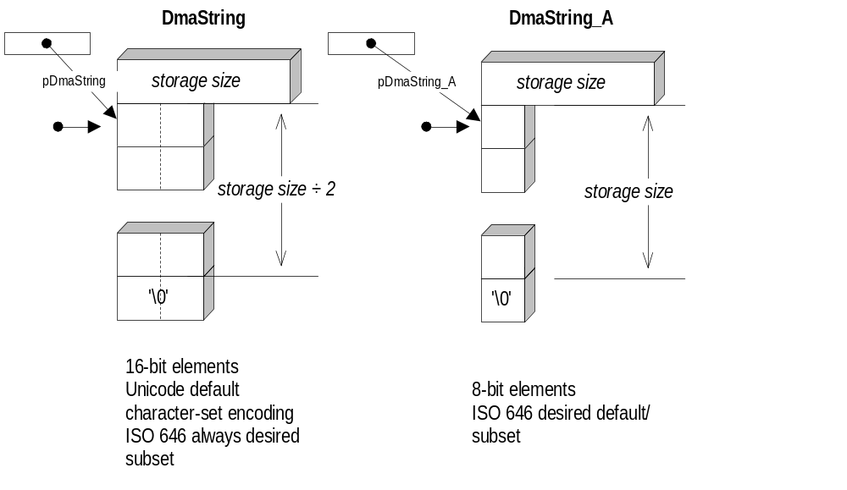
MNCS Sketch:
Define octet-string datatype
Notes:
This diagram is updated to reflect the discussion at the meeting. Notice that the DmaString is built with 16-bit storage elements and that storage size for all forms is expressed in size_t units.
The limitation on DmaString for carrying different string storage forms is that the elements are integers and thereby may be subject to byte-swapping or other conversions as part of transport.
The power of all of the formats is that they are elements of binary integers. Remote transport of the information preserves the integer values of the elements without regard to their use to encode character text information. [There is an exception in the implementation of RPC for conversion between ASCII and EBCDIC, but this is not used with COM-interface remoting.]
The DmaString is technically DmaString_B (a pun on ASTR and BSTR), but it has no suffix, being the default.
There is room in this model for DmaString_C (32 bits), etc.
The reference to ISO 646 is to the characters of the ISO 646 (7-bit international version of ASCII) character code.
Because the dmaOIID property and other string-valued properties honor the syntax of URL’s, the character set required for URL’s must be supported
Because the platform-specific strings used with the system registry interface are conveyed in the prevailing character-set encoding, the registry functions are generally available only where the ISO 646 characters are available for specification in platform-specific strings (e.g., file names).

Slide 7
MNCS Sketch:
Encoding separate from String
DMA allows character-set encodings that fit in the elements of the string format:
  String format is just for the bits of particular element/frame sequence
  character-set encoding specified using IANA identifications (e.g., UCS-2, ISO 8859-7, EUC-J)
Language of text specifiable and variable separate from character-set encoding
Notes:
Here is another place where we need to get our language and nomenclature straight, and properly reflect the nuances of character-set terminology in IANA and the ISO standards.
As already discussed, the language of text is set at the Document Space connection level and it automatically applies to the descriptive material from a system and document space:
error message texts that may be offered to users
dmaProp_DisplayName string-valued properties providing user-readable descriptive names for classes and properties in the language of the selected locale
dmaProp_DescriptiveText string-valued properties providing user-readable descriptive text for classes and properties in the language of the selected locale (e.g., about the use of the class or property)
“localized-identifier” within the connection-string format used in IdmaAuthenticate operations. These identifiers provide a language-specific form for presentation to operators in carrying out authentication exchanges. The normal labels used in connection strings are not language-varying and need not be useful to operators -- they are echoed by the DMA requester’s software but need not be displayed to operators if a localized-identifier is provided.
Language of text does not extend, in DMA 1.0, to the language of the values of properties on non-metadata or non-infrastructure operations. Conventions for the language in which a string-valued property of a DocVersion (e.g., myProp_Title) is expressed is not specified within DMA 1.0.

Slide 8
MNCS Sketch:
MN String Portability Library
Supplement basic support macros for octets
  DMA_CREATE_STRING_A, DMA_FREE_STRING_A, ...
Add BSTR and ASTR functions to simplify portability and reuse
  Copying strings, comparing strings, counting characters, ...
  Build character set encodings from literals
Add DmaString_T Libraries for working with either format in a compiled program
  DmaString_T mapped to either BSTR or ASTR everywhere
    DMA_CREATE_STRING_T, ...
  DmaString and DmaString_A remain explicitly usable
Notes:
Although there is no need to duplicate names of interfaces and macros that have no string-format-dependent methods or parameters, it simplifies the specification of programs to allow _A suffixes systematically. Even IUnknown_A is tolerated. There is no actual increase in the number of interfaces in this case, just redundancy in program-language namings of the same interface.
The DmaString_T approach follows a convention already used for building char and wchar_t applications using a common source.
It remains possible to build programs that operate internally in more than one string format and more than one character-set encoding (and language) under any string format.
Such applications require an extreme standard of care in their construction to operate properly and to be confirmed correct
Simple applications using a single string format and a single character-set encoding in that format are supported more directly and simply, without any special burden on the developer to determine whether the expected strings are being supplied
DmaString and DmaString_A operations are strongly typed, so the developer of applications is provided a first-level of defense against using the incorrect string type with any macro or interface method.
Language (locale) mixing is the responsibility of the program design to keep straight
character-set-encoding mixing is also the responsibility of the program design to keep sorted out.

Slide 9
MNCS String Format Extensions:
Next Steps
Post Resource Information
Post Proposal Sketches
Convene Integration Subcommittee
  include Europe and Asia-Japan
  InfoNuovo and Xerox Middleware team will convene subcommittee
SC Create and Report statement of work
Complete initiation by 30 June 1999
Notes:
Dennis Hamilton agreed to convene the Integration subcommittee. It will need to produce statement(s) of work and schedules for the carrying out the MNCS extension definitions.
The initiation is promised for 30 June. This means that the first call should be scheduled and everything needed to commence MNCS processing is available.
The posting of resource information includes updated sources on all of the character-set encodings and the international standards on character sets, especially 10646 and the 8859 family.
The proposed sketches were not circulated at the meeting because of a breakdown in Dennis Hamilton’s use of his configuration-management software. Old versions were moved to his laptop and the newest versions were not available in Costa Mesa. This was resolved by creating these slides instead.

Slide 10
MNCS String Format Extensions:
Resources & More Information
Build Resource Information ASAP
  DMA 1.0 integration and internationalization mechanisms - sources on the current specification
  ftp://www.aiim.org/dma/TechnicalCommittee /integration creation of MNCS topic
  http://www.infonuovo.com/dma/integration/MNCS area for pre-submission information and collateral material
  links to IANA and related sources for character set definitions, collation sequences, etc.
  integration subcommittee to be convened, with sponsorship of InfoNuovo and Xerox DMA Middleware team
Post Information by 30 June 1999
Notes:
The references to the IANA and ISO specifications need to be cleaned up first. We need clarity on exactly what we are talking about. Dennis Hamilton has requested Larry Masinter’s review to ensure that we deal with this properly.
The other organization of materials will be done by Dennis Hamilton as part of convening the Integration Subcommittee.

Slide 11
