Slide 1

Standards to the Rescue?
Convergence of Document Management and Records Management
Dennis E. Hamilton
AIIM DMware Technical Coordinator
Dennis.Hamilton@acm.org
http://NuovoDoc.com/activities/A020400.htm
Notes:
This presentation was originally made to a joint meeting of the Northwest chapters of AIIM and ARMA.
Portions of this presentation are based on the WebDAV Overview slides provided by Jim Whitehead, co-chairman of the IETF WebDAV Working Group. An expanded (and also not annotated) tutorial on WebDAV can be found at http://Dmware.info/WebDAV/.
2002-04-10: Hyperlinks were added for all of the references in the material. This note page is the only one added. Based on the valuable feedback from the initial presentation, I see where this needs to be made more clear and also be given a better grounding for less technical audiences. I will apply that valuable advice as I move from slides to Web versions of the material. -- dh.

Slide 2
Standards to the Rescue
Themes
WebDAV: Purpose and Approach
WebDAV: History and Progress
WebDAV: Enabling Interoperability
Connecting the Dots: End to End Usability
Managed Documents and ERM?
Resources
EDM & ERM Standards Efforts

Slide 3
Themes - I
Emerging standards for the Web and XML are accelerating interoperability among commodity services and computer products.
The appeal of low-cost, uniform fixtures challenges the existing document-management market structure.
At the same time, promoters of commodity technologies have their eye on records management.

Slide 4
Themes - II
We’ll Illustrate this disruptive influence with the WebDAV, the standard for Distributed Authoring and Versioning via Web servers.
Consider the impact on managed documents and how these documents will constitute records.
The central question of "metadata" will be examined, along with sources of further information on what is being standardized, who is doing the work, and how to find out more about the products and their use.

Slide 5
WebDAV: Purpose and Approach
  Collaborative authoring on the Web
  Edit and manipulate as easy as navigate and view
  Honor Web model
  Extend HTTP, the Web’s foundation
  Modularize:
    WebDAV for basic distributed authoring
    DeltaV for comprehensive versioning and configuration management
    ACL for fine-grained authorization
    DASL for multi-collection search and access

Slide 6
WebDAV: History and Progress
    SPECIFICATION DEVELOPMENT
    1996 – First Working Group Meeting
    IETF Process Adopted
    1999 – RFC 2518 HTTP Extensions for Distributed Authoring – Proposed Standard Status
    2002 – January: DeltaV in press as Proposed Standard
    2002 – 2518bis in-progress for promotion to Draft Standard
    2002 – ACL and DASL accelerate

Slide 7
WebDAV: History and Progress
    IMPLEMENTATION AND ADOPTION
    Clients
    12 commercial, including Windows
    & OSX
    4 open-source
    5 open-source client SDK/libraries
    Servers
    12 commercial
    10 open-source
    4 open-source server SDK/libraries
    11 On-Web Servers
    Interoperability Confirmation Testing

Slide 8
Major WebDAV Clients
Application Software:
  Microsoft: Office 2000/XP (Word, Excel, PowerPoint, Publisher)
  Adobe: Photoshop 6, Illustrator 10, Acrobat 5, In Design 2
Web Site Authoring
  Adobe: Go Live 5
  Macromedia: Dreamweaver 4
Remote File Access:
  Apple: Mac OS X webdavfs
    OS X also ships with Apache and mod_dav
  Microsoft: Windows Web Folders
  Wind River Software: WebDrive
  Goliath (Mac, open source)
  WebDAV Explorer (UC Irvine, Feise/Kanomata, open source)
XML editors
  Excosoft: Documentor
  Altova: XML Spy
  SoftQuad: XMetal

Slide 9
Major WebDAV Servers
Microsoft: IIS 5/6, Exchange 2000, Sharepoint
Apache: mod_dav (over 95,000 sites)
Oracle: Internet File System
Adobe: InScope
Xythos: Web File Server
Novell: Netware 5.1, Net Publisher
W3C: Jigsaw
Endeavors: Magi-DAV
IBM: DAV4J (DeveloperWorks)
FileNet: Panagon ECM
Intraspect: 4i
Merant: PVCS Dimensions, Content Manager
Hyperwave: Information Server 5.5
4D: WebSTAR V

Slide 10
WebDAV: Enabling Interoperability
    WebDAV Disguise as File Systems
    WebDAV Repositories Customizable from Beginning
    Higher-Level Applications Have Powerful Persistent Storage with WebDAV
  EVERY WebDAV Server IS A WEB SERVER
    WebDAV Capabilities Discoverable

Slide 11
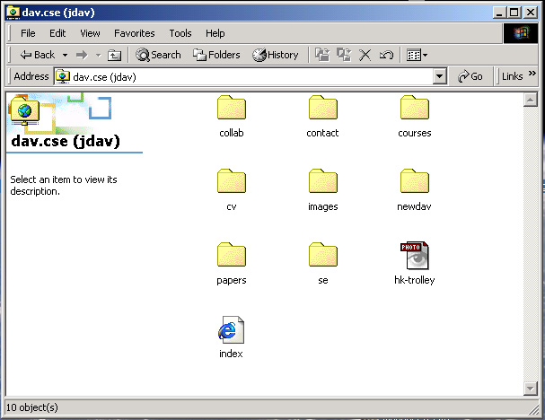
Filesystem View

Slide 12
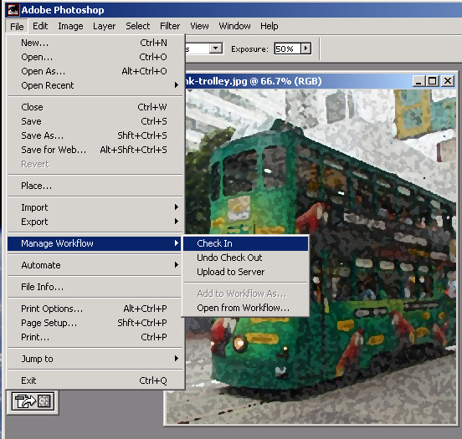
Work-flow meta-phor

Slide 13
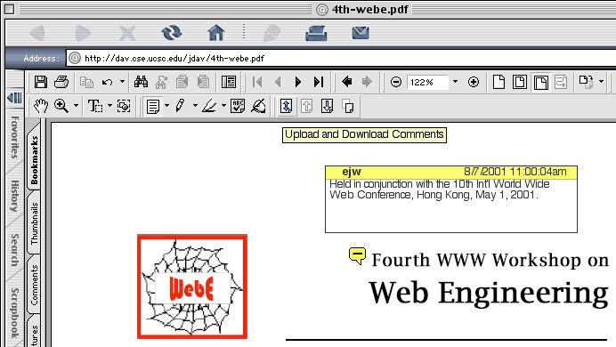
Remote Collaborative Annotation

Slide 14
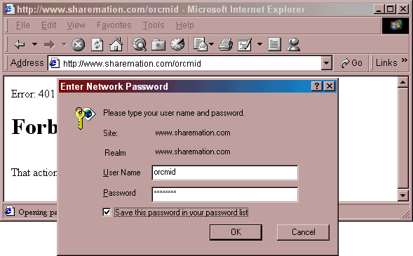
Accessing as Web

Slide 15
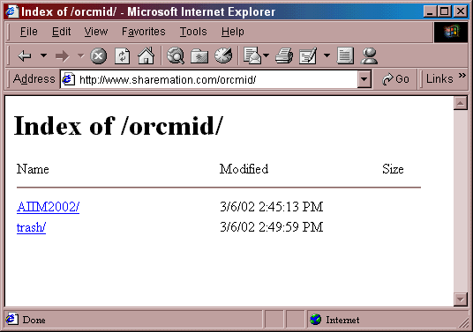
Accessing as Web

Slide 16
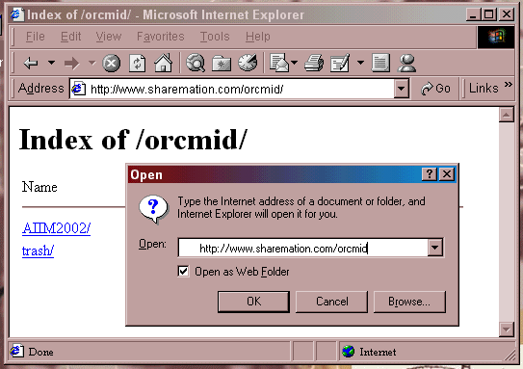
Accessing as WebFolder

Slide 17
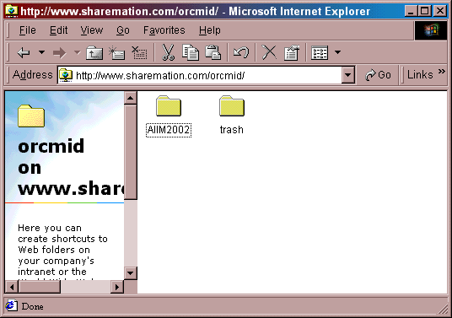
Accessing as WebFolder

Slide 18
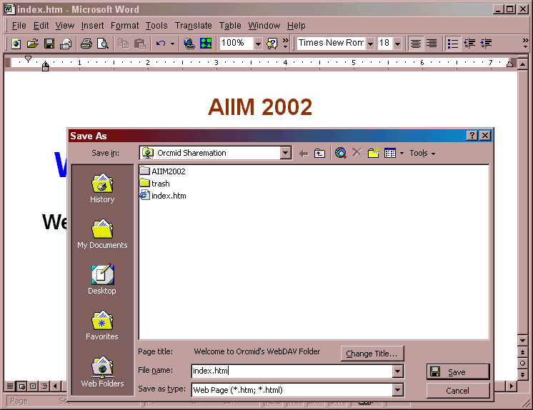

Slide 19
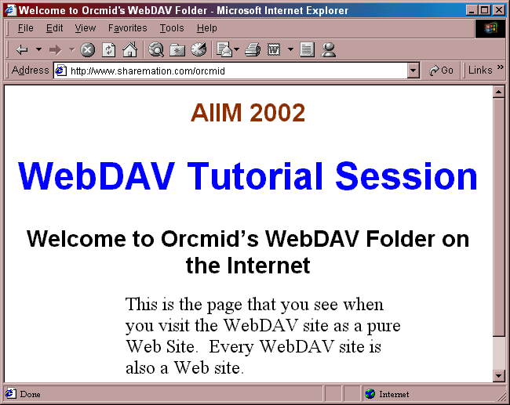
Accessing as Web

Slide 20
WebDAV: Connecting the Dots
    Desktop Presence/Transparency
    Web Presence/Transparency
    Supporting Managed Documents
    Customization for Managed Documents and Records

Slide 21
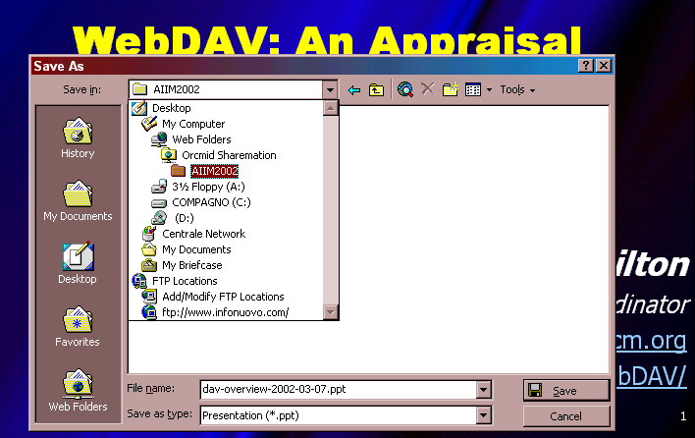
Desktop Presence: Transparency

Slide 22
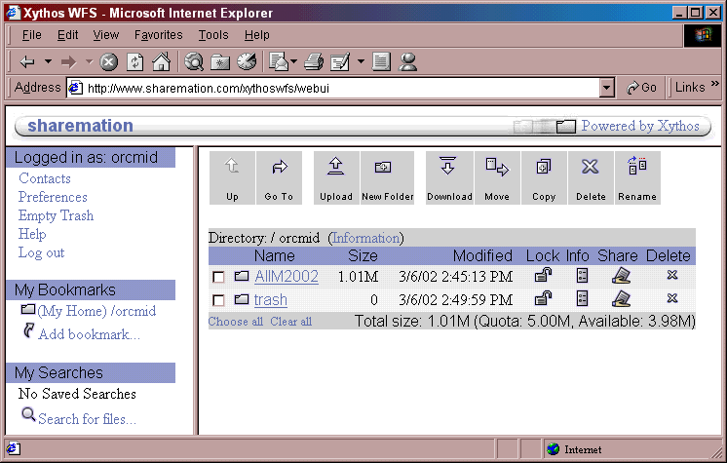

Slide 23
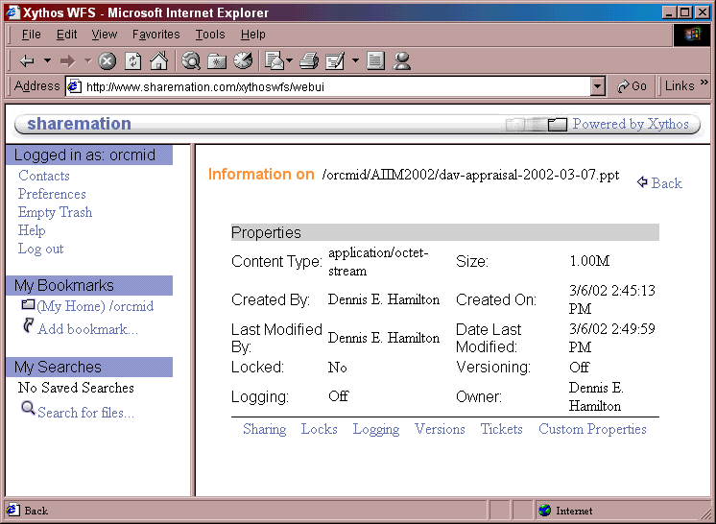

Slide 24
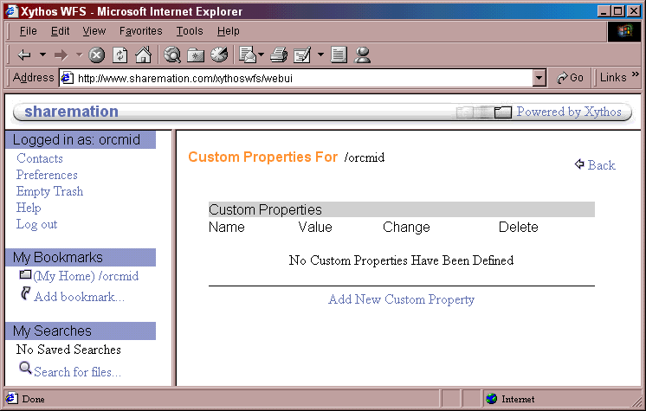
WebDAV: Connecting the Dots

Slide 25
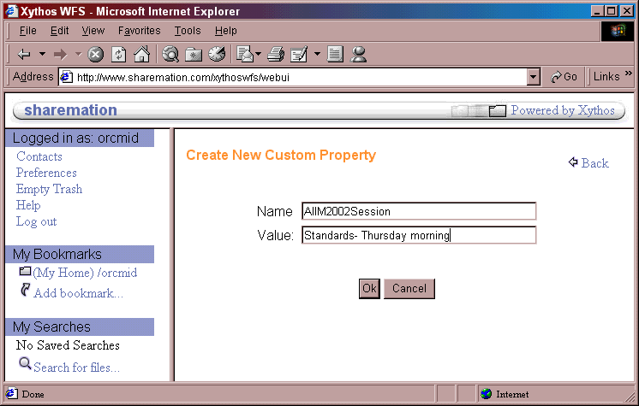
WebDAV: Connecting the Dots

Slide 26
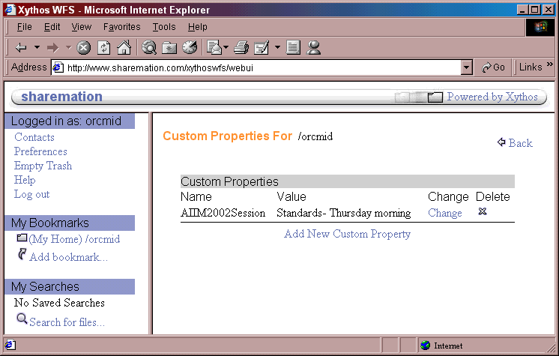
WebDAV: Connecting the Dots

Slide 27
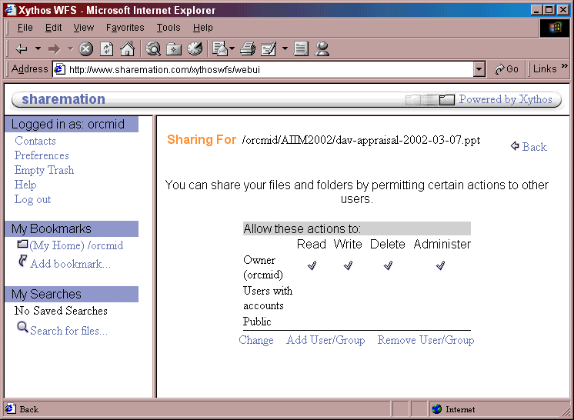
WebDAV: Connecting the Dots

Slide 28
WebDAV: Managed Documents
    WebDAV Support Not Consistently Deployed
    Managed-Document Controls Still Obtrusive
    Software Development and Site Authoring more-developed
    Interoperable ACL Not Soup Yet
    No Technical Obstacles

Slide 29
Electronic Records Management
US Government agencies are required to support standard DoD 5015.2
  Describes metadata items useful for archiving electronic records
  5015.2 is not an interoperability standard
Approach
  Develop an XML representation of 5015.2 metadata items
  Store 5015.2 metadata in WebDAV properties
  Develop server support for
    automatic archiving/disposal of records
    automatic setting of 5015.2 property values
  Develop client support for entry/viewing/searching 5015.2 items
Payoff
  Wide deployment of interoperable, low-cost infrastructure for archiving electronic records
Work being performed at UC Santa Cruz

Slide 30
WebDAV: Learning Curve
    Start Simple
    Scale as WebDAV suite matures
    Use availability to practice in non-critical areas

Slide 31
More Disruption
    E-mail
    Wiki
    Instant Messenger Services
    Peer-to-Peer Collaborative Systems
      Groove and the like
    More Dynamic, More Ephemeral, Less Managed (?)

Slide 32
WebDAV Resources
WebDAV
  http://www.webdav.org/
    A central collection of pages and links to all things WebDAV.
WebDAV Working Group
  http://www.ics.uci.edu/pub/ietf/webdav/
    Contains links to active documents, and a complete list of WebDAV-supporting applications.
Electronic Records Management Work
  http://www.cse.ucsc.edu/~dgordon/
  Select Draft ERM Schema Paper (ERMSchemaPaper.doc)

Slide 33
EDM & ERM Standards Efforts
IETF: http://www.ietf.org; W3C: http://www.w3c.org
AIIM Standards Efforts
  http://standards.aiim.org/
  Digital imaging and moving to metadata concerns
ARMA Standards Efforts
  http://www.arma.org/standards/
  Looking at software and migration issues
NARA
  http://www.nara.gov/records/
  Source of DoD 5015.2 and related work
  Addressing to Electronic Records Archiving
OASIS: http://www.oasis-open.org/
Digital Preservation: http://digitalpreservation.org/

