Slide 1

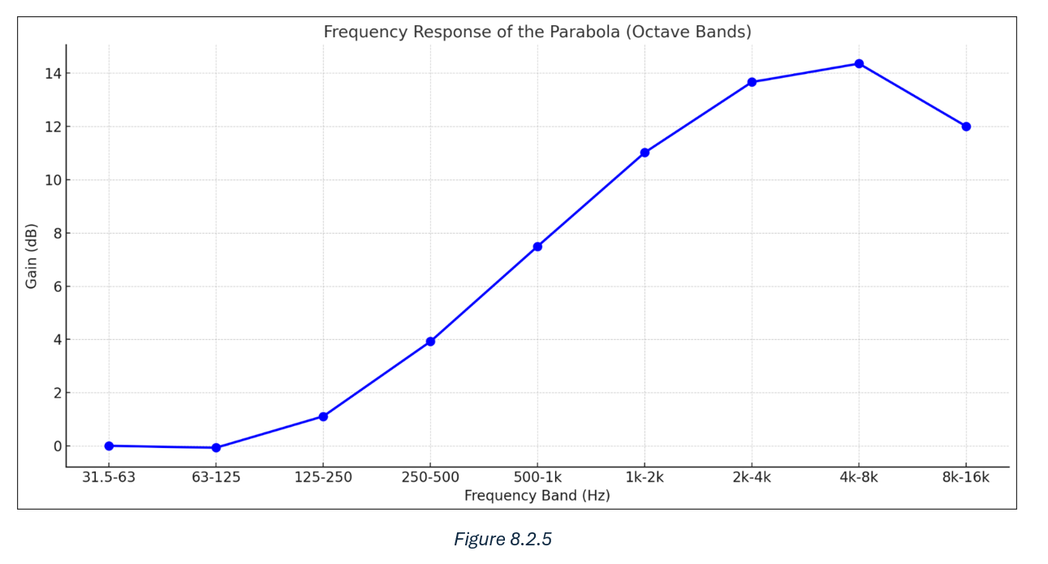
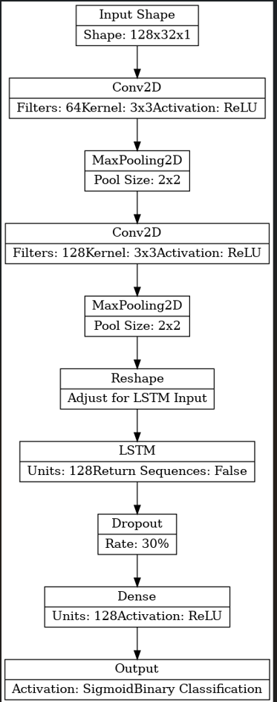
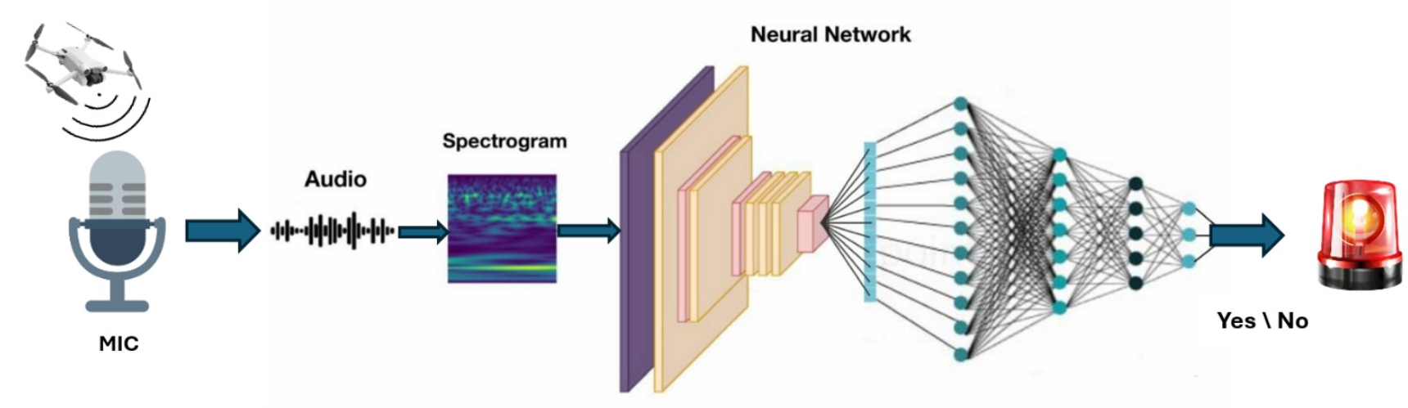
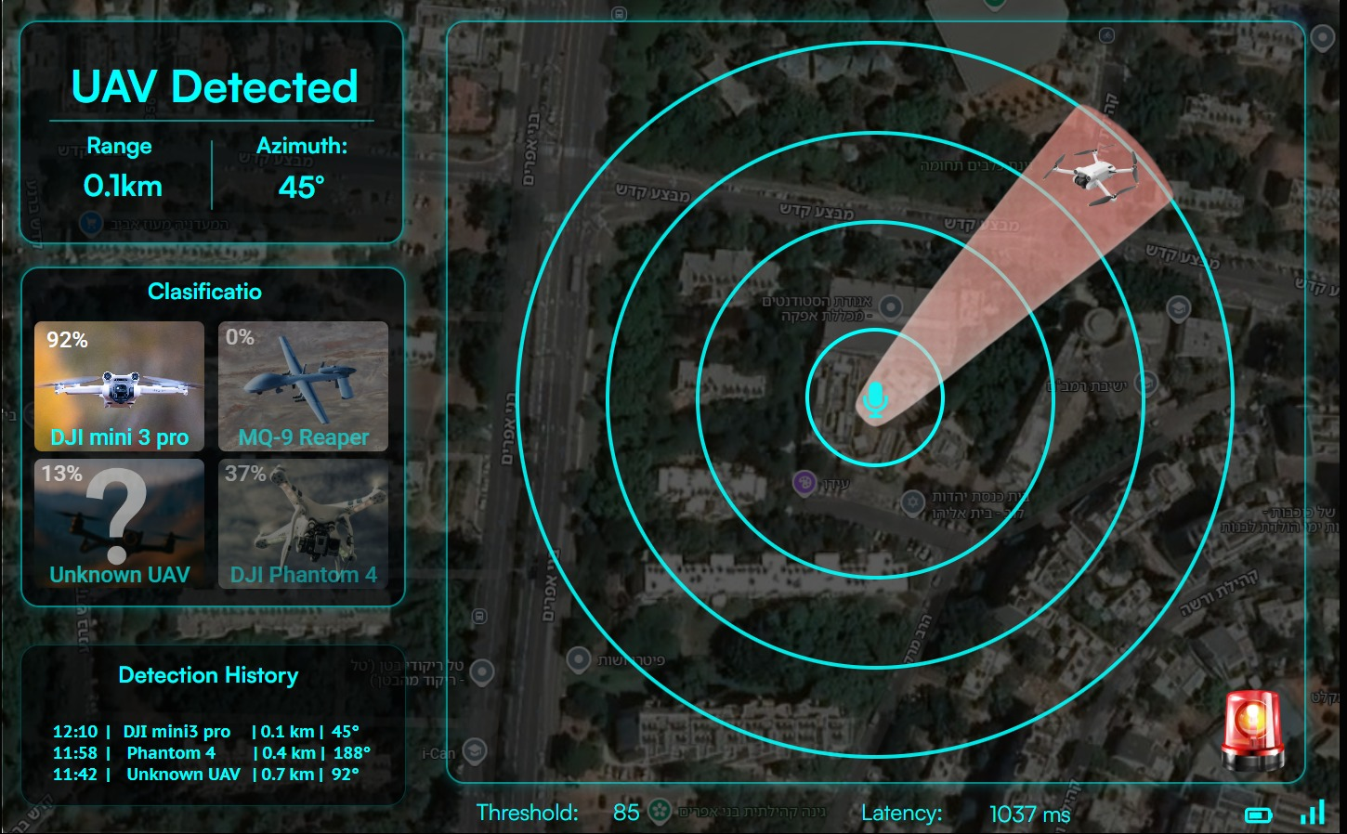
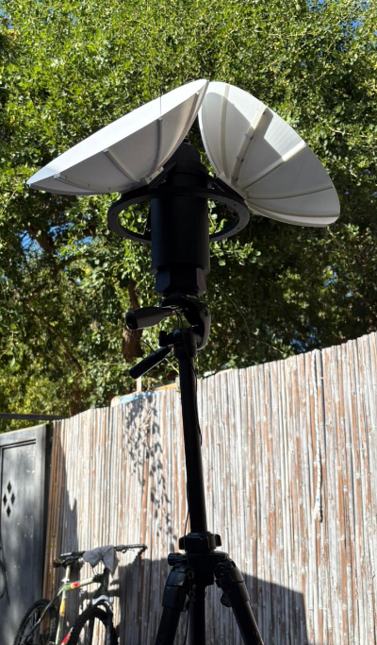
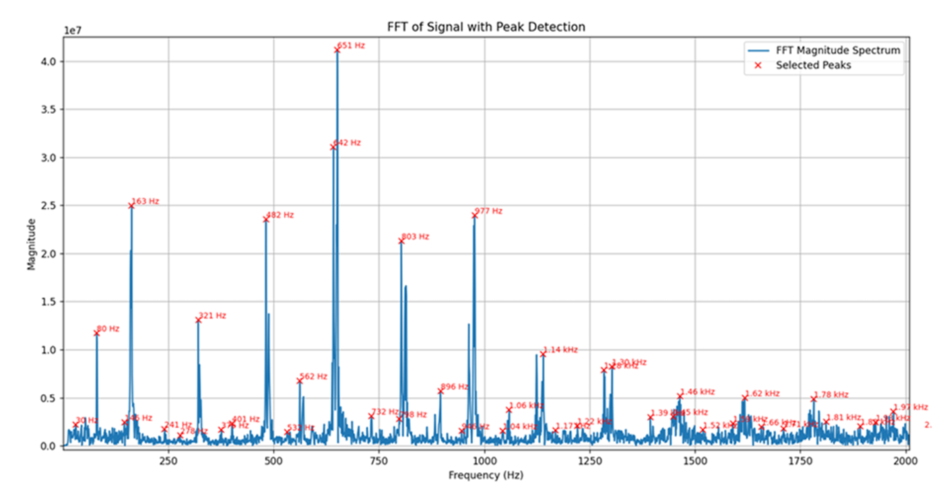
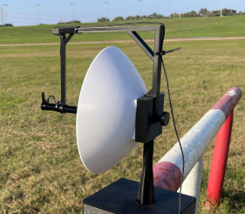
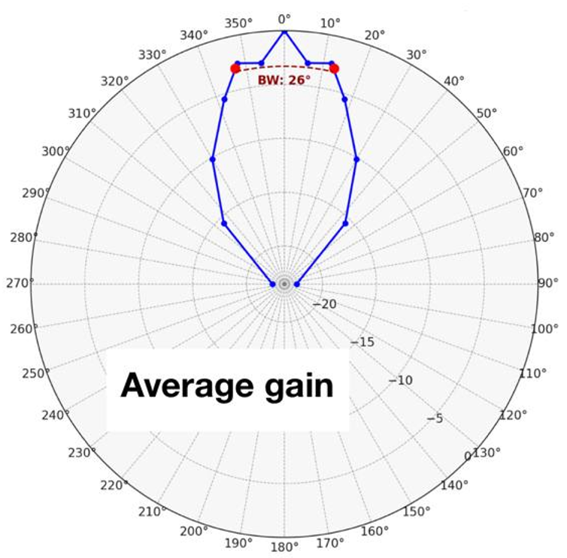
| Electrical Engineering
Students: Or Meir Cohen, Bar Gvili, Saar Green
Advisor: Ehud Dayan
Acoustic Drone Detector
To compensate for the frequency distortion introduced by the
parabolic dish, the dataset was intentionally manipulated to
reduce differences from regular recordings
Deep learning was preferred over classical machine learning due to its ability to learn features directly from raw input. ANN, CNN, and CRNN architectures were evaluated. CRNN was chosen for its superior balance of accuracy and response time
1. Background
The widespread use of autonomous drones presents a growing security challenge. Unlike regular UAVs, autonomous drones emit no radio signals and often fly below radar coverage, making traditional radar and RF-based systems ineffective. Acoustic detection, based on the unique sound of drone propellers, offers a cost-effective and reliable alternative especially in environments without line of sight or under poor visibility conditions.
4. Design and products
A portable UAV detection system was developed, weighing under 7 kg and
designed for field deployment, with a 33 cm parabolic reflector.
The AI model was developed and trained using Mel spectrograms as images
Synthetic data was generated using a GAN model to improve robustness.
The software was developed in a Docker environment and includes separate
containers for audio capture, signal processing, classification, and UI.
2. Objective
Develop a portable, acoustic-based system for short-range UAV detection and general direction estimation, delivering real-time and highly accurate results using advanced signal processing and neural networks
3. Functional structure
An analysis of drone acoustic behavior and free-space attenuation was performed to identify the relevant
frequency ranges, minimum sampling window, and
required gain to meet the system’s detection range.
Based on the required directionality and amplification, a parabolic reflector was designed. Its frequency-dependent gain introduces spectral distortion compared to a regular microphone, which must be addressed during data processing.
Given the known frequency range and window length, STFT, MFCC, and Mel spectrograms were evaluated. Mel was selected for its balance between information and compression, and its alignment with human auditory perception, aiding visual interpretation during development.
5. Summary and conclusions
Target Accomplishment
Achieved 95% detection accuracy (vs. 80% target)
Response time of 1.1 seconds (vs. 5-second target)
Detection range of over 100 meters (vs. 25-meter target)
Direction estimation within 60° (vs. 120° target)
Built a dataset of over 200,000 labeled audio samples
Designed and constructed a custom parabolic dish with ~15dB gain
Future Plan
The dish size can be increased to extend detection range
Response time can be reduced to 0.1 seconds
A microphone array in the parabolic dish can enhance angular accuracy

