Slide 1
W
Workprint
Building is becoming
abundant.
Attention is not.
OPENAI BUILD WEEK · HYDERABAD
Notes:
AI is making software easier to build than ever. But that changes what is scarce. When anyone can build, attention is the bottleneck.

Slide 2
W
Workprint
For builders before they
are known, visibility matters.
01
02
03
04
Feedback
before launch.
Trust
before purchase.
Proof
before credentials.
Relationships
before they need them.
Building in public lets you build the product and the audience at the same time.
Notes:
For early-stage founders, indie hackers and ambitious students, building in public means feedback before launch, trust before purchase, proof before credentials, and relationships before they need them.

Slide 3
W
Workprint
But building in public
becomes another job.
Decide what matters.
Find the story.
Write the post.
while you are trying to ship the actual product.
Do it again tomorrow.
Notes:
But it becomes another job: decide what matters, find the story, write the post, and do it again tomorrow while you are trying to ship the actual product.

Slide 4
W
Workprint
Today, every
developer gets a
communications team.
W
Workprint
Your AI communications team for building in public.
Notes:
So we asked: what if every developer had a communications team? This is Workprint: your AI communications team for building in public.

Slide 5
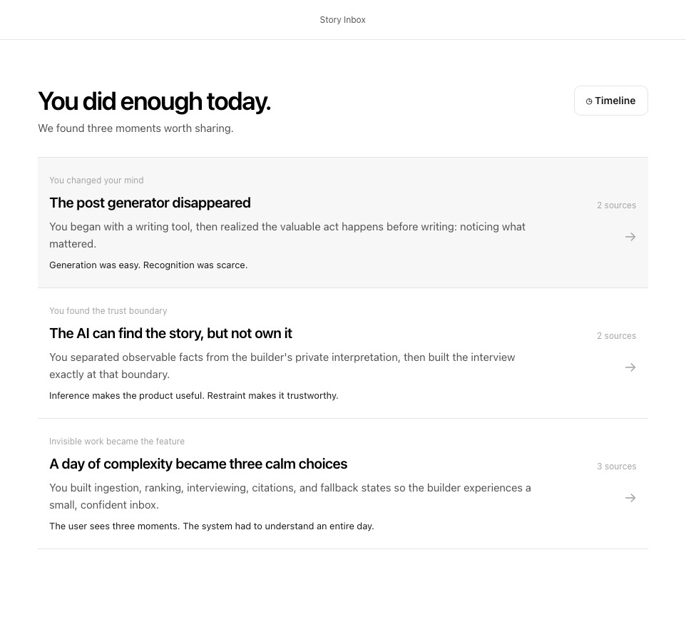
W
Workprint
It finds the story
hiding in the work.
GitHub history · Codex sessions · progress
Not ‘we added browser automation.’
“AI assistants look intelligent
until you ask them to complete
an ordinary, messy task.”
A story people care about—already grounded in the work.
Notes:
Workprint looks at GitHub history, Codex sessions and project progress. It finds a moment worth sharing. Instead of ‘we added browser automation,’ it finds the real story: AI assistants look intelligent until you ask them to complete an ordinary, messy task.

Slide 6
W
Workprint
Build the product.
Build the audience.
From the same work.
Workprint handles the archaeology and first draft.
You bring the judgment.
workprint
Notes:
Workprint does not manufacture content or pretend to be your voice. It handles the archaeology and first draft. You bring the judgment. Builders should not have to choose between building their product and building the audience that will make it matter.

