Slide 1
MyLine – An Interactive Timeline Editor
Orion Davis
Tim Synder

Slide 2
Implementation
PHP
MySQL
HTML
CSS
JavaScript

Slide 3
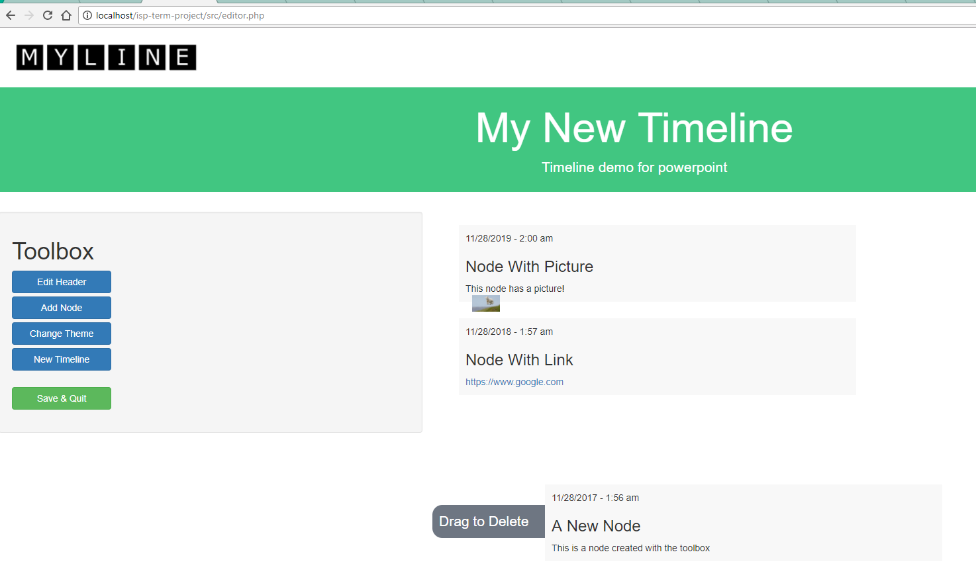
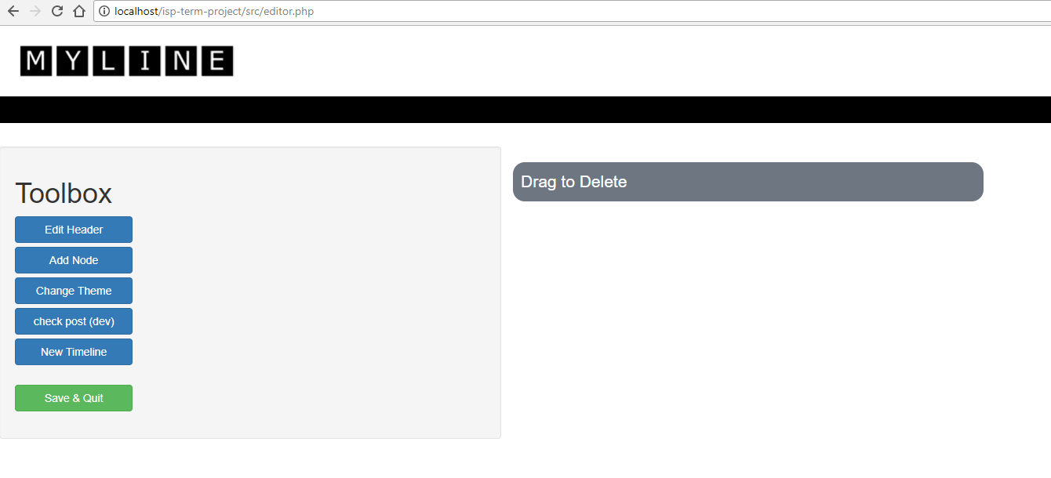
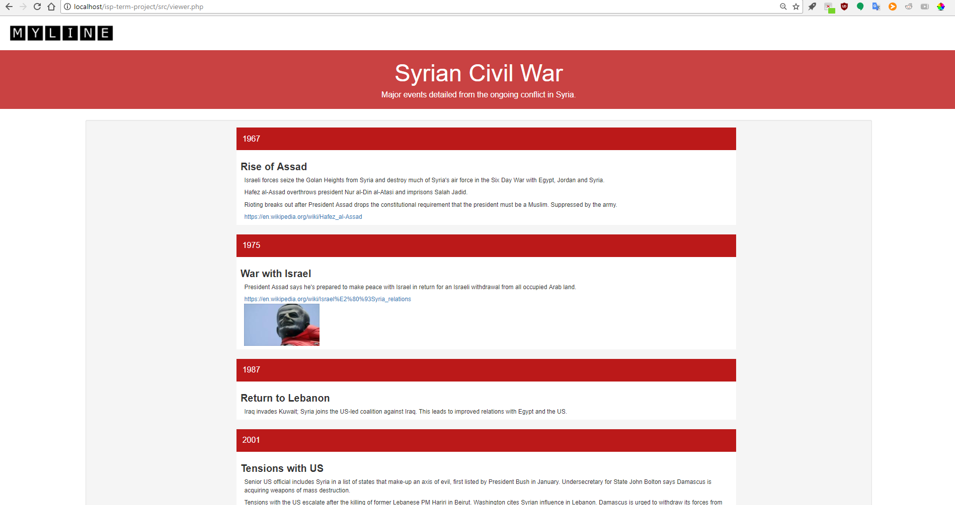
Screenshots

Slide 4
Issues
Make the editor dynamic
How to represent timeline information
How to distribute application

Slide 5
Conclusions
Learned how to develop full scale web application
Learned how to represent data with JSON
Learned basics of deploying web applications

