Slide 1
Game Store Web App
Flask + AI Chatbot
Made by Akylbek and Maksat

Slide 2
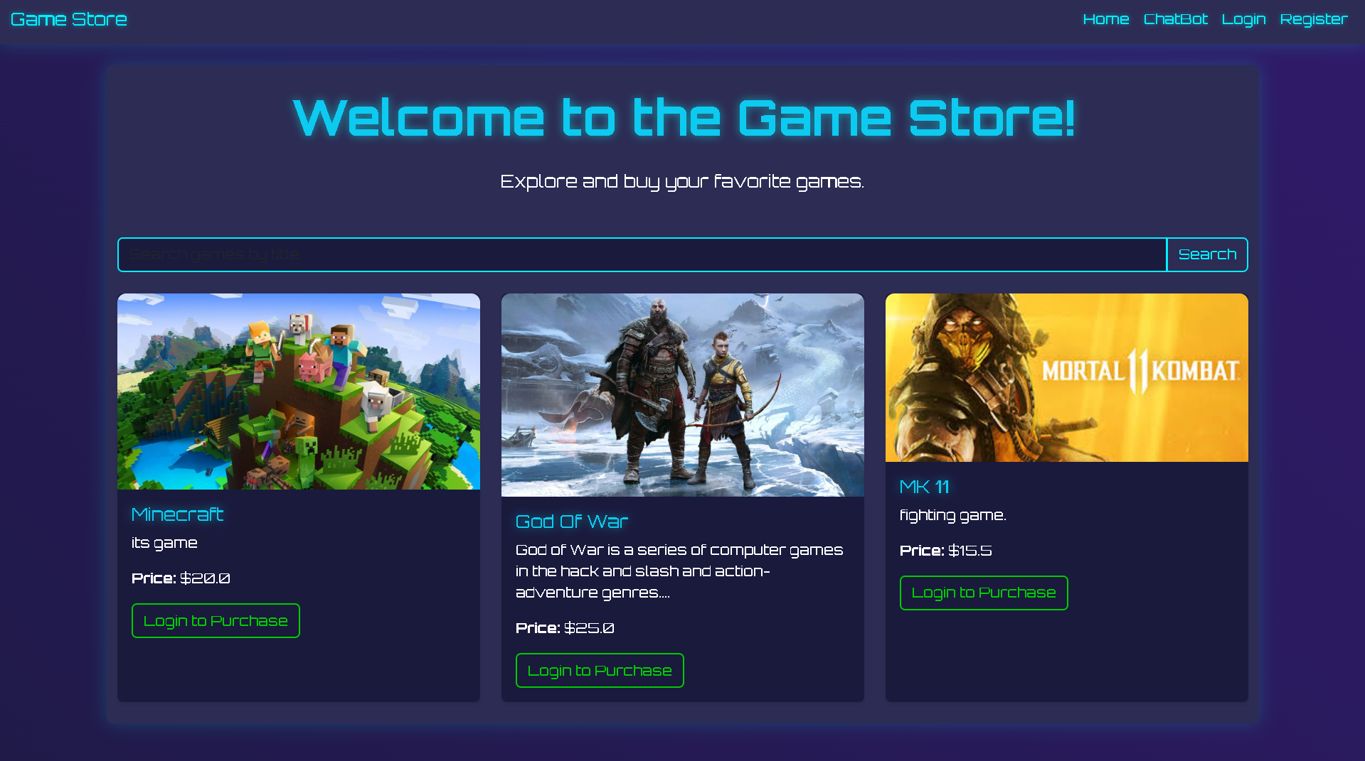
Introduction
Goal: Platform for game browsing & purchasing
Features: Login, role-based access, CRUD, AI chatbot, search
Tech: Flask, SQLAlchemy, WTForms, Jinja2, PostgreSQL

Slide 3
Key Features
Users
Browse, search, buy games, view library
Developers
Add/edit/delete games with images
Admins
Manage users, view purchases
AI ChatBot
Answers game queries
Search
Filter games by title

Slide 4
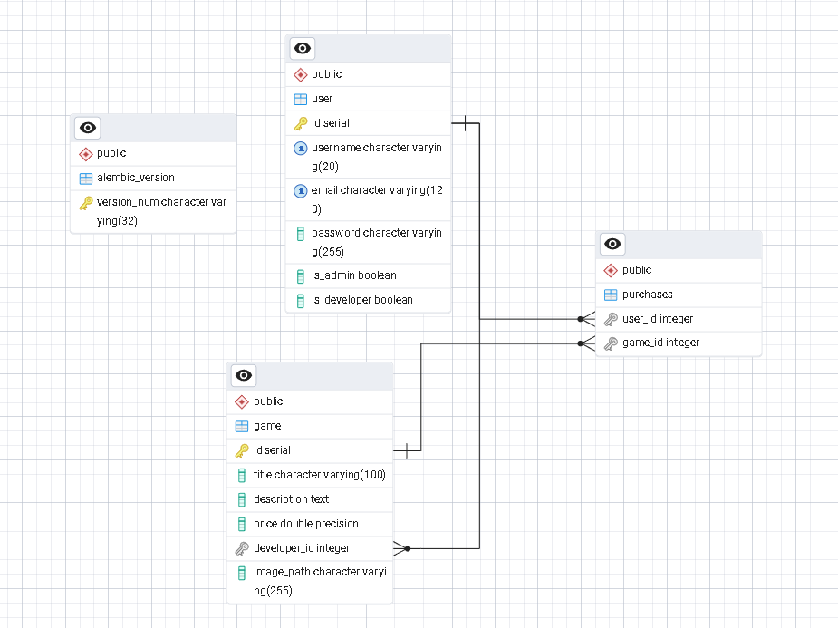
DataBase
Tables: User (id, email, username, password, roles), Game (id, title, price, developer_id), Purchases (user_id, game_id)
Relationships: User → Game (1:N), User ↔ Game (M:N)

Slide 5
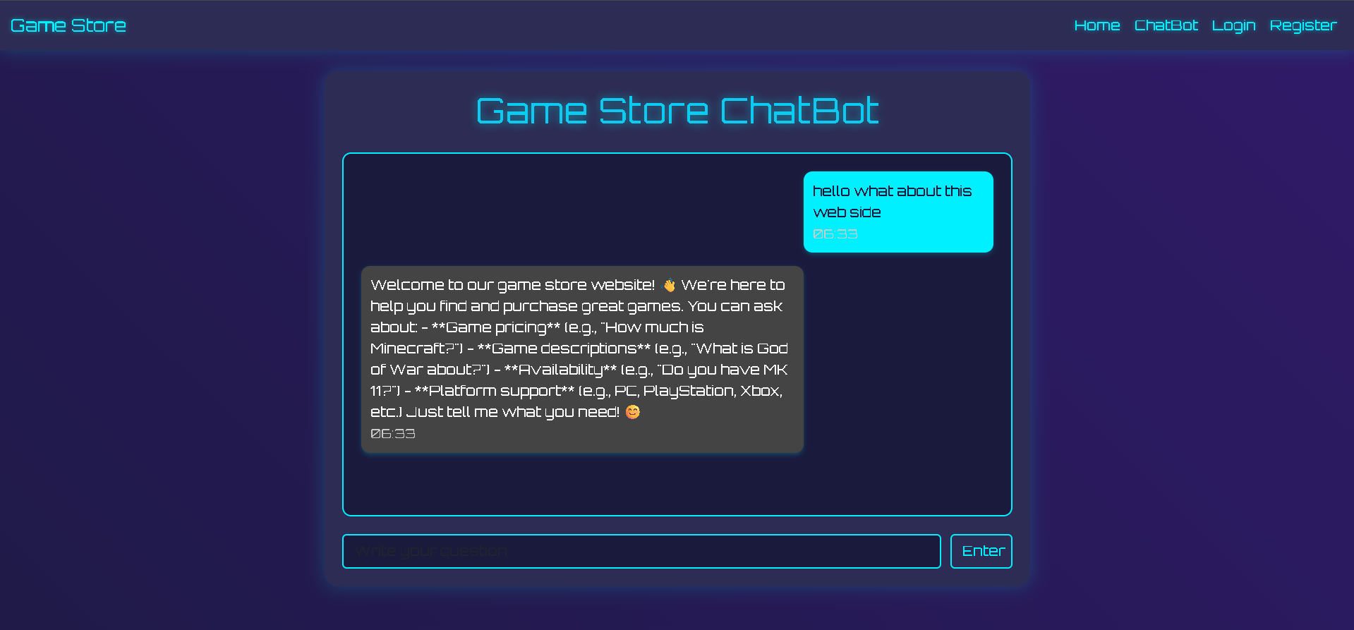
AI Integration
Feature: Chatbot for game FAQs
API: OpenRouter (DeepSeek model)
How: Uses game data context, answers price/description queries
Example: "Price of Game X?" → Returns price

Slide 6
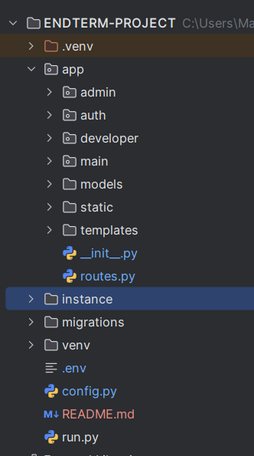
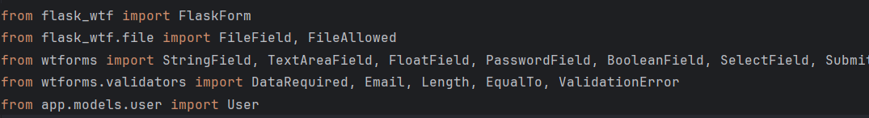
Code Struckture
Folders: app/ (Models, Blueprints, Templates), config.py, run.py
OOP: Models (User, Game), WTForms, Blueprints (main, auth, admin, developer)

Slide 7
Setup Instructions
Clone: git clone https://github.com/ordabekuly/BAC-END-END-TERM.git
Install: pip install -r requirements.txt
Env: Set SECRET_KEY, DATABASE_URL, OPENROUTER_API_KEY
DB: flask db init/migrate/upgrade
Run: python run.py → localhost:5000

Slide 8
Thank you for attention !

