Slide 1


Comparing sleep patterns as measured in actigraphy versus EEG
Niv Siton, Yonatan Goldstein,
Or Dezachyo, Gilad Schrift, Yael Gat
Sagol School of Neuroscience,
Data Science Hackathon,
July 2021
[https://github.com/ordezachyo/Hackaton]

Slide 2
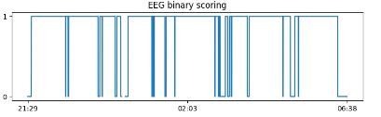
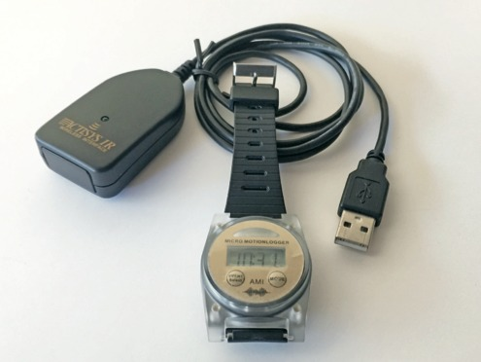
Project Goal
The goal of the project is to assess the relationship between sleep scoring as evaluated using EEG versus its evaluation from actigraphy using standard measures.
Notes:
Create an application that recieves actigraph data and uses it to predict sleep quality, as represented by EEG data, in the following night

Slide 3
Major Components - Flowchart
Subject Class
Figures
Database
Regression
model
Statistics
Correlations

Slide 4
Yasa measurements
Sleep Period Time (SPT): duration from first to last period of sleep
Wake After Sleep Onset (WASO): duration of wake periods within SPT
Total Sleep Time (TST): SPT – WASO
Sleep Maintenance Efficiency (SME): TST / SPT * 100 (%)

Slide 5
Main Challenges and Difficulties
Creating time stamps was a challenge
We had trouble downloading ‘action_4’ software.
Data was not uniform
Epoching the nights turned out to be a hassle.
Finally, we decided to epoch it by hours and then cut off the wake time from each file.

Slide 6
Major Components
Component 1: Database – The database handles the actigraph & EEG data for each subject for each night.
Component 2: Class and Methods – The class allows the user to load each participant and access immmmedietly all his relevant data and calaulate for him sleep parameters.
Component 3: Figures – The Figures allows the user to visualize each subject’s night data and assess it.
Component 4: Regression model – To examine how well actigraphy data predicts EEG data regarding sleep quality.

Slide 7
Major Components
Component 1: Database – The database handles the…
Component 2: GUI – The GUI allows the user to…

Slide 8
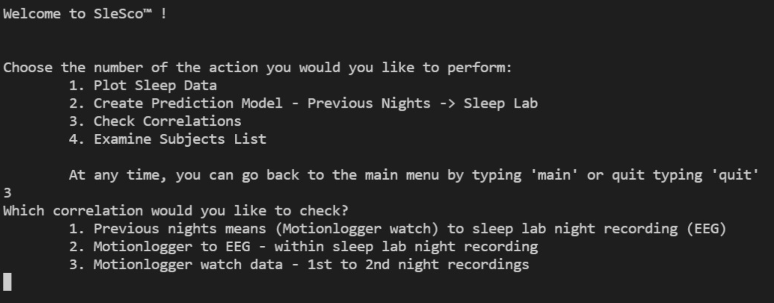
Project Demo

Slide 9
Concluding Remarks
Is the project usable?
The project is usable and user friendly. Scientists can choose which features they would like to use: our application suggests ploting figures for different physiology data for each subject, as well as calculating different statistics based on sleep parameters, in order to predict and understand the correlations.
What’s left to do?
Integrating physiological measurements with other advanced monitors.

Slide 10
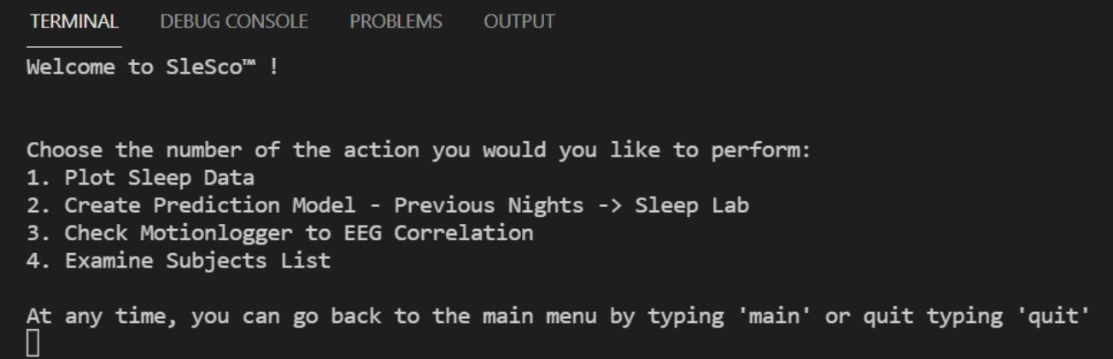
UI Key Features
*** IMAGE OF UI ***
*** CODE SAMPLE ***

Slide 11
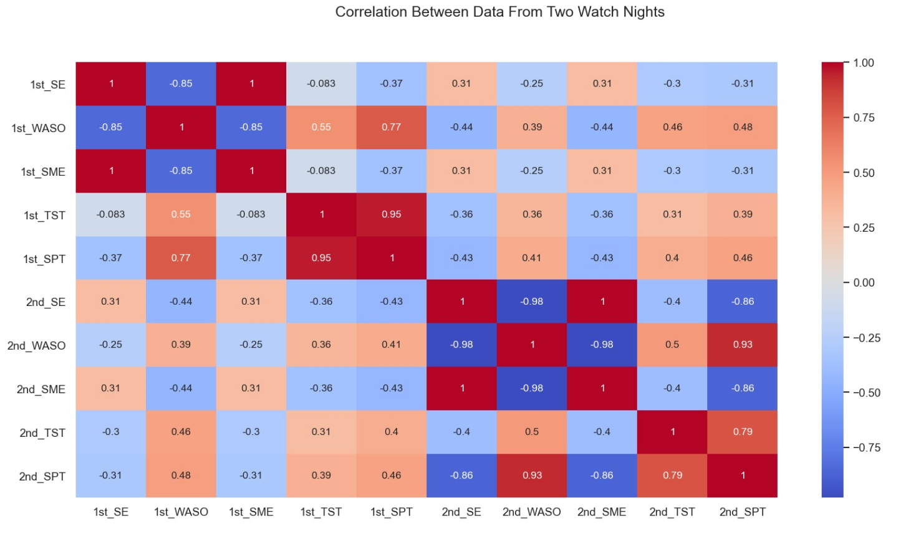

Slide 12
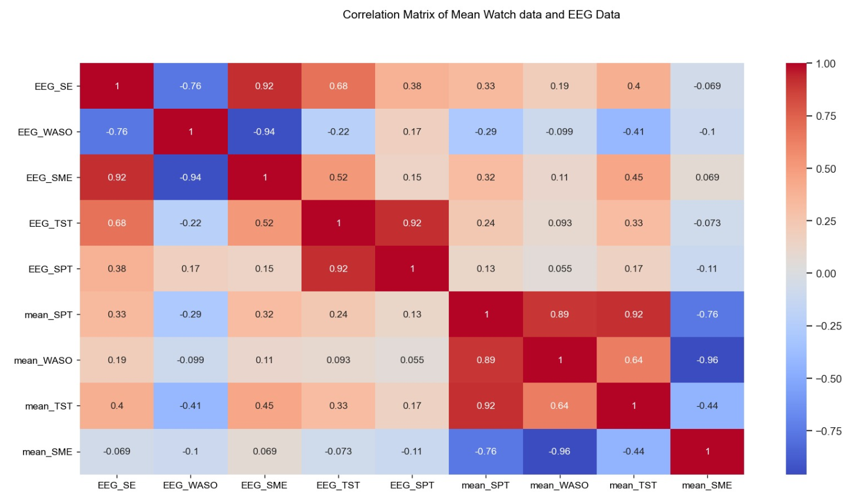

Slide 13
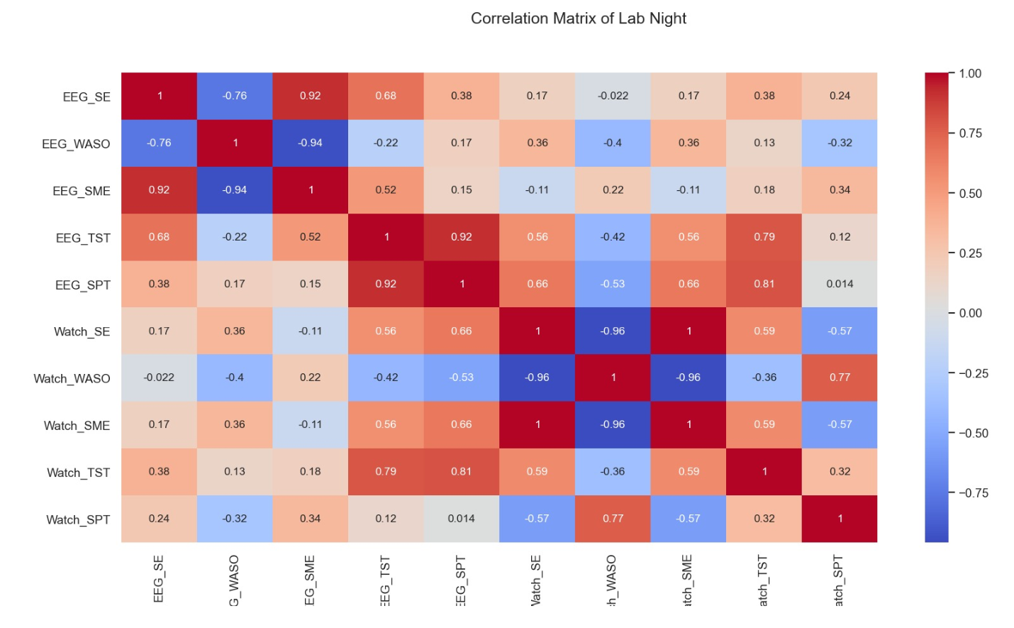

Slide 14
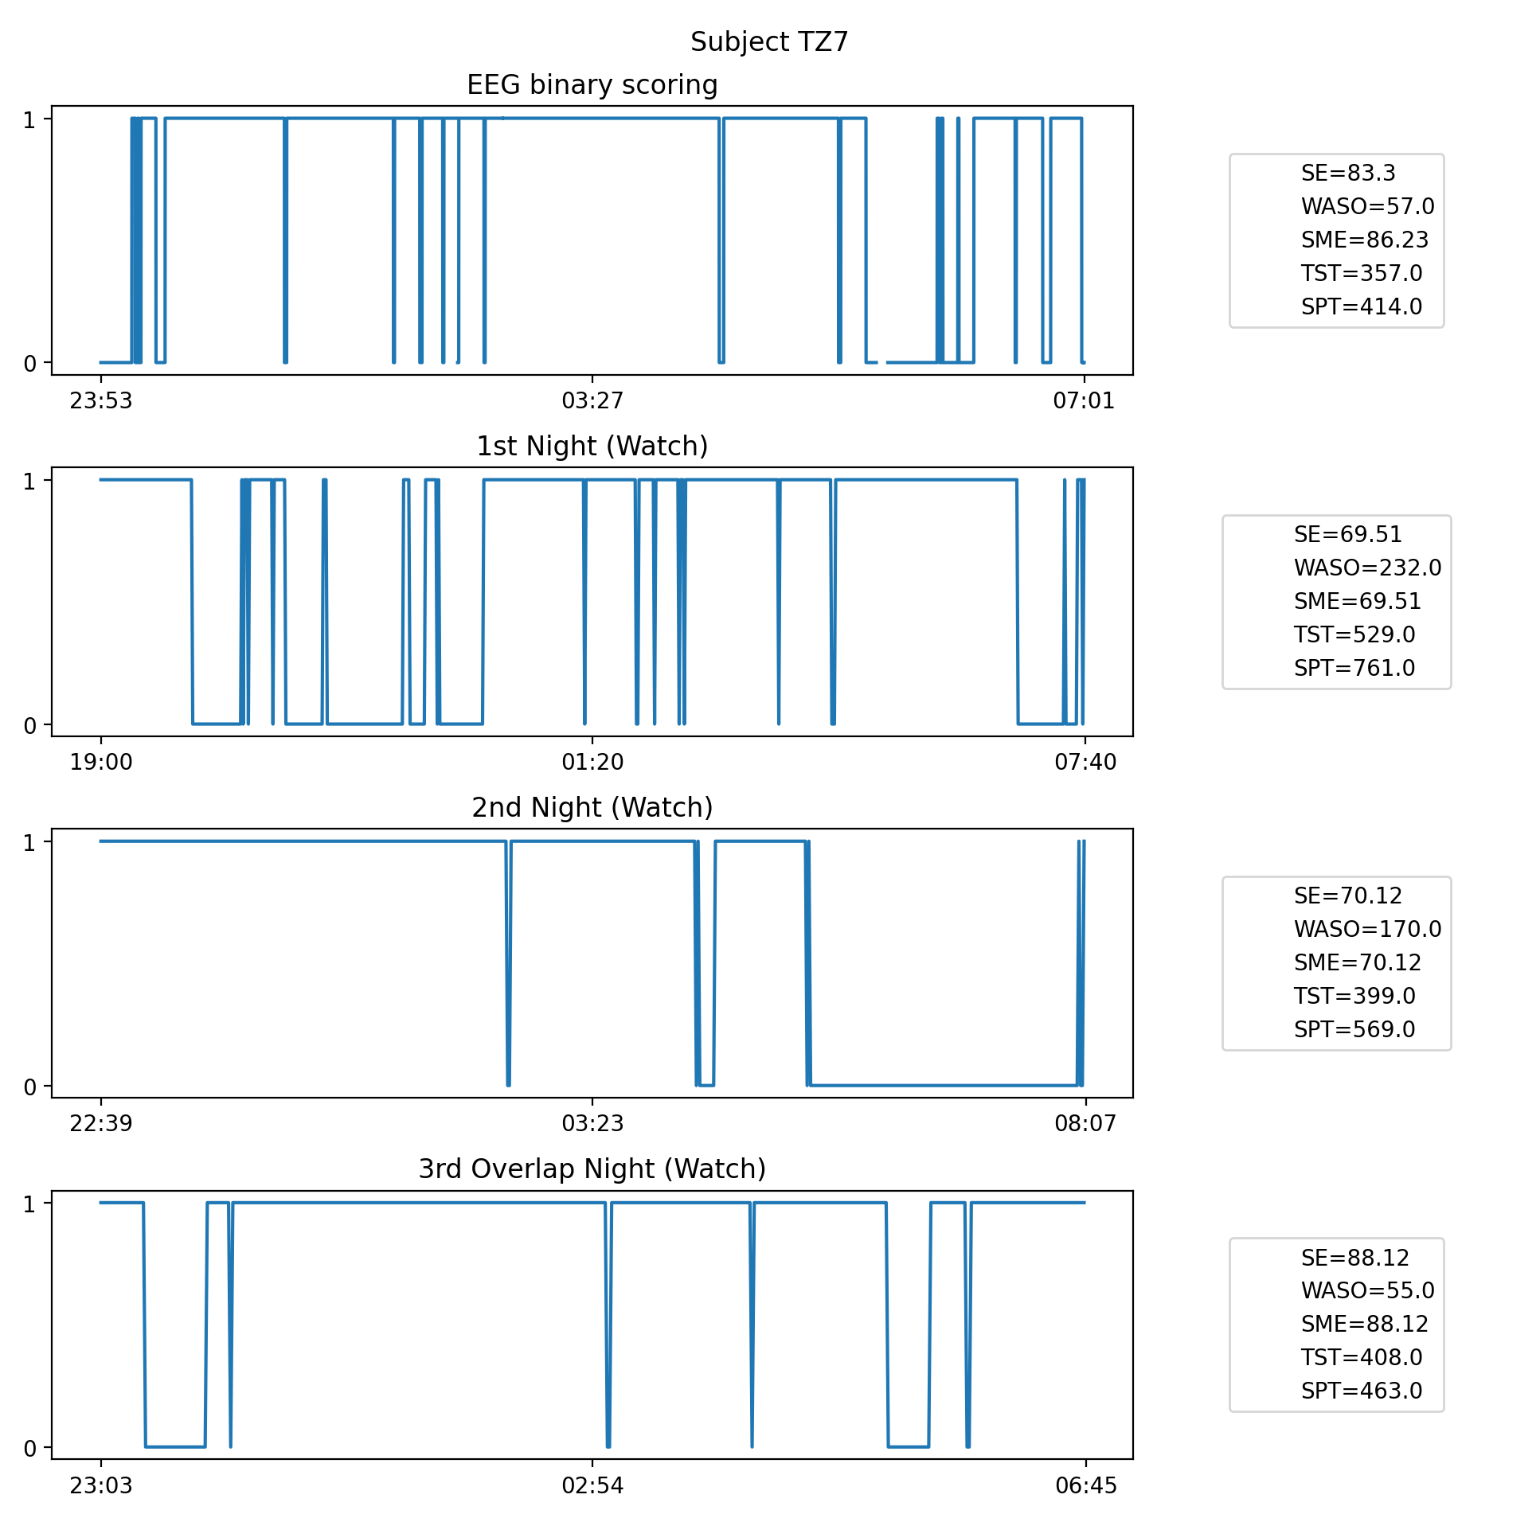

Slide 15
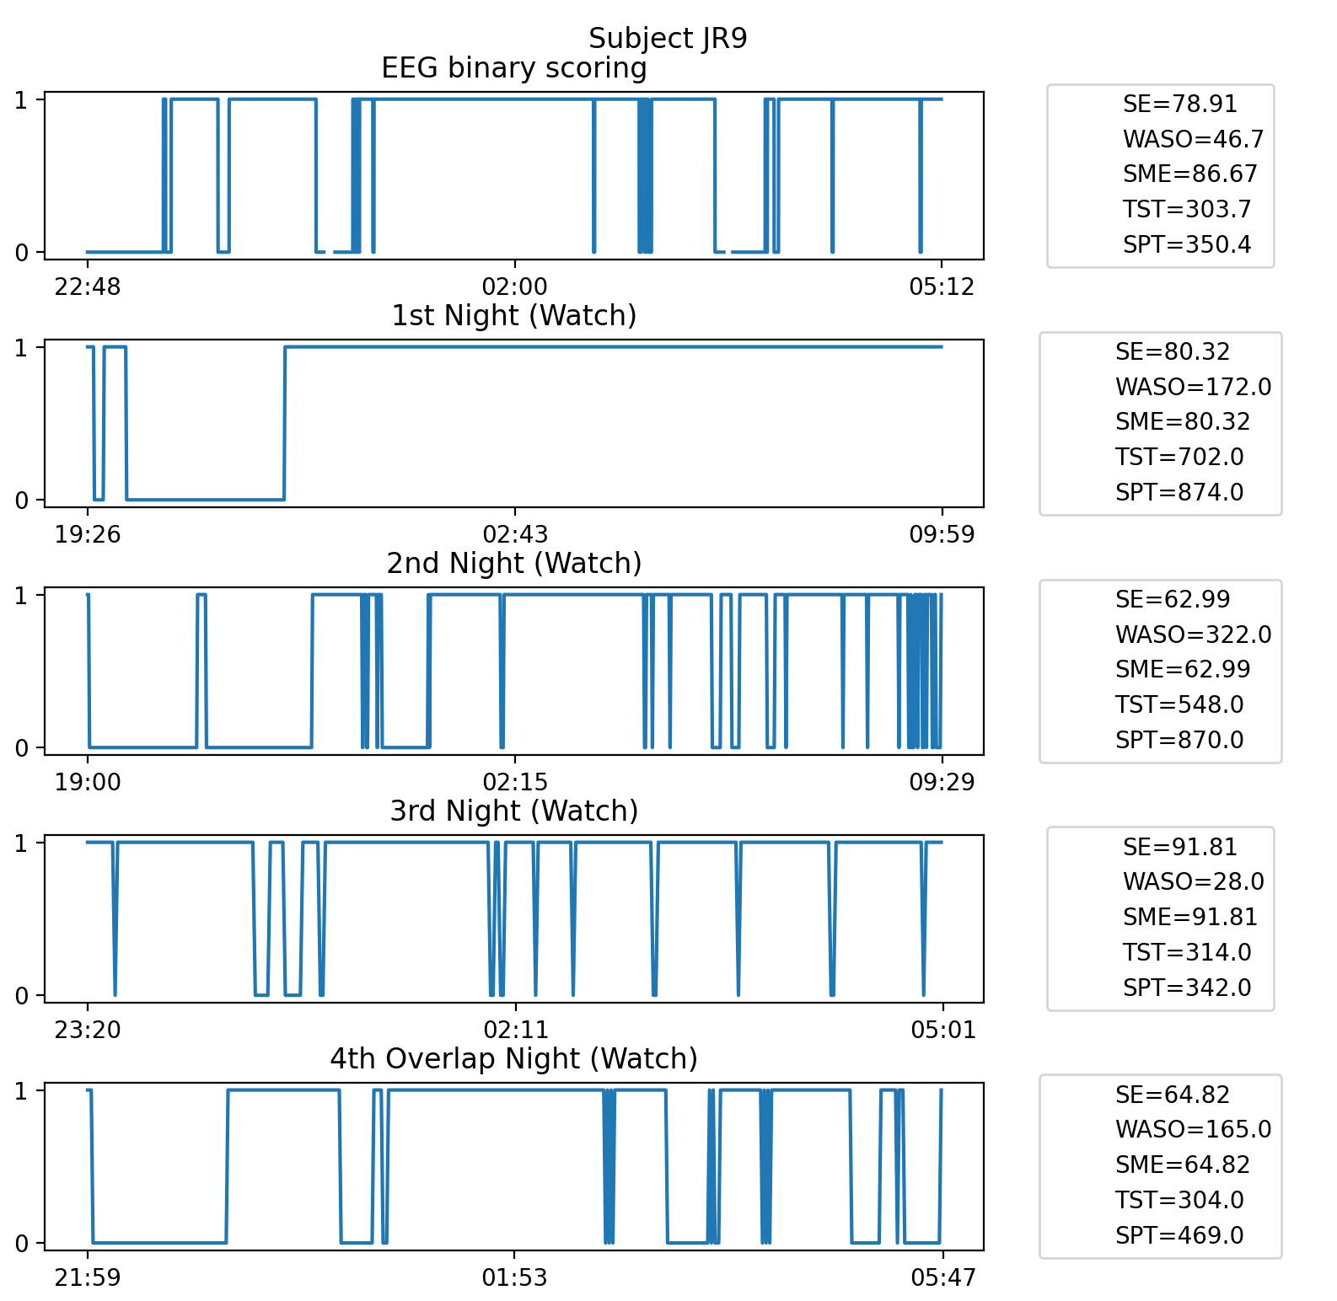

Slide 16
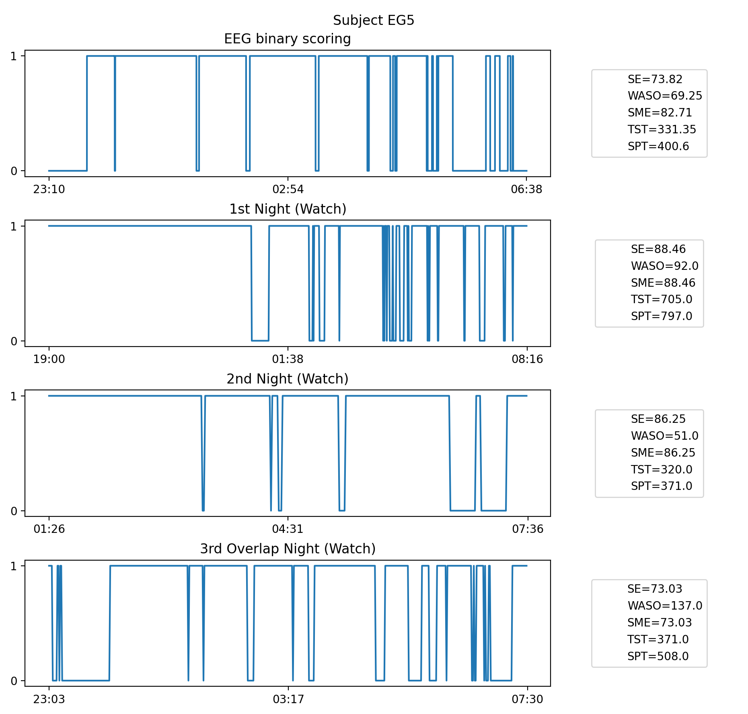

Slide 17
