Slide 1









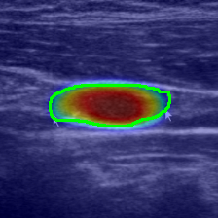
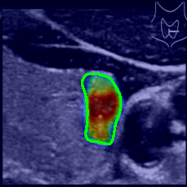
a
Human Input
Compute & Visualize
b
+10.5%
0.786
Use SHAP to identify the most important radiomic features for benign–malignant classification.
FTC/PTC Subtype
(Tiger-Model) AUROC
Baseline
Compute SHAP values, feature importance
Visualize Beeswarm, Waterfall
Write Analysis summary
ThyroidXAgent
Identify Samples &
Main Models
FTC/PTC Subtype
(Tiger-Model) AUPRC
+12.9%
0.805
ThyroidXAgent
SHAP Analysis
Build Background & Explain Sets
Lymph Node Metastatis
(LLNM-Net) AUROC
+19.6%
0.881
Outputs
Load data & Objects
Load AutoGluon predictor
Read training CSV
Preprocess data
Lymph Node Metastatis
(LLNM-Net) AUPRC
+12.7%
0.864
SHAP
Values
Feature
Importance
Beeswarm
Plots
Waterfall
Plots
Analysis
Summary
c
High
0.70
0.75
0.80
0.85
0.90
INT: Maximum
d
Metric Score
INT: Energy
Toward
LNM-positive
Toward
LNM-negative
LNM-negative
SHAPE: Elongation
TEX(GLCM): Cluster Shade
INT: Maximum
TEX(GLCM): Cluster Tendency
Feature Value
NGTDM: Contrast
SHAPE: Perim/Area
SHAPE: Perimeter
SHAPE: Perim/Area
SHAPE: Minor axis
TEX(GLCM): Cluster Tendency
NGTDM: Contrast
SHAPE: Pixel Surface
INT: Energy
-1.5
-1.0
-0.5
0.0
0.5
1.0
1.5
Low
-1.0
-0.5
0.0
0.5
1.0
SHAP contribution toward LNM-positive (raw score)
High
SHAP contribution toward LNM-positive(raw score)
e
f
RLM: GLNU
Toward
FTC
Toward
PTC
FTC
TEX(GLCM): Imc2
SHAPE: Sphericity
SHAPE: Sphericity
TEX(NGTDM): Strength
RLM: RunEnt
Feature Value
RLM: RunEnt
RLM: SRLGLE
TEX(RLM): Gray Level V
TEX(GLCM): Cluster Shade
NGTDM: Coarse
TEX(GLCM): Imc1
SHAPE: Elongation
TEX(GLCM): Cluster Shade
INT: Skewness
-0.6
-0.4
-0.2
0.0
0.2
0.4
0.6
Low
-1.0
-0.5
0.0
0.5
1.0
SHAP contribution toward FTC (raw score)
SHAP contribution toward FTC(raw score)

