Slide 1

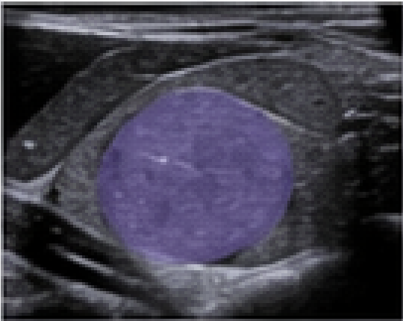

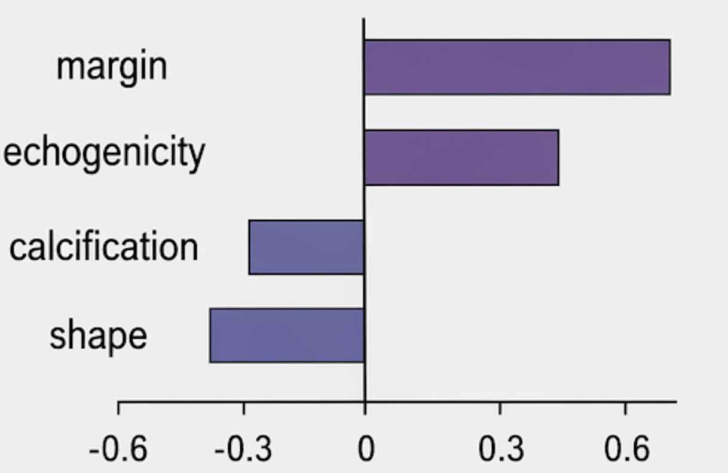
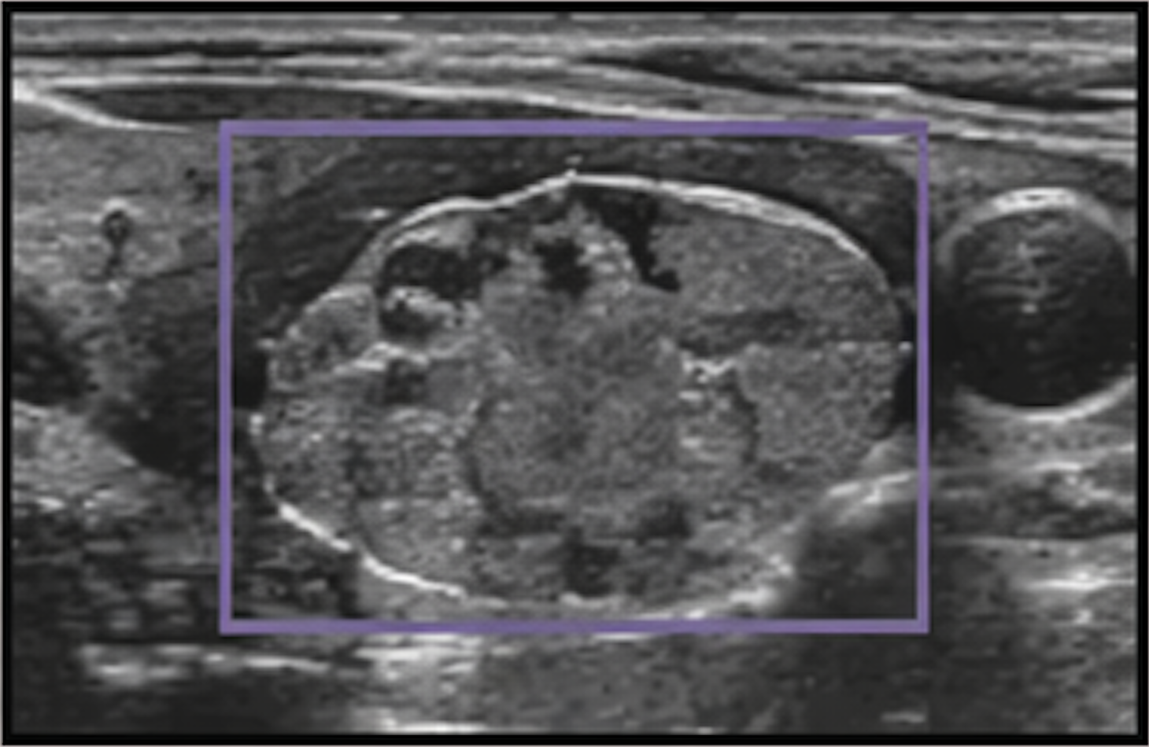


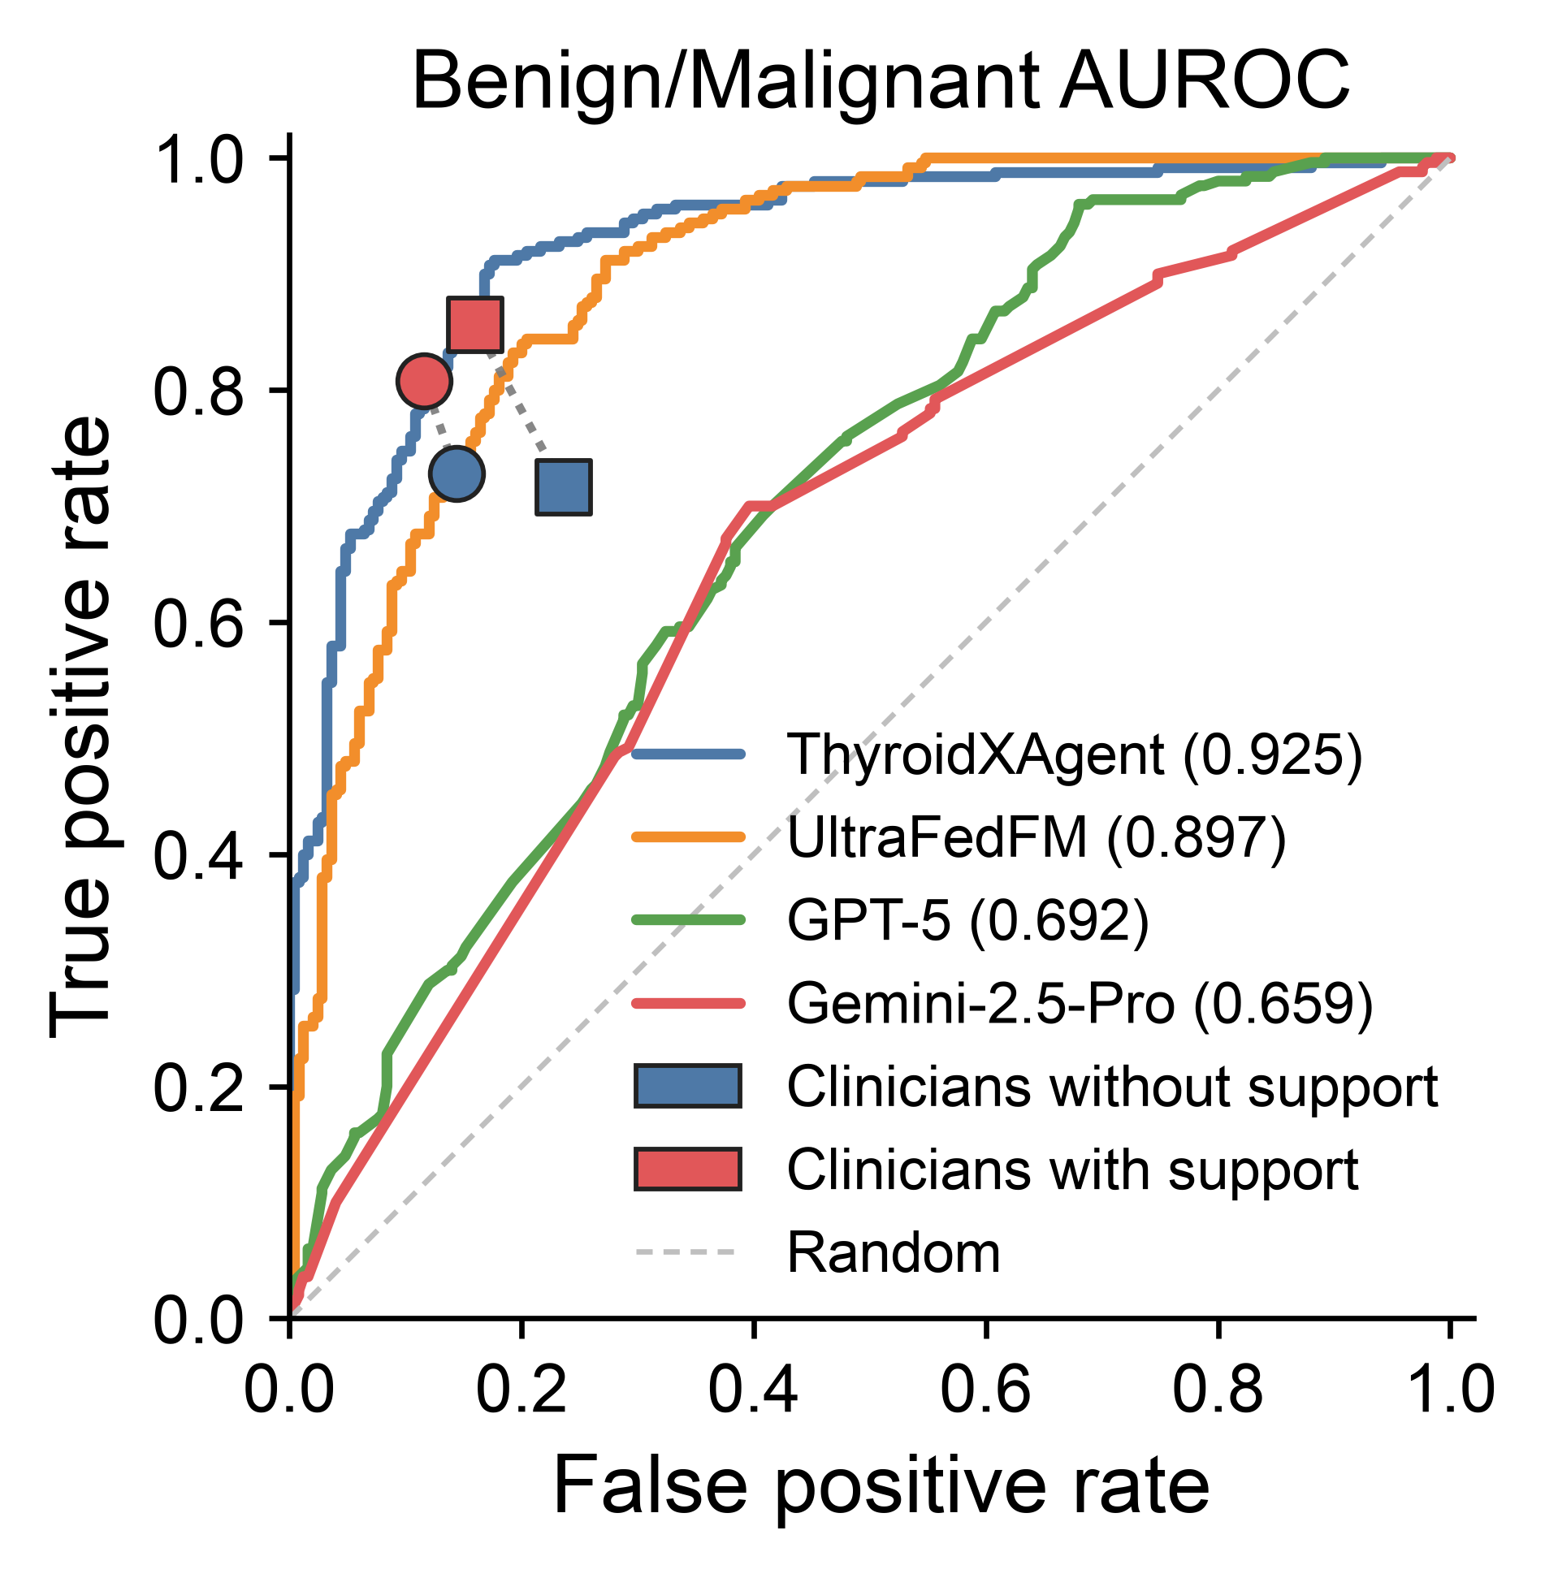
a
Human Input
Nodule Segmentation
Doctor Review
Assisted Diagnosis
Classify this Thyroid Nodule is Benign or Malignant
Reliable Mask?
Yes
SHAP feature analysis
No
Mask, SHAP features, and Class prediction
ThyroidXAgent
Doctor box annotation
Reliable segmentation updates SHAP features and classification confidence
Prediction: benign
Confidence: 0.86
Interactive medical Segmentation models
b
c
d
e
f
High
g
h
0.823
SHAPE: Sphericity
ThyroidXAgent
9.4mm
SHAPE: Elongation
MedSAM2
0.232
101.2mm
RLM: LRHGLE
MedSegX
0.288
Segmentation
INT: Skewness
87.0mm
INT: Median
TransUnet
10.6mm
0.730
GLCM: Corr
Feature Value
UltraFedFM
27.0mm
0.589
TEX(RLM)
ThyroidXAgent
0.819
TEX(GLCM)
MedSigLIP
0.520
0.823
RLM: SRLGLE
0.519
Classification
BiomedCLIP
0.434
INT: 10th pctl
0.450
Low
UltraFedFM
0.436
-3
-2
-1
0
1
2
3
0
0.2
0.4
0.465
SHAP contribution toward malignant (raw score)
Dice
0.6
0.8
1.0
HD95 ↓
AUROC
AUPRC
i
30.0
14.2 -> 9.2 s; 1.56x faster
j
Doctor Review
k
Normalized score(0~1; HD95 shows/110)
35.9% shorter segmentation time
20
1.0
22.5
15
0.9
10
35.9% shorter overall
5.1s/case saved
0.8
Segmentation time (s)
Manual– AI time (s)
Dice Score
15.0
5
0
0.7
7.5
-5
0.6
0.0
-10
0.5
Manual
N=30
AI-Assisted
N=30
Paired cases sorted by time saving
Manual
AI-Assisted

