Slide 1
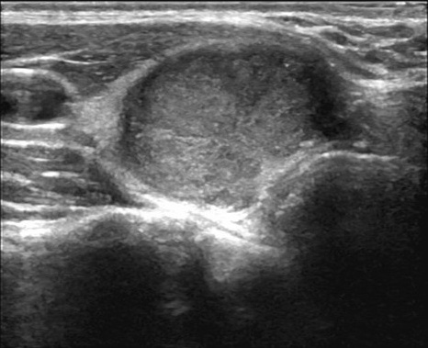





US Image
Seg Mask
Dataset consolidation
Fixed Preprocessing
ROI & Feature Extraction
Image / Pixel Confidence
Public Dataset Collection
Cls Label
Traditional: Static CAD process
ThyroidAgent: Dynamic CAD process
Joint Seg & Cls Labels,
Cross-Dataset Training
& Evaluation
Cls
Experts
Seg
Experts
Agent Result
Confidence
Reasoning
Select model …
Radiomics
Mask Select
US Image
Multi Experts
Result
selection
Infer
result
Seg Mask
Cls Label
Analysis of DataFactors
Affecting Generalizatior
ThyroidAgent
Metadata

