Slide 1
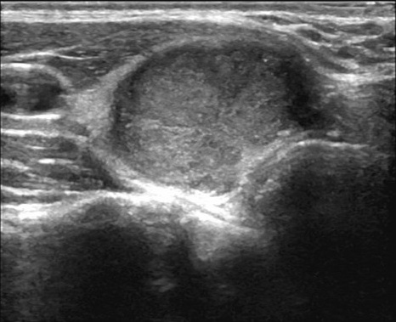

TRAINING(offline) & INFERENCE (online)
Base Public Datasets
(TN3K, DDTI, ThyroidXL, …)
Stacked Dataset Builder
Dataset division
Label harmonization
Train Seg/Cls
Experts
DINOV3-Unet
GAP+GMP → Attention
Experts Zoo
Metadata Registry
Validation priors
Model IDs + configs
Frozen checkpoints
Experts inference
Seg/Cls Evidence
Confidence
Agreement score
ThyroidAgent
Strict JSON decision
Ensemble
/ Select
Final Mask/Label
Preprocess
Ultrasound
Image
Experts Zoo
Context
/ Prompt
Radiomics
features

Slide 2


TRAINING(offline) & INFERENCE (online)
Base Public Datasets
(TN3K, DDTI, ThyroidXL, …)
Stacked Dataset Builder
Dataset division
Label harmonization
Train Seg/Cls
Experts
DINOV3-Unet
GAP+GMP → Attention
Experts Zoo
Metadata Registry
Validation priors
Model IDs + configs
Frozen checkpoints
Experts inference
Seg/Cls Evidence
Confidence
Agreement score
ThyroidAgent
Preprocess
Consensus
Context
/ Prompt
Final Mask/Label
Seg Masks
Ultrasound
Image
Cls Labels
Experts Zoo
Radiomics
features
Result Selection

