Slide 1
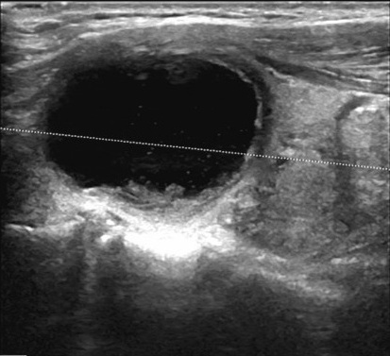

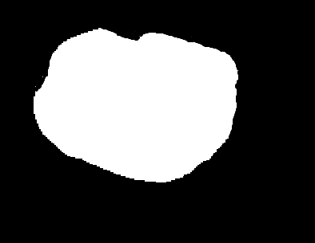


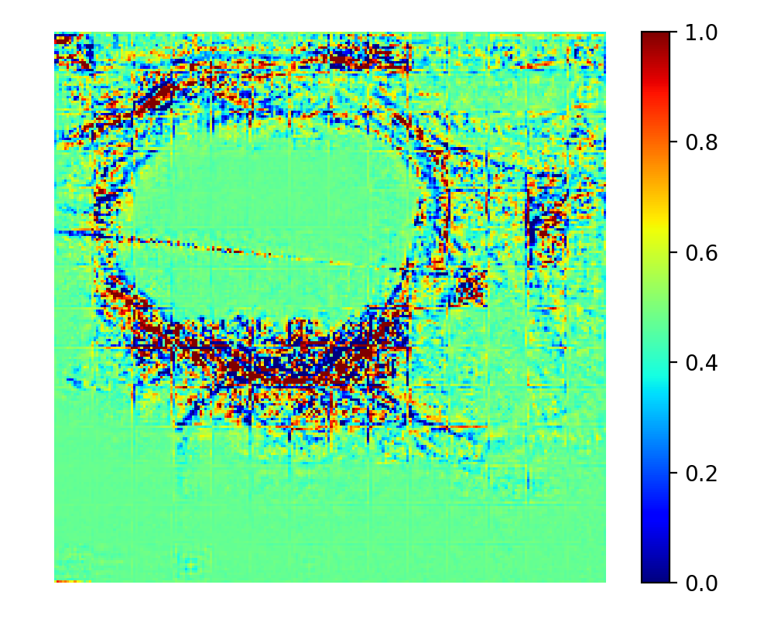
(c) Seg masks vs GT masks.
Image
GT Mask
(a) SHAP waterfall (classification)
(b) SHAP beeswarm (classification)
TransUnet
UltraFedFM
ThyAgent-Seg
HeatMap

Slide 2
(c) Seg masks vs GT masks.
Image
GT Mask
(a) SHAP waterfall (classification)
(b) SHAP beeswarm (classification)
TransUnet
UltraFedFM
ThyroidAgent
HeatMap

