Slide 1
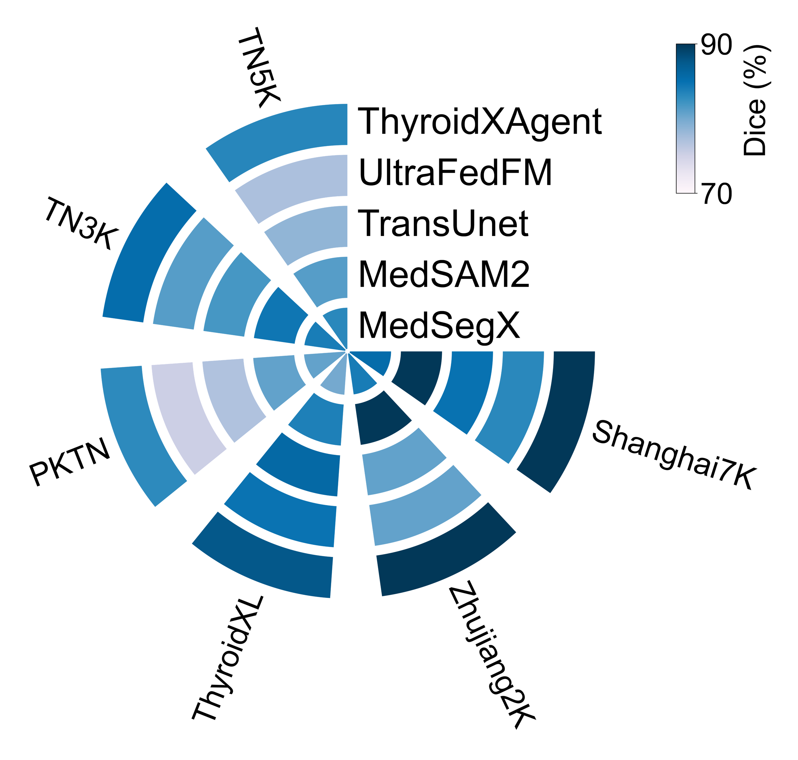
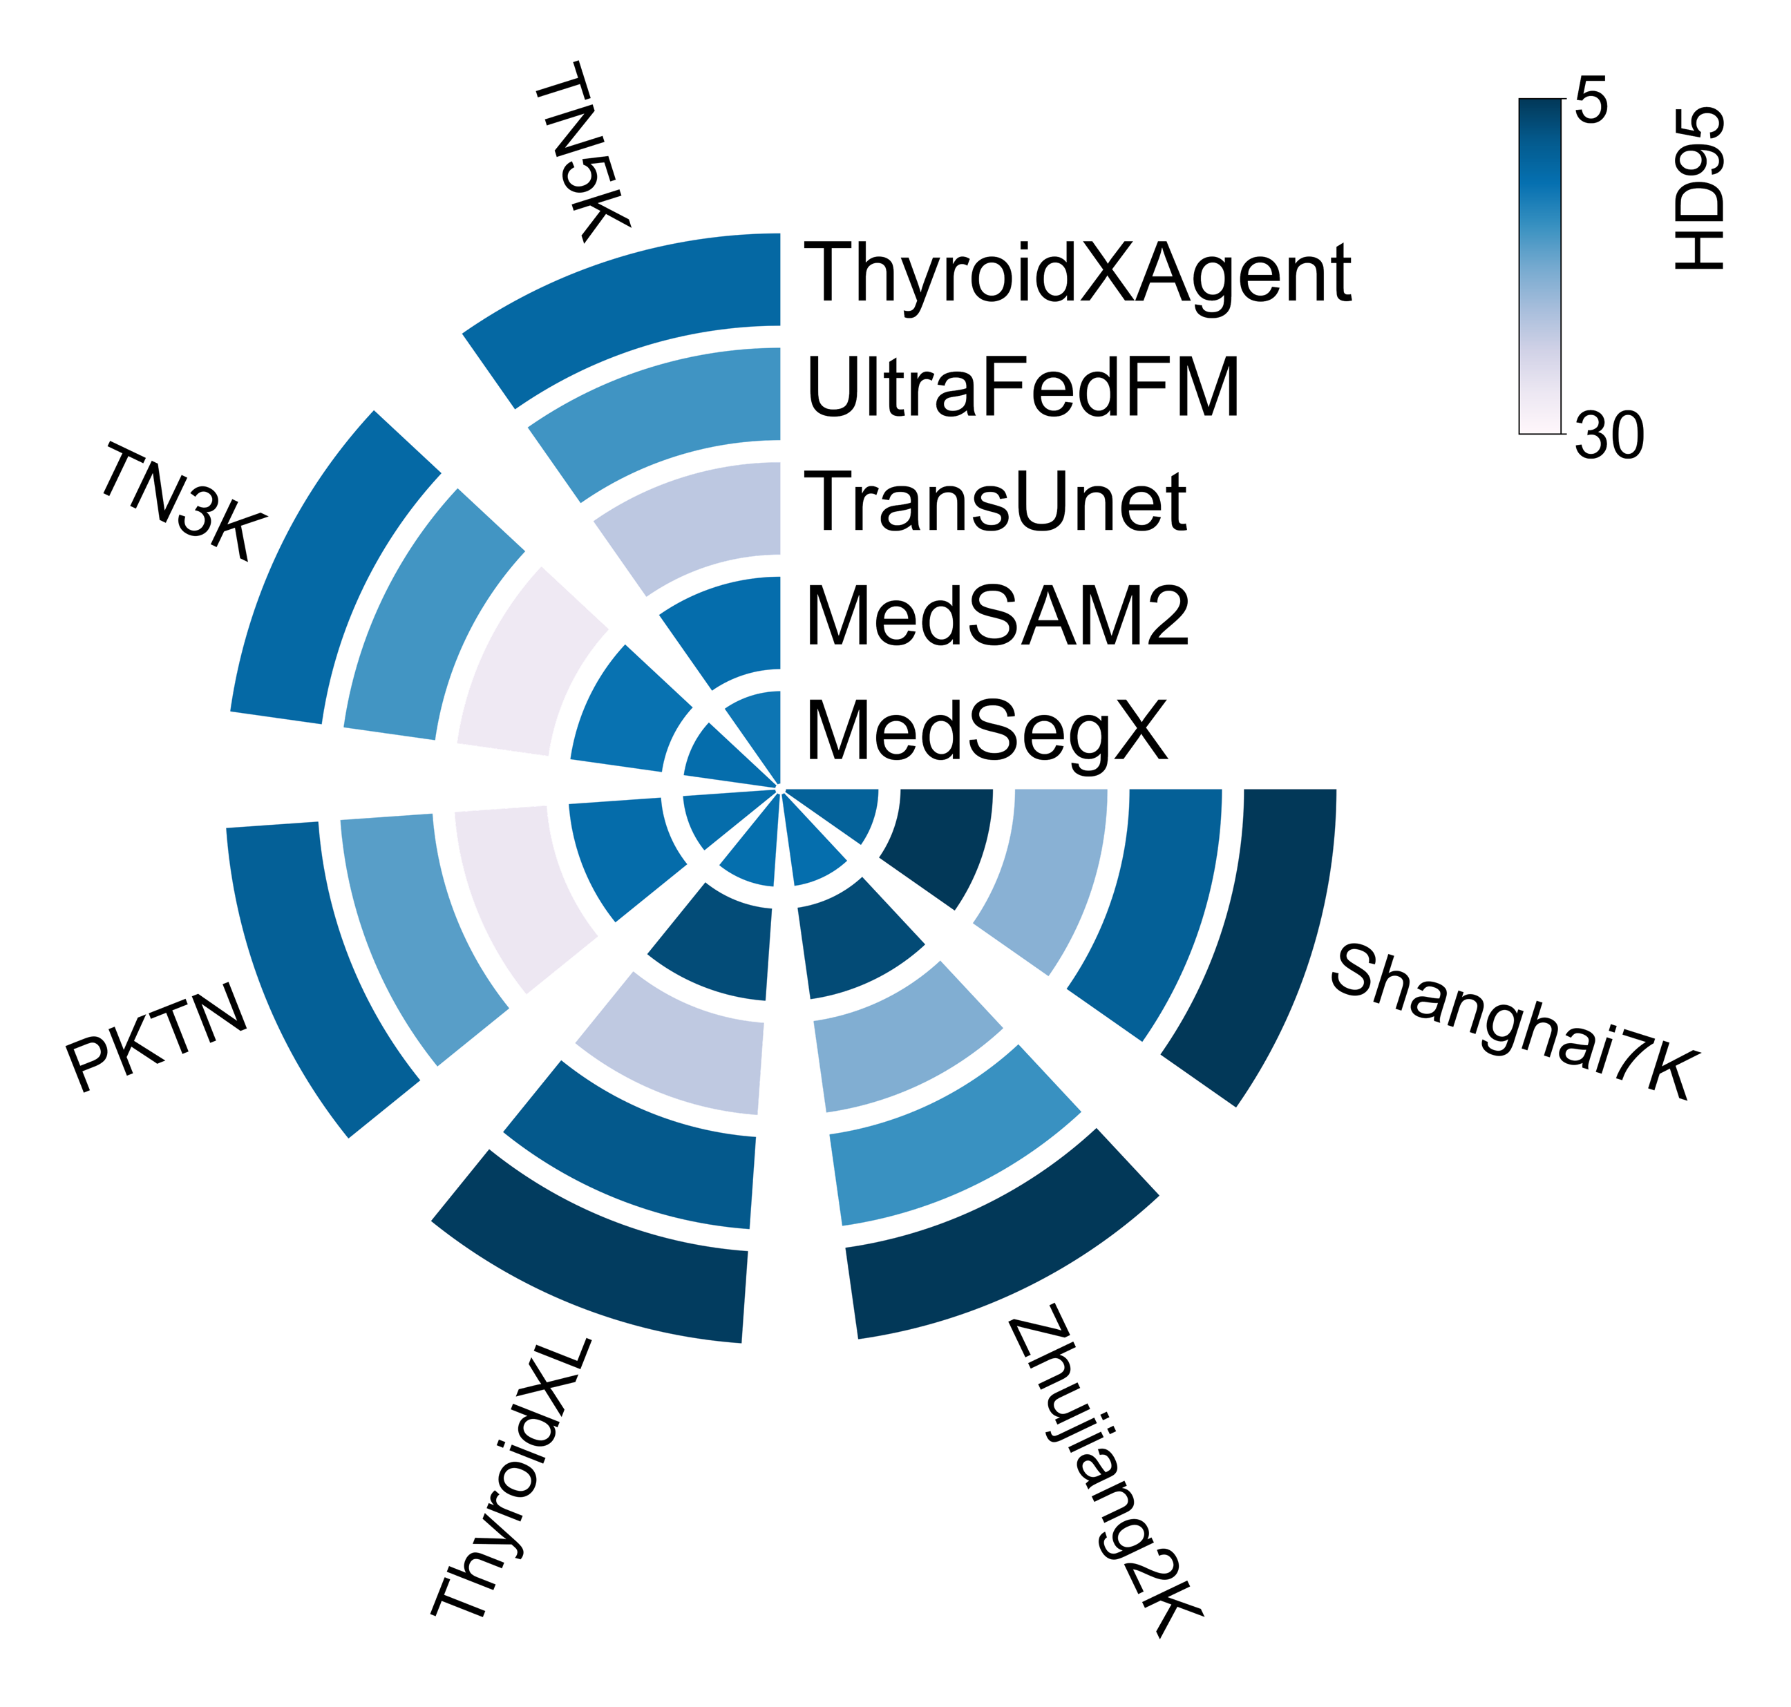
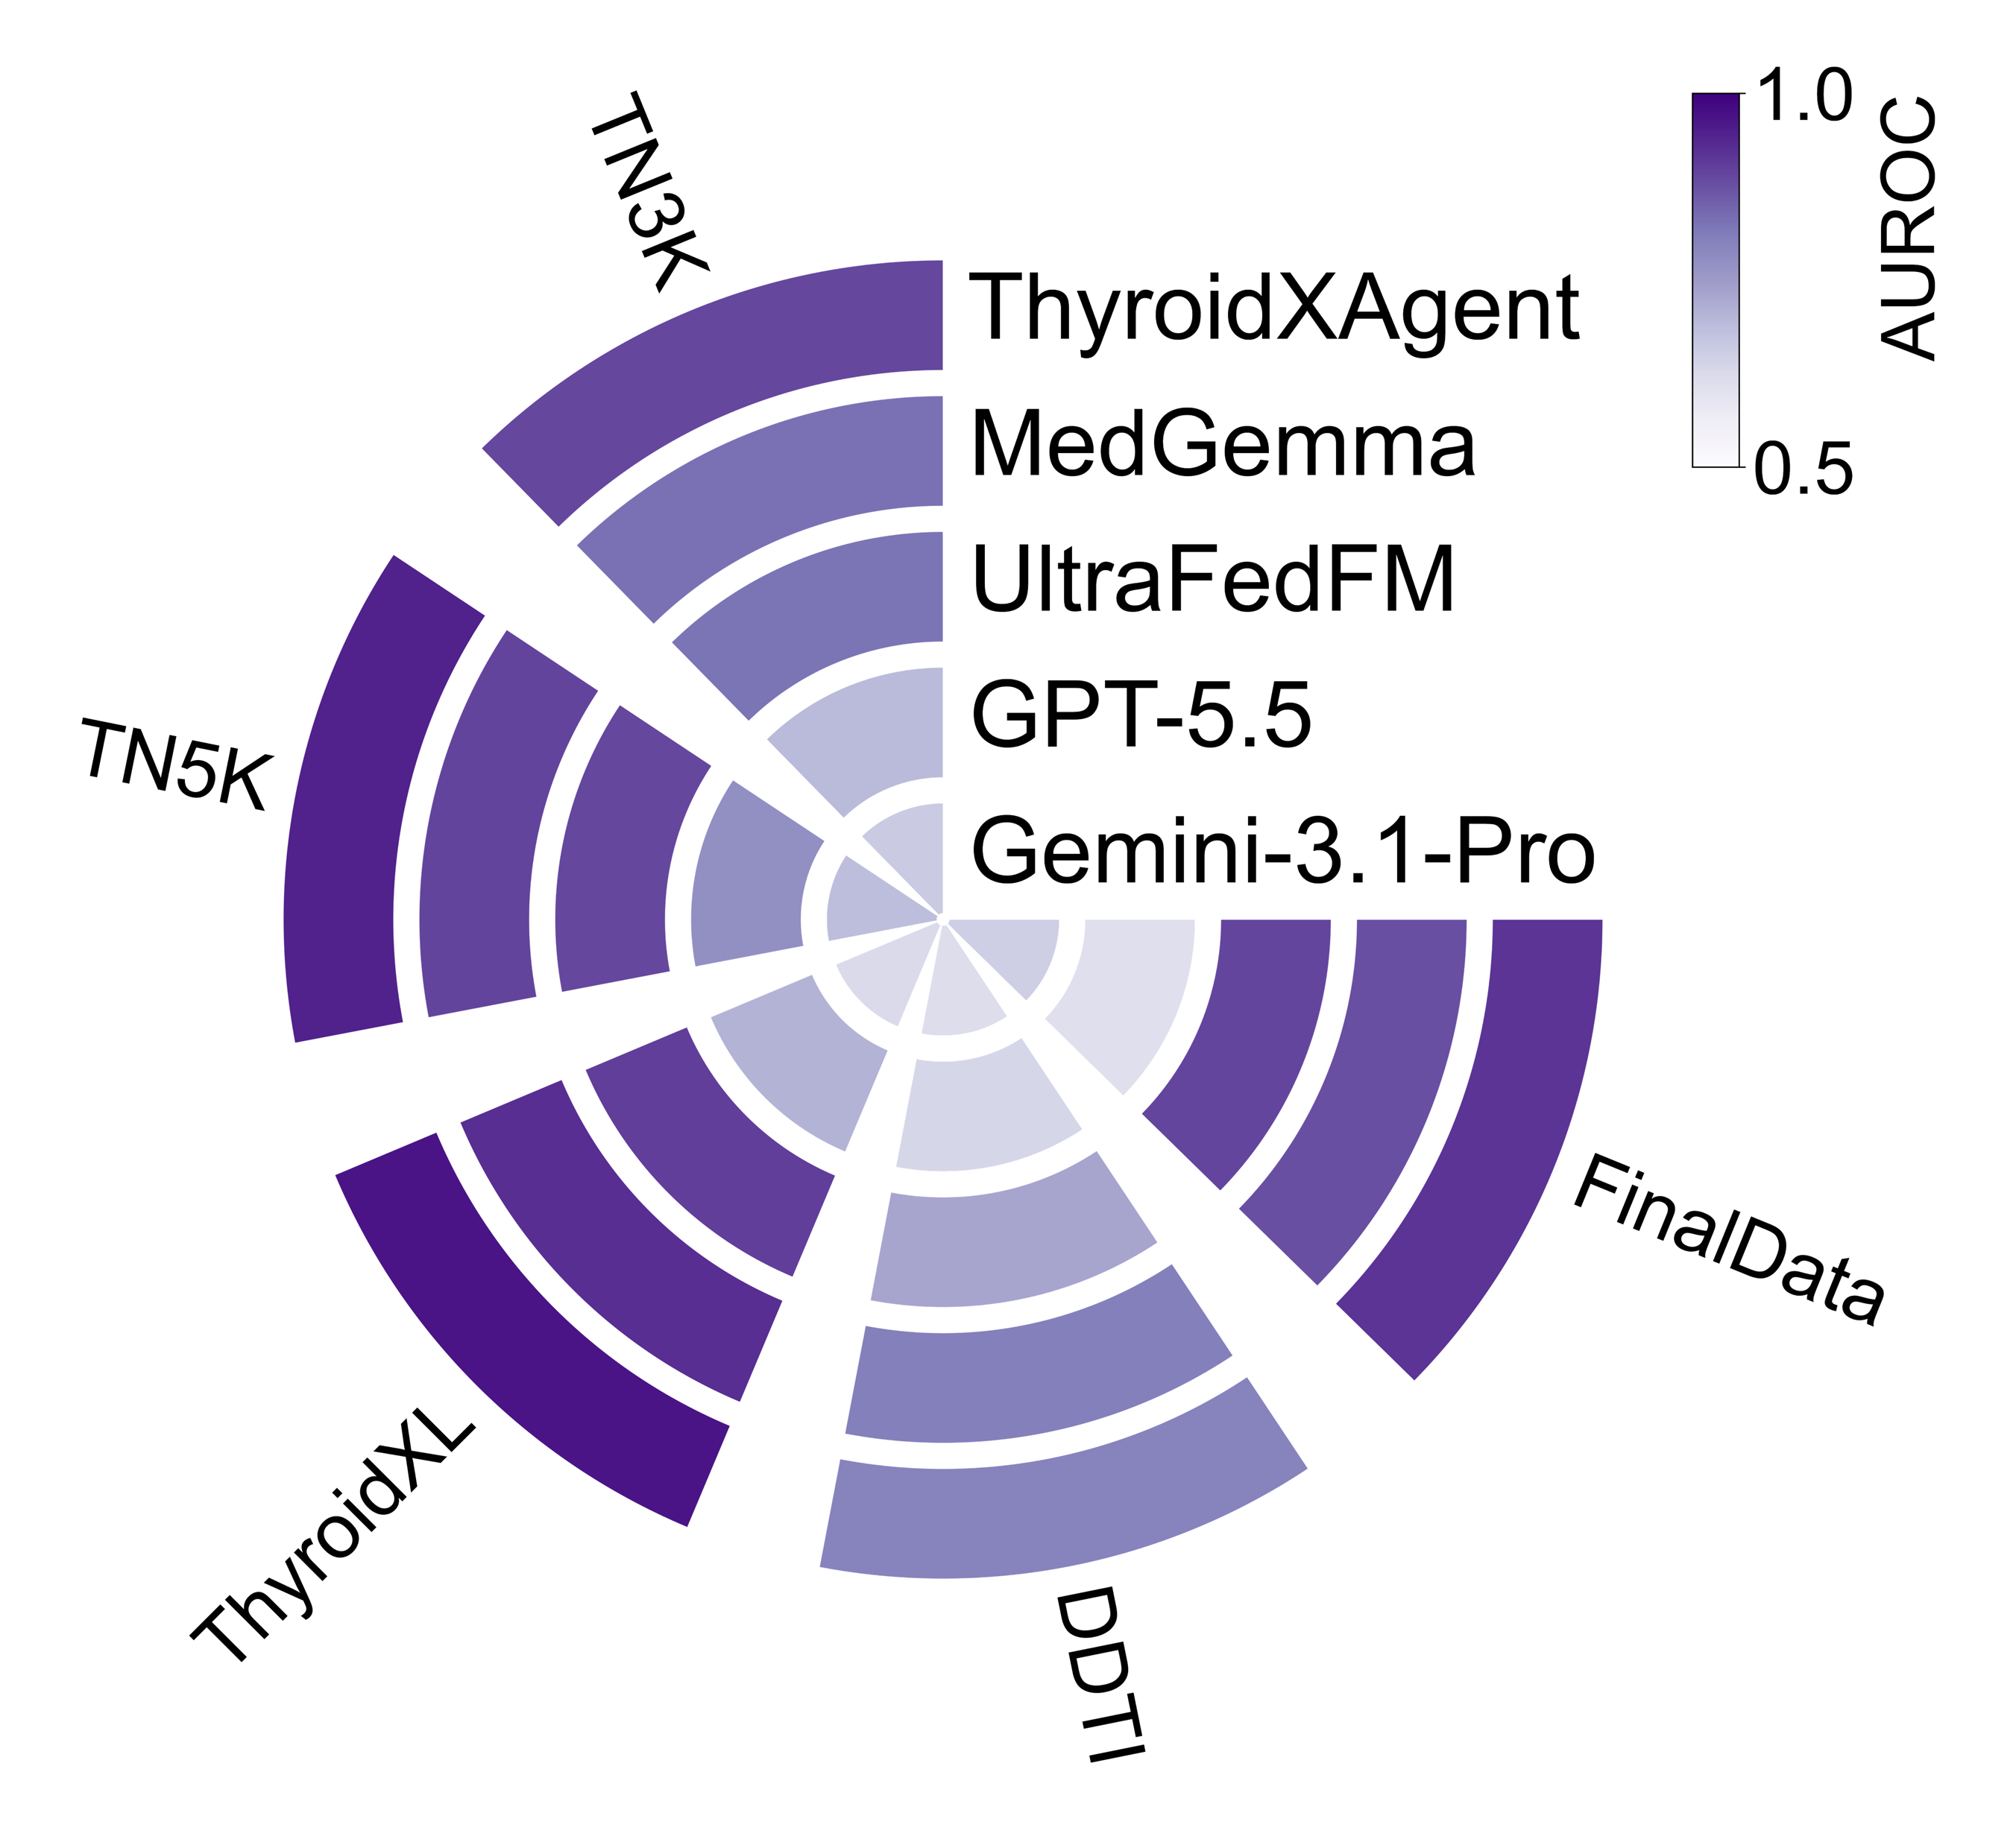
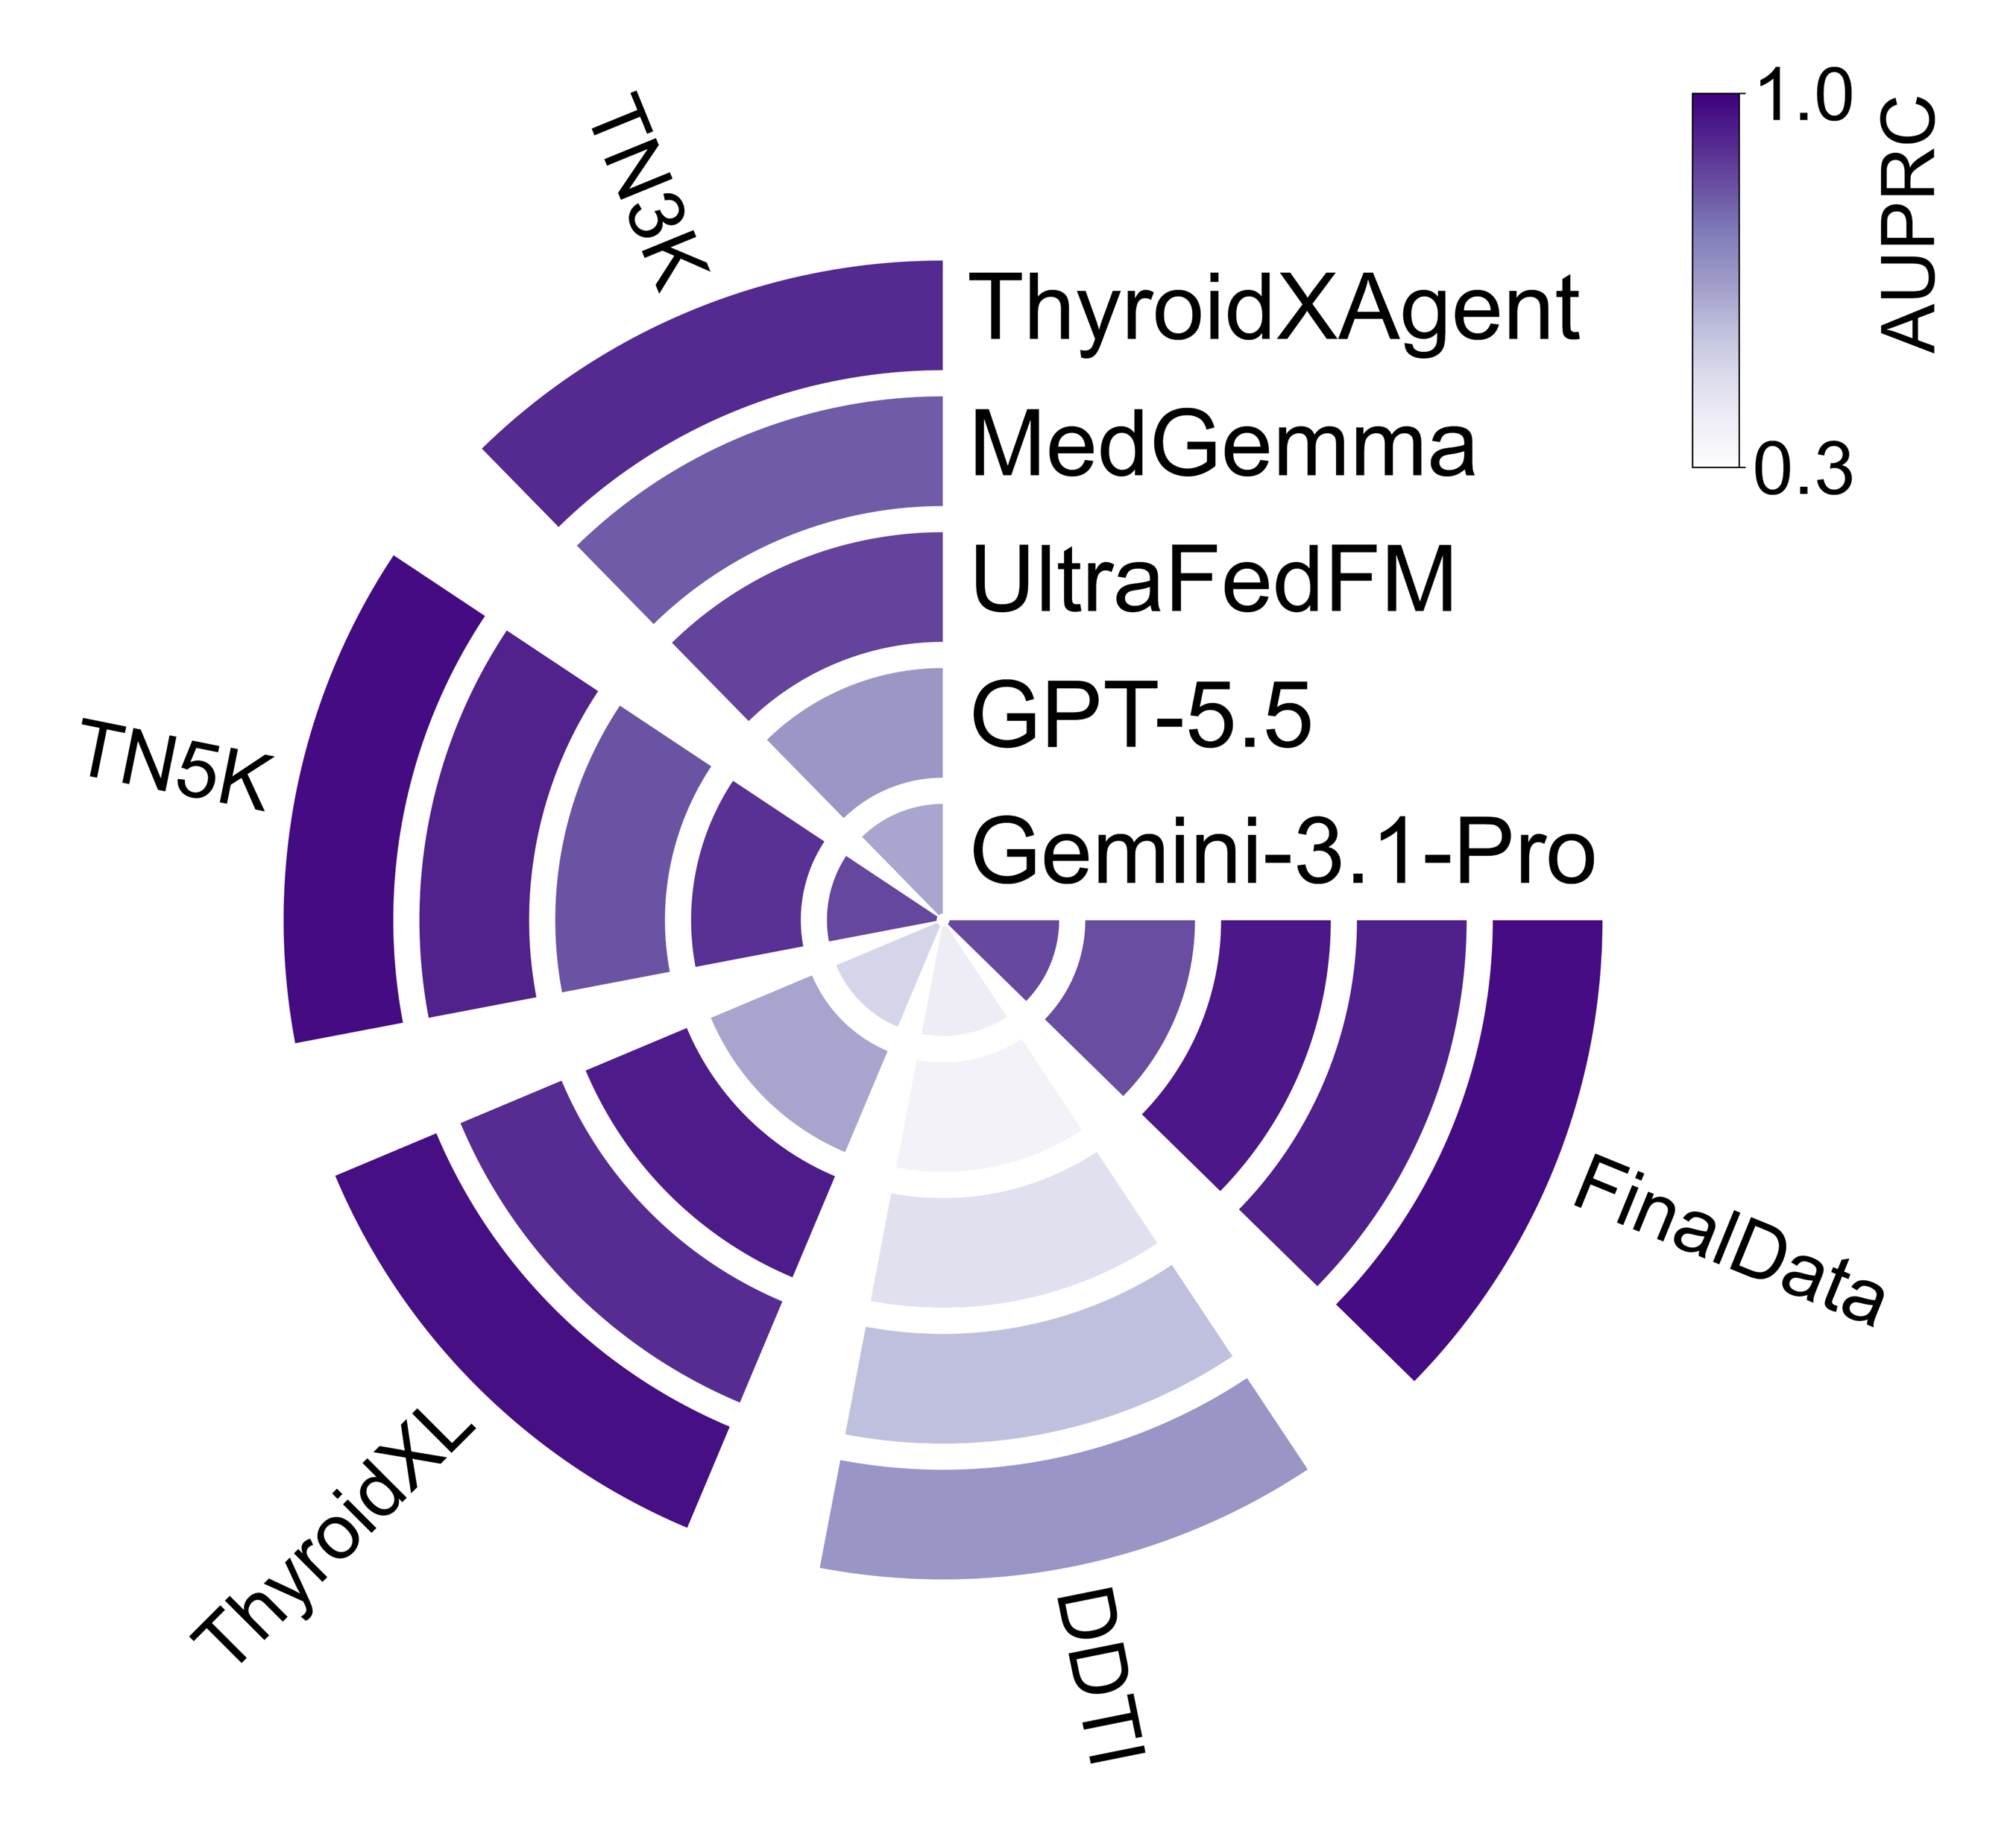
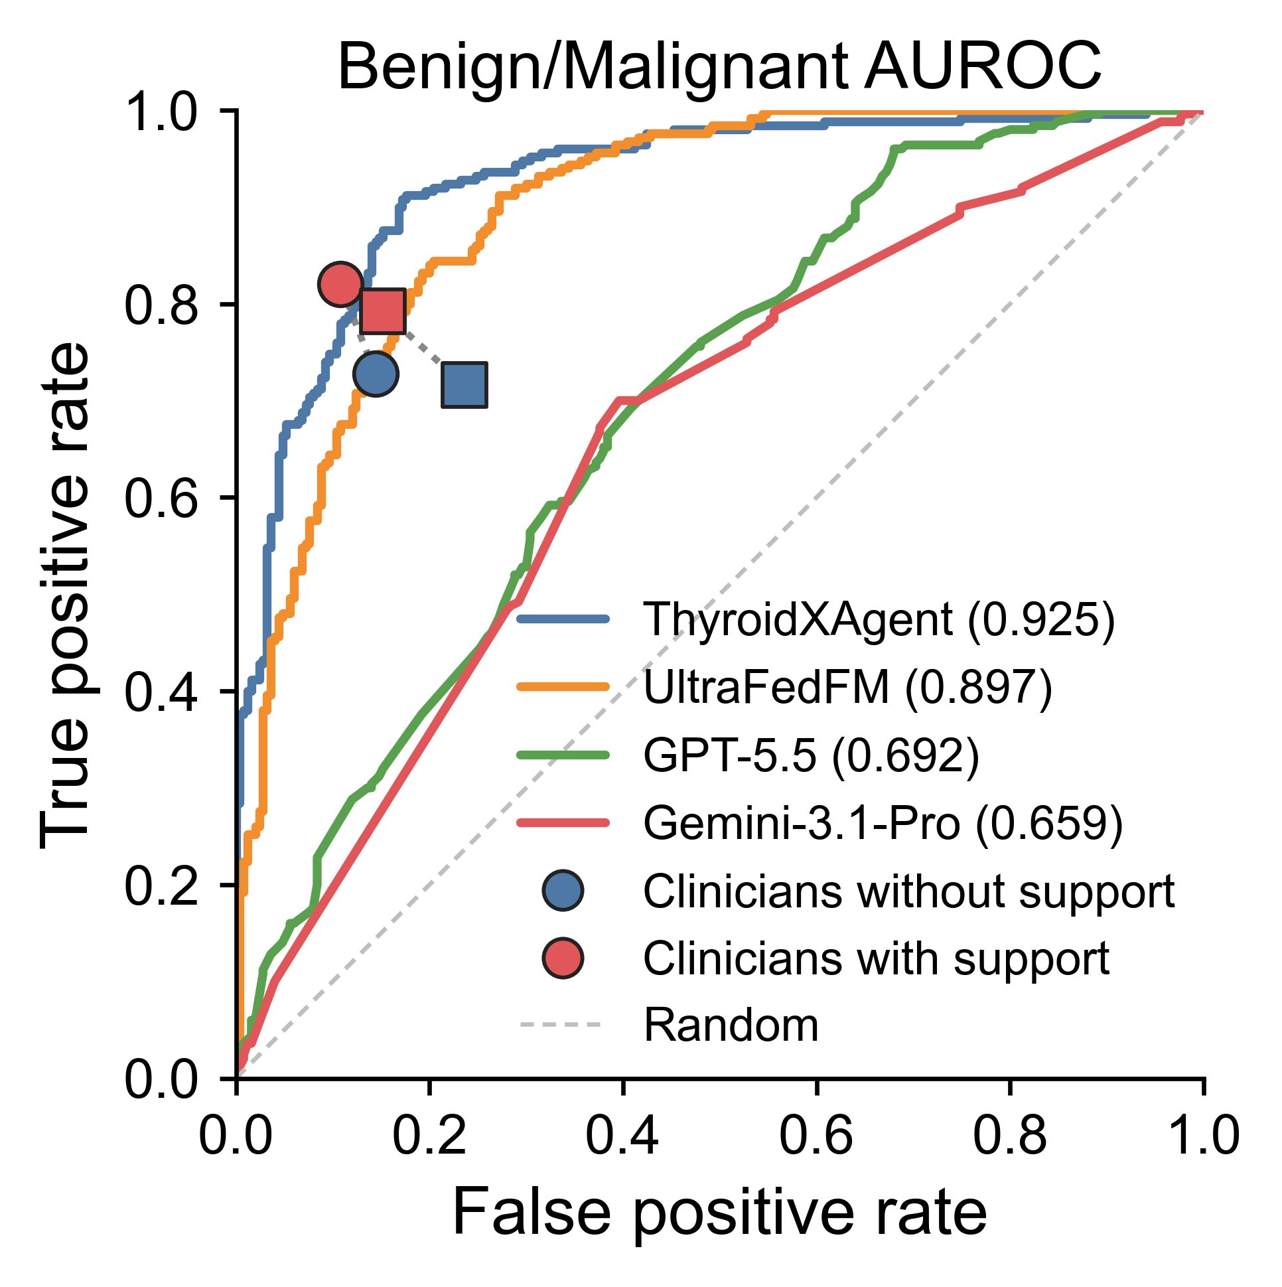
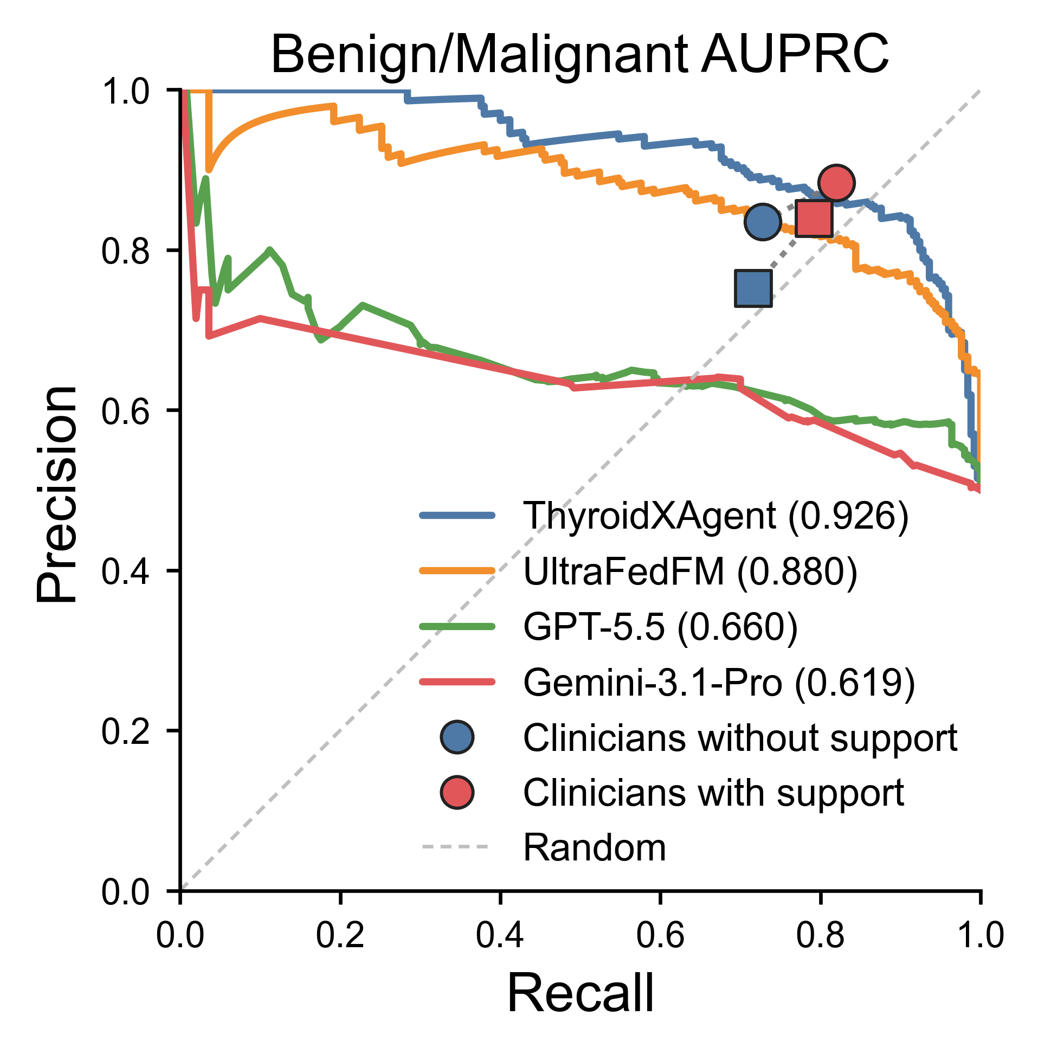
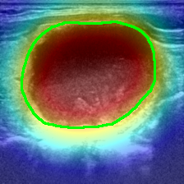
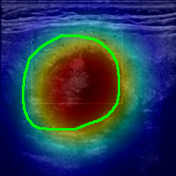
a
b
c
d
e
High
f
g
SHAPE: Sphericity
SHAPE: Elongation
RLM: LRHGLE
INT: Skewness
INT: Median
Feature Value
GLCM: Corr
TEX(RLM)
TEX(GLCM)
RLM: SRLGLE
INT: 10th pctl
-3
-2
-1
0
1
2
3
Low
SHAP contribution toward malignant (raw score)
h
Toward
malignant
Toward
benign
i
Toward
benign
benign
Toward
malignant
benign
SHAPE: Sphericity
SHAPE: Elongation
GLCM: Corr
RLM: RLNU
SHAPE: Elongation
SHAPE: Sphericity
RLM: LRHGLE
TEX(RLM): RLNUN
SHAPE: Perim/Area
RLM: SRLGLE
-2
-1
0
1
2
-0.4
-0.2
0.0
0.2
0.4
SHAP contribution toward malignant (raw score)
SHAP contribution toward malignant (raw score)

Slide 2
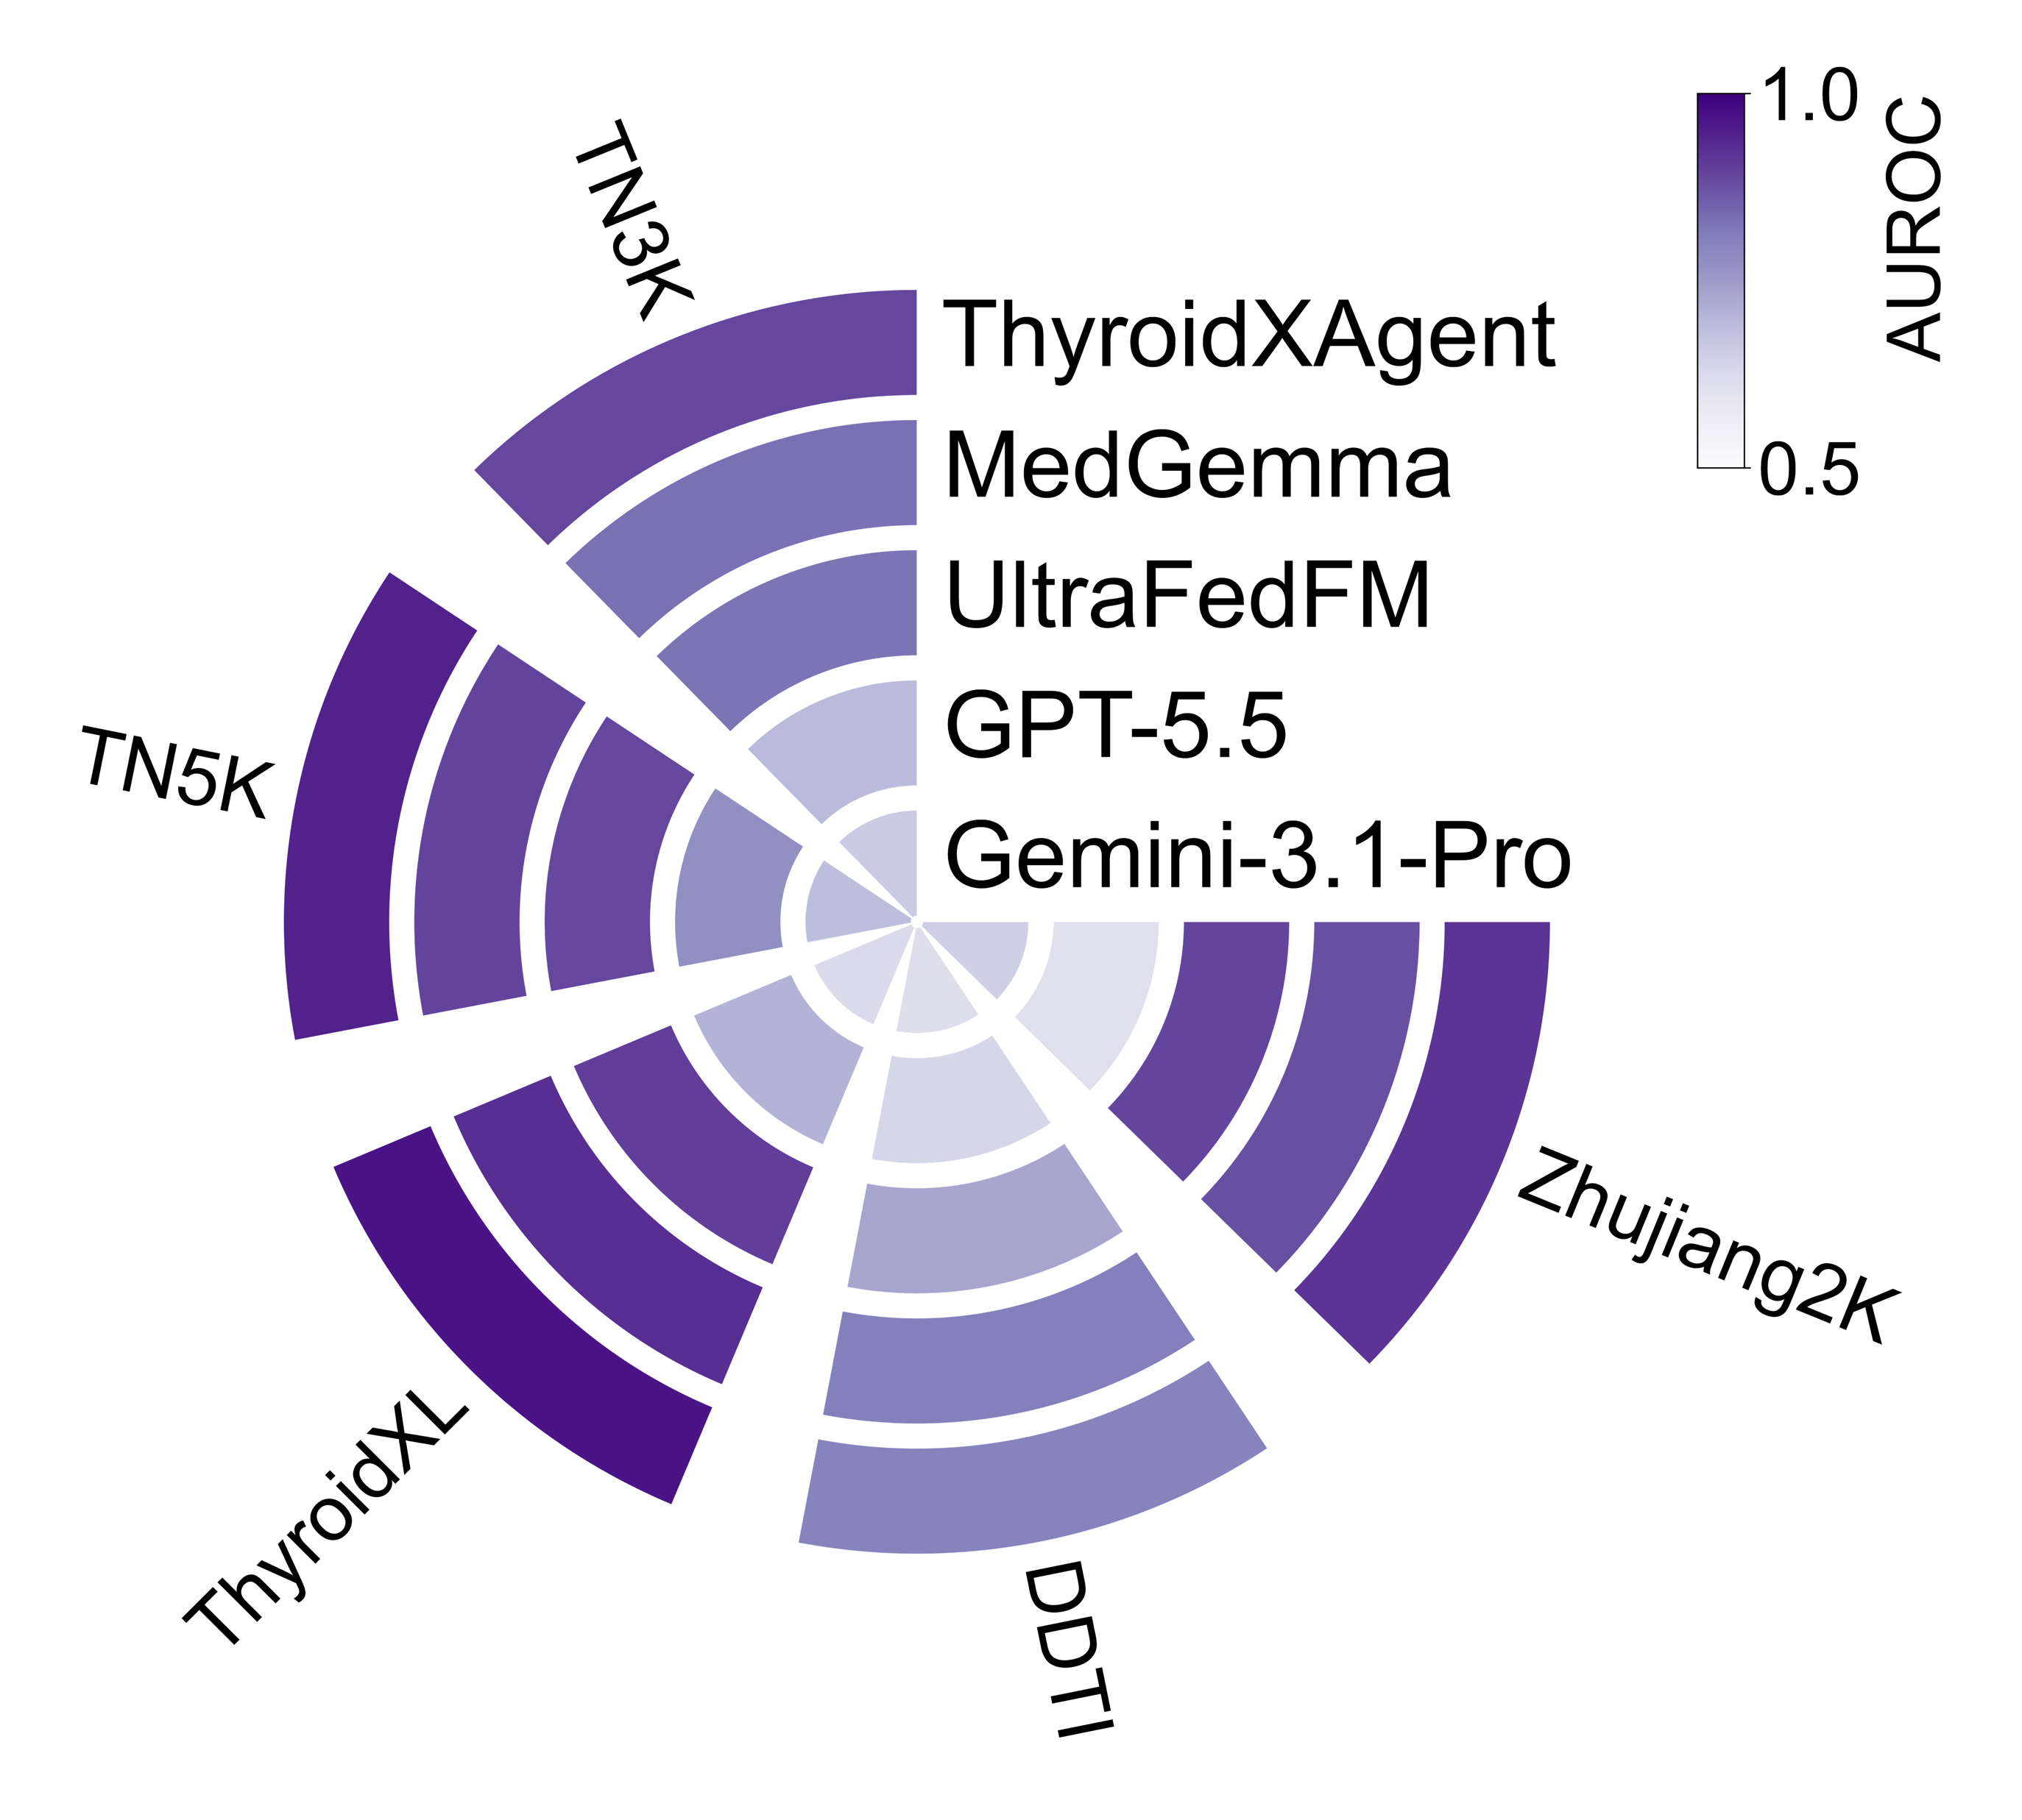
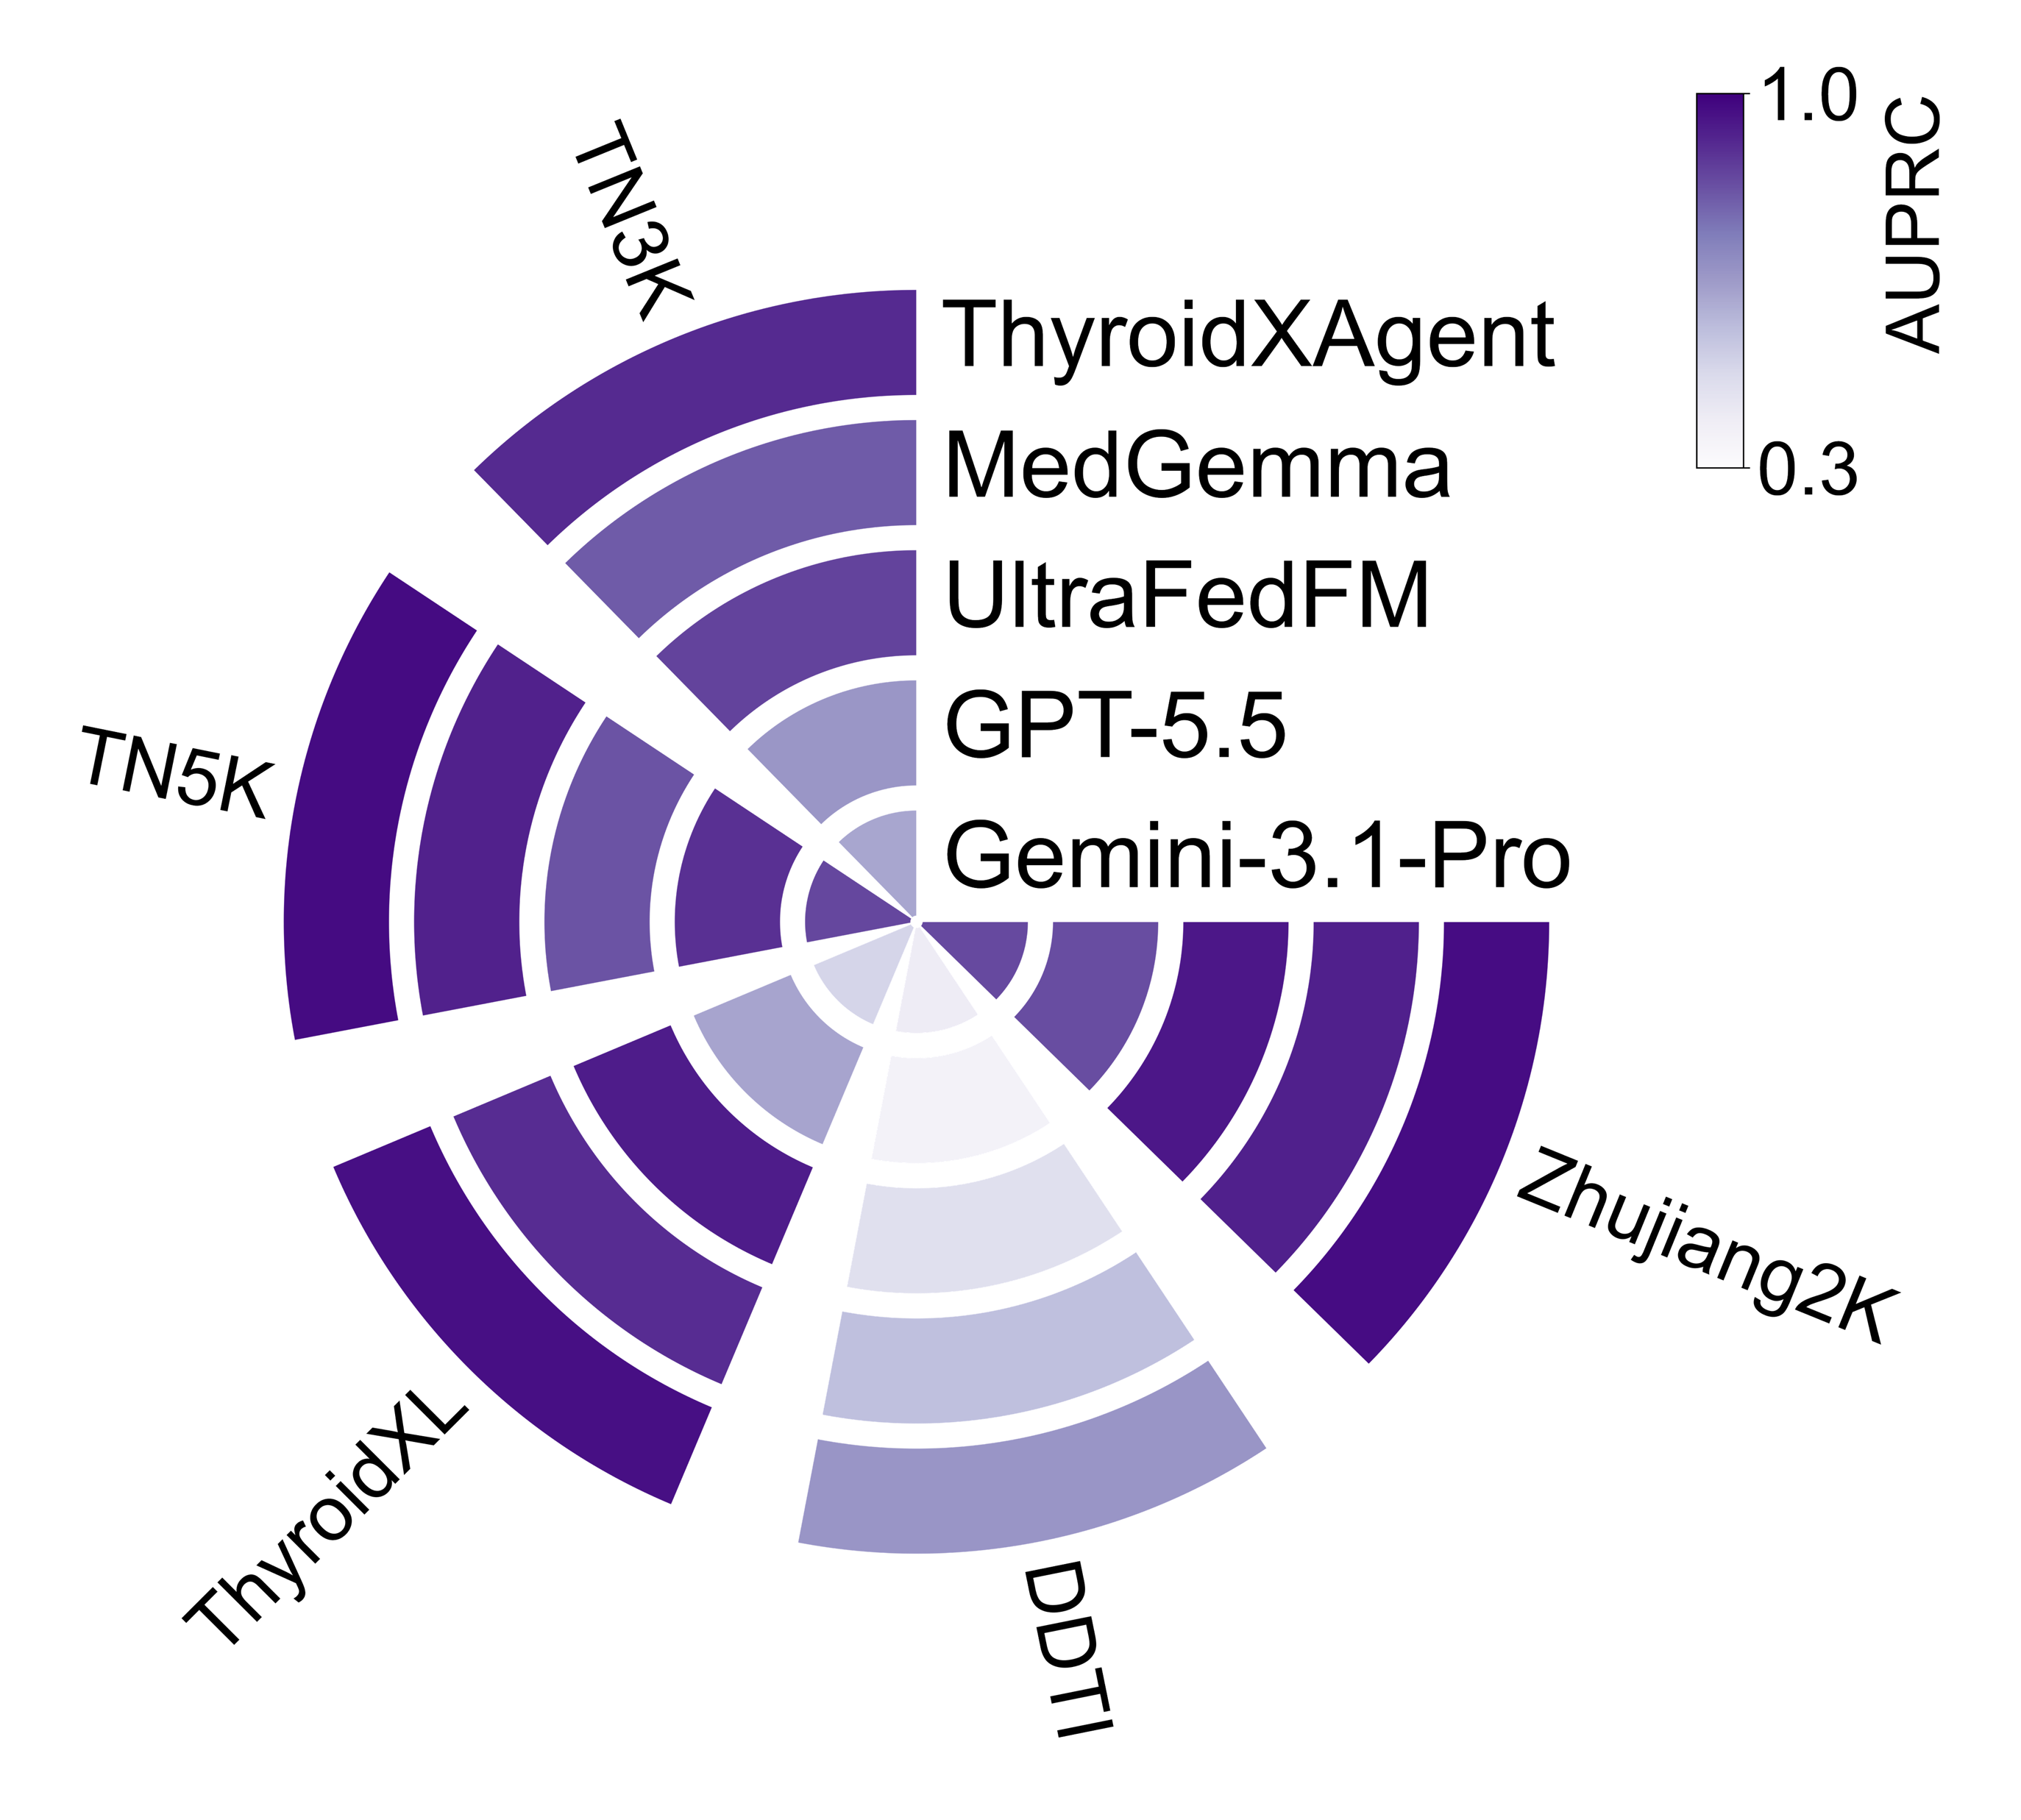
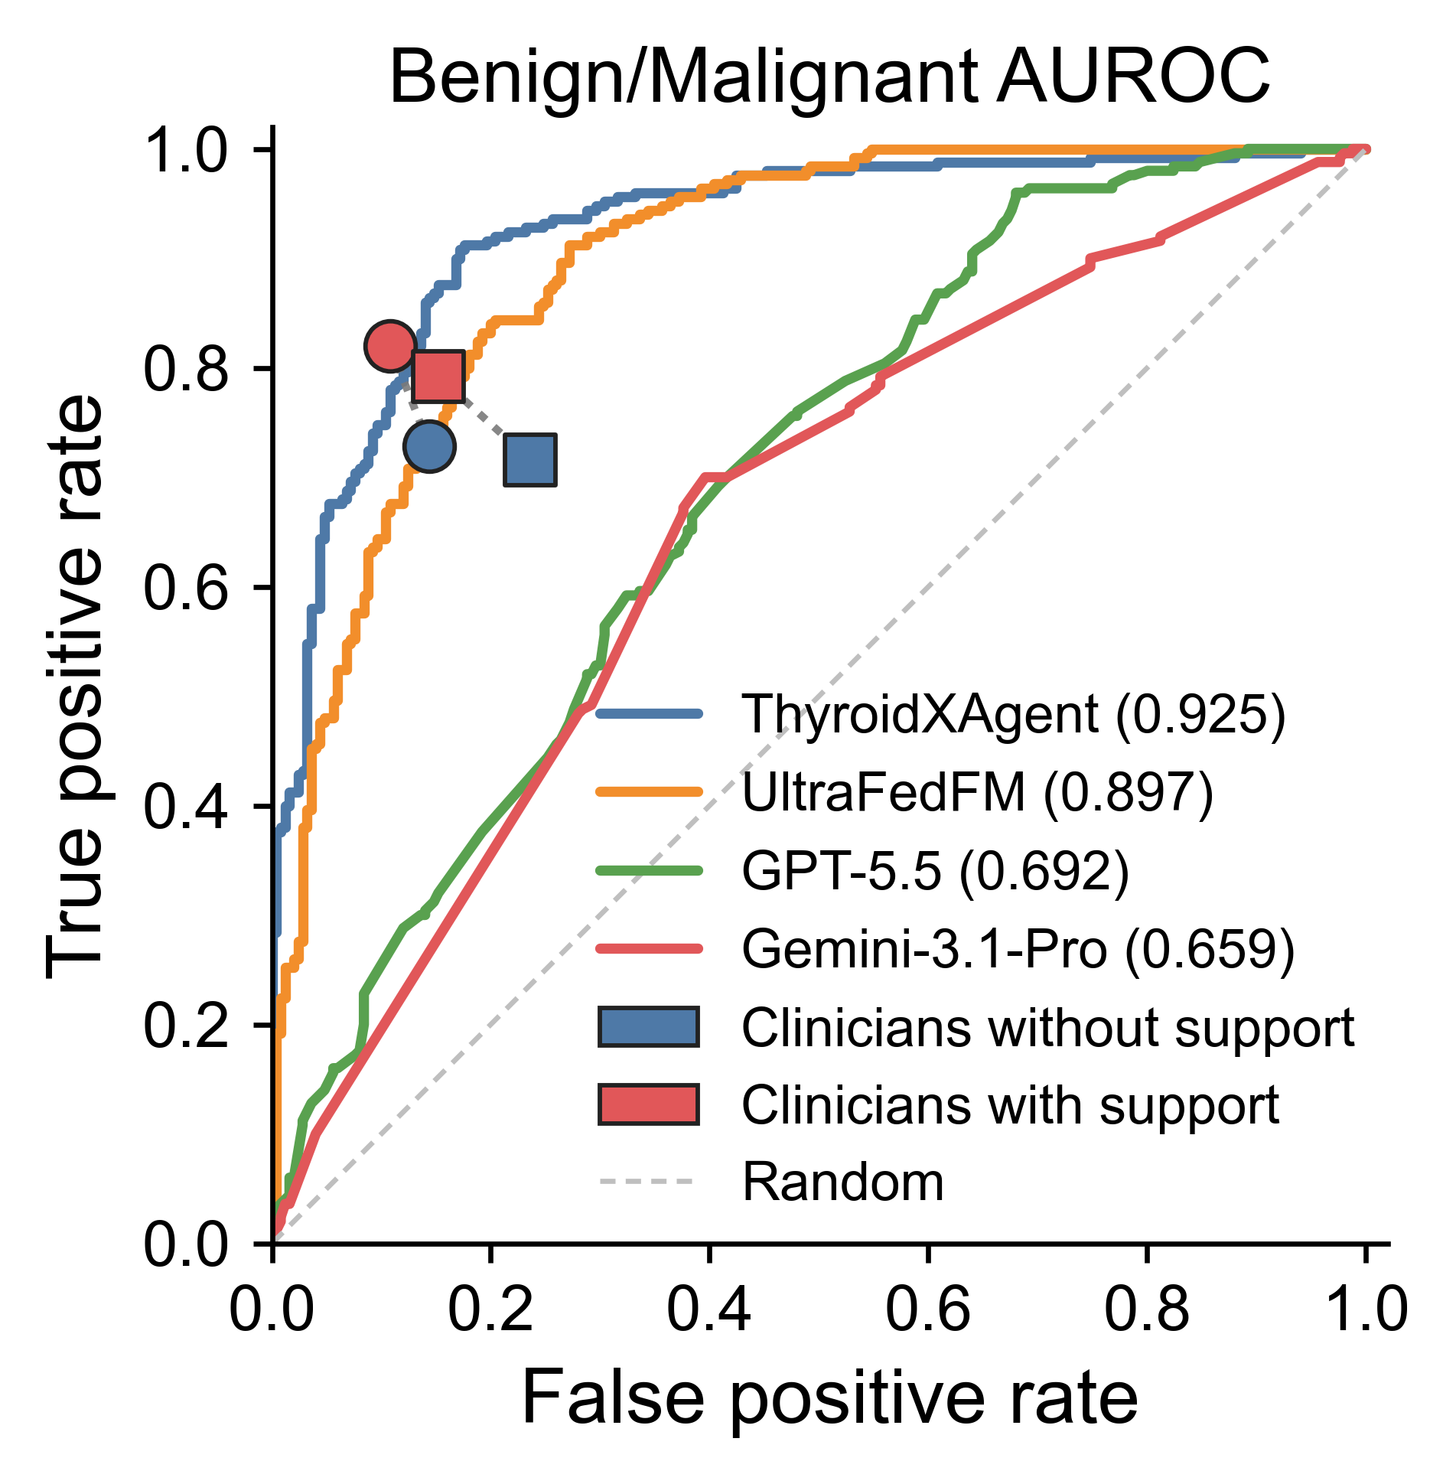
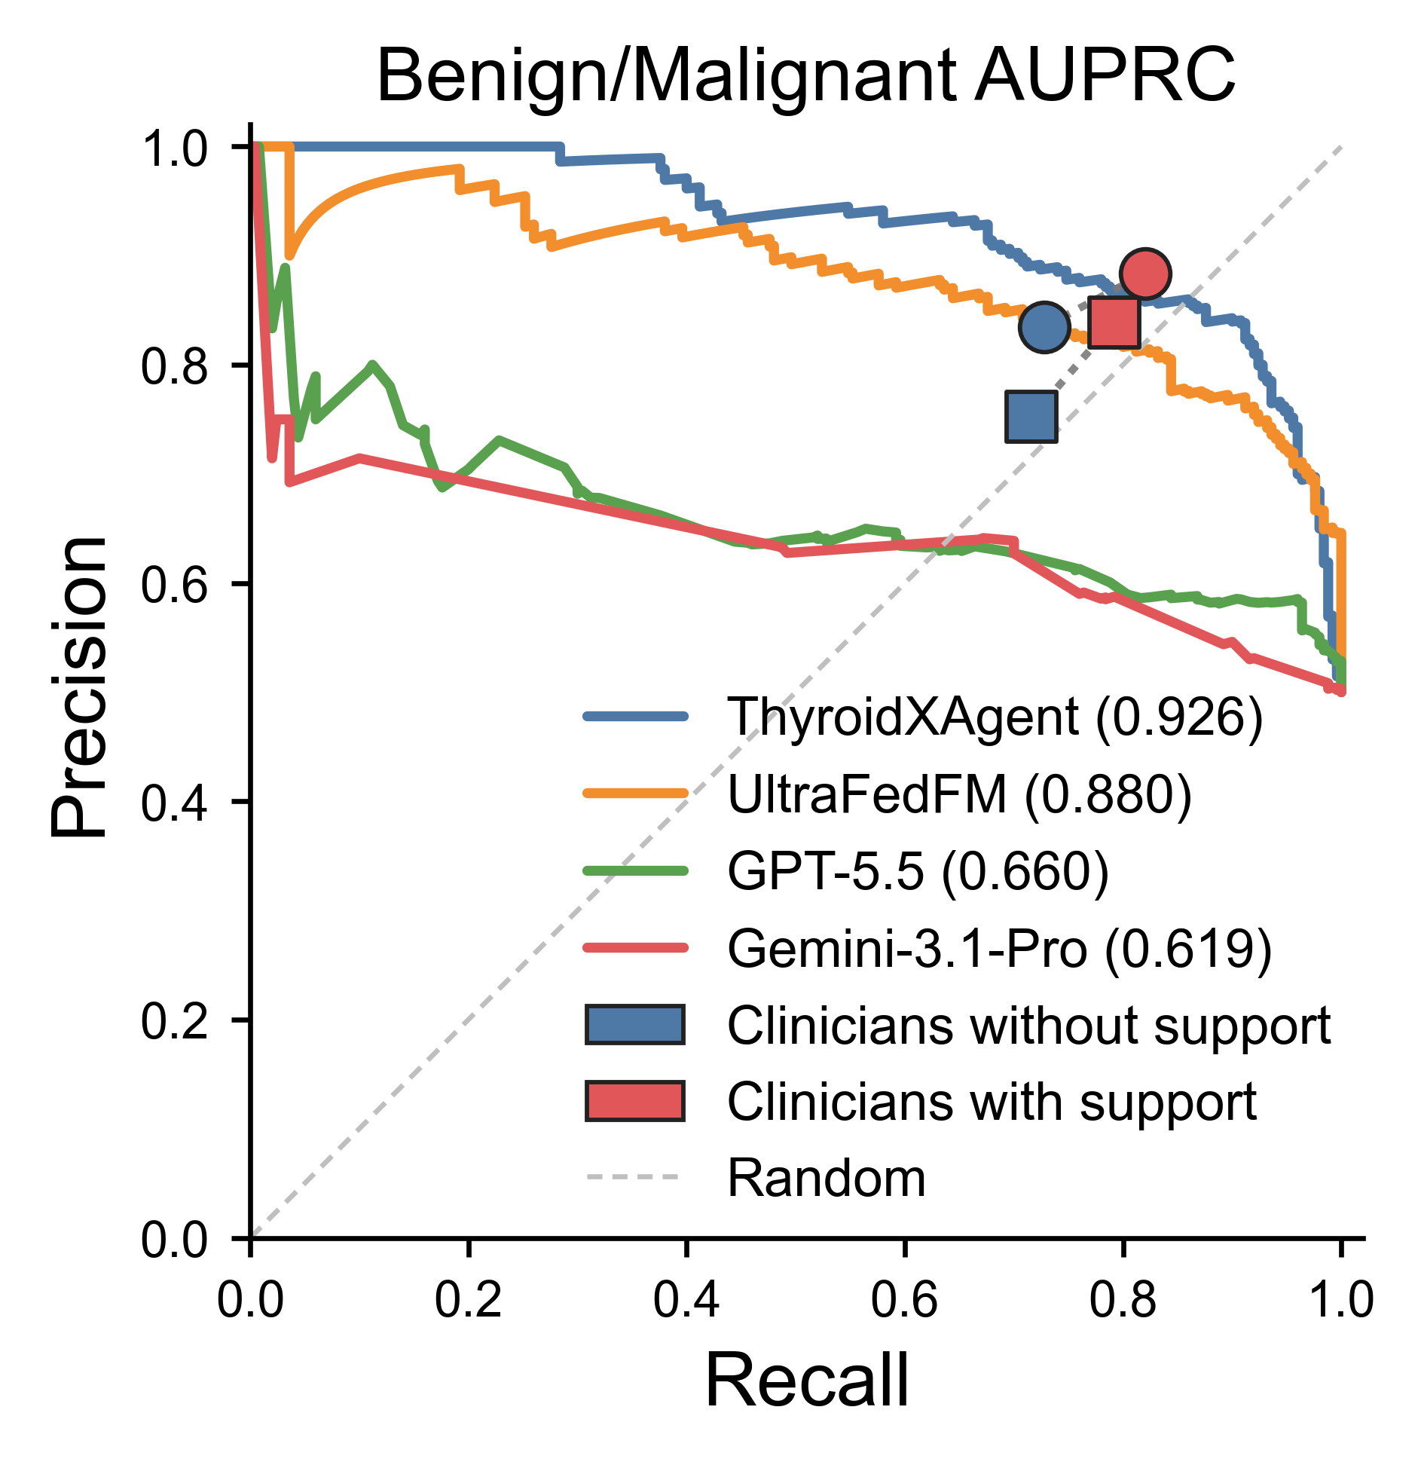

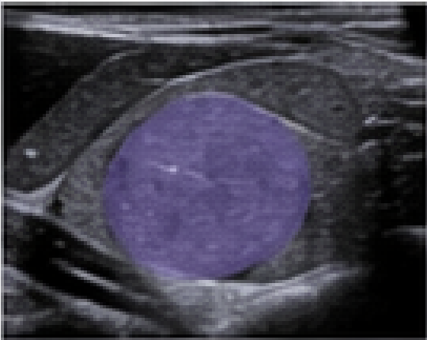
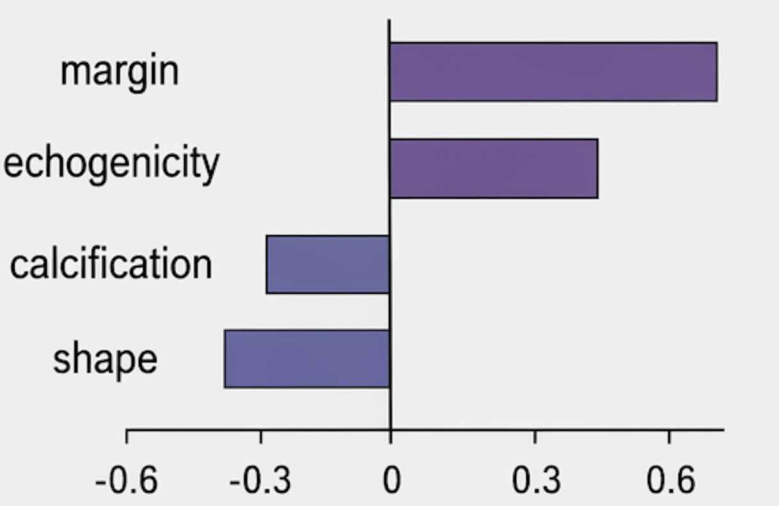

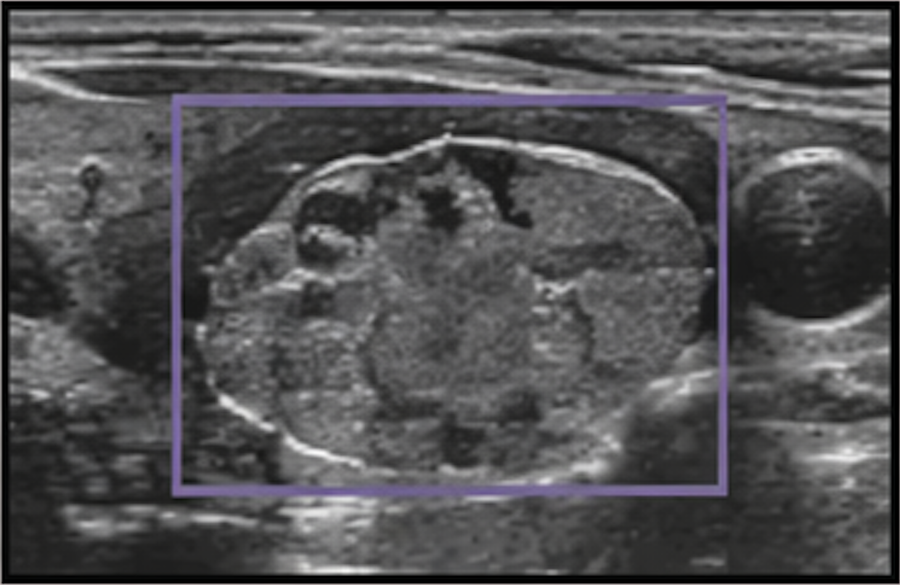
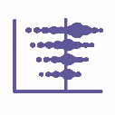

a
b
c
d
e
High
f
g
SHAPE: Sphericity
SHAPE: Elongation
RLM: LRHGLE
INT: Skewness
INT: Median
Feature Value
GLCM: Corr
TEX(RLM)
TEX(GLCM)
RLM: SRLGLE
INT: 10th pctl
-3
-2
-1
0
1
2
3
Low
h
SHAP contribution toward malignant (raw score)
Human Input
Doctor Review
Assisted Diagnosis
Classify this Thyroid Nodule is Benign or Malignant
Nodule Segmentation
Reliable Mask?
Yes
Mask, SHAP features, and Class prediction
SHAP feature analysis
No
ThyroidXAgent
Doctor box annotation
Reliable segmentation updates SHAP features and classification confidence
Prediction: benign
Confidence: 0.86
Interactive medical Segmentation models

Slide 3
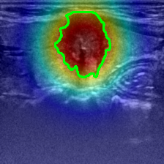
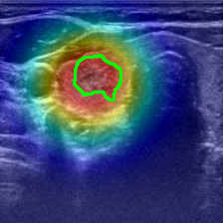
a
Toward
malignant
Toward
benign
b
Toward
malignant
Toward
benign
benign
benign
SHAPE: Sphericity
SHAPE: Elongation
GLCM: Corr
RLM: RLNU
SHAPE: Elongation
SHAPE: Sphericity
RLM: LRHGLE
TEX(RLM): RLNUN
SHAPE: Perim/Area
RLM: SRLGLE
INT: Interquartile Range
SHAPE: Perim/Area
RLM: SRLGLE
TEX(GLCM): Cluster Prominence
NGTDM: Contrast
SHAPE: Perimeter
INT: Variance
RLM: LRHGLE
TEX(DM): Gray Level V
GLCM: Corr
-2
-1
0
1
2
-0.4
-0.2
0.0
0.2
0.4
SHAP contribution toward malignant (raw score)
SHAP contribution toward malignant (raw score)
c
Toward
malignant
Toward
benign
malignant
d
Toward
malignant
Toward
benign
malignant
SHAPE: Elongation
SHAPE: Sphericity
SHAPE: Sphericity
RLM: LRHGLE
RLM: SRE
INT: Skewness
SHAPE: Perimeter
INT: Median
TEX(RLM): RLNUN
TEX(GLCM): Cluster Shade
INT: Skewness
INT: 10th pctl
RLM: SRLGLE
RLM: LRLGLE
TEX(GLCM): Cluster Shade
INT: Kurtosis
INT: Median
INT: Mean
RLM: LRHGLE
TEX(GLCM): Joint Average
-1.5
-1.0
-0.5
0.0
0.5
1.0
1.5
-3
-2
-1
0
1
2
3
SHAP contribution toward malignant (raw score)
SHAP contribution toward malignant (raw score)
Notes:
ThyroidXL_train_00002730_C9690598_1.png
TN3K_test_0040.jpg
ThyroidXL_test_00000364_B1B830C3_3.png
ThyroidXL_test_00002838_A9C56A4B_0.png

