Slide 1










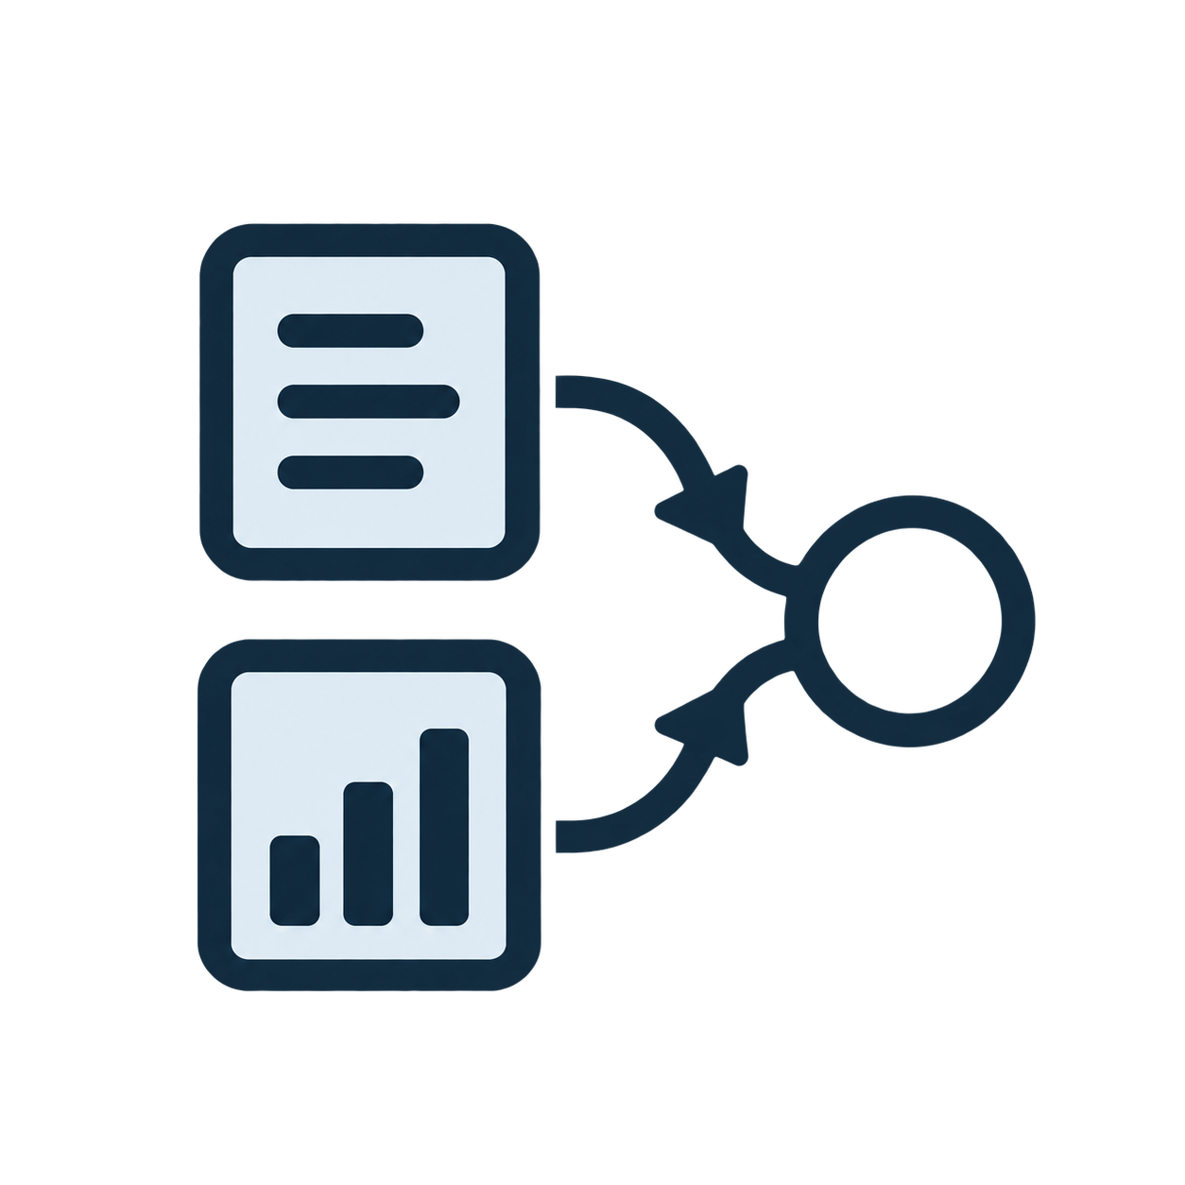

Development Data
Shared Pipeline
External evaluation
Segmentaion & BM Classification
Expert Pool
Public benchmarks
Image experts
TN3K 614
ThyroidXL 2,090(739)
TN3K train: 4,633, val: 100
DINO checkpoints（seg + cls）
TN5K 1,000
PKTN 150
ThyroidXL train: 9,441(3,354), val: 100(85)
Tabular expert
PyRadiomics 2D + AutoGluon Tabular
DDTI 637
RJH-7K 7,288
PKTN train: 703, val: 150
Image experts — DINO (seg + cls)
Tabular expert — PyRadiomics + AutoGluon
GT masks on cls development set
600 s budget; 8-fold bagged CV (internal)
Subtasks: separate tabular models on orange pool
TN5K train: 3,500, val: 500
Institutional hold-out
ZJH-8K 7,958(1,146)
same image different tasks
Seg = TN3K + ThyroidXL + TN5K + PKTN
Cls = TN3K + ThyroidXL + TN5K
Multicentre private
Router
NHC 8,721
LNM & FTC/PTC
Validation on main-task val (left)
· Expert selection · Learned router
· Referral thresholds · Frozen at test
ZJH-8K malignant: 4,573(723)
Evaluate only - frozen pipeline
LymphUs Center1: 180
Dual-role cohort (ZJH)
LNM = ZJH-8K malignant + LymphUs C1
FTC/PTC = ZJH-8K malignant
Case / Inference outputs
ZJH malignant subset
Selected nodule mask (segmentation)
Malignancy decision (classification)
Agreeing classifiers → direct label
Else fused outputs (LLM in primary)
LNM dev
FTC/PTC dev
Malignant dev validation = 5-fold CV
LymphUs C2 test 158
FangDai test 200

Slide 2

