Slide 1

IDS PROJECT
Session Aug 2019 - Dec 2019
OLYMPICS- Performance and Participation Analysis

Slide 2

Team Details:
Kavya P K- PES1201800151
Roshni Poddar- PES1201800161
Shraddha Bhardwaj- PES1201800306
Guide: Prof. Jamuna S Murthy(Assistant Professor)Dept. of CSE , PESU

Slide 3
AGENDA
This project deals with Exploratory Data Analysis of a historical dataset on modern olympic games, from ATHENS 1896 to RIO 2016.
AIM :
To clean the dataset.
To analyse existing data on medal tallies of countries over the years, and figure out unforeseen patterns .
To extract beneficiary insights from the various factors that contribute to winning a medal.

Slide 4
INTRODUCTION
The project aims to clean and subsequently analyse, visualise and make some conclusions about the Olympics dataset.
To analyze the Winning DNA and what it takes to earn an Olympic medal for each country.
To thereby use this analysis and predictions to strategize a country’s game plan and to optimize their medal tally, participation diversity and performance.
To perform hypothesis testing to make some conclusions about the data.

Slide 5
SCOPE AND MOTIVATION:
This dataset provides an opportunity to ask questions about :
How the Olympics have evolved over time.
Participation and performance of women in different events.
Performance of different nations across different sports.
Performance trend of a country over time.
How the physical attributes i.e. height, weight, etc. of participants have changed over time.
The answers to these questions give us a path to identify what it takes to build a winning DNA for each country in Olympics.

Slide 6
DESCRIPTION
ATTRIBUTES OF DATA SET
ID - Unique number for each athlete
Name - Athlete's name
Sex - M or F
Age - Integer
Height - In centimeters
Weight - In kilograms
Team - Team name
NOC - National Olympic Committee 3-letter code
Games - Year and season
Year - Integer
Season - Summer or Winter
City - Host city
Sport - Sport
Event - Event
Medal - Gold, Silver, Bronze, or NA
The Dataset has 15 different columns, and a whole 271116 rows.
Each row corresponds to an individual athlete competing in an individual Olympic event (athlete-events)

Slide 7
TOOLS AND TECHNOLOGY
Language : Python
Libraries:
Pandas
Numpy
Matplotlib
Sklearn
Seaborn

Slide 8
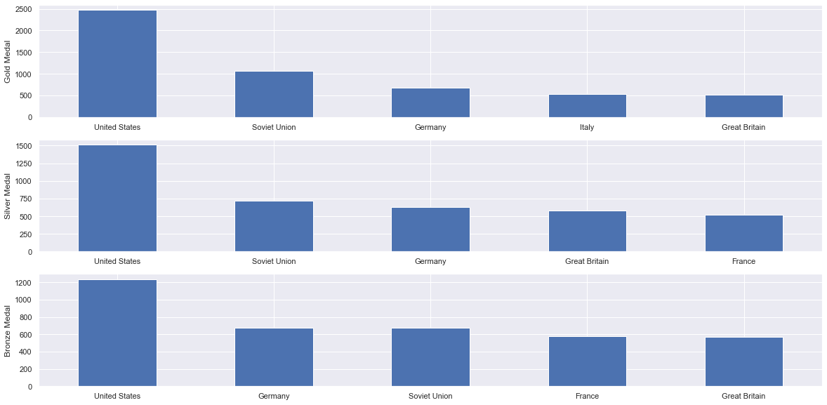
VISUALISATION:
Medal Tally of top 5 countries over 120 years - order: GOLD,SILVER,BRONZE

Slide 9
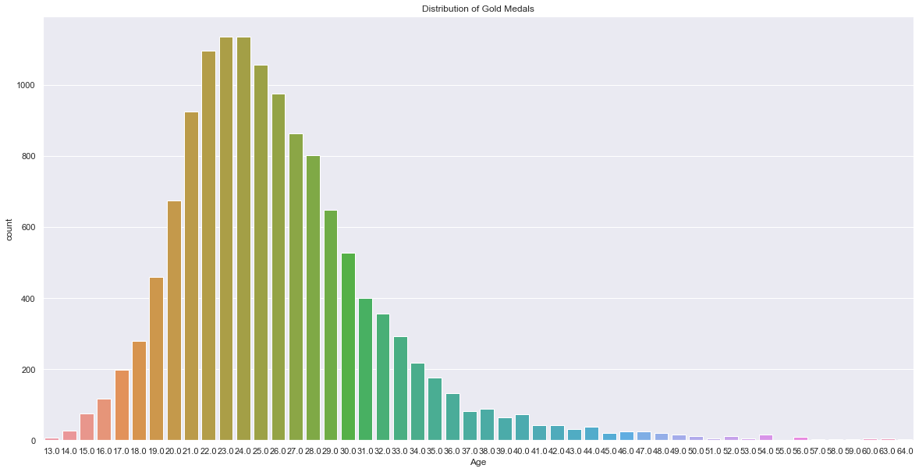
2. Distribution of Gold medals with respect to age of winners.

Slide 10
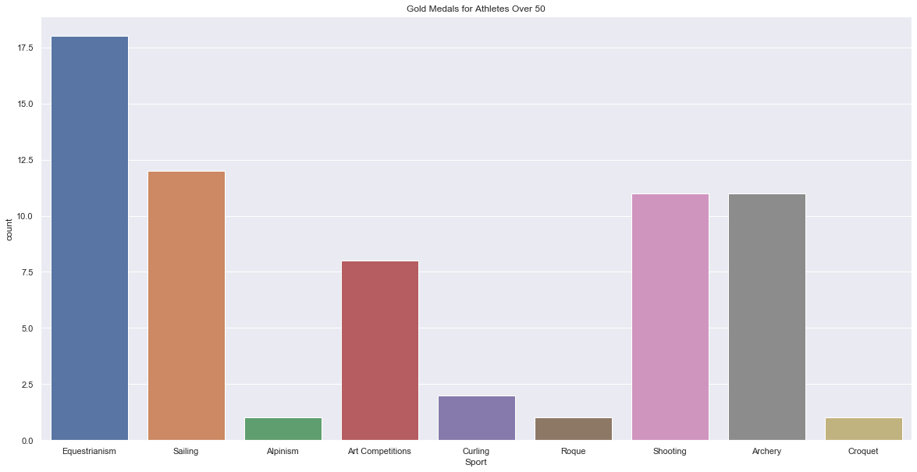
3. Events in which participants of age >50 have won GOLD medals.

Slide 11
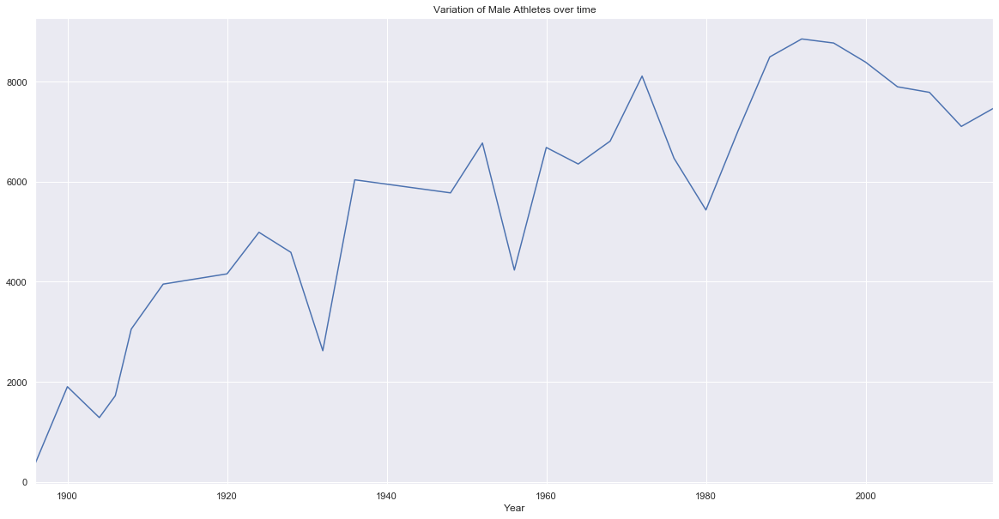
4. Male participation over the years.

Slide 12
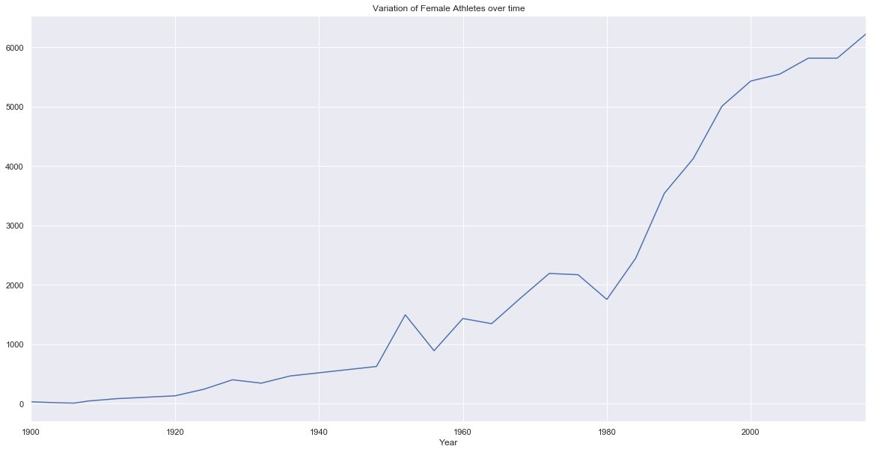
5. Female participation over the years

Slide 13
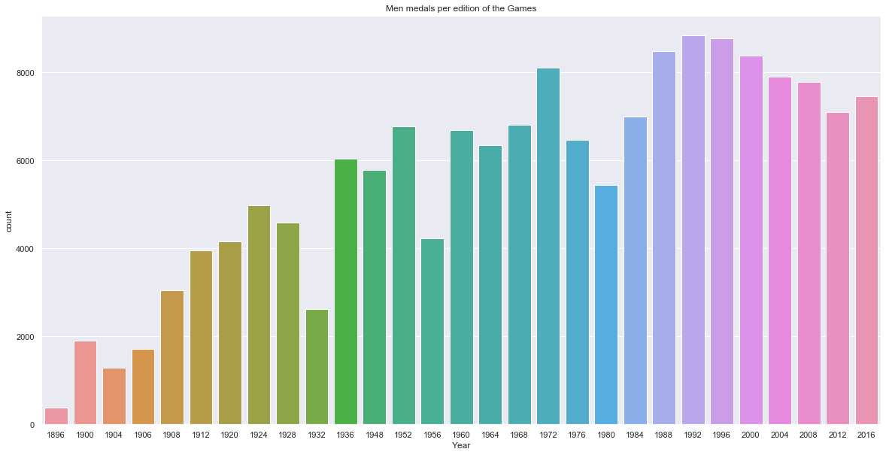
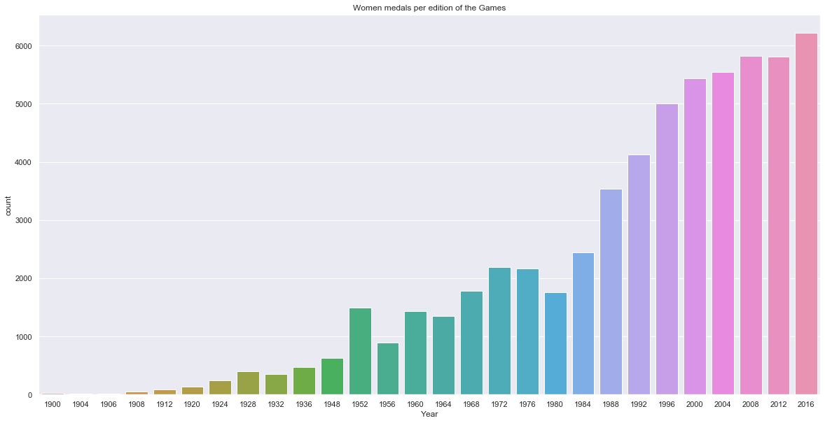
6. Male vs Female medal tallies over the years.

Slide 14
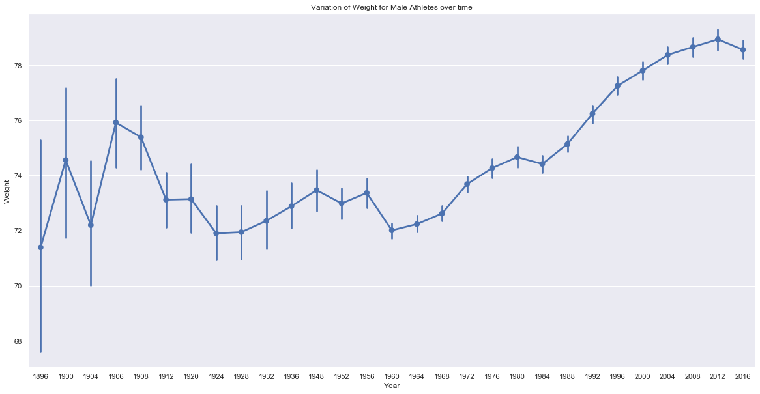
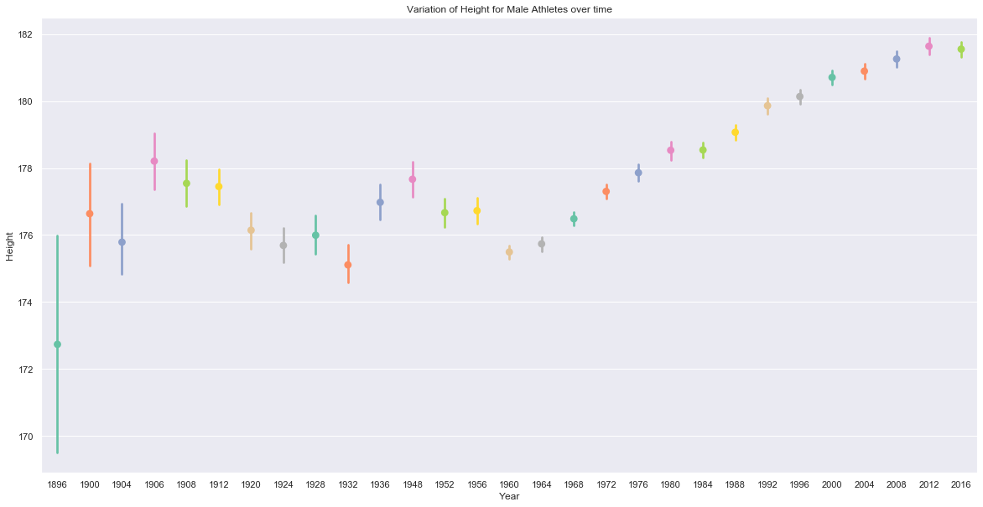
7. Height and Weight variation of participants over the years.

Slide 15
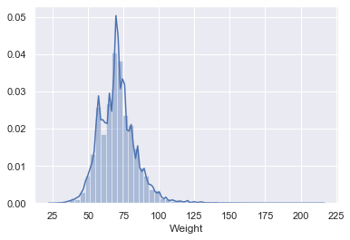
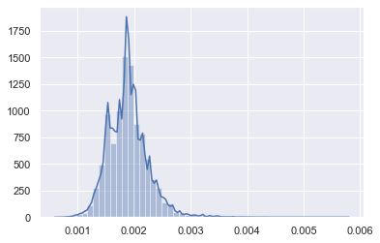
NORMALISATION
The goal of normalization is to change the values of numeric columns in the dataset to use a common scale, without distorting differences in the ranges of values or losing information. Normalization is also required for some algorithms to model the data correctly.

Slide 16
HYPOTHESIS TEST
Is there a significant difference between the population proportions of the participants from Great Britain and the participants from Italy who won medals?
Population: All participants from Great Britain and Italy.
Parameter of interest: p1-p2; p1 - Great Britain; p2 - Italy
Null Hypothesis: p1 - p2 = 0
Alternative Hypothesis: p1 - p2 != 0
P value= 0.4693672139582684
CONCLUSION: Since the p-value is quite high, we cannot reject the Null hypothesis in this case i.e. the difference in the population proportions are not statistically significant. Therefore, it is very plausible that the population proportions of the participants from Great Britain and the participants from Italy who won Gold medals are equal.

Slide 17
REFERENCES
DATA SET:
https://www.kaggle.com/heesoo37/120-years-of-olympic-history-athletes-and-results
The data set was scraped from www.sports-reference.com
BLOGS:
https://towardsdatascience.com/exploratory-statistical-data-analysis-with-a-real-dataset-using-pandas-208007798b92
https://towardsdatascience.com/olympics-kaggle-dataset-exploratory-analysis-part-2-understanding-sports-4b8d73a8ec30
https://nycdatascience.com/blog/student-works/olympic-games-data-visualization/
https://medium.com/@aadil.contractor94/olympic-data-analysis-to-find-winning-dna-for-athletes-b4480eecbb20
Publications: https://www.researchgate.net/publication/333263347_Performance_Analysis_in_Olympic_Games_using_Exploratory_Data_Analysis_Techniques

