Slide 1
MINDBRIDGE
A small group for
every big question
Mentor-led learning, explainable cohort matching, and a live AI study coach.
Hackathon pitch · 9 October 2026
Notes:
MindBridge is a working hackathon prototype. The intended outcome is more active participation in a small guided learning group. We do not yet claim improved learning outcomes or traction.

Slide 2
MINDBRIDGE
02
The participation gap
Online education expands access to content. It does not guarantee a place to ask, practise and be noticed.
Recorded courses
Private tutoring
Large live classes
Flexible lessons. Questions often wait.
Focused attention, without a peer group.
Peers are present. Airtime can be scarce.
Our hypothesis: 4–5 learners with one mentor can make participation routine.
Notes:
These are product-design observations and a hypothesis, not survey or impact statistics. A pilot must measure whether smaller groups improve participation and learning.

Slide 3
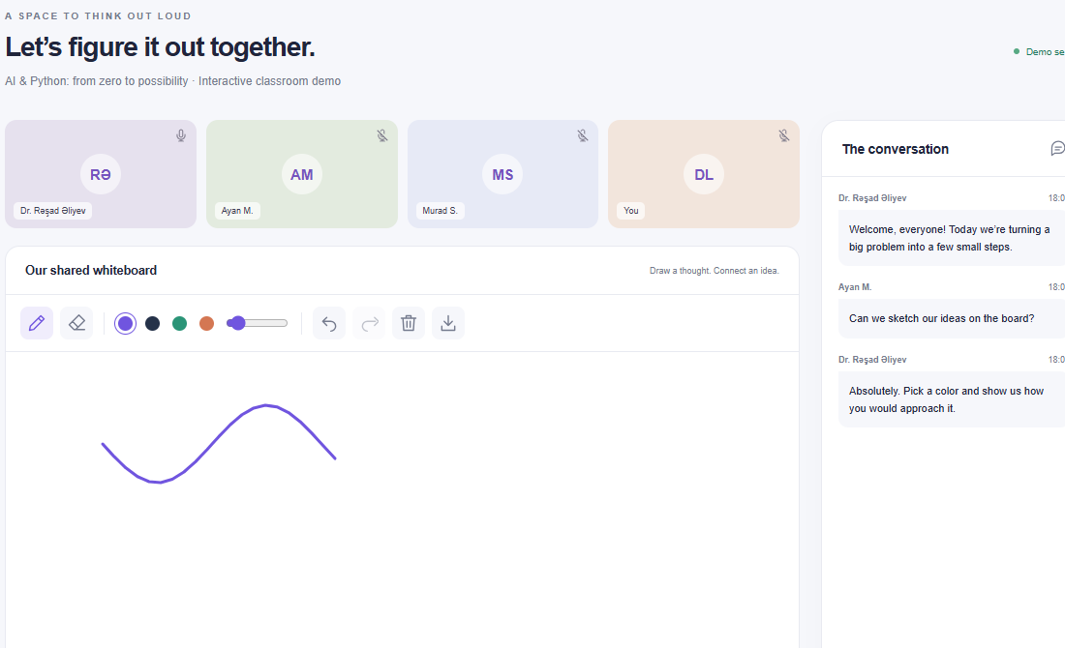
MINDBRIDGE
03
One mentor. Four or five learners.
Learners with compatible goals, level and time meet in one guided cohort. The shared whiteboard turns questions into visible practice.
Interactive today
Drawing, erasing, undo and group chat work in the browser.
Classroom video tiles and participant identities are sample content.
Notes:
The screenshot is captured from the current local prototype. Whiteboard strokes and chat controls work. Video, audio and participant identities are simulations; no real learners are connected.

Slide 4
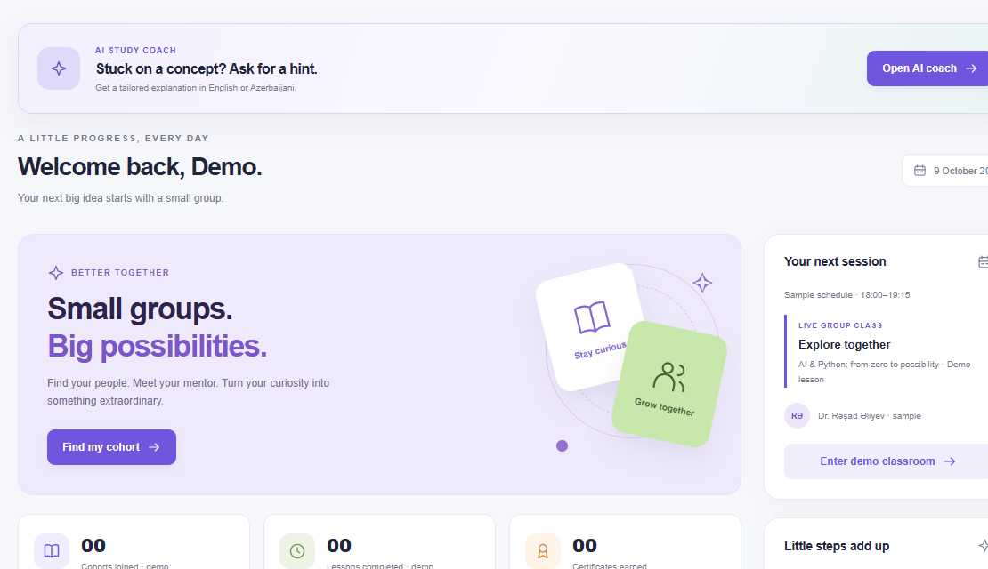
MINDBRIDGE
04
One connected learner journey
01
Register
Student and Teacher open different workspaces.
02
Find a cohort
A written goal changes the ranking and its explanation.
03
Learn together
Mentor-led practice plus AI help between sessions.
04
Show progress
Quizzes and a coding task gate the demo certificate.
Continuation payment is gated after the demo lesson; no real charge occurs.
Notes:
The current dashboard screenshot shows the AI coach link and learner workspace. Registration and profile edits are local to the browser. The payment flow is a demo with no processor or actual card collection.

Slide 5
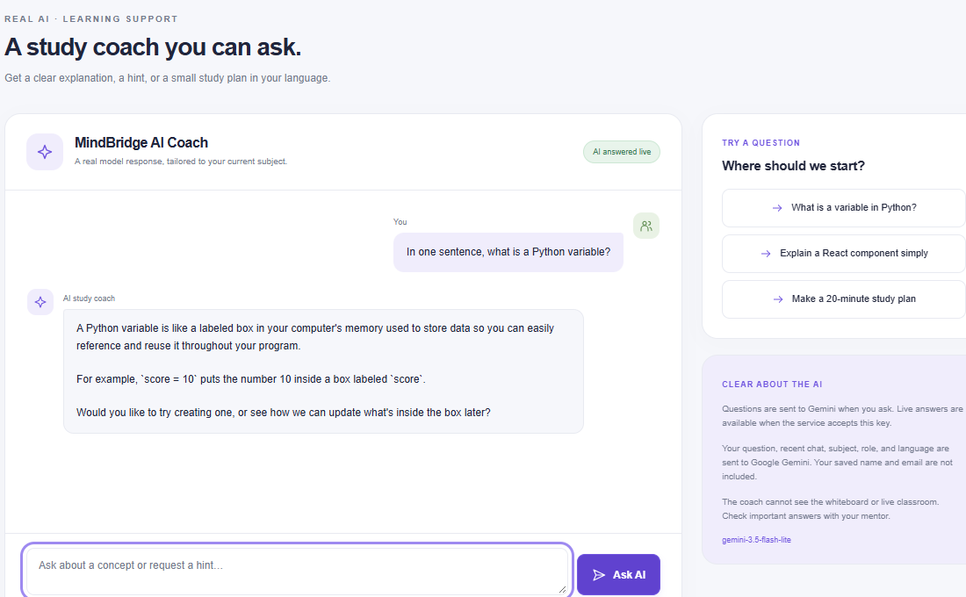
MINDBRIDGE
05
Two AI tasks, each with a clear role
Before class: explain the match
A local TF-IDF matcher compares the written goal with course topics. Age filters eligibility; level and schedule add visible fit points.
Between classes: answer a question
Gemini generates live explanations and hints in English or Azerbaijani.
Live English and Azerbaijani answers verified on 9 October 2026.
Notes:
The matcher is deterministic, content-based and runs locally; it is not a trained predictive model. The study coach uses Google Gemini 3.5 Flash-Lite through the server. A live response was verified in both English and Azerbaijani. The browser sends question, recent turns, subject, role and language, but excludes saved name and email. The screenshot shows a real model response.

Slide 6
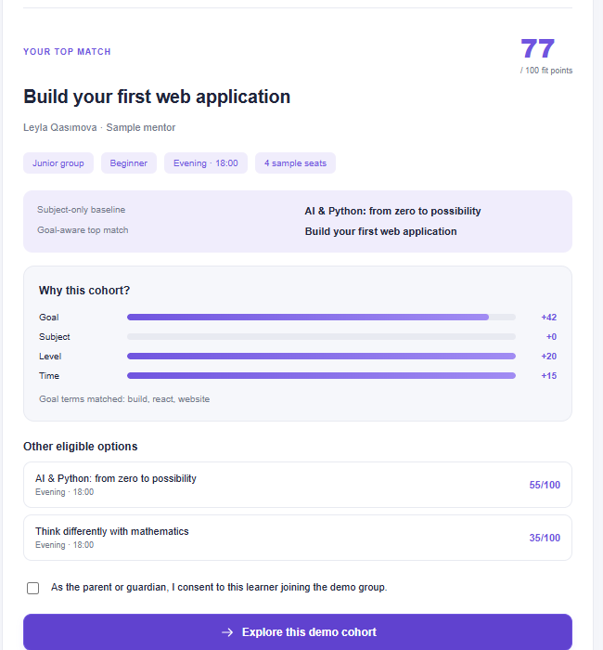
MINDBRIDGE
06
The written goal changed the match
Selected subject
AI & Python
Written goal
“Build a React website”
Subject-only baseline: AI & Python
Goal-aware result: Web application
Another test: an adult Scratch request excludes child-only cohorts.
Notes:
This is an actual deterministic prototype case. With AI & Python selected and a React website goal, the subject-only baseline would retain AI & Python, while the goal-aware model chooses the web application cohort. The current screen exposes the factor breakdown and other eligible options. A separate adult Scratch case checks the age filter. No real-user comparison has been run yet.

Slide 7
MINDBRIDGE
07
Our place among existing options
Competitors already solve parts of this need. MindBridge combines them in one journey.
Option | Primary offer | MindBridge emphasis
Coursera | Self-paced online courses | A small live group to practise with
Preply | Private one-to-one lessons with AI practice | Peers learn with one mentor
Outschool | Live small-group classes | Explained cohort fit and an AI study coach
Khanmigo | AI tutoring and teaching help | Human mentor, peers and a shared lesson
Public product descriptions, 9 Oct 2026. Positioning comparison, not a full feature audit.
Notes:
Public sources: Coursera https://www.coursera.org/courses?query=self%20paced ; Preply https://preply.com/en/app ; Outschool https://support.outschool.com/en/articles/4321090-faq-for-outschool-families ; Khanmigo https://www.khanacademy.org/khanmigo . The table compares primary offers and our intended emphasis. It does not claim that any competitor lacks every adjacent feature.

Slide 8
MINDBRIDGE
08
The pilot economics are testable
₼12
~US$0.90
Next lesson in the demo checkout
Illustrative Gemini cost for 1,000 short turns*
₼39
The dominant pilot work is mentor time, safe operations and real cohort supply.
Monthly pass in the demo checkout
*500 input and 300 total output tokens per turn; paid-tier list price. Actual usage will vary.
Notes:
The checkout prices are prototype prices in Azerbaijani manat. They are not validated willingness to pay, revenue or actual charges. AI cost illustration: 1,000 turns times 500 input tokens is 0.5 million tokens; at US$0.30 per million = US$0.15. 1,000 times 300 total output tokens is 0.3 million; at US$2.50 per million = US$0.75. Total US$0.90, before tax or other infrastructure, assuming all output including thinking fits in 300 tokens. Source: Google Gemini 3.5 Flash-Lite standard paid pricing https://ai.google.dev/gemini-api/docs/pricing . The server also caps message length, recent history, output tokens and request rate.

Slide 9
MINDBRIDGE
09
Working now. Still to prove.
Verified in the prototype
Required for a real service
28 automated checks pass
Live Gemini answers in both languages
Explainable matching and age eligibility
Whiteboard, assessment and certificate gates
Verified mentors and live scheduling
Authentication and parent consent records
Real video, moderation and payments
Learning outcomes with real cohorts
No traction or learning-impact result is claimed yet.
Notes:
Automated tests cover route gating, matching changes, age handling, whiteboard state, assessment/certificate requirements, payment sequencing and AI request safety. The classroom participants, video and payments remain simulated. We have not measured live learner impact.

Slide 10
MINDBRIDGE
10
The next proof is a real cohort
Proposed four-week pilot
2 cohorts · up to 10 learners · 2 mentors
What we would measure
Attendance, questions per learner, quiz progress, match fit and willingness to continue.
MindBridge team
Magsad Huseynli · Murad Zeynalov · Ordukhan Ordukhanli · Elgun Ibrahimli
Notes:
This is a proposed pilot, not an announced partnership. Recruit two vetted mentors and up to ten learners across two small cohorts for four weeks. Compare participant-rated fit of the goal-aware matcher with a subject-only baseline, and record attendance, questions, quiz progress and continuation intent. Team names come from the earlier supplied Canva pitch; confirm spelling before public submission. Close with a live walkthrough: goal-aware match, Gemini question, whiteboard stroke and assessment gate.

