Slide 1
Automatic Music Recommendation system using Content Based Classification
Guided By: PROF. NISA A. K PROF. REENA MARY GEORGE | Group Members: Faseru Emmanuel Swaraj Krishnan
Notes:
1

Slide 2
Overview
INTRODUCTION
MOTIVATION
TYPES OF RECOMMENDATION SYSTEMS
PROPOSED SYSTEM
FEATURE EXTRACTION
MUSIC CLASSIFICATION
MUSIC RECOMMENDATION
ONLINE DATABASE CREATION
GUI IMPLEMENTATION
EVALUATION
LIMITATION
SOCIAL RELEVANCE
PROGRAMME OUTCOMES
CONCLUSION
FUTURE WORK
REFERENCES

Slide 3
INTRODUCTION
Feature extraction is transforming the input data into a reduced representation set of features (also named as features vector).
Cluster analysis or clustering is the task of grouping a set of objects in such a way that objects in the same group (called a cluster) are more similar.
Classification is a data mining function that assigns items in a collection to target categories or classes
Content Based recommendation makes use of features extracted from the songs to make recommendations to users

Slide 4
MOTIVATION
There is a large amount of readily accessible musical content available on the internet.
Users need help in finding music that are similar to their taste and preference
10 Songs 1979 | 1,000 Songs 2001 | 10,000,000 Songs 2011

Slide 5
Types of music recommender systems:
Notes:
Metadata-based approaches use information about music that is not directly derivable
from the audio signal itself, but has been associated with a specic song
by a human subject. This can be any explicit metadata like genre, tags, artist,
song names or user ratings or any kind of implicit metadata like purchase information,
play counts or skip rates.
User-based collaborative filtering systems first estimate similarities
among users based on the collected ratings and then recommend items that have
been bought by similar users.
In tag-based systems users assign descriptive terms, so-called tags, to each song. All terms assigned to a specific song together form a song description. Songs or artists with similar descriptions
are considered to be similar too. At the track level data is very sparse and tags are often not available. Additionally, there exist a number of issues related to the tags themselves. For example synonyms like
\Hip-Hop" and \HipHop pose a problem.
Expert-based systems do not collect information about music from a crowd of users,
but rather rely on explicit metadata assigned by musical experts. Expert-based
approaches are special in the sense that only trustworthy and well-trained experts
collaborate in the annotation process. Probably the only music service that is based on meta information assigned by music experts is Pandora. The music experts at Pandora manually quantify properties of songs
5
5

Slide 6
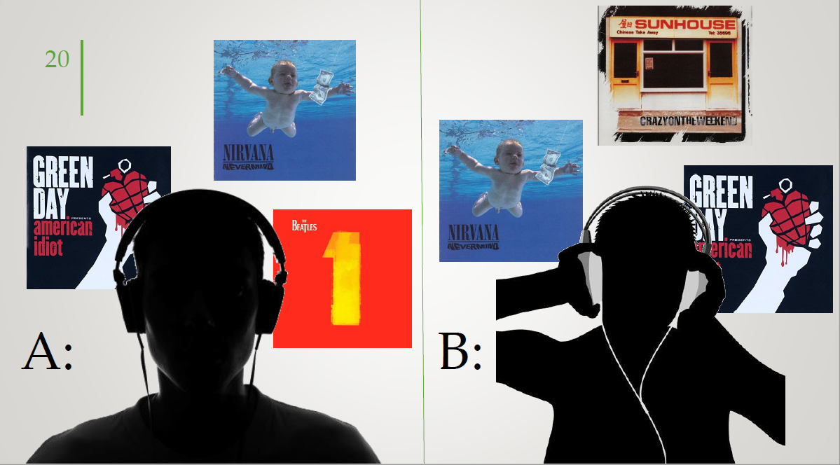

Collaborative Recommendation
Notes:
Main problem:
A critical mass of users is needed in order to create a database of preferences: first-rater or cold start problem
The Popularity-Bias Problem (PBP)
Many recommender systems, especially metadata-based systems, tend to
have a popularity bias, which means that popular items are recommended
very frequently, while unpopular or unknown items are not recommended
at all [
6
6

Slide 7
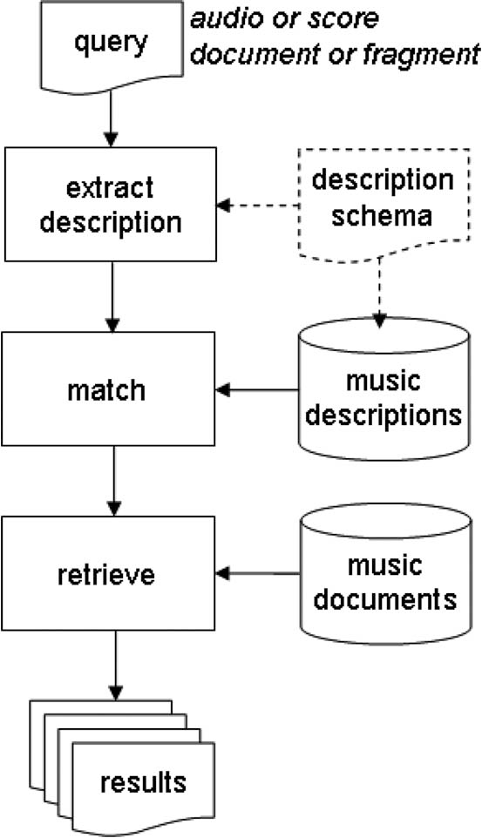
Content Based Recommendation
Notes:
7
7

Slide 8


Popular recommender systems
Pandora: Manual classification
Mufin: Classification algorithms only
Lala: Explicit P2P Recommendations
eMusic: Hybrid approach
Notes:
Other services, like Lala, have decided to not feature any real recommendation technology at all. Instead, Lala purely relies on users following each other on the service and recommending new music to each other.
Social based recommend
8
8

Slide 9
Our Proposed System
The proposed system consists of the following components;
Music feature extraction
Music classification
Music online database creation
Music recommendation system
GUI implementation
Notes:
The goal of the first step, feature extraction, is to get the essential information out of the input data. The second step is to find what combinations of feature values correspond to what categories, which is done in the classification part. The two steps can be clearly separated: the output of the feature extraction step is
the input for the classification step
9
9

Slide 10
Feature Extraction
Feature extraction is transforming the input data into a reduced representation set of features (also named as features vector).
It involves computing a compact numerical representation that can be used to characterize the song.
Spectral Features : obtained by converting the time based signal into the frequency domain using the Fourier Transform, examples are spectral centroid, spectral skewness, spectral spread, spectral rms, etc.
These features can be used to identify the notes, pitch, rhythm, and melody.
The temporal features (time domain features), which are simple to extract and have easy physical interpretation, like zero crossing rate and energy.

Slide 11
Feature Extraction
Two types of scales used in audio analysis:
Mel scale: The name mel comes from the word melody to indicate that the scale is based on pitch comparisons.
Barkscale: Above about 500 Hz this scale is more or less equal to a logarithmic frequency axis. Below 500 Hz the Bark scale becomes more and more linear
Notes:
LowLevelSpectralEqloudExtractor
[vector_real] dissonance - See Dissonance algorithm documentation
An unstable tone combination is a dissonance; its tension demands an onward motion to a stable chord. Thus dissonant
chords are "active"; traditionally they have been considered harsh and have expressed pain, grief, and conflict.
| [vector_real] spectral_centroid - See Centroid algorithm documentation
It indicates where the "center of mass" of the spectrum is. Perceptually, it has a robust connection
with the impression of "brightness" of a sound.
| [vector_real] spectral_kurtosis - See DistributionShape algorithm documentation
flatness around mean value
| [vector_real] spectral_skewness - See DistributionShape algorithm documentation
Indicates whether or not the spectrum is skewed towards a particular range of values.
| [vector_real] spectral_spread - See DistributionShape algorithm documentation
spread around mean value
help(essentia.standard.LowLevelSpectralExtractor())
| [vector_real] barkbands_kurtosis - kurtosis from bark bands. See DistributionShape algorithm documentation
| [vector_real] barkbands_skewness - skewness from bark bands. See DistributionShape algorithm documentation
| [vector_real] barkbands_spread - spread from barkbands. See DistributionShape algorithm documentation
| [vector_real] hfc - See HFC algorithm documentation
| [vector_vector_real] mfcc - See MFCC algorithm documentation
MFCCs are commonly used as features in speech recognition system.
A widely used metric for describing timbral characteristics based on the Mel scale.
| [vector_real] pitch - See PitchYinFFT algorithm documentation
pitch is the quality that makes it possible to judge sounds as "higher" and "lower" in the sense associated with musical melodies
| [vector_real] pitch_instantaneous_confidence - See PitchYinFFT algorithm documentation
| [vector_real] pitch_salience - See PitchSalience algorithm documentation
| [vector_real] spectral_complexity - See Spectral algorithm documentation
| [vector_real] spectral_crest - See Crest algorithm documentation
ratio of maximum value of the spectrum to am of energy spectrum value
| [vector_real] spectral_decrease - See Decrease algorithm documentation
ammount of decreasing of spectral amplitude
| [vector_real] spectral_energy - See Energy algorithm documentation
| [vector_real] spectral_flatness_db - See flatnessDB algorithm documentation
The flatness of the spectrum as represented by the ratio between the geometric and arithmetic means. It is an indicator of the â€˜noisinessâ€™ of a sound.
[vector_real] spectral_flux - See Flux algorithm documentation
A measure of the difference between the current spectrum and that of the previous frame. Often corresponds to perceptual roughness.
| [vector_real] spectral_rms - See RMS algorithm documentation
| [vector_real] spectral_rolloff - See RollOff algorithm documentation
The frequency below which is contained 99% of the energy of the spectrum.
| [vector_real] spectral_strongpeak - See StrongPeak algorithm documentation
| [vector_real] zerocrossingrate - See ZeroCrossingRate algorithm documentation
Zero crossing rates are used for Voice activity detection (VAD), i.e., finding whether human speech is present in an audio segment or not.
| [vector_real] inharmonicity - See Inharmonicity algorithm documentation
In music, inharmonicity is the degree to which the frequencies of overtones (also known as partials or partial tones) depart from whole multiples of the fundamental frequency (harmonic series)
| [vector_real] oddtoevenharmonicenergyratio - See OddToEvenHarmonicEnergyRatio algorithm documentation
Even harmonics are some number of octaves above the original note.
Examples (for A at 440 Hz)
2nd harmonic: 880 Hz -- up one octave
4th harmonic: 1760 Hz -- up two octaves
and so forth.
even harmonices are more musical
The 3rd odd harmonic is an octave plus a fifth above the fundamental.
3rd harmonic: 1320 Hz -- E above the A at 880 Hz
|
[real] loudness - the loudness of the input signal
[real] logAttackTime - the log (base 10) of the attack time [log10(s)]
[real] strength - See Key algorithm documentation
| [real] bpm - the tempo estimation [bpm]
| [vector_real] ticks - the estimated tick locations [s]
| [real] confidence - confidence with which the ticks are detected (ignore this value if using 'degara' method)
11

Slide 12
Music Classification (Clustering)
Cluster: A collection/group of data objects/points
similar (or related) to one another within the same group
dissimilar (or unrelated) to the objects in other groups
Cluster analysis
find similarities between data according to characteristics underlying the data and grouping similar data objects into clusters
Clustering Analysis: Unsupervised learning
no predefined classes for a training data set
Two general tasks: identify the “natural” clustering number and properly grouping objects into “sensible” clusters

Slide 13
K – Mediod approach
A medoid can be defined as the object of a cluster whose average dissimilarity to all the objects in the cluster is minimal. i.e. it is a most centrally located point in the cluster.
k-medoid is a classical partitioning technique of clustering that clusters the data set of n objects into k clusters
Initialize: select k of the n data points as the medoids
Associate each data point to the closest medoid.
While the cost of the configuration decreases:
For each medoid m, for each non-medoid data point o:
Swap m and o, recompute the cost (sum of distances of points to their medoid)
If the total cost of the configuration increased in the previous step, undo the swap

Slide 14
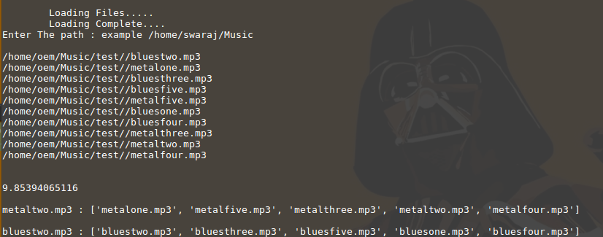

Slide 15
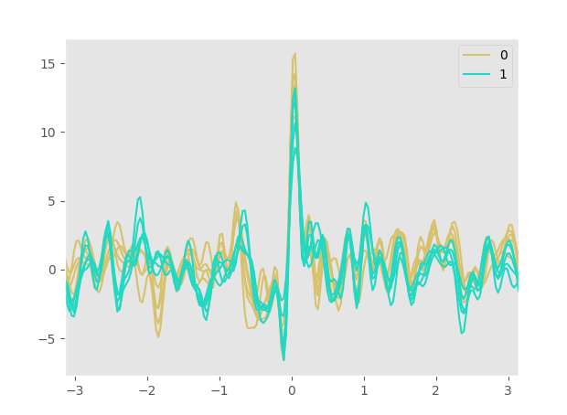
Notes:
15

Slide 16
K – Means approach
k-means clustering aims to partition n observations into k clusters in which each observation belongs to the cluster with the nearest mean
Algorithm:
Step 1: The algorithm arbitrarily selects k points as the initial cluster centers (“means”).
Step 2: Each point in the dataset is assigned to the closed cluster, based upon the Euclidean distance between each point and each cluster center.
Step 3: Each cluster center is recomputed as the average of the points in that cluster.
Step 4:Steps 2 and 3 repeat until the clusters converge

Slide 17
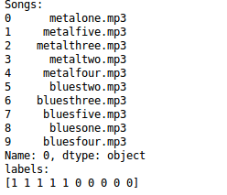
INPUT:
OUTPUT::

Slide 18
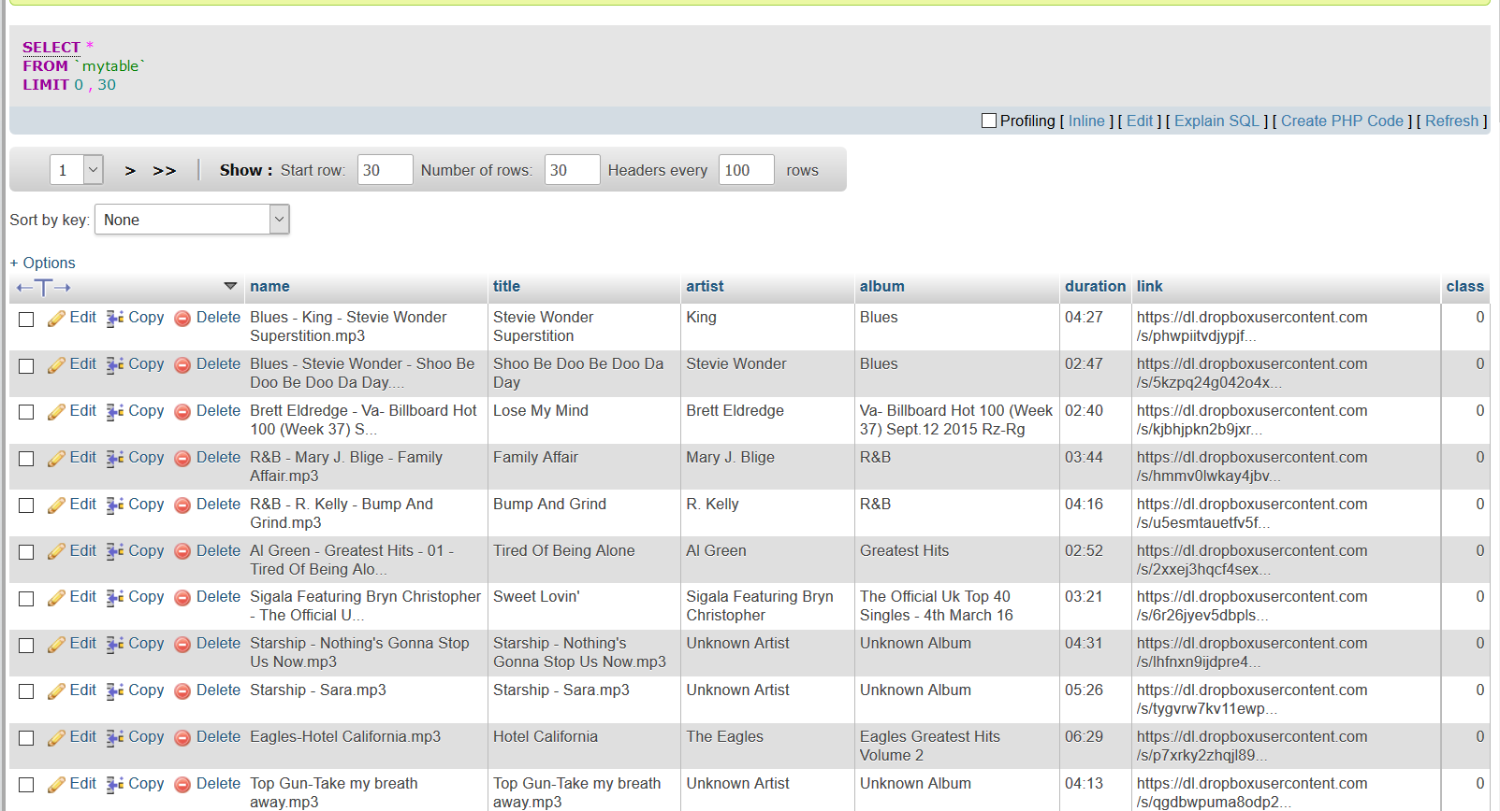
Online Database Creation
The songs are stored in a dropbox account and all the song information including links are stored in an sql database on a hosting server
Queries can be made to the database to retrieve song data to the player.

Slide 19
RECOMMENDATION SYSTEM
To give recommendations, the songs in the user playlist should be assigned to a class from the clustered data in the database.
This can be done using a suitable classification algorithm
For this project 3 algorithms were used:
K-nearest neighbor algorithm
Support vector machine algorithm
Naïve Bayes algorithm

Slide 20
RECOMMENDATION SYSTEM
In k-NN classification, the output is a class membership. An object is classified by a majority vote of its neighbors, with the object being assigned to the class most common among its k nearest neighbors
An SVM model is a representation of the examples as points in space, mapped so that the examples of the separate categories are divided by a clear gap that is as wide as possible.
The Naive Bayes algorithm is an intuitive method that uses the probabilities of each attribute belonging to each class to make a prediction. Naive bayes simplifies the calculation of probabilities by assuming that the probability of each attribute belonging to a given class value is independent of all other attributes

Slide 21
IMPLEMENTATION
The whole project was implemented using python (including the gui) and the database is managed using sql
The reference songs were stored in a dropbox account and are accessed using dropbox api
Why Python?
Essentia : Uses python to perform complex calculations on audio data.
Sklearn : Collection of libraries for performing machine learning operations

Slide 22
IMPLEMENTATION
Functionalities include:
Loading of user songs into player library
Automatic extraction of user song features
Clustering the songs based on extracted features.
Assign labels to songs on database.
Normal play, pause, stop, next track and previous track buttons
Option to view songs by album
Inclusion of context menu to recommend songs to the user in pop-up window

Slide 23
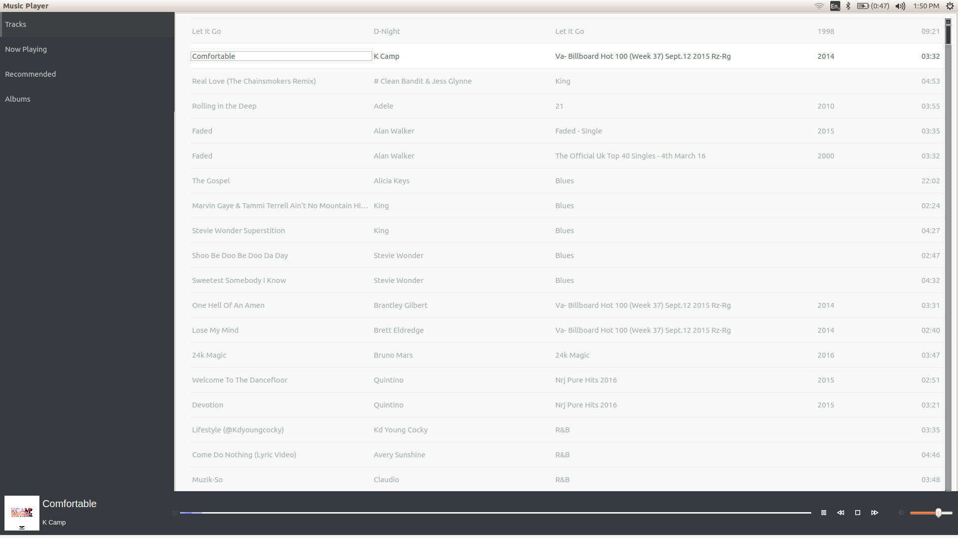
Notes:
23

Slide 24
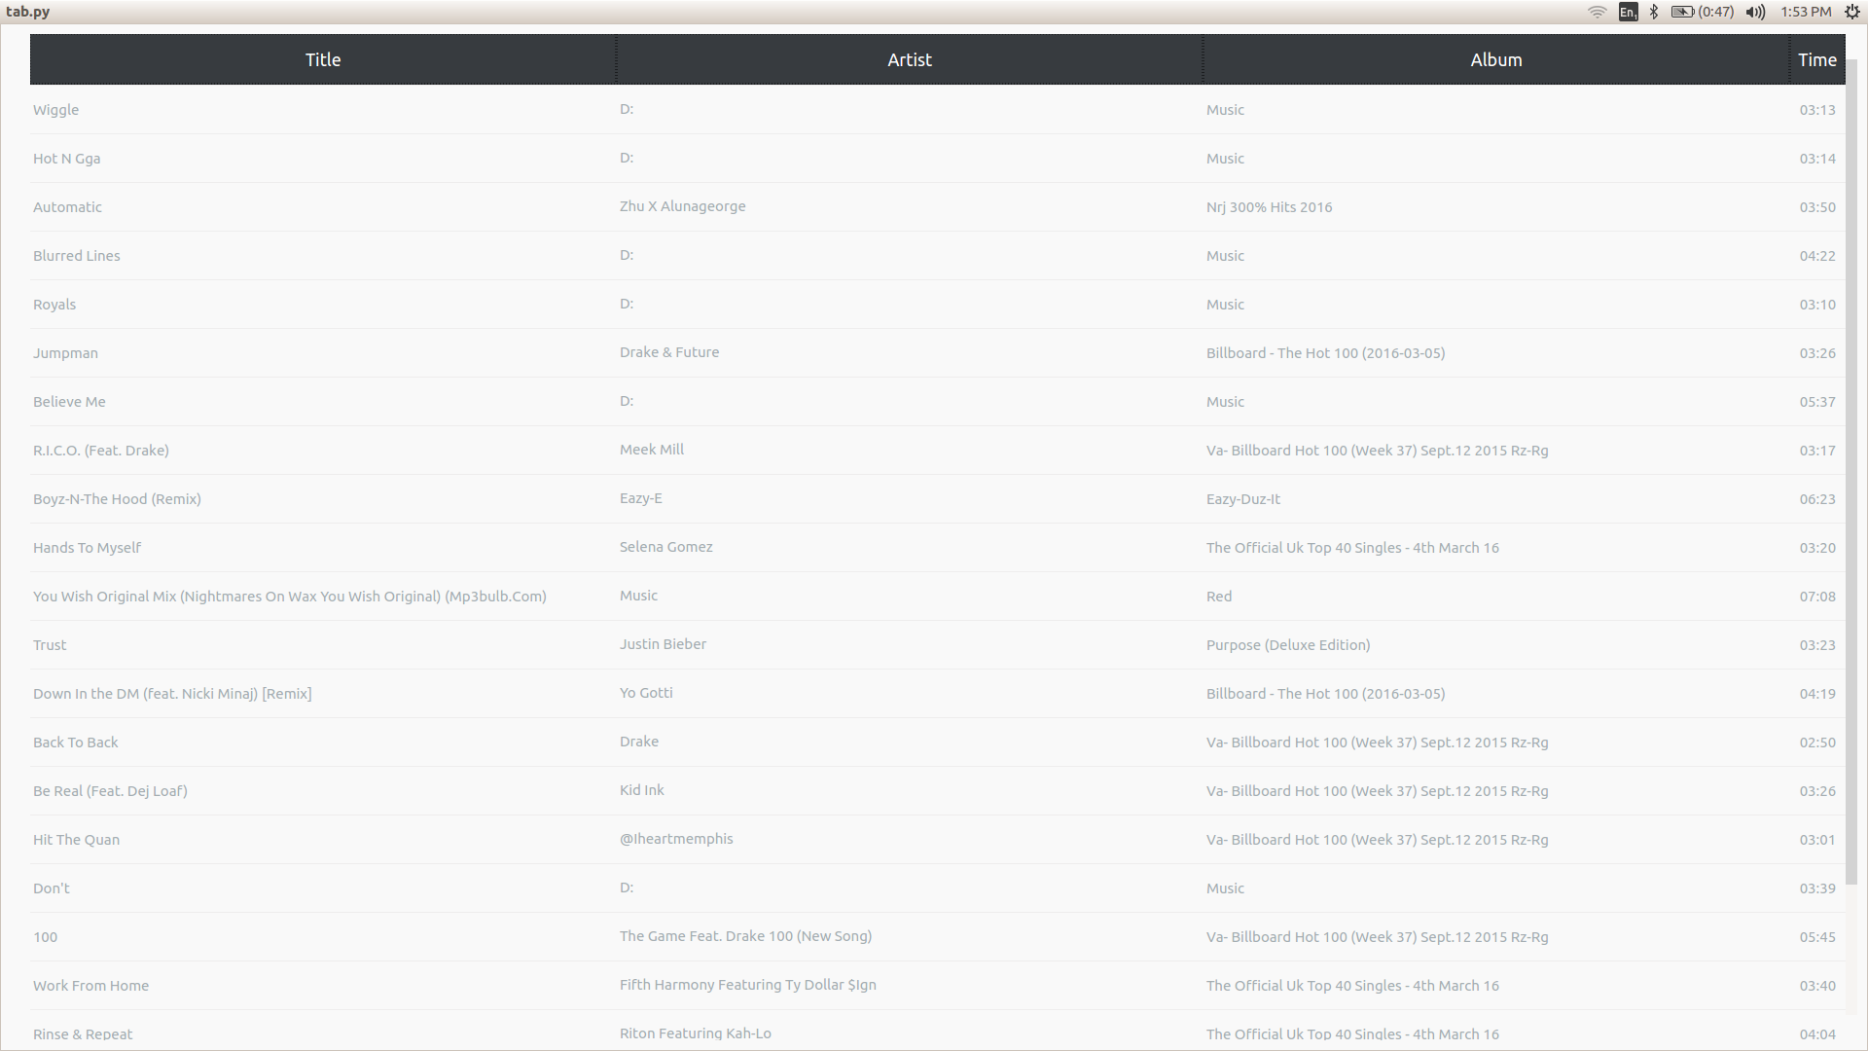

Slide 25
EVALUATION
The clustering of the songs gave a good result as similar songs were mostly put into similar groups
When repeatedly classifying the clustered data, the classifiers were tested and cross validated
The average accuracy of the predictions with knn :
K-mediod : 0.829
K-means: 0.827
The average accuracy of predictions with svm ranged :
K-mediod: 0.8
K-means: 0.87
The average accuracy of predictions with naïve bayes :
K-mediod: 0.769
K-means: 0.834

Slide 26
K-means Cross Validation results

Slide 27
K-mediod Cross Validation results

Slide 29
LIMITATIONS
Use of signal analysis alone does not give information on its cultural features
Recommendation is limited to the songs present in the database
It is difficult to determine the actual number of clusters that will efficiently classify the songs
When recommending songs from a predicted class the nearest neighbours are not considered
The execution time for feature extraction on large number of songs was a bit high

Slide 30
SOCIAL RELEVANCE
This system makes it easier for users to discover new songs
This gives a platform for upcoming musicians to distribute their music to a large audience

Slide 31
PROGRAMME OUTCOMES
Developed software solutions for multidisciplinary environment, tested performance and maintained it
Identified, analysed and defined the computing requirements appropriate to problems relevant to Computer Science and Engineering discipline
Performed effectively as an individual, as a member or a leader of a group for achieving common goal
Recognized and adapted to latest changes in the relevant technologies in the world

Slide 32
CONCLUSION
We were able to propose an automatic music recommendation system using content based classification of data.
Clustering was used to group similar songs based on the extracted features
The svm algorithm was used to predict the classes for recommendation due to it’s higher accuracy
The major problems are the limited information that can be gotten from music signal, the limited size of recommending database and execution time
Notes:
32

Slide 33
FUTURE WORK
A hybrid approach using collaborative filtering along with content based recommendation can be used to improve recommendation result
More advanced classification algorithms can be used to give better classification accuracy
More features like mood based playlists can be implemented in the player
Move most of the high calculation intensive calculations can be moved to the cloud

Slide 34
REFERENCES
[1] Berenzweig, A., Logan, B., Ellis, D. P.W., and Whitman, B.(2004). A large-scale evaluation of acoustic and subjective music-similarity measures. Computer usic Journal, 28(2):63–76.
[Celma, 2008] Celma, O. (2008). Music Recommendation and Discovery in the Long Tail. PhD thesis, Universitat Pompeu Fabra.
[Jiang et al., 2002] Jiang, D.; Lu, L.; Zhang, H.; Tao, J.; and Cai, L. (2002). "Music Type Classication by Spectral Contrast Feature". In Proc. IEEE Int. Conf. on Multimedia and Expo (ICME-02).

Slide 35
THANK YOU
Notes:
35

