Slide 1
ODUG – April, 2024
Source Control Thoughts

Slide 2
What is version control?
Version Control is a kind of “database” or “coding transaction log” that lets you snapshot your code/project at any time.
You can later take a look at these snapshots (“versions”) to show you exactly how it differed from a previous one—or how your current code has changed.
It is independent of the kind of project or technology or framework you’re using.

Slide 3
Why should I use version control?
It might not be much use if I:
  Do not have other people working on the code.
  Do not plan on letting others have the code.
References:
  https://stackoverflow.com/questions/1408450/why-should-i-use-version-control

Slide 4
Have you ever…
Made a change to code, realized it was a mistake and wanted to revert back?
Lost code or had a backup that was too old?
Had to maintain multiple versions of a product?
Wanted to see the difference between two (or more) versions of your code?
Wanted to prove that a particular change broke or fixed a piece of code?
Wanted to review the history of some code?
Wanted to submit a change to someone else's code?
Wanted to share your code, or let other people work on your code?
Wanted to see how much work is being done, and where, when and by whom?
Wanted to experiment with a new feature without interfering with working code?

Slide 5
Benefits of using Version Control?
Collaboration
Storing Versions
Revert Errors
Restoring Previous Versions
Understand What Happened
Backup
References:
  https://www.git-tower.com/learn/git/ebook/en/desktop-gui/basics/why-use-version-control
  https://medium.com/@lanceharvieruntime/version-control-why-do-we-need-it-1681f4888cec
  https://www.wrike.com/project-management-guide/faq/why-should-i-use-version-control-in-project-management-software/

Slide 6
Many Different Systems
JediVCS (1st one to integrate with Delphi; now obsolete)
SourceSafe (Microsoft’s first—now obsolete)
TeamCoherance
Vault
SVN (Subversion)
Mercurial
Git
  Global standard now
  Online hosting of repositories: GitHub / GitLab / BitBucket / others
  Distributed – each person has a complete copy of the repository
  Steep Learning Curve – but worth it!

Slide 7
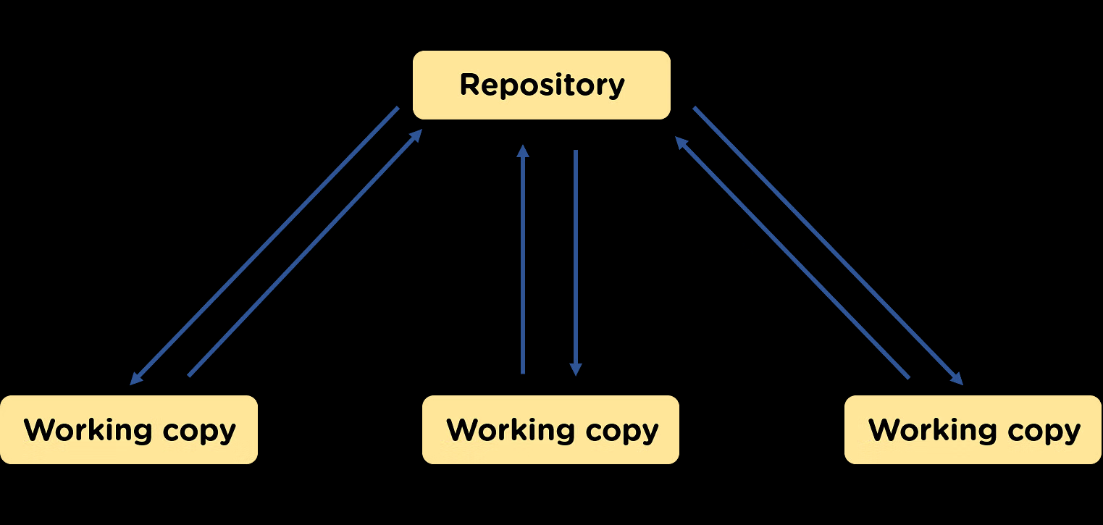
Git is Distributed
https://www.simplilearn.com/tutorials/devops-tutorial/version-control

Slide 8
Git Clients
SourceTree
GitHub Desktop
Aurees
Git-Cola
Tortoise Git
Fork
GitKraken
SmartGit

Slide 9
Git Clients - Reviews
https://dev.to/themeselection/best-git-gui-clients-for-developers-5023
https://www.gitkraken.com/blog/best-git-gui-client
  GitKraken vs …
https://nira.com/best-git-gui-clients/

