Slide 1

Supermorgue “Anubis”
powered by ShiftCo.

Slide 2

Poll #1: Have you ever thought about your death?
Yes
Yes, I do it constantly
No, but plan to do so
No I haven’t

Slide 3

Poll #2: Do you keep yourself in tune with recent deaths?
Yes, I am the first one to know
No, but I would like to

Slide 4

The problem

Slide 5


Slide 6



What is “Anubis Supermorgue”?

Slide 7

How did we do it
Roles division
Technologies choice
Development phase
Production

Slide 8
Phase 1. Roles division
Back-end
Front-end
Database etc.

Slide 9





Phase 2. Technologies choice

Slide 10


Phase 3. Development

Slide 11
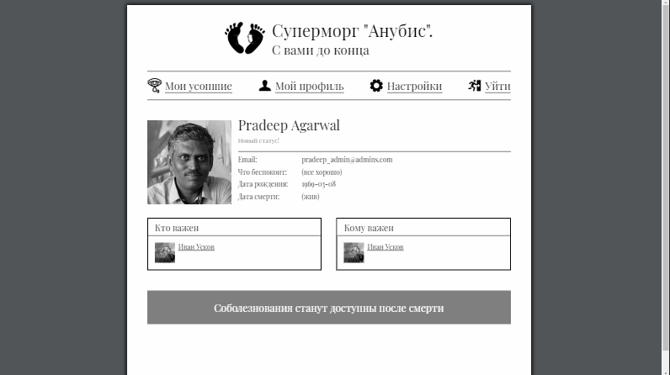

Slide 12
Anubis. With you till the end.

