Slide 1
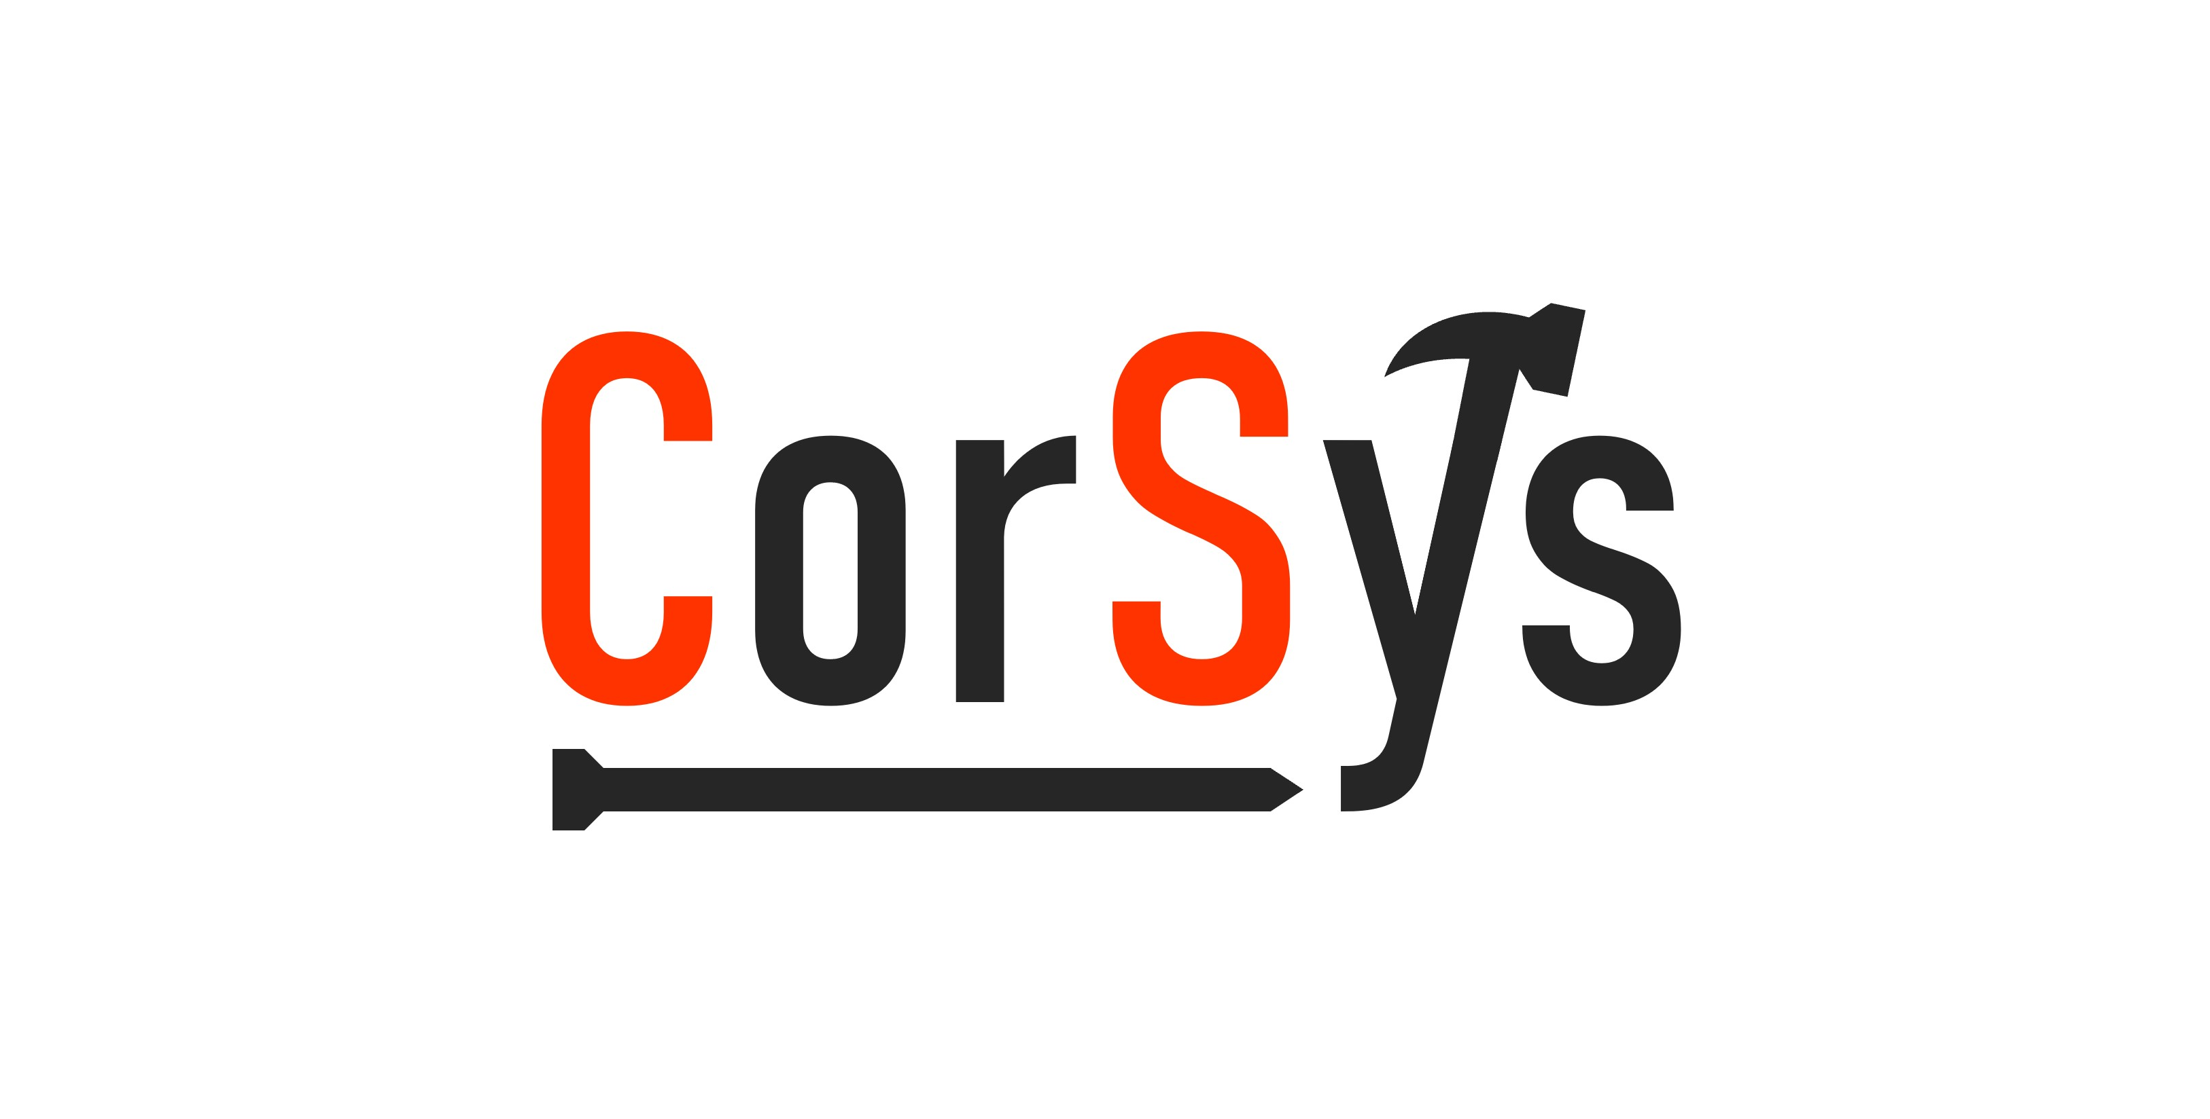
CorSys
Orel Adivi and Daniel Noor
This is final project in the course "Software Synthesis and Automated Reasoning" (236347)
Technion - Israel Institute of Technology
18 October 2022

Slide 2
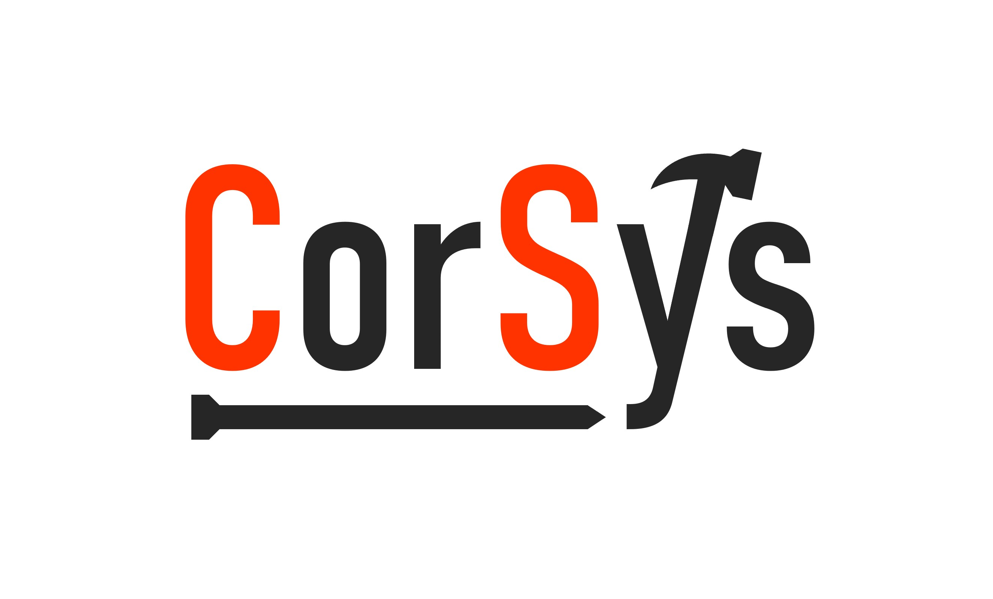
Download CorSys
The implementation is available in GitHub: https://github.com/orel-adivi/CorSys
The project also has a website: https://orel-adivi.github.io/CorSys/
The README.md contains all the documentation: https://github.com/orel-adivi/CorSys/blob/main/README.md

Slide 3
The problem
Programmers make mistakes.
Input-output specifications given by the user may be incorrect.
We would like to generalize a concept for a solution, previously presented by Peleg and Polikarpova (2020).
CorSys is a program synthesizer, which synthesizes best-effort Python expressions while weighting the chance for mistakes in given user outputs, using various metrics for mistake probability evaluation.

Slide 4
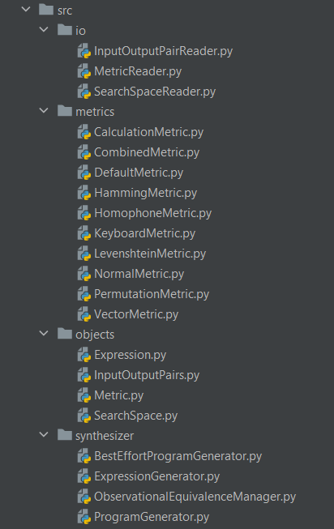
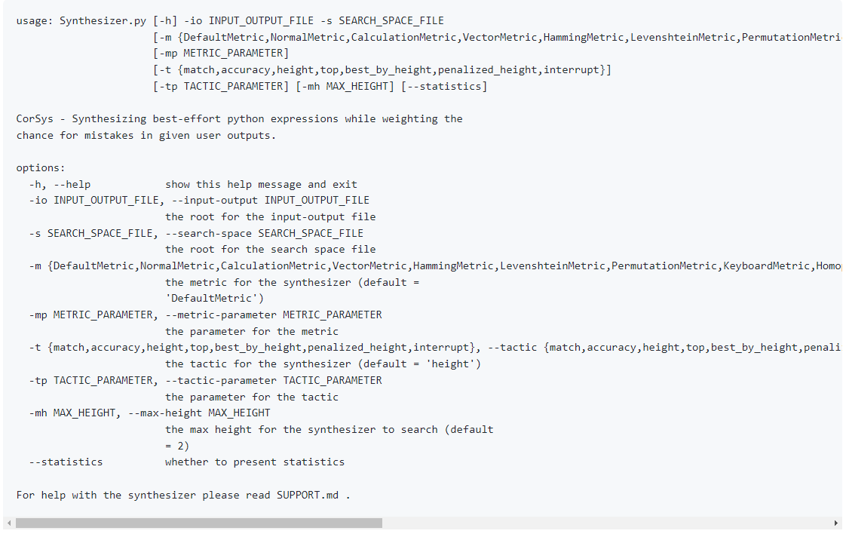
Usage
From the documentation

Slide 5
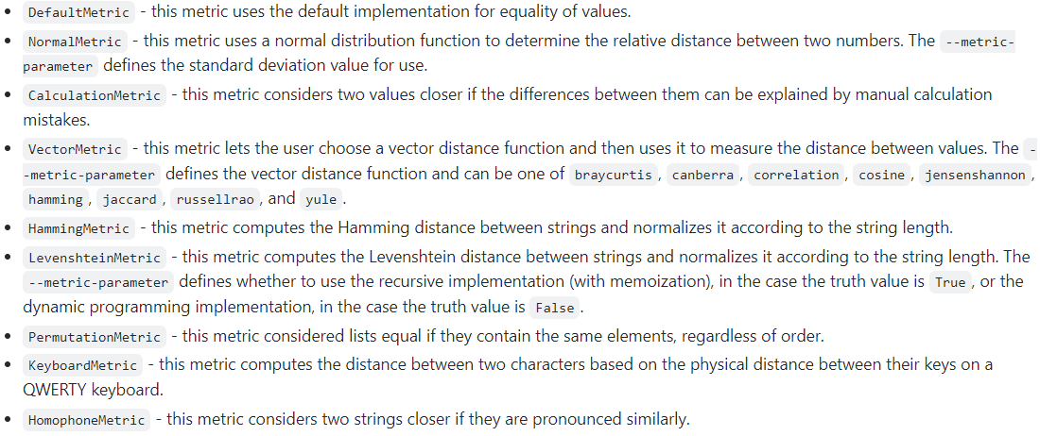
Metrics
From the documentation

Slide 6
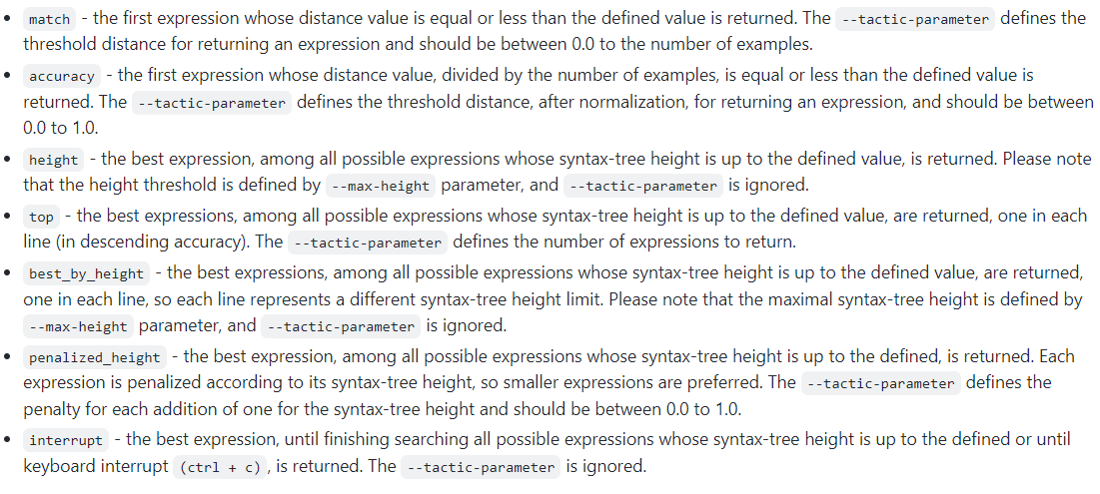
Tactics
From the documentation

Slide 7
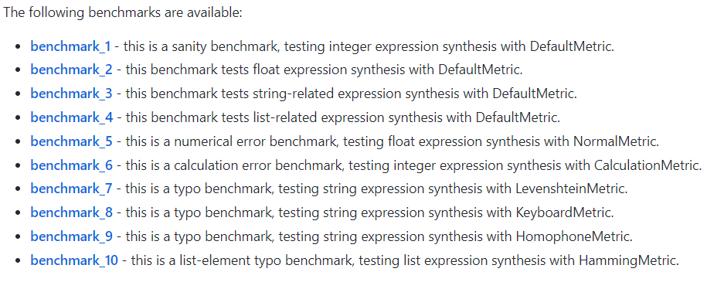
Benchmarks
From the documentation

Slide 8
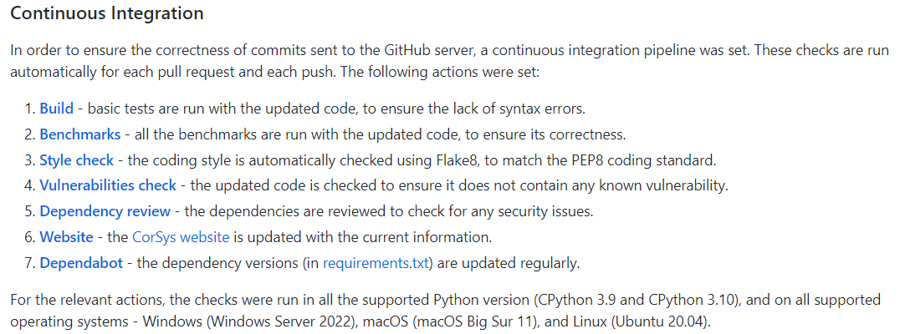
Project Engineering
From the documentation

Slide 9
Suggestions for Future Research
We could not synthesize expressions whose syntax-tree height is 3 (due to both long runtime and RAM requirements).
Adding additional metrics
Analyzing the frequency of user mistakes
Dealing with incorrect input specifications
Improving the efficiency with different implementations
Improving the efficiency with jitting
Testing the current implementation
Using the current implementation for different tasks

Slide 10
Demo time!

