Slide 1
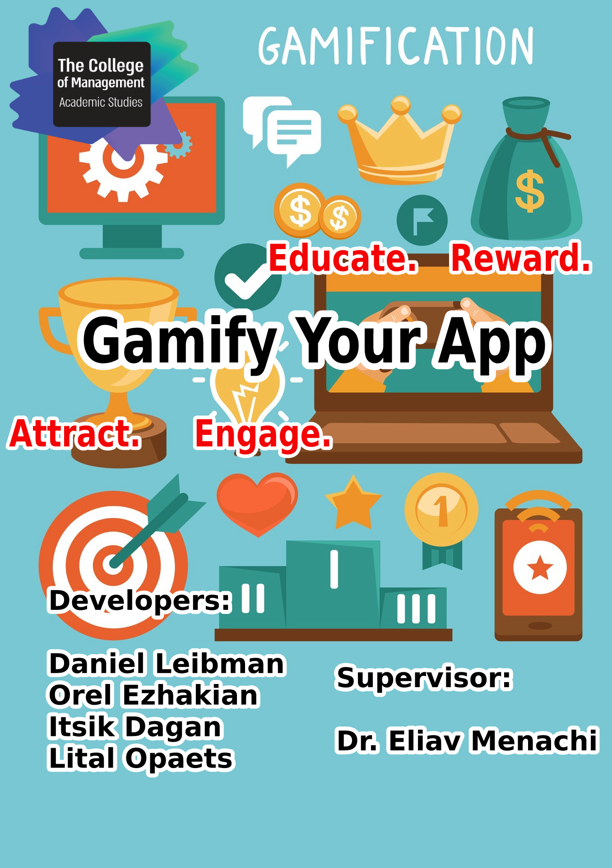
Gamification

Slide 2
What is Gamification?
Gamification takes the natural desire of the user for socializing, learning, competition, achievement, status and self-expression and analysis him through specific scenarios/situations.
Among famous applications that use gamification you can find:
Waze
Facebook
Instagram
Stackoverflow
Gamification takes the actions that user make in the application and according to set of rules grants him with points and badges.

Slide 3
Importance of the project
Gamification has come to our life in purpose of encouraging active participation of users in online communities.
We want to make members use the social applications positively, frequently and with interest.
This project saves development time for the developer who doesn’t have to worry about re-creating gamification model for his app every time.
Instead of this, we created infrastructure for every kind of application and every type of developing environment and all is needed is for the developer to insert the appropriate data in the web and to attach the infrastructure to the application.
We didn’t see much of this type of project in different places.

Slide 4
Complexity of the project
In taking this kind of project we needed to investigate the subject.
In order to do this we characterized the requirements according to the research that we chose in to set of tables and functions, as well as adding some new features.
It was needful for us to learn some new technologies in order to succeed in the project:
Firebase
Angular
Swift
Nodejs

Slide 5
Gamification Model
set of rules for giving points
Members in the community
Possible Actions/Activities
set of rules for giving badges
G = <M, A, C, P, B, Rp, Rb,Ch,Rch>
possible
context
set of points
set of rules for setting challenges
set of badges
challenges
link to article

Slide 6




System architecture
Firebase DB
Admin Interface
firebase trigger
IOS
Application
API
sever
Node.js

Slide 7

The feed of our application.
Users can post their images and see it on home page.

Slide 8
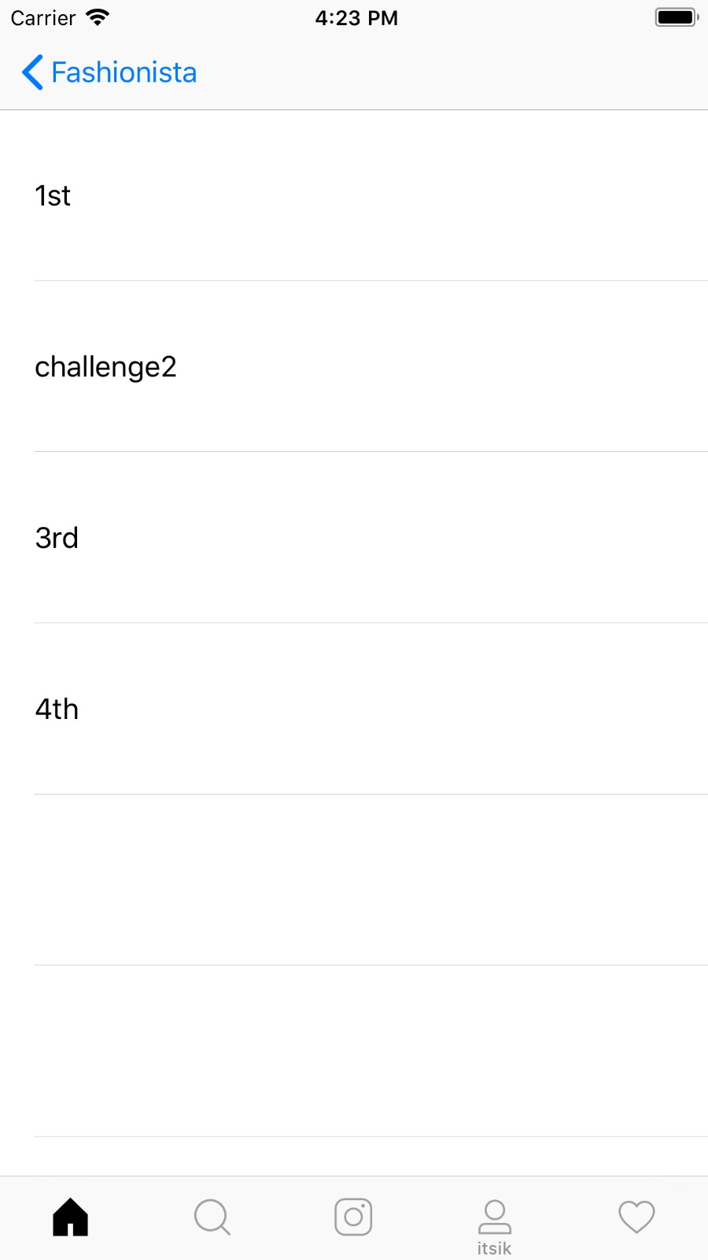
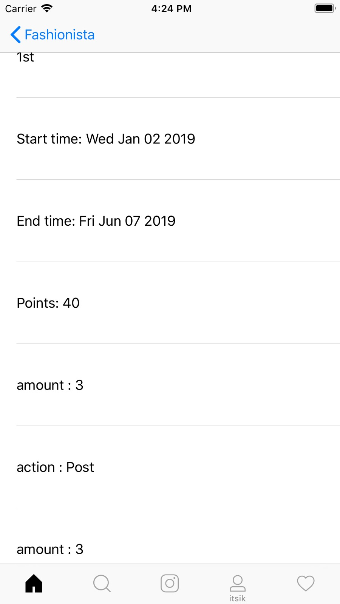
The “All challenges” page
shows the all challenges in the application. (Their names)
After pressing on one of the challenges, it will open all the necessary data about this challenge

Slide 9
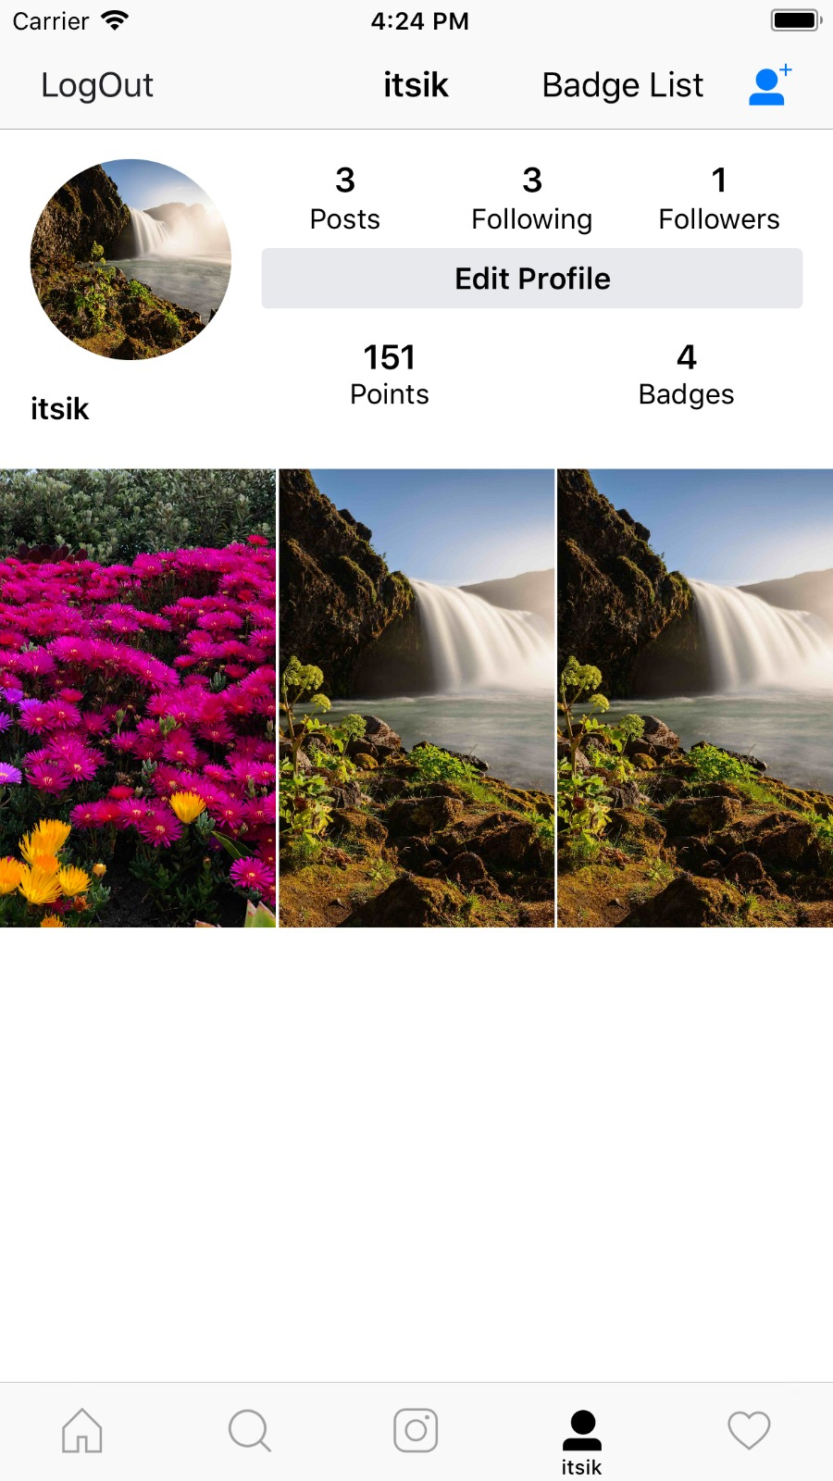
The profile page of the user.
Shows all the data of the user including points and badges

Slide 10
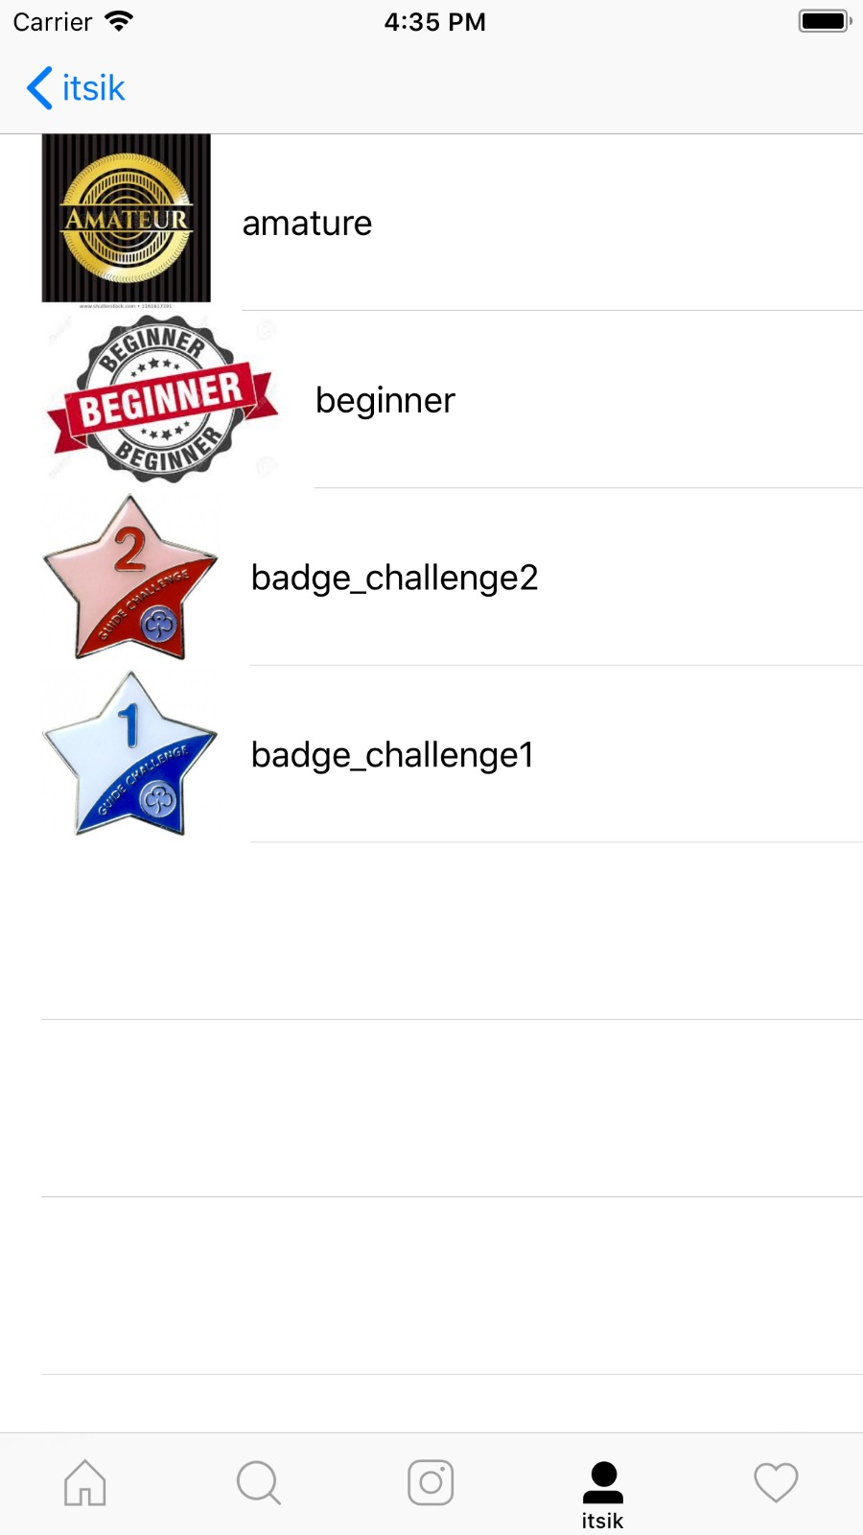
The “Badge list” page
Shows all the badges that the user received in the application

