Slide 1
Treasure Hunter

Slide 2
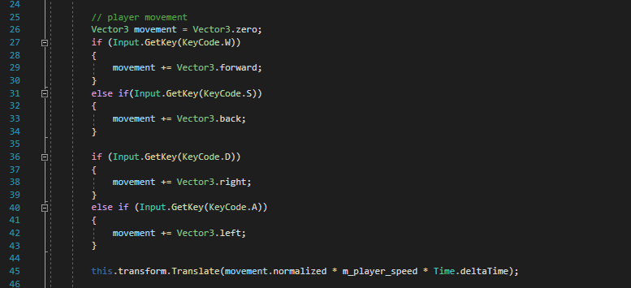
Player Object
Movement
The player moves when the user inputs WASD key codes. There is a movement vector that keeps track of the user inputs and then calculates the directional vector. The player position is then moved in the direction of that vector. This makes sure that the diagonal motion isn’t calculated as two different actions but combined into one.

Slide 3
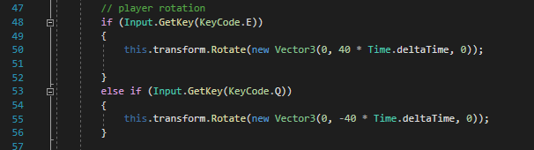
Player Object Cont.
Rotation
Player can rotate if the user inputs E or Q. The rotation is 40 degrees per second, and can help navigate the player towards the treasure.

Slide 4
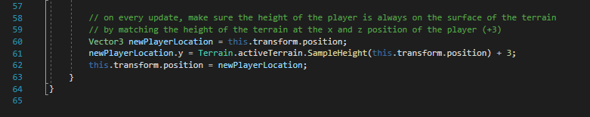
Player Object Cont.
Player Elevation
In order to keep the player above the terrain at all times, the location of the player is used to find the height of the terrain at that point. Then the player’s y value is modified to match the terrain height (+ 3, to make sure most of the cube is seen above ground).

Slide 5
Player Object Cont.
Winning Scenario

Slide 6
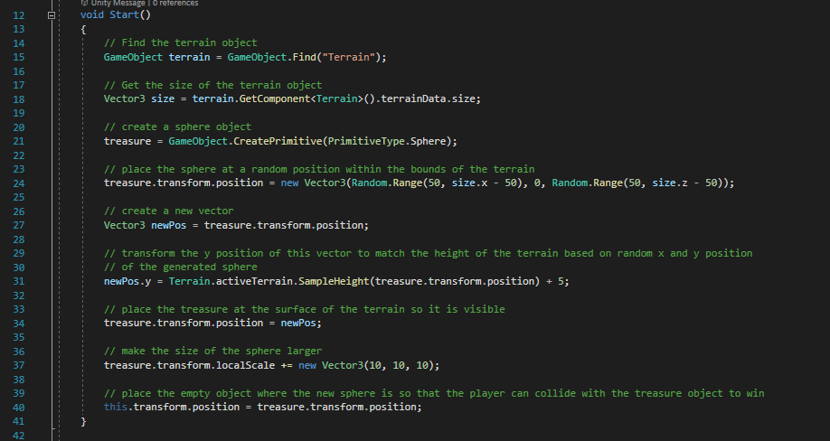
Treasure Object
Treasure Creation
The treasure object is created dynamically when the game starts. The script is attached to an empty object that already exists. This keeps track of whether the player has collided with the object in order to win. The object must appear anywhere within the bounds of the terrain, and so is randomly placed based on the x and z values of the terrain boundary. The object must be placed above the terrain during generation, to make sure the object is visible at any elevation. Similar to the player object, this is calculated based on the y value of the terrain at the point where the object randomly spawned. The object is then elevated. Finally the empty object is positioned where the treasure object spawned, to keep track of player collision.

Slide 7


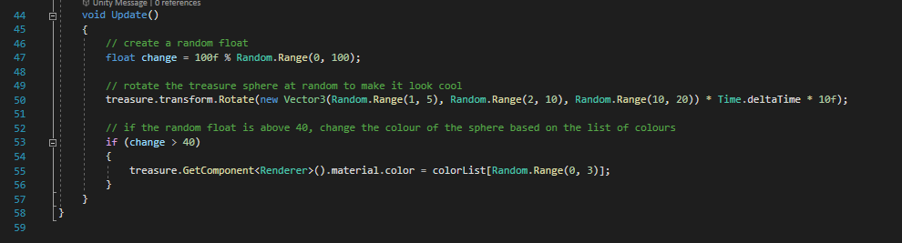
Treasure Object Cont.
Visual Aspects
In order to see the treasure easily, the treasure sphere rotates randomly during every update, as well as changes colours at random. This way the player will have no confusion as to which object is which.

Slide 8
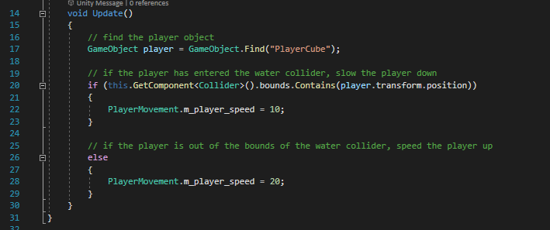
Water Object
Player Detection
The water object will slow down a player that enter its bounds. A large collider object is placed over the entire area of the water. On every update, the water objects checks to see if the bounds contain the player object. If it does, the speed of the player is dropped. If the player is no longer in the bounds, the speed increases.

Slide 9
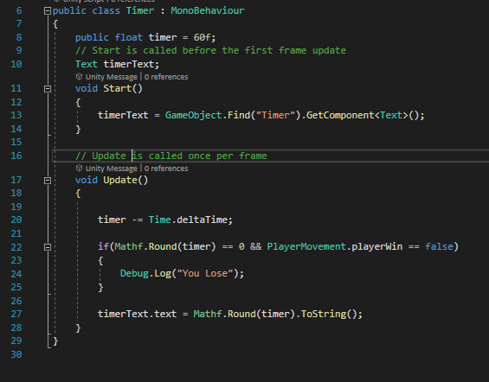
Timer Object
Count Down
The timer object is displayed as a text on the bottom of the player screen. It has an initial value of 60. It subtracts a second on each update and displays the count down to the player. If the value reaches 0 and the player has not been able to find the treasure, the screen for “Player Loses” is displayed.

