Slide 1




Visit Us
Ransomware Detection
Orel Rahum 316423615 Supervisors : Dr. Amit Dvir, Harel Berger
Dept. of Computer Science, Ariel University

Slide 2
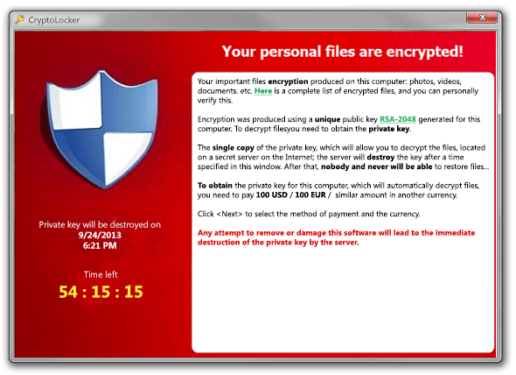
ABSTRACT
Ransomware is one of most prevalent malicious software in 2020 that encrypts the files in a victim’s machine and demands money. The global damage cost and financial losses of individuals and organizations due to ransomware is increasing year by year.

Slide 3
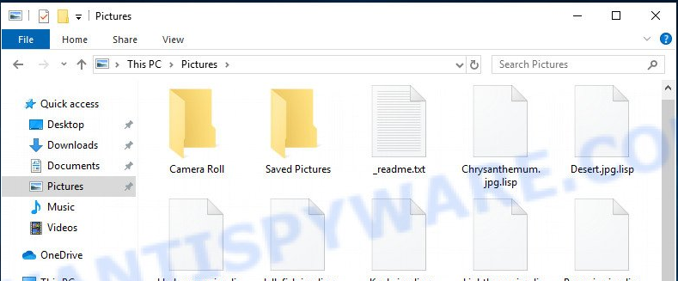
INTRODUCTION
Ransomware is a type of malware that prevents users from accessing their system or personal files. It demands a ransom payment to regain access. There are 2 type of ransomware
Lock the file
Encrypted file

Slide 4
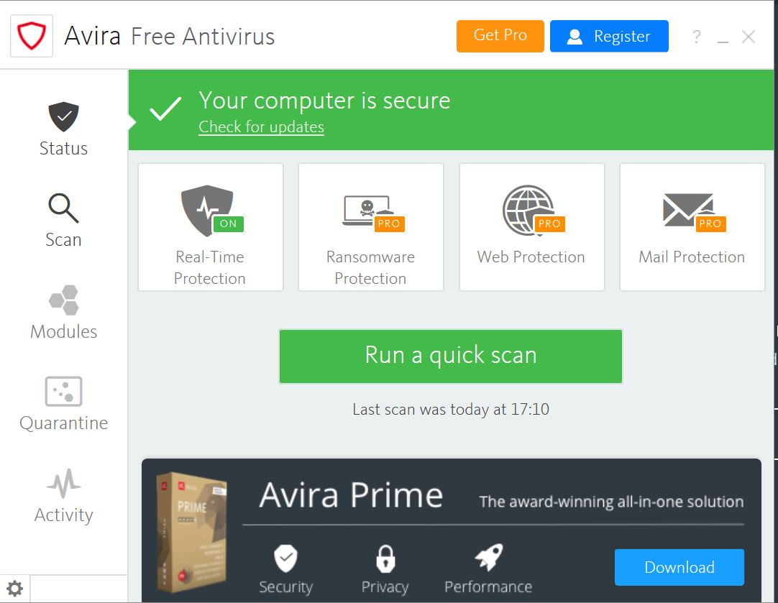
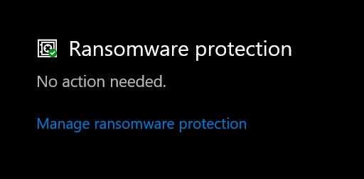
Ransomware Protector software's

Slide 5
GOAL
My goal is to detect by machine learning whether an attack using ransomware has occurred

Slide 6
Cryptography
An encryption system uses cryptological building blocks such as a symmetric code, a current code, a public key, stacking functions, a message verification code, a random pseudo-generator, and so on.
In this article we will focus on the field of encryption in cryptography and explain the number of types of encryption and the differences between them

Slide 7
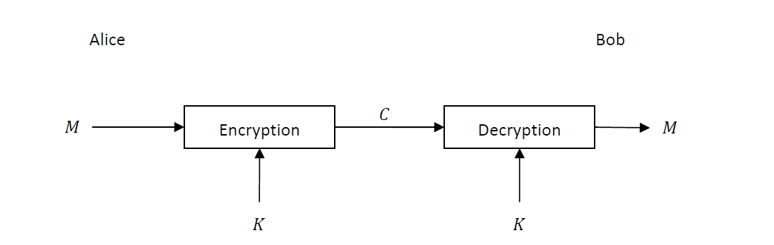
Cryptography
Symmetrical encryption:
In the world of symmetric encryption the assumption is that two people who want to communicate encrypted have a key
With which they can encrypt messages and decrypt encrypted messages or authenticate messages

Slide 8
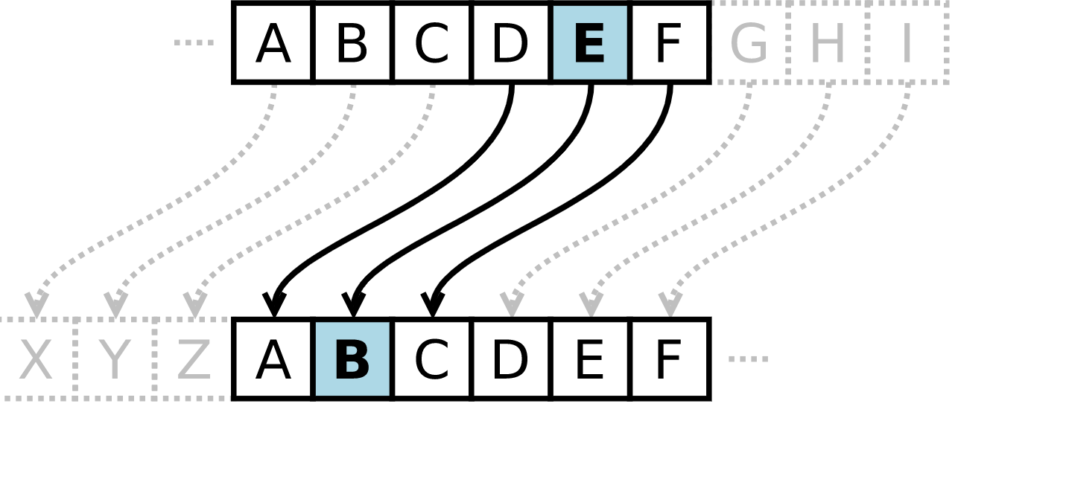
Cryptography
Symmetrical encryption:
It is a type of substitution cipher in which each letter in the plaintext is replaced by a letter some fixed number of positions down the alphabet. For example, with a left shift of 3, D would be replaced by A, E would become B, and so on.
Caesar cipher

Slide 9
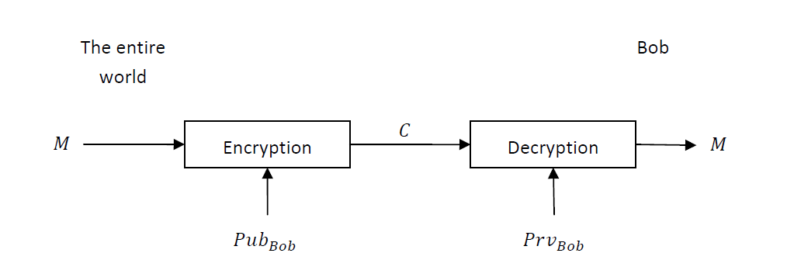
Cryptography
Asymmetric encryption:
In the asymmetrical world each entity has a pair of keys - a public key and a private key. The public key is used
The rest of the world to send messages and verify received messages while the private key is used to decrypt
Messaging and signing outgoing messages.

Slide 10
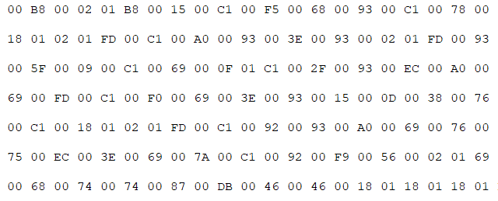
Cryptography
Asymmetric encryption:
An RSA user creates and publishes a public key based on two large prime numbers, along with an auxiliary value. The prime numbers are kept secret. Messages can be encrypted by anyone, via the public key, but can only be decoded by someone who knows the prime numbers
RSA cipher

Slide 11
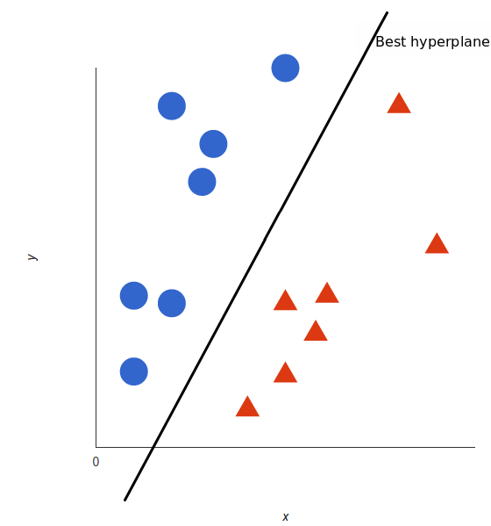
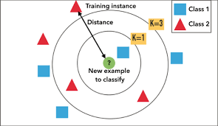
Machine learning
is the study of computer algorithms that improve automatically through experience. It is seen as a subset of artificial intelligence
For Learn my Machine learning need dataset I used with 2 Famous models : SVM ,KNN

Slide 12
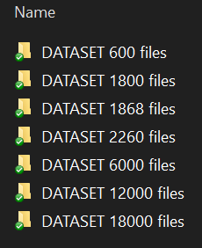
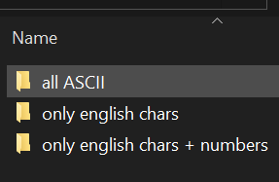
My DATASET
I have a few group of DATASET. One of them have 18000 text file that divide to 26 folder. (for each folder have a reason to get the best result. I divide all my data to 3 type : all type ASCII , only English chars , only English chars + number

Slide 13
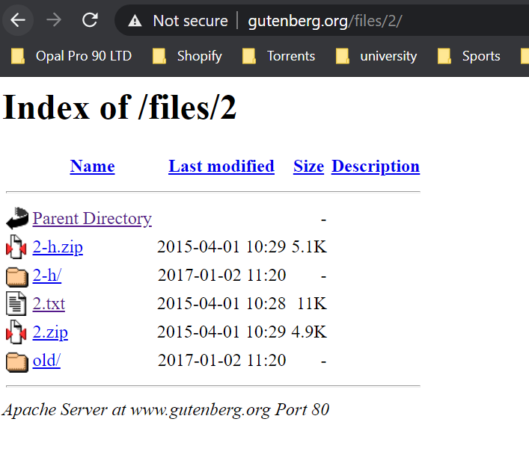
My DATASET
Every type of text files have 50% text file that Unencrypted and 50% text file that encrypted by 6 type of encrypted. My Unencrypted took from : 1. download from this site: http://www.gutenberg.org/ . 2. divide few big text files to a lot of small text file (200-2200 rows)

Slide 14
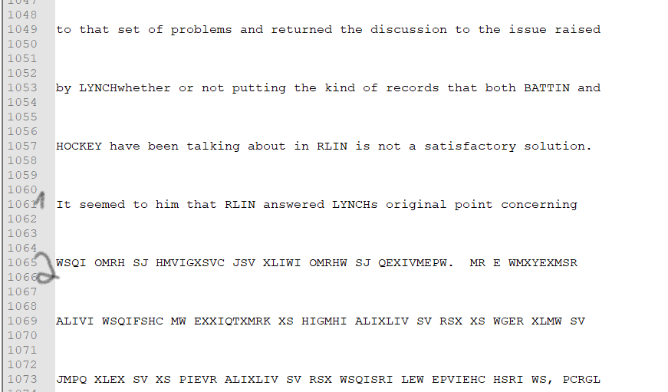
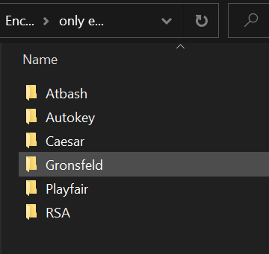
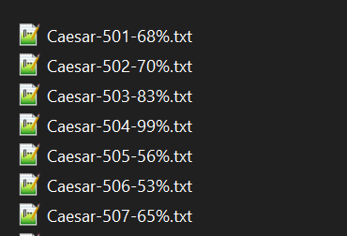
My DATASET
Encrypted -> made by me with custom code. Encrypted type : Atbash , Autokey , Caesar , Gronsfeld , Playfair , RSA.

Slide 15
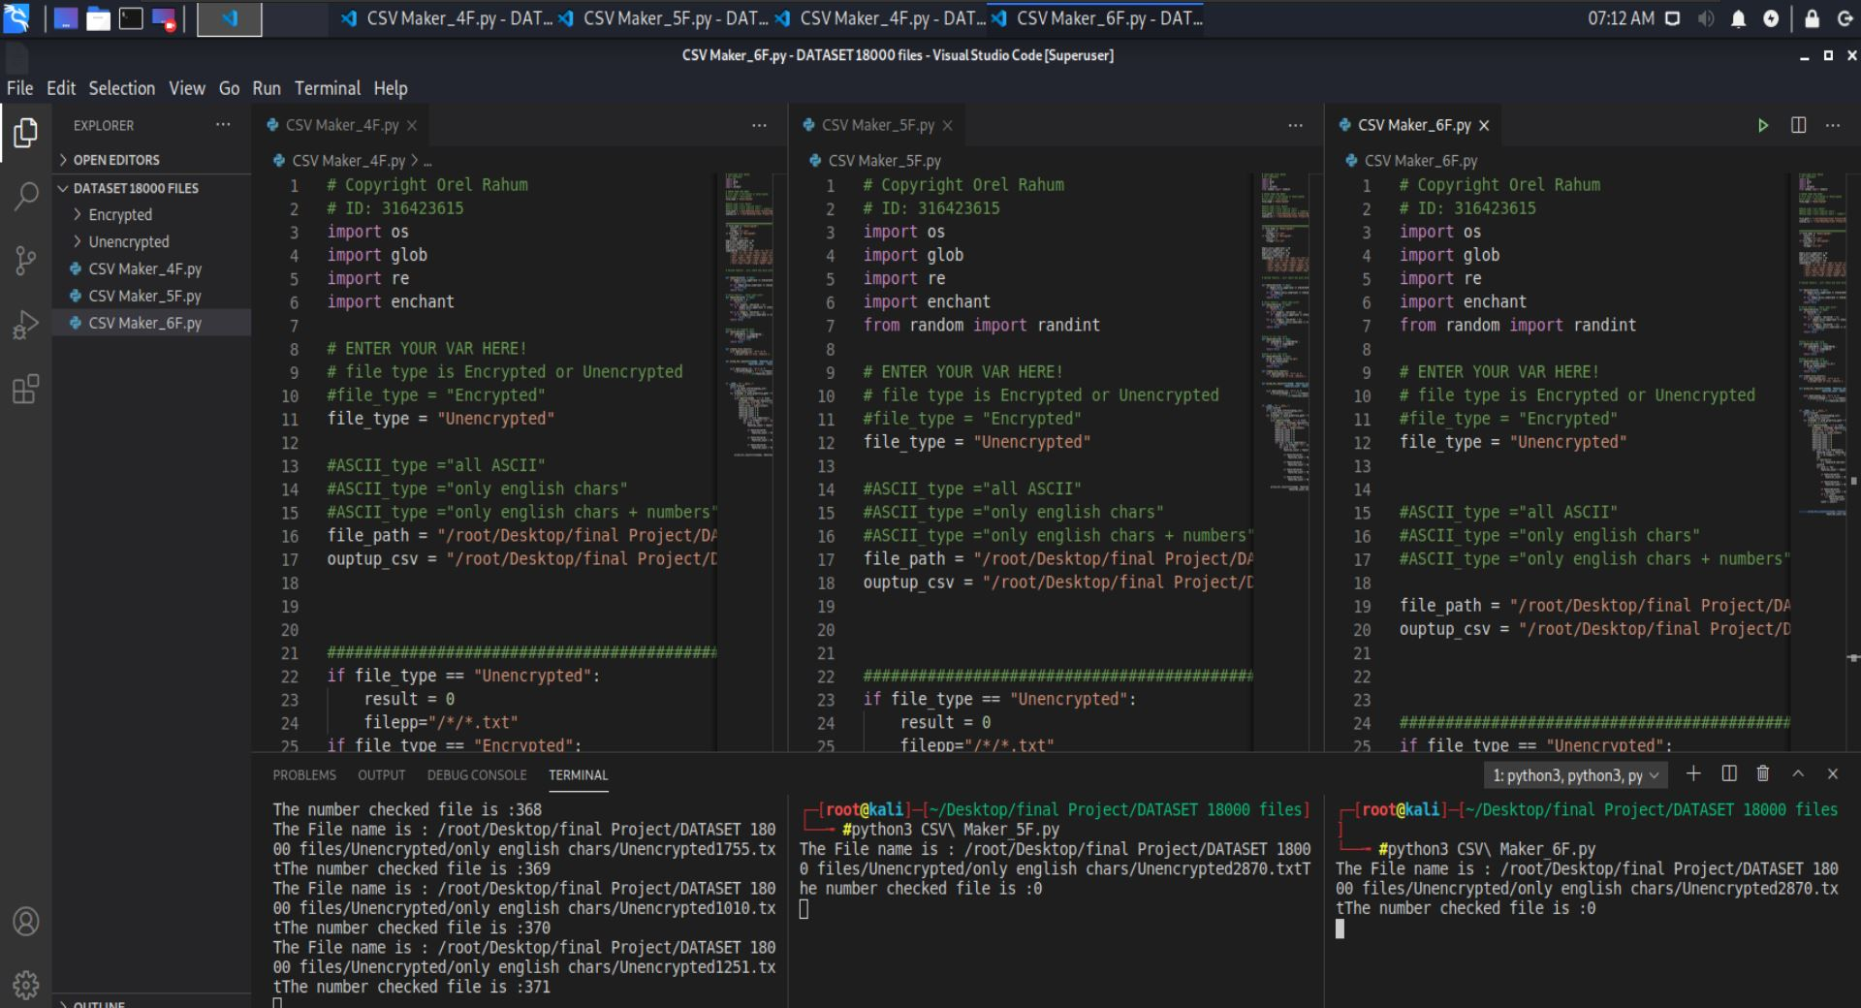
My work
All my DATASET was Translated to CSV file with all Features results. I Try to have a lot of type of text files with different data and different chars to get max result. After deeply research I am happy to explain you my features in next slides

Slide 16
First Feature
Count the number of word in my text file. To know the Length of my text file I need some information to show me. Count my word on my text is the best way to check it

Slide 17
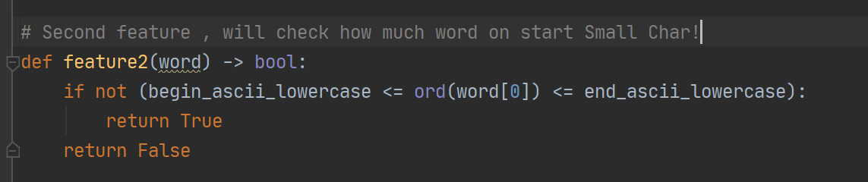
Second feature
Count if word start on small char Because I work on on different text files , the file can have 20 row or 1200 row.

Slide 18
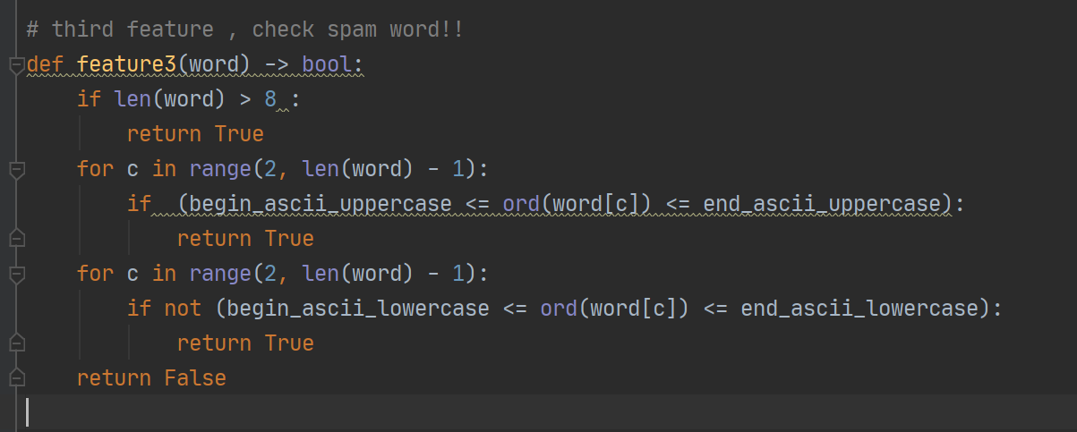
third feature
Count if its spam word!!
After read about cryptographic encrypted I learn how need look Suspicious words

Slide 19
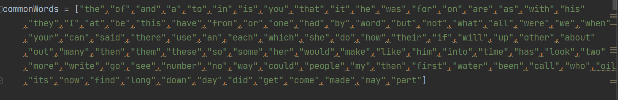
Fourth feature
Count how much popular word in text
I took the popular 100 English word to array. And count how much popular word in text . (this feature based on feature 5 what we will explain next slide)

Slide 20
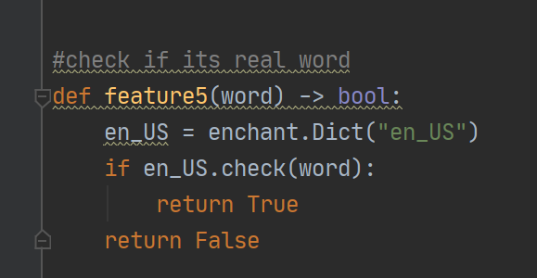
Fifth feature
Check if the word is in English or no. Basically in Descriptive word this feature is enough
So I try 3 type of this feature :
1. only 1 word at row 2. Only 3 word at row

Slide 21
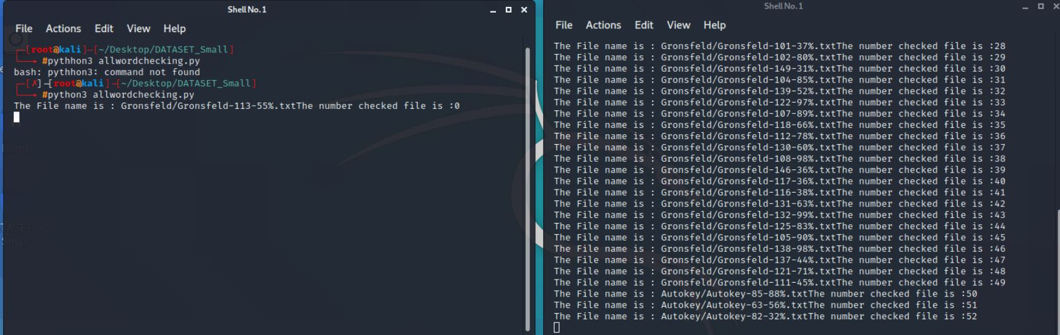
Fifth feature
Running time to check 1 word on line VS all word!

Slide 22
sixth feature
Count how much line on text :
This feature work only when feature 5 is on. This feature is to check how much line in the text and because we check only 1/3 word in line . This data can help to ML used in max on with feature 5

Slide 23
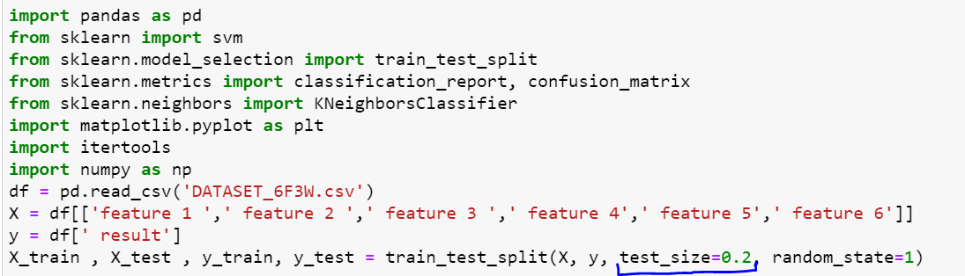
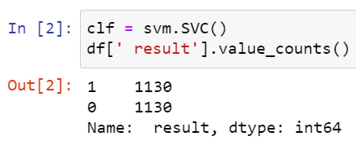
My Machine Learning
I have 2 type of ML :KNN , SVM my data is divided 50%-50% (Encrypted /Unencrypted) and to 80% Train 20% test.

Slide 24
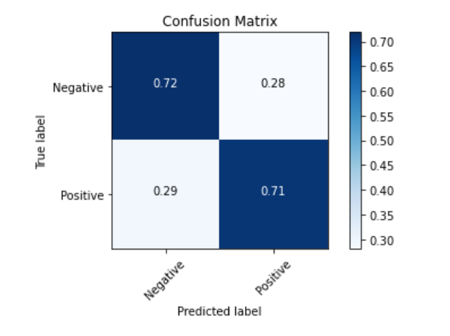
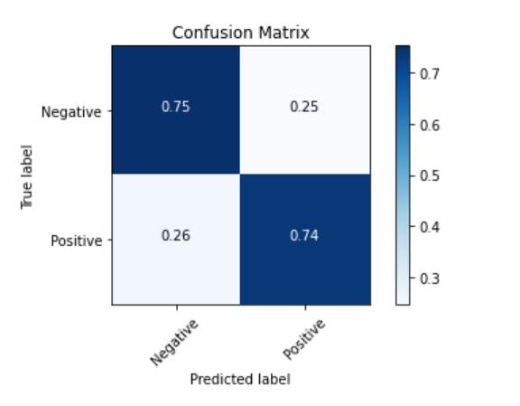
My Machine Learning results
SVM KNN

Slide 25
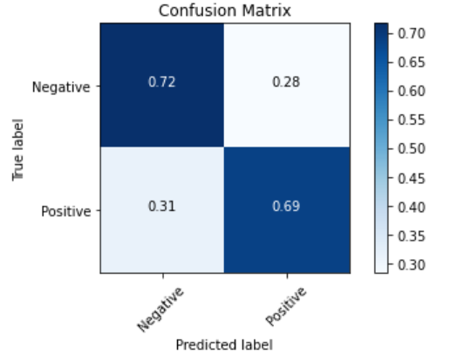
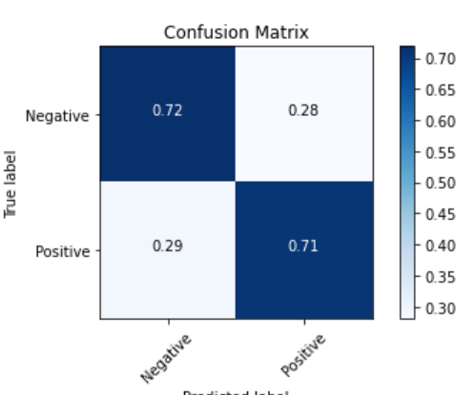
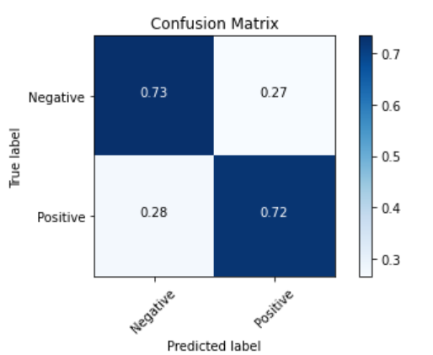
My Machine Learning results for Middle Research
English Chars Plus Numbers
ALL ASCII Chars
English Chars

Slide 26
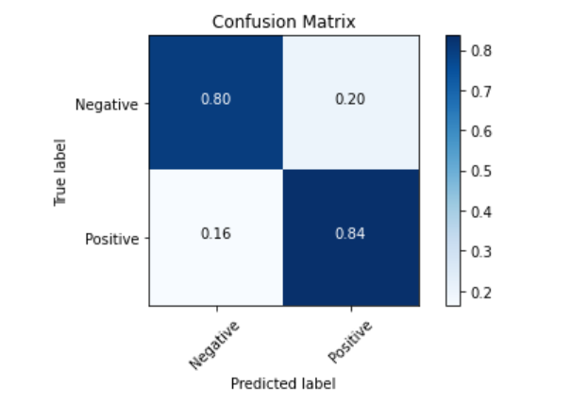
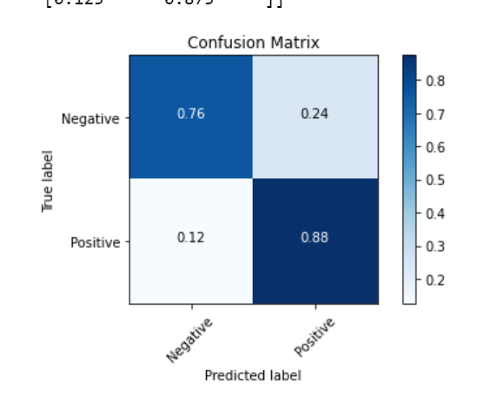
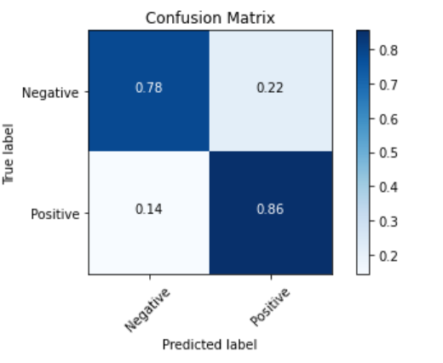
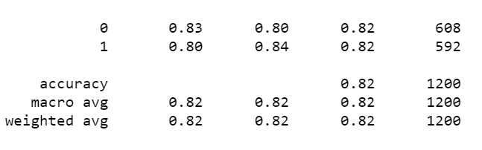
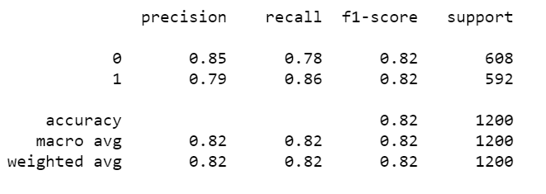
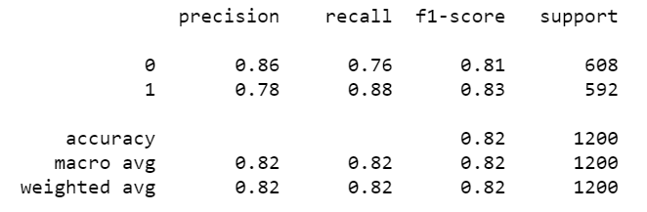
My Machine Learning results
English Chars Plus Numbers
English Chars
ALL ASCII Chars

Slide 27
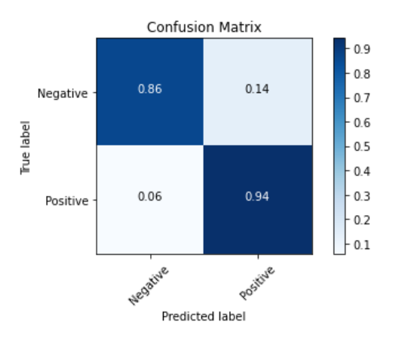
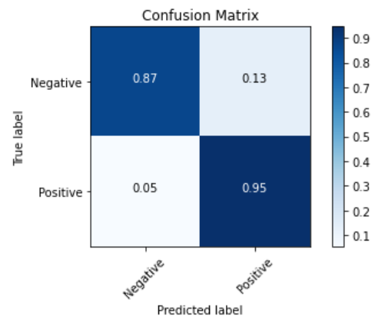
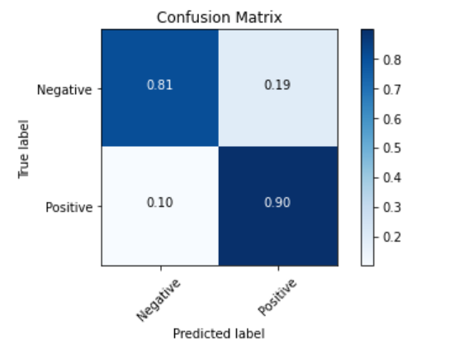
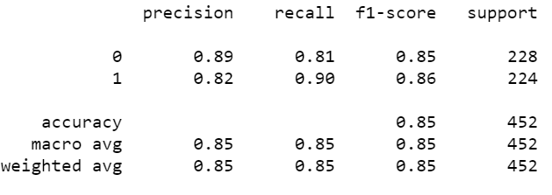
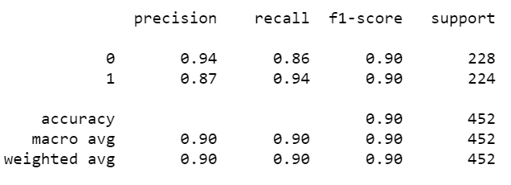
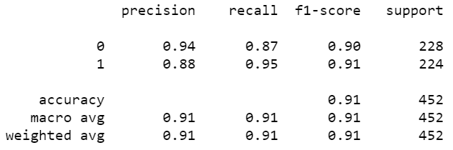
My Machine Learning results
Only 4 Features (without check word in Directory)
6 Features (check one word per line in Directory)
6 Features (check three word per line in Directory)

Slide 28
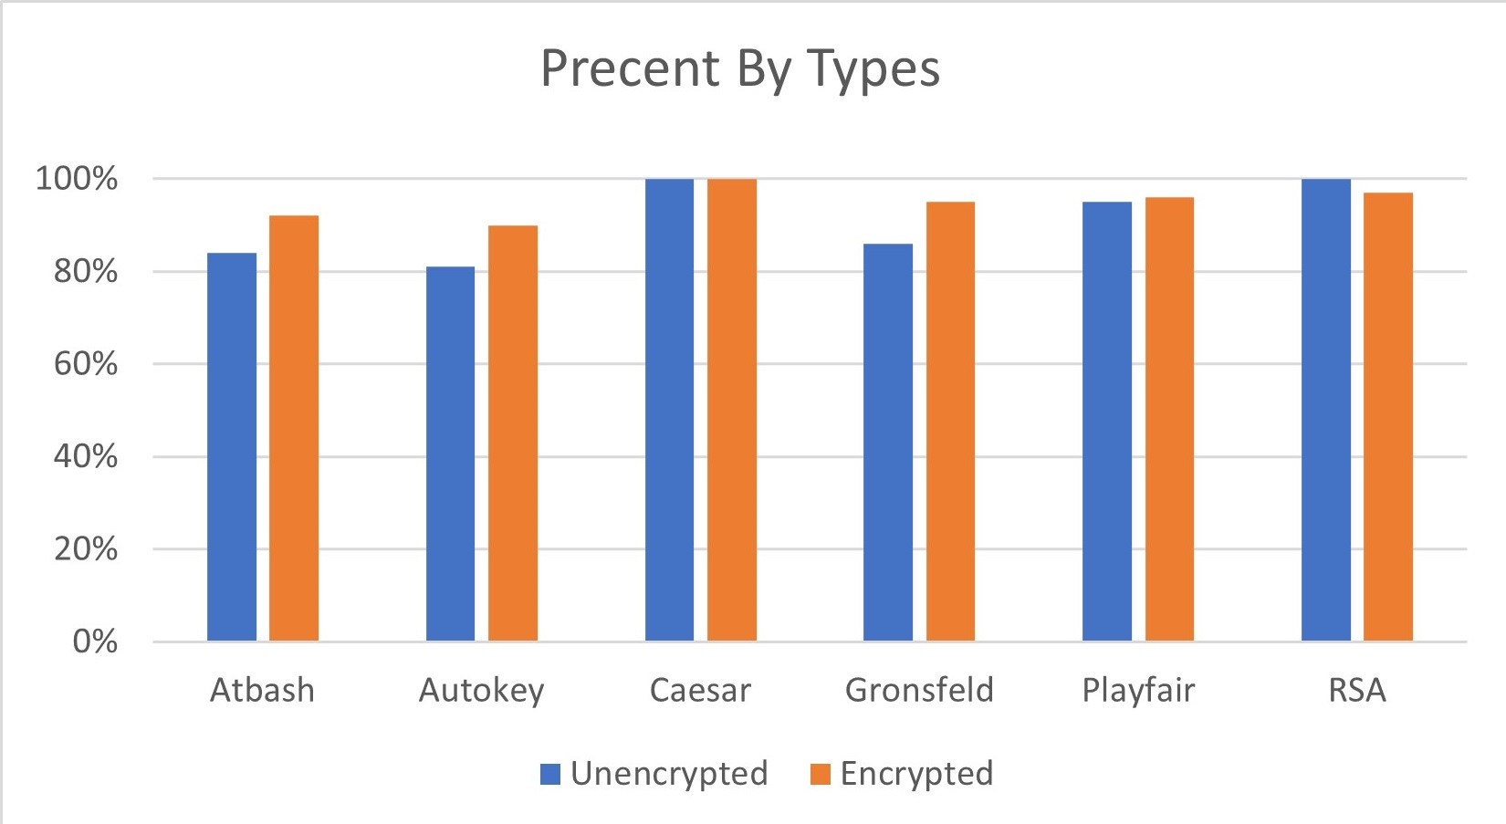
My Machine Learning results

