Slide 1


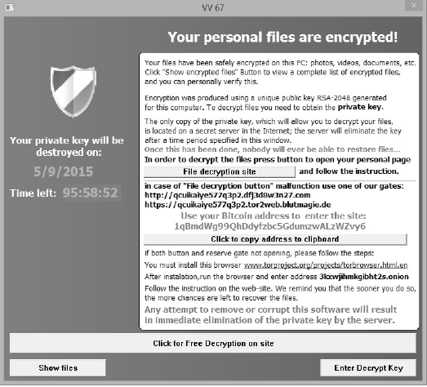
Ransomware Orel Rahum Advisor : Dr. Amit Dvir and Harel Berger
Scan QRCode for full Instructions
Visit Us
Introduction
Ransomware is a type of malware that prevents users from accessing their system or personal files. It demands a ransom payment to regain access.
Operation in two ways:
By is blocking access to the computer.
By is making user data unusable using of employing encryption algorithms.
My goal is to detect a ransomware attack at maximum speed and accuracy.
Suggested method:
My methodology target is to make software that
detects most of the type files that encrypted in real-time,
base on:
Real-time flag.
Deep Learning Algorithm.
Ransomware message example:
Existing solutions
In this section, we review existing work. We can divide the techniques used to detect ransomware few categories:
Detection by the hardware.
Detection by electricity use.
Detection by internet traffic.
Text detecting result
Detecting ransomware text attack already on my project. The code based on related work and the probability ratio if the file is encrypted.
The feature on my code:
Real-time.
Identifying suspicious characters.

