Slide 1


Ransomware Detection
Orel Rahum 316423615 Supervisors : Dr. Amit Dvir, Harel Berger
Dept. of Computer Science, Ariel University

Slide 2
ABSTRACT
Ransomeware is one of most prevalent malicious software in 2020that encrypts the files in a victim’s machine and demands money,i.e., ransom, for decrypting the files. The global damage cost andfinancial losses of individuals and organizations due to ransomwareis increasing year by year.

Slide 3
INTRODUCTION
Ransomware is a type of malware that prevents users from accessing their system or personal files. It demands a ransom payment to regain access. There are 2 type of ransomware:
Lock the file
Encrypted file

Slide 4
GOAL
My goal is detection ransomware by using machine learning.

Slide 5
Cryptography
An encryption system uses cryptological building blocks such as a symmetric code, a current code, a public key, stacking functions, a message verification code, a random pseudo-generator, and so on.
In this article we will focus on the field of encryption in cryptography and explain the number of types of encryption and the differences between them

Slide 6
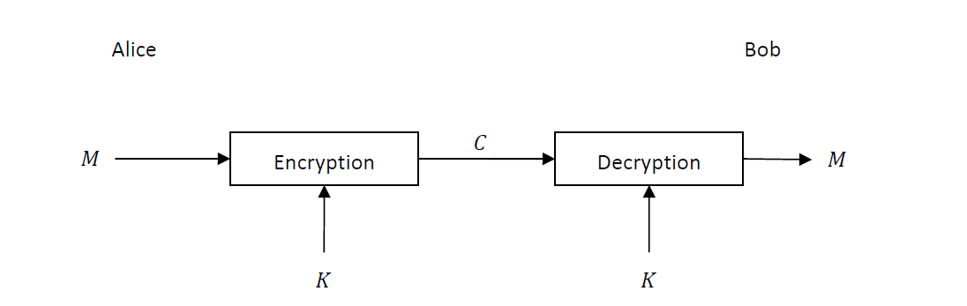
Cryptography
Symmetrical encryption:
In the world of symmetric encryption the assumption is that two people who want to communicate encrypted have a key
With which they can encrypt messages and decrypt encrypted messages or authenticate messages

Slide 7
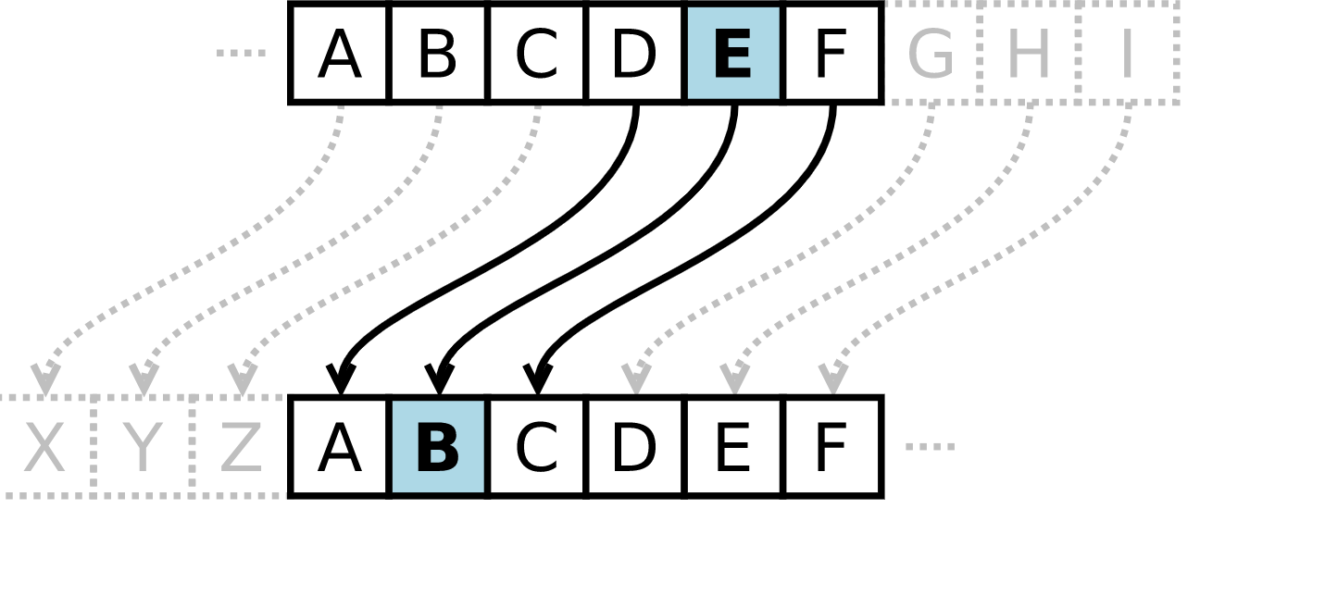
Cryptography
Symmetrical encryption:
It is a type of substitution cipher in which each letter in the plaintext is replaced by a letter some fixed number of positions down the alphabet. For example, with a left shift of 3, D would be replaced by A, E would become B, and so on.
Caesar cipher

Slide 8
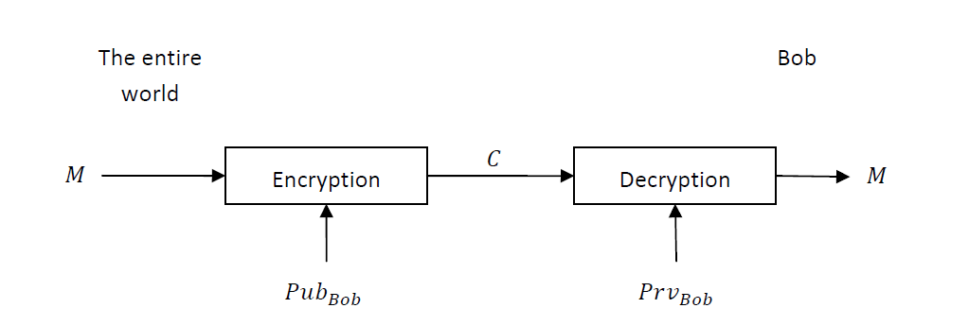
Cryptography
Asymmetric encryption:
In the asymmetrical world each entity has a pair of keys - a public key and a private key. The public key is used
The rest of the world to send messages and verify received messages while the private key is used to decrypt
Messaging and signing outgoing messages.

Slide 9
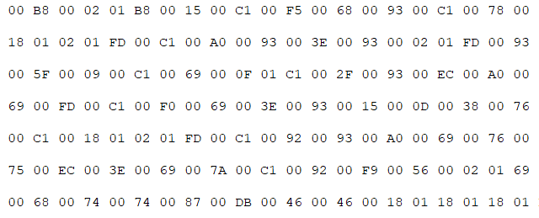
Cryptography
Asymmetric encryption:
An RSA user creates and publishes a public key based on two large prime numbers, along with an auxiliary value. The prime numbers are kept secret. Messages can be encrypted by anyone, via the public key, but can only be decoded by someone who knows the prime numbers
RSA cipher

Slide 10
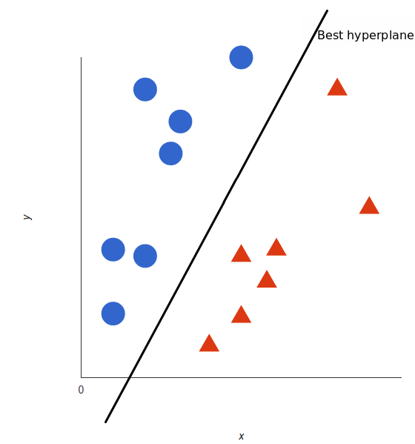
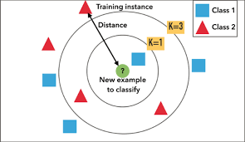
Machine learning
is the study of computer algorithms that improve automatically through experience. It is seen as a subset of artificial intelligence
For Learn my Machine learning need dataset I used with 2 Famous models : SVM ,KNN

Slide 11
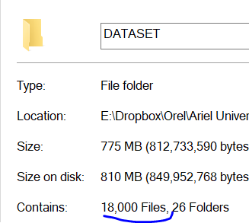
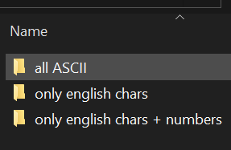
My DATASET
I have 18000 text file that devide to 26 folder. (for each folder have a reason to get the best result. I divide all my data to 3 type : all type ASCII , only English chars , only English chars + number

Slide 12
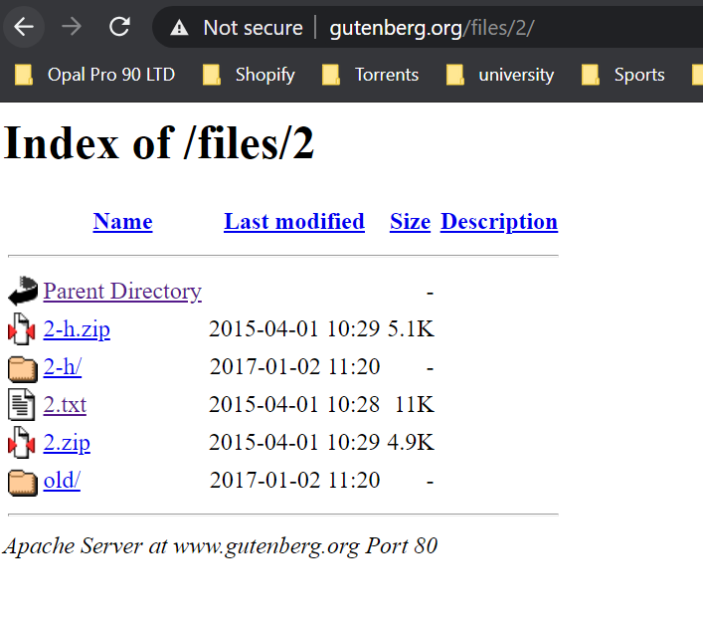
My DATASET
Every type of text files have 3K text file that uncrypted and 6 type of encrypted file with 500 files each. Uncrypted -> took from the site http://www.gutenberg.org/ .

Slide 13
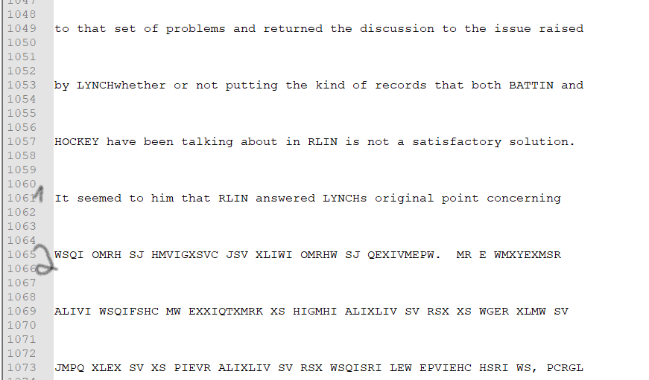
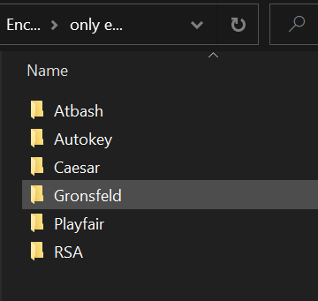
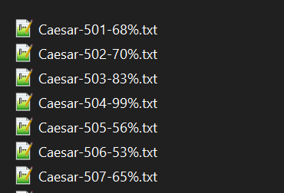
My DATASET
Encrypted -> made by me with coustom code. Encrypted type : Atbash , Autokey , Caesar , Gronsfeld , Playfair , RSA.

Slide 14
First Feature
only count number of word.
Because I work on on different text files , the file can have 20 row or 1200 row.

Slide 15
Second feature
will check how much word on start on Big CHAR/Small Char! Because I work on on different text files , the file can have 20 row or 1200 row.

Slide 16
third feature
check spam word!!

Slide 17
Fourth feature
Count how much pouplar word in text

Slide 18
Fifth feature
Check if the word is in English or no. Basically in Descriptive word this feature is enough
So I try 3 type of this feature :
1. All my world (just for few files because it take too much time) 2. only 1 word at row (normal time) 3. without it

Slide 19
ML reasults

