Slide 1

Car Insurance Fraud Detector
Submitted and presented by:
Orel Yosef and David Zilensky

Slide 2
Introduction And Motivation
Insurance fraud causes massive financial losses annually. Manually detecting fraud is time-consuming and often inaccurate due to the complexity and volume of claims.
This project uses machine learning and deep learning image classification to identify fraudulent insurance claims. Our key goals:
Reduce financial losses through early fraud detection
Automate claim screening to ease manual workload
Leverage data insights to uncover hidden fraud patterns
Address class imbalance (fraud cases are rare but critical)
The project showcases how data-driven models can improve both accuracy and efficiency in fraud detection.

Slide 3
So what is the problem?
Fraudulent insurance claims are rare but costly. The core challenges include:
Severe Class Imbalance Only ~6% of claims are labeled as fraud, making them hard to detect.
Subtle Fraud Patterns Fraudulent claims often mimic legitimate ones, requiring nuanced detection.
High False Positive Cost Flagging honest customers as fraud hurts customer trust and wastes resources.
Data Complexity Claims involve various features vehicles, customers, regions, and safety creating a high-dimensional problem space, and as for the images, those are highly hard to classify by alone.

Slide 4
Model Applications
Our fraud detection models can be integrated into real-world insurance workflows to provide value at multiple stages:
Claim Triage Automatically flag high-risk claims for manual review before approval.
Fraud Investigation Support Provide ranked lists of suspicious cases to investigation teams for further analysis.
Real-Time Alerting Trigger fraud alerts immediately during claim submission for faster response.
Risk Profiling Identify patterns across high-risk customer segments, regions, or vehicle types.
Resource Optimization Focus investigation efforts where fraud is most likely, reducing wasted time and costs.
This model empowers insurers to act faster, smarter, and more efficiently.

Slide 5
Uniqueness Of Solution
What sets our solution apart from typical fraud detection models?
Hybrid Approach Combines structured data analysis with image-based fraud detection, improving overall model robustness.
Image Classification Model Uses accident or damage photos to assess visual fraud indicators — an innovative layer of evidence.
Advanced Feature Engineering Extracted interaction terms, ratios, and risk flags to enhance model understanding of real-world behavior.
Balanced Sampling Strategies Implemented both oversampling (SMOTE) and undersampling to combat class imbalance effectively.
Explainability Used mutual information and feature importance plots to gain insight into model decisions.
This multi-modal, interpretable pipeline provides a smarter and more comprehensive fraud detection system.

Slide 6
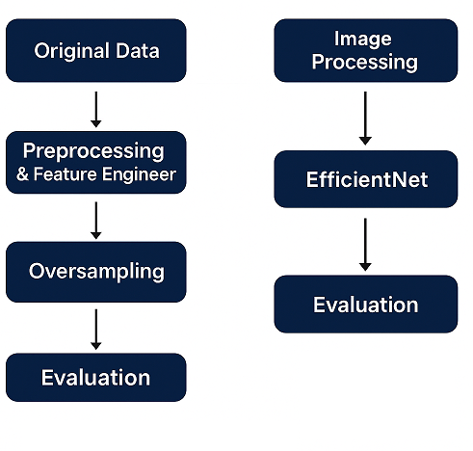
Workflow

Slide 7
Our Models
We developed two complementary models to detect fraudulent insurance claims:
1. Structured Data Classifier
Input: Tabular features from customer, vehicle, and policy data
Models Tried:
Random Forest
LightGBM
CatBoost
Enhancements:
Advanced feature engineering
SMOTE and undersampling for class balance
2. Image Classification Model
Input: Accident/damage images from claims
Model: EfficientNetB0 (pretrained on ImageNet)
Pipeline:
Images resized to 224×224
Fine-tuned on labeled fraud vs. non-fraud images
Evaluated on accuracy and visual patterns

Slide 8
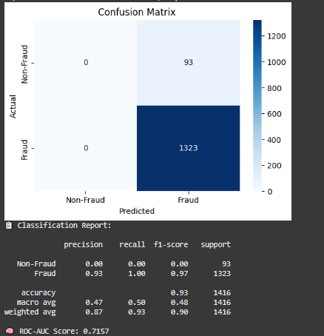
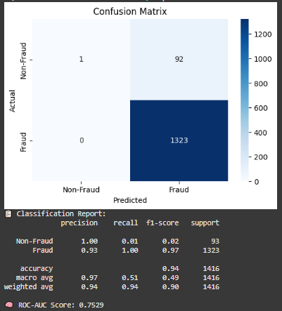
Models Comparation
EfficientNet
AlexNet

Slide 9
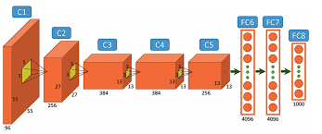
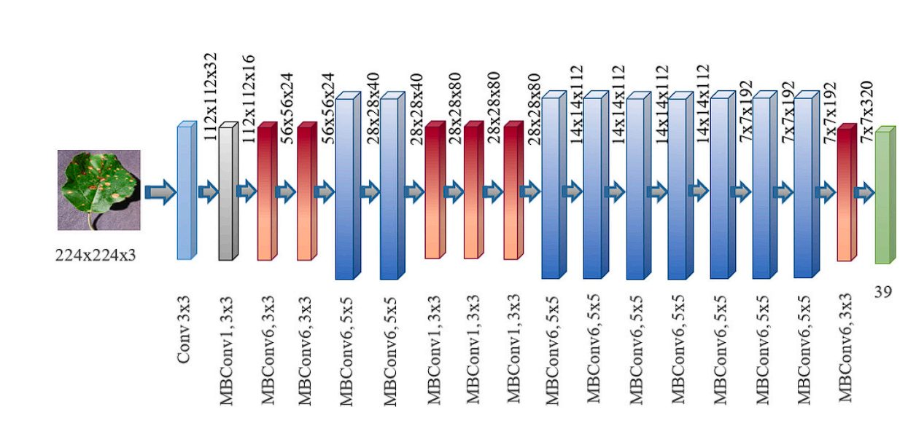
Image Models
AlexNet
EfficientNet
Consists of 5 convolutional layers followed by 3 fully connected layers.
Uses ReLU activations, max pooling, and dropout to reduce overfitting.
Large number of parameters.
Marked the beginning of deep learning’s dominance in computer vision.
Built with MBConv (Mobile Inverted Bottleneck) blocks and depthwise separable convolutions.
Achieves state-of-the-art accuracy with fewer parameters and FLOPs than traditional models.
Available in multiple versions (B0 to B7) with increasing size and accuracy.

Slide 10
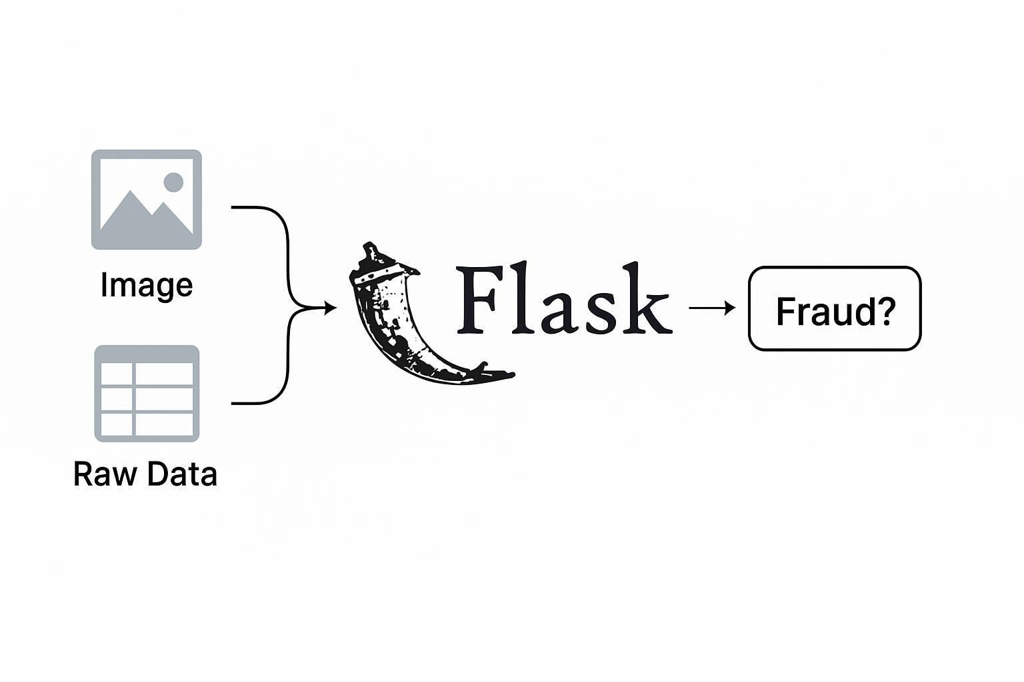
Future Plans
Deploy a Flask web app that takes an accident image and claim data as input and predicts fraud using both the structured model and image classifier, if both indicates it is a fraud with high certainty it is a fraud.
Git: https://github.com/orelyosefbgu/projectfraud

