Slide 1
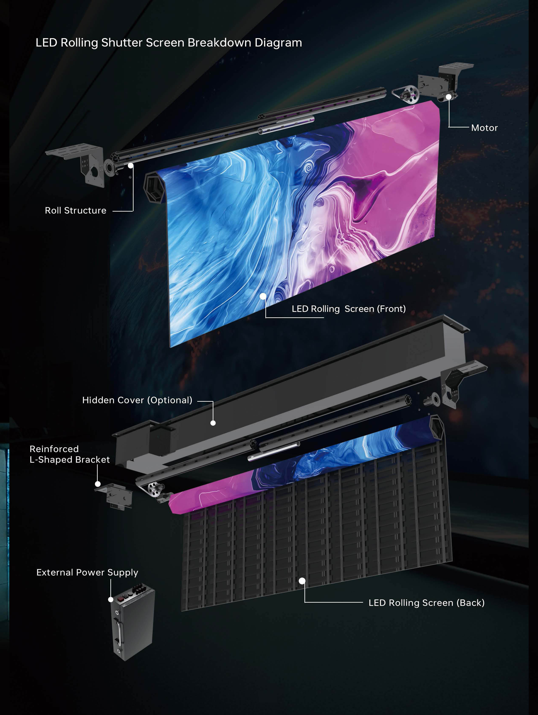
LED DISPLAY IMPORT PROGRAM
Rolling & Fixed LED Displays
Commercial, technical and operating framework for the first GLIND import program in Israel
Meeting deck for Top TV
TOP TV × i-feel × GLIND TECH
01
Notes:
[Sources]
- GLIND Rolling LED Display Product Catalog, p. 3.

Slide 2
THE DECISION
Build an import-ready offer — not just buy a screen
The first order should validate product-market fit, landed cost, safety, training and after-sales capability in Israel.
TOP TV × i-feel × GLIND TECH
02
Notes:
[Sources]
- Prepared from the full source set listed in the meeting brief.

Slide 3
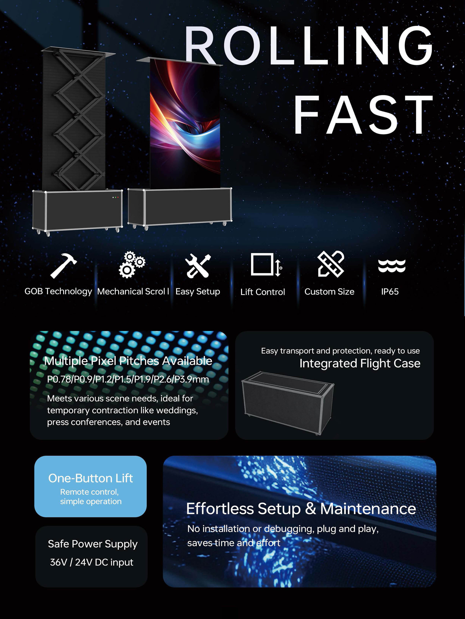
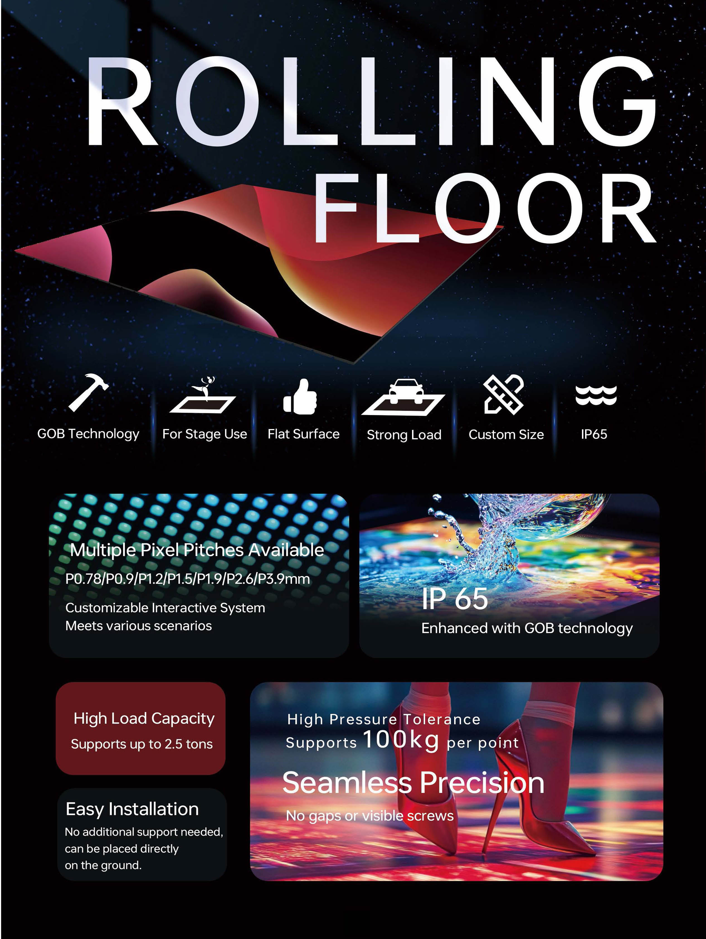
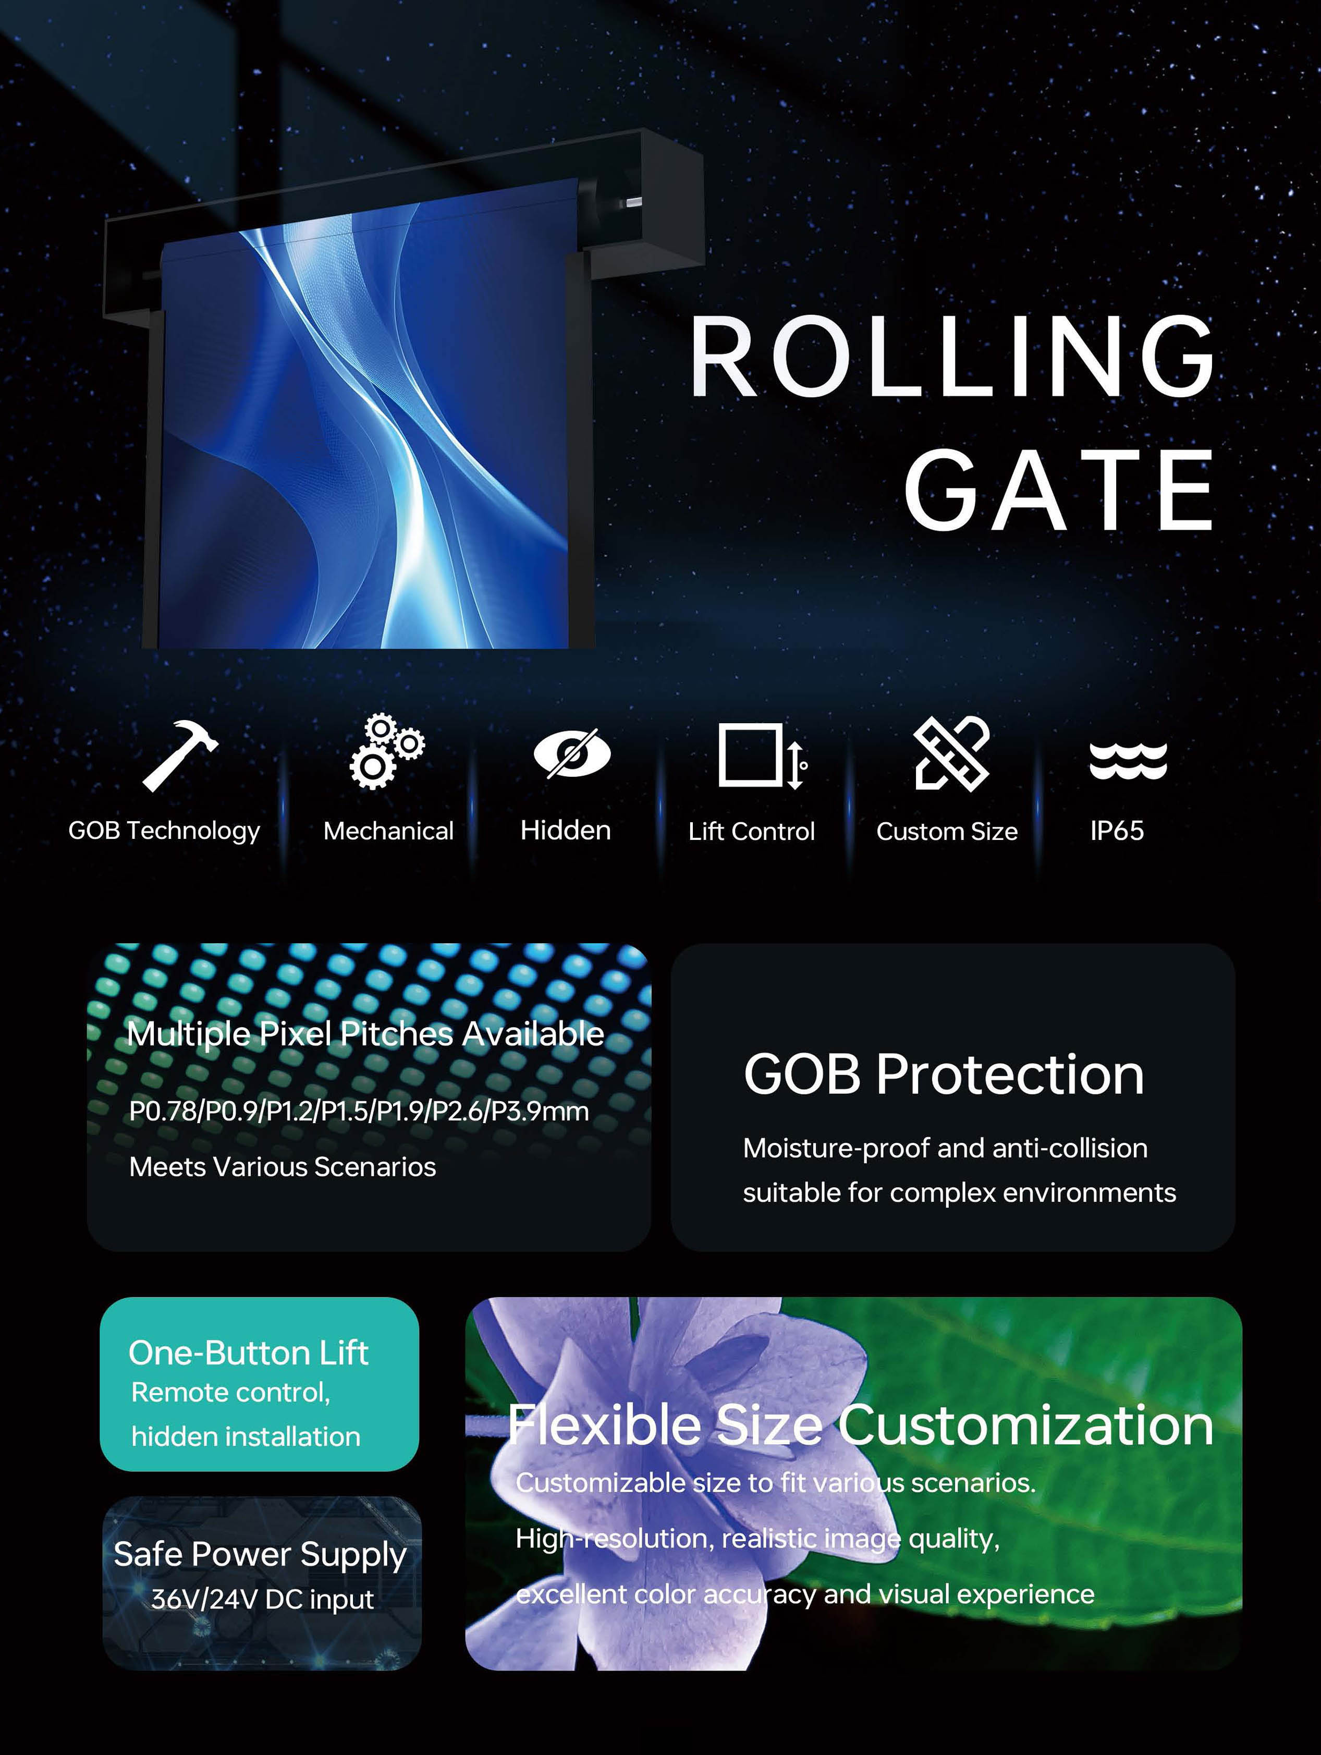
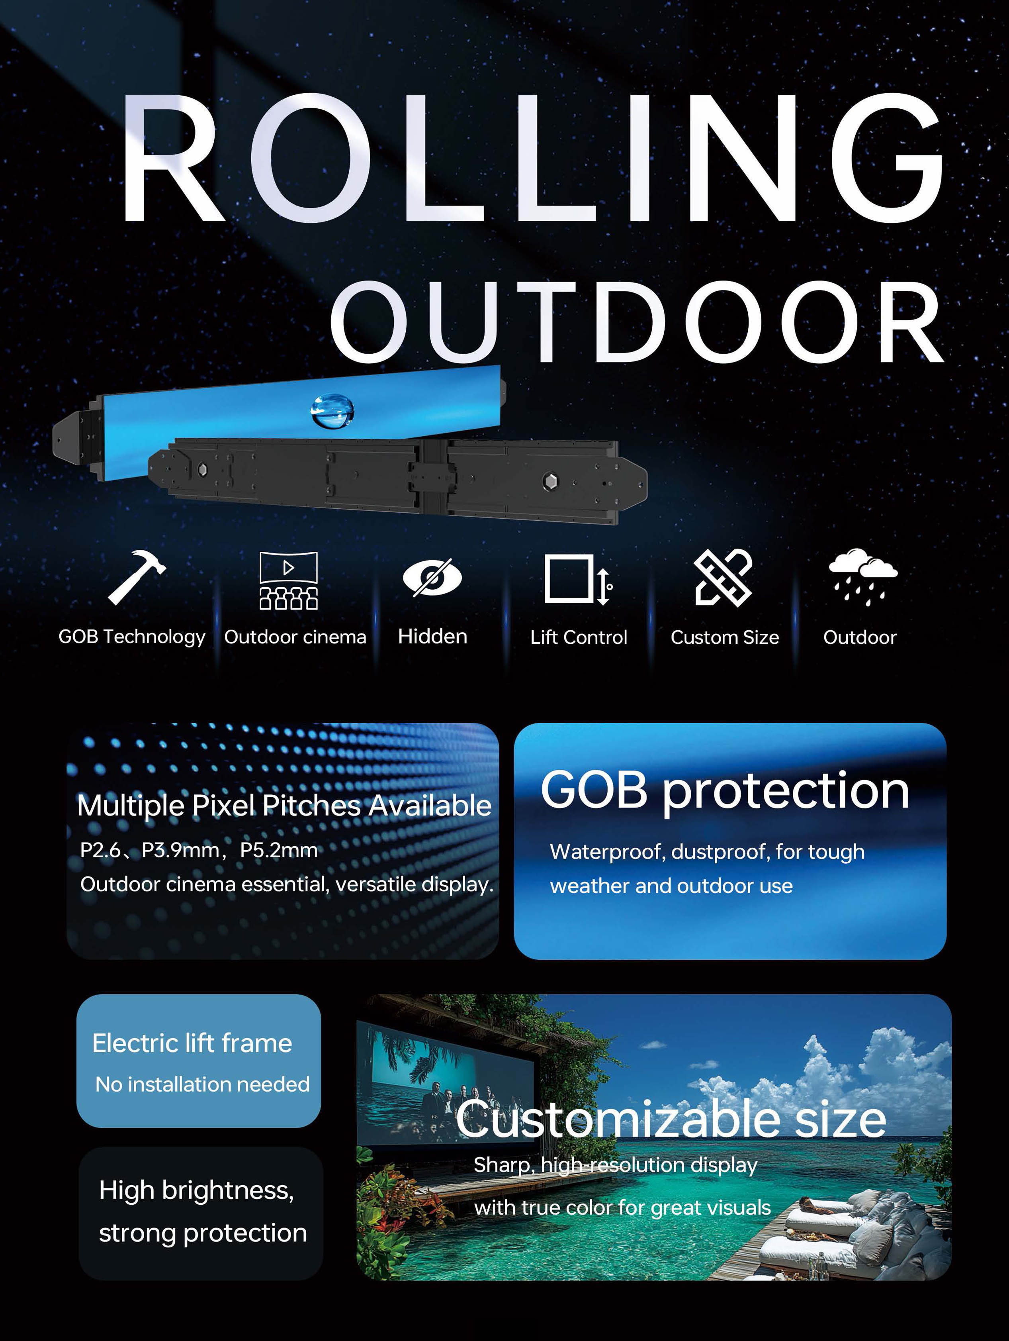
PRODUCT LANDSCAPE
GLIND offers multiple rolling formats — the import program needs focus
Rolling Fast
Rolling Floor
Rolling Gate
Rolling Outdoor
Recommended starting point: one flagship 3×2 m roll-up model plus a defined fixed-installation range.
TOP TV × i-feel × GLIND TECH
03
Notes:
[Sources]
- GLIND Rolling LED Display Product Catalog, pp. 6, 8, 12 and 25.

Slide 4
ROLLING DISPLAY ECONOMICS
The 3×2 m options span $26.4k–$44.4k EXW before freight
P1.953 correction
Remove the mistakenly retained $870 spare power supply. Corrected calculated EXW: $43,500.24.
Commercial implication
P3.91 offers the strongest price / outdoor brightness balance for a scalable commercial line.
TOP TV × i-feel × GLIND TECH
04
Notes:
[Sources]
- GLIND quotations: P1.953 (Aug 6, 2026), P2.604 (Aug 3, 2026), P3.91 and P5.2 (Aug 6, 2026).
- Calculation workbook: top-tv-led-commercial-comparison.xlsx.

Slide 5
3×2 M TECHNICAL COMPARISON
Resolution, brightness and viewing distance define the target application
Model | Resolution | Brightness | Quoted IP | Viewing distance
P1.953 | 1536×1024 | 3,500 nit | IP68 / IP68 | >2.0 m
P2.604 | 1152×768 | >3,000 nit | IP68 / IP68 | >2.6 m
P3.91 | 768×512 | >5,000 nit | IP65 / IP65 | >3.9 m
P5.2 | 576×384 | >5,000 nit | IP65 / IP65 | >5.2 m
All four quotations state ≥3,840 Hz refresh, 600 W/m² maximum consumption, 180 W/m² average consumption and ≥100,000 h claimed lifetime.
Documentation conflict: the general outdoor specification lists IP65 for all models, while two quotations state IP68.
TOP TV × i-feel × GLIND TECH
05
Notes:
[Sources]
- GLIND model quotations.
- specification of outdoor rolling led.xlsx.

Slide 6
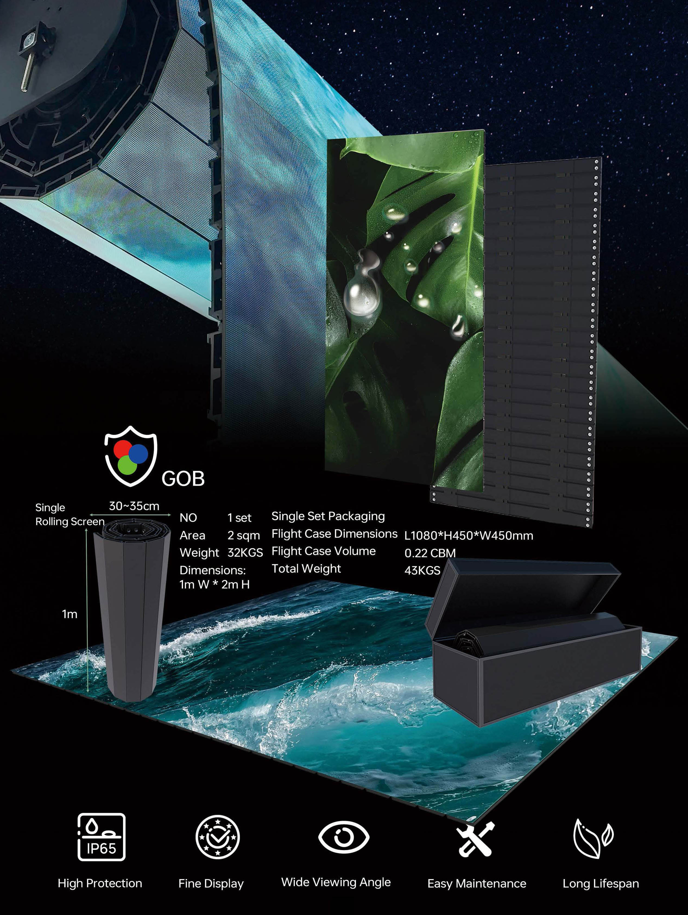
FIRST INSTALLATION CANDIDATE
P1.953 is the flagship showroom choice — with the highest cost and strictest closeout needs
Core configuration
• 3×2 m / 6 m²
• GOB + anti-glare treatment
• Kinglight SMD1010 LEDs
• ICND2153S driver IC
• NovaStar A5s Plus receiving cards
• Electric lifting system
Must be re-quoted
• No video processor
• No main or spare power supplies
• Eight spare LED modules + two receiving cards
• Separate enclosure and wind-system options
TOP TV × i-feel × GLIND TECH
06
Notes:
[Sources]
- Customize P1.9 3×2m Rolling Up LED Display.xlsx.
- Oren Levy email: Final Corrections and Shipping Request – P1.953 Roll-up LED Display for Israel, Aug 7, 2026.
- GLIND Rolling LED Display Product Catalog, p. 4.

Slide 7
CUSTOM LARGE-FORMAT OPTION
The 2×10 m concept is mechanically defined — but not commercially quoted
20 m²
1.5 kW / 220 V
200 kg
screen area
motor, gearbox ratio 1:300
weight shown on drawing
• Includes fall-prevention device, lockable waterproof access door and 63 A distribution box.
• Drawing notes “no waterproof edge protection installed.”
• No commercial price, pixel pitch, final packing weight, warranty or delivery terms are provided.
Required next: engineering pack + product specification + quotation under one signed document set.
TOP TV × i-feel × GLIND TECH
07
Notes:
[Sources]
- P3.9-2X10M-LED Rolling screen.pdf, 3-page mechanical drawing.

Slide 8
DISTRIBUTOR PRICE LIST
Fixed-installation pricing is attractive — but it is not yet a landed system cost
Category | Pitch | Distributor price / m² | Commercial meaning
Outdoor | P2.976 | $1,154–$1,990 | High-resolution outdoor
Outdoor | P3.91 | $875–$1,057 | Core outdoor candidate
Outdoor | P4.81–P10.42 | $682–$980 | Value / distance range
Indoor | P0.97 | $3,615–$4,000 | Fine-pitch premium
Indoor | P1.25–P1.5625 | $1,451–$2,259 | GOB mid-fine pitch
Indoor | P1.95–P3.91 | $712–$1,144 | Main commercial range
Still missing: brightness/IP by SKU, cabinet structure, power, control, spares, warranty, packing, freight and installation.
TOP TV × i-feel × GLIND TECH
08
Notes:
[Sources]
- Distributor Price for Fixed-installation LED Display.xlsx, Outdoor and Indoor sheets.

Slide 9
COMPONENTS AND ACCEPTANCE
The quality architecture is credible — contract control is still essential
Display electronics
Procurement controls
GOB protection, anti-glare treatment, named LEDs and drivers, NovaStar receiving cards.
• Signed bill of materials
• No component substitution without approval
• Factory acceptance test with video record
• Serial-number list and burn-in evidence
• Inspection of limits, E-stop and manual chain
• Spare-parts acceptance and wiring documents
Power system
Mean Well UHP-2500-36: 36 V, 69.4 A, ~2.5 kW. The supply itself requires a protected enclosure.
Acceptance quality must be written into the purchase order — not left to catalog claims.
TOP TV × i-feel × GLIND TECH
09
Notes:
[Sources]
- Customize P1.9 quotation.
- UHP-2500-spec-cn.pdf.
- Summary of Discussion – Aug 7.

Slide 10
CRITICAL RISKS
Three unresolved safety topics block a responsible purchase order
01
Wind rating
No guaranteed deployed wind speed before order.
02
Motor certification
Supplier states the motor has no CE or other certification documents.
03
IP / humidity consistency
Quotation and datasheet values conflict across documents.
Purchase gate: certified wind data, compliant lifting-system documentation and one signed environmental specification.
TOP TV × i-feel × GLIND TECH
10
Notes:
[Sources]
- Summary of Discussion – Aug 7.
- GLIND rolling display quotations.
- specification of outdoor rolling led.xlsx.

Slide 11
WARRANTY AND SUPPORT
The two-year warranty needs an Israel-ready service model
What is currently stated
What Top TV needs
• Two-year warranty for screen body and lifting system
• Free remote technical support
• Factory repair at no labor charge
• Locally sourced parts are excluded
• Customer pays return shipping
• DOA replacement policy
• Response-time SLA and escalation path
• Local swap-stock and critical spares
• Fault diagnosis and RMA workflow
• Maximum repair turnaround
• Warranty survival after approved local integration
Service capability will determine repeat sales more than the first-screen discount.
TOP TV × i-feel × GLIND TECH
11
Notes:
[Sources]
- GLIND rolling display quotations.
- Summary of Discussion – Aug 7.
- Oren Levy email, Aug 7, 2026.

Slide 12
KNOWLEDGE TRANSFER
Factory training must create an independent Israeli installation team
01
02
03
04
DESIGN
INSTALL
COMMISSION
SERVICE
Mechanical clearances
Power and data design
Wind and enclosure rules
Roller and lifting assembly
Anchoring and wiring
Limits, E-stop and chain
NovaStar configuration
Image calibration
FAT and site acceptance
Diagnostics and logs
Module/card/motor swap
Remote escalation
Close in writing: training days, participants, language, hands-on scope, materials, certification, travel costs and live support for the first Israel installation.
TOP TV × i-feel × GLIND TECH
12
Notes:
[Sources]
- Oren Levy email requesting free factory technical and installation training, Aug 7, 2026.
- No approved training plan was found in the received materials.

Slide 13
SUPPLY AND LOGISTICS
The published lead time is 67 days — the shipping package is still incomplete
50%
60 days
7 days
50%
before production
production
installation & commissioning
before delivery
• Final packing list: cases, dimensions, net/gross weight and CBM
• HS codes, port of departure and production-completion date
• Separate EXW, FOB, CIF Ashdod and DAP quotations
• Separate product, packing, inland freight, sea freight and insurance
• FAT window, export documents and country-of-origin evidence
TOP TV × i-feel × GLIND TECH
13
Notes:
[Sources]
- GLIND rolling display quotations: payment and lead-time terms.
- Oren Levy email requesting shipping alternatives and final packing list, Aug 7, 2026.

Slide 14
OPEN POINTS
Close the commercial package before negotiating the first-order discount
Topic | Required supplier response | Status
P1.953 price | Corrected EXW + FOB + CIF Ashdod | Open
Weatherproof enclosure | Price + fabrication drawing + IP rating | Open
Wind system | Sensor price, threshold and auto-retraction logic | Open
Warranty | DOA, SLA, local swap stock and RMA terms | Open
Training | Written program and first-installation support | Open
Fixed LED range | Complete system pricing and commercial terms | Open
Flagship-project leverage: reference site, professional media, customer visits and future Israeli pipeline — subject to owner approval.
TOP TV × i-feel × GLIND TECH
14
Notes:
[Sources]
- Oren Levy email: Final Corrections and Shipping Request – P1.953 Roll-up LED Display for Israel, Aug 7, 2026.

Slide 15
PROPOSED OUTCOME
Approve a gated first-project plan
1
Select P1.953 for flagship quality or P3.91 for commercial scalability.
2
Issue a consolidated supplier closeout list with a fixed response deadline.
3
Place an order only after technical, safety, training and landed-cost gates are closed.
TOP TV × i-feel × GLIND TECH
15
Notes:
[Sources]
- Synthesis of all reviewed supplier, email and WhatsApp-summary materials.

