Slide 1
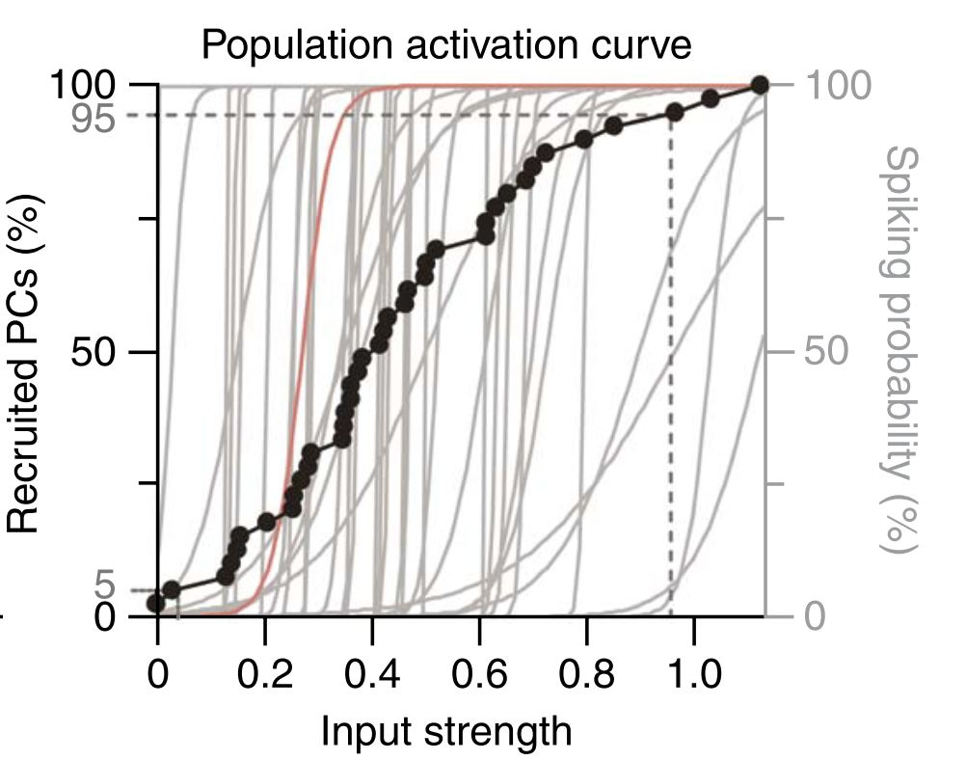
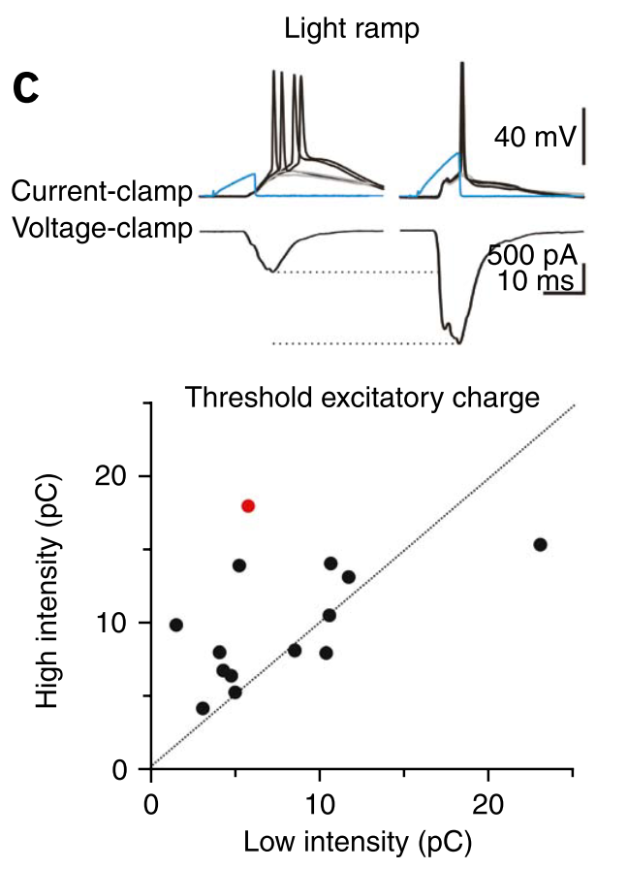
Experiment reproduction : Input normalization by global feedforward inhibition expands cortical dynamic range
Frédéric Pouille^{1,2}, Antonia Marin-Burgin^{1,2}, Hillel Adesnik¹, Bassam V Atallah¹ & Massimo Scanziani¹
NATURE NEUROSCIENCE VOLUME 12 | NUMBER 12 | DECEMBER 2009
Neo Cortex
Hippocampus

Slide 2
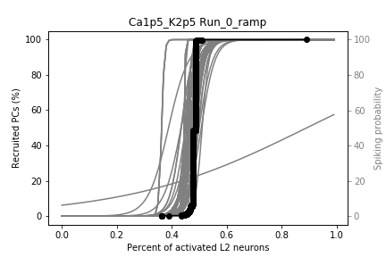
Cortex results does not fit experiment estimation
They did not create a similar figure for the cortex
BBP Column
Hipocampus
L5
It seems that in the cortex after a specific percent of L23 neurons activation, there is an explosion of activity.
Anyway, as most of their paper talks about the hippocampus it is hard to replicate exactly the paper
Estimated from extracellular recording

Slide 3
Voltage response
I tired to replicate this figure:
Which if from the cortex, but the problem is that the different between the L23 activation needed to reach 0.5 firing probability is really low 340 to 342. You can see that in the figure the difference in ChR activation is much larger.

